Slide 1
Proposed solution
By ESS

Slide 2
Proposed workflow
Calculate TVD
Calculate VCL
Isolate mudstone (by Vcl cut-off) and cemented layer (by a machine leaning model – 0 or 1)
Unit breakdown/ detect GR shapes
Label depofacies in key wells
Build machine learning model using GR shape + conventional logs + “some rules” as inputs
Apply to all other wells
Locate bad hole intervals
Interval of interest: Miocene section only – Below Urenui formation

Slide 3
Locate bad hole intervals
CAL – BS > 1.5 inch
CAL: caliper
BS: bit size
Final results will be a flag curve (0 or 1)
This is done to isolate bad data intervals caused by wellbore washout

Slide 4
Calculate TVD
To calculate thickness – more accurate than using MD
Unit_thickness = TVD_Base – TVD_Top
Please refer to TVD computation on i2G

Slide 5
Calculate Vsh (Vmud)
Mud contents = Vsh (clip to 0:1)
I_{GR} = (GR-50)/75
Mud contents < 15% → lithofacies = sandstone
15% < Mud contents < 50% → lithofacies = muddy sandstone
50< Mud contents < 70% - lithofacies = sandy mudstone
Mud contents > 70% - lithofacies = Mudstone
When lithofacies = mud: don’t have to find GR_shape

Slide 6
Cemented layer prediction
Build a machine learning model to predict cemented layer based on labeled data (find them on i2G)

Slide 7
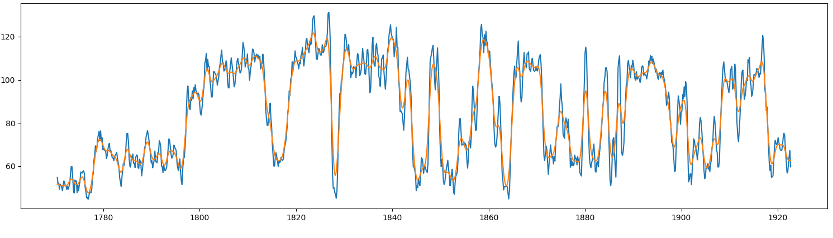
Unit break down
Using smoothed GR curves
Find deflection points where GR trend changes in direction as shown in the example below
Doing from bottom to top (deeper to shallower or from right to left in this example)
If the thickness between two deflection points < 1 m: delete the upper one…
Minimum unit thickness = 1m

Slide 8
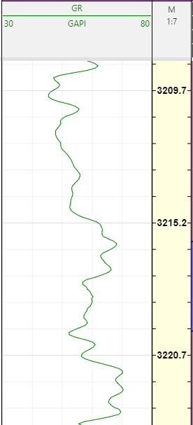
Detect GR shape
Using the original GR curve to detect SR GR shape
|∆GR| = |GR2-GR1|= 8 < 10 API
GR2: average between 2 or 3 samples right above the lower unit boundary
GR1
UN |∆GR| < 10
GR2
GR1: average between 2 or 3 samples right below the upper unit boundary
CU -- ∆GR > 10
FU -- ∆GR < -10
CU -- ∆GR > 10
1.1 m
UN -- |∆GR| < 10

Slide 9
To be continued…

