Slide 1


Anime Recommendation System
Norrawee Charnpinyo

Slide 2
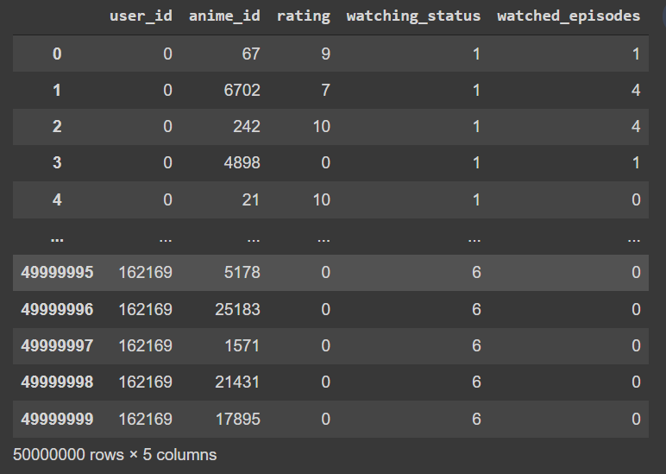
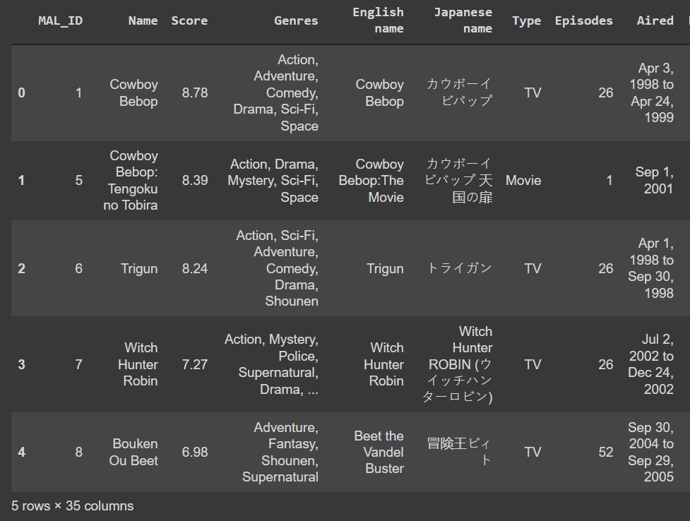
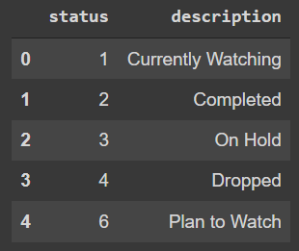
Introduction to dataset
There are 3 files animalist.csv (100M rows but used only 50M), watching_status.csv, and anime.csv.
This dataset can be downloaded from Kaggle.
animelist.csv
watching_status.csv
anime.csv

Slide 3
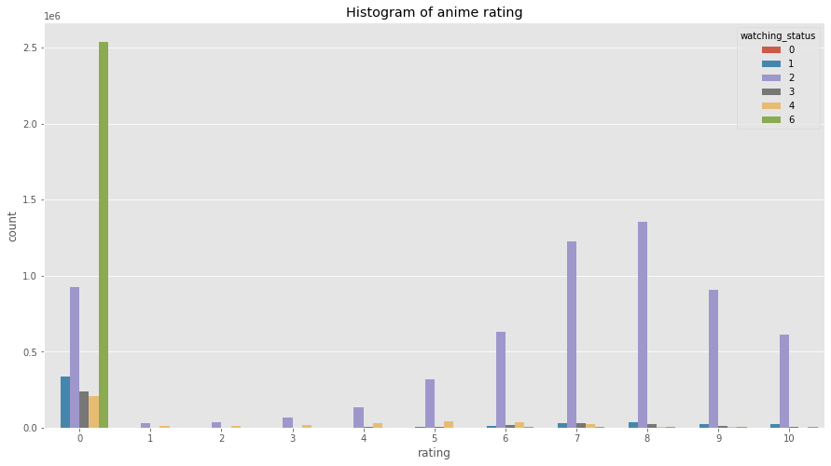
From the histogram, rating on anime cannot be used directly since the animes that are planned to watch (watching_status=6) usually get rating 0 which did not make sense. Consequently, I excluded rating 0 before feeding into the model.

Slide 4
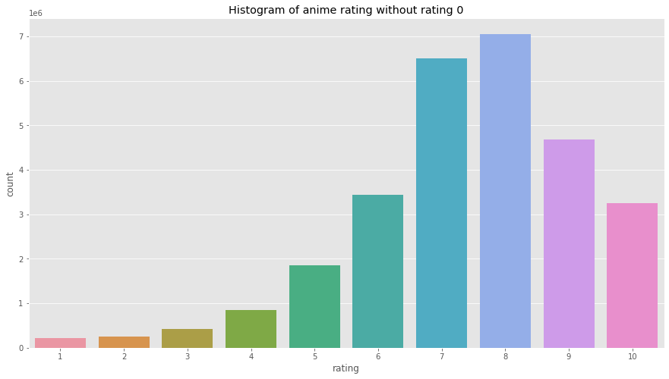
After I excluded the rating 0, the amount of data left is 28M.

Slide 5
Methodology
User
embedding layer
Dot two vectors and go to sigmoid
Rating
range from 0 to 1
Anime
embedding layer
Model size: 6M parameters

Slide 6
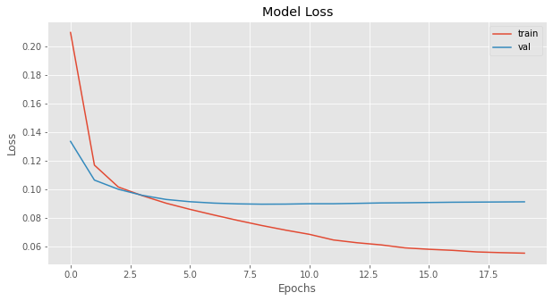
The embedding size is 128.
Loss function: Mean absolute error
Optimizer: Adam( lr=0.0002 )
Epochs: 20
The mean_absolute_error on test set is 0.0147.

Slide 7

Recommendation system (3 methods)
Recommend the similar anime.
Use the anime embedding layer to transform to anime to the vector and use cosine similarity to find similar anime.
2. Recommend anime which are watched by similar users.
Use the user embedding layer to transform to user to the vector and use cosine similarity to find similar users.
3. Recommend top rating anime.
Use model to predict ranting of anime and recommend the top rating anime

Slide 8
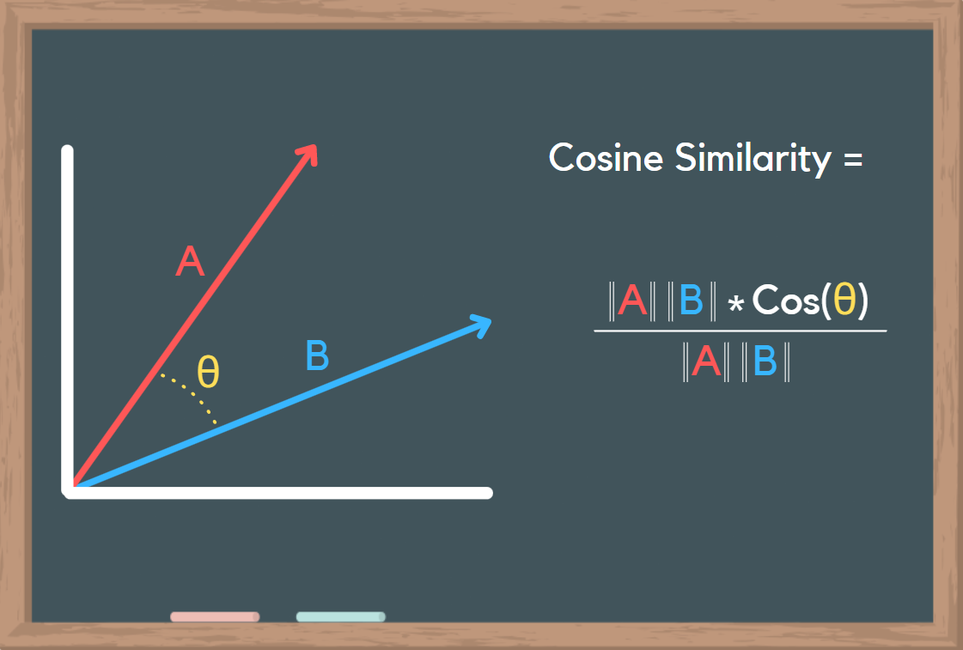
1. Recommend the similar anime.
Anime
Sword Art Online
Embedding weights
0.5
0.7
.
.
.
0.9
Pair the anime and the others to
find consine similarity.

Slide 9

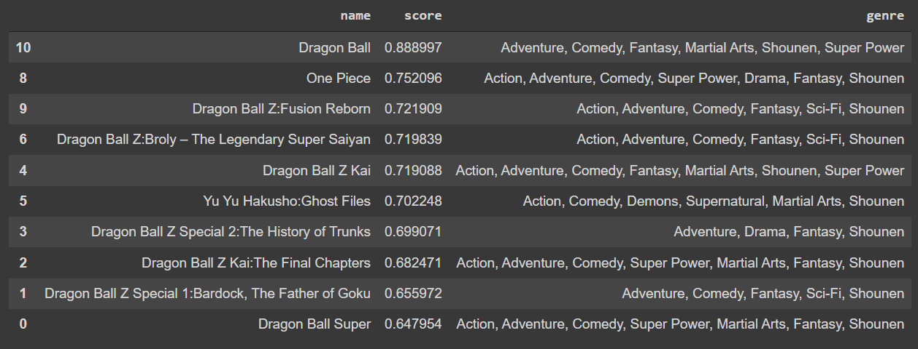
The score is the value of cosine similarity which range from -1 to 1.
We can see that many versions of Dragon Ball are shown which means that we successfully find the similar anime.

Slide 10
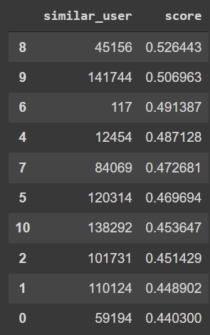
2. Recommend anime which are watched by similar users.
Use the same process to find similar users and then we get the favourite anime of each similar users. Suggest the anime that are most frequently the favourite ones.
Anime A : 10
Anime B : 8
Anime C : 5
Anime D : 2
Anime E : 2
Suggest the top k anime that are most frequently the favourite anime.

Slide 11
3. Recommend top rating anime.
Use the model to predict the rating and suggest the top rank anime.

Slide 12
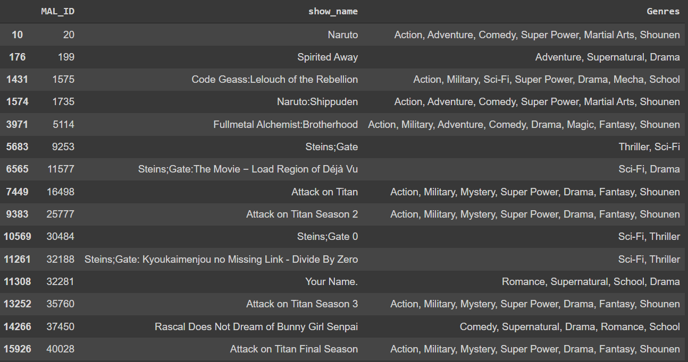
Favourite anime of a user

Slide 13
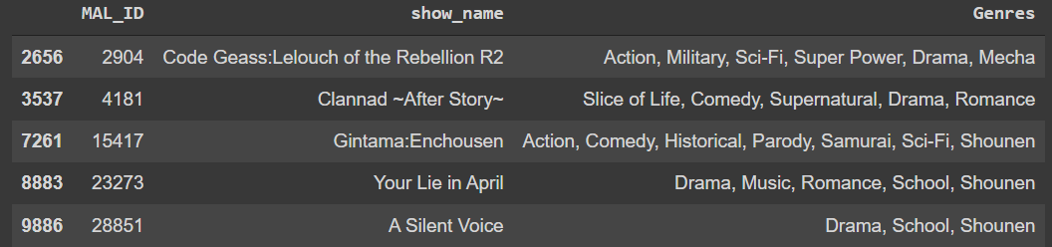
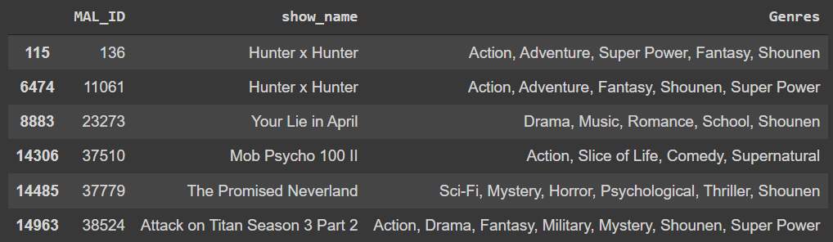
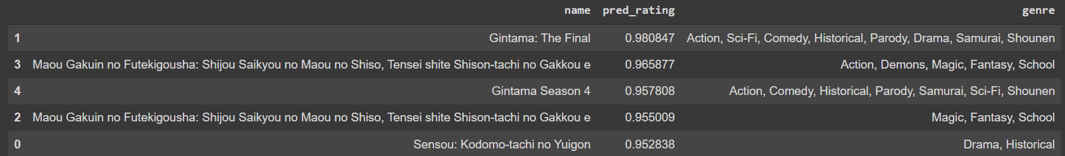
Method1
Method2
Method3

