Slide 1
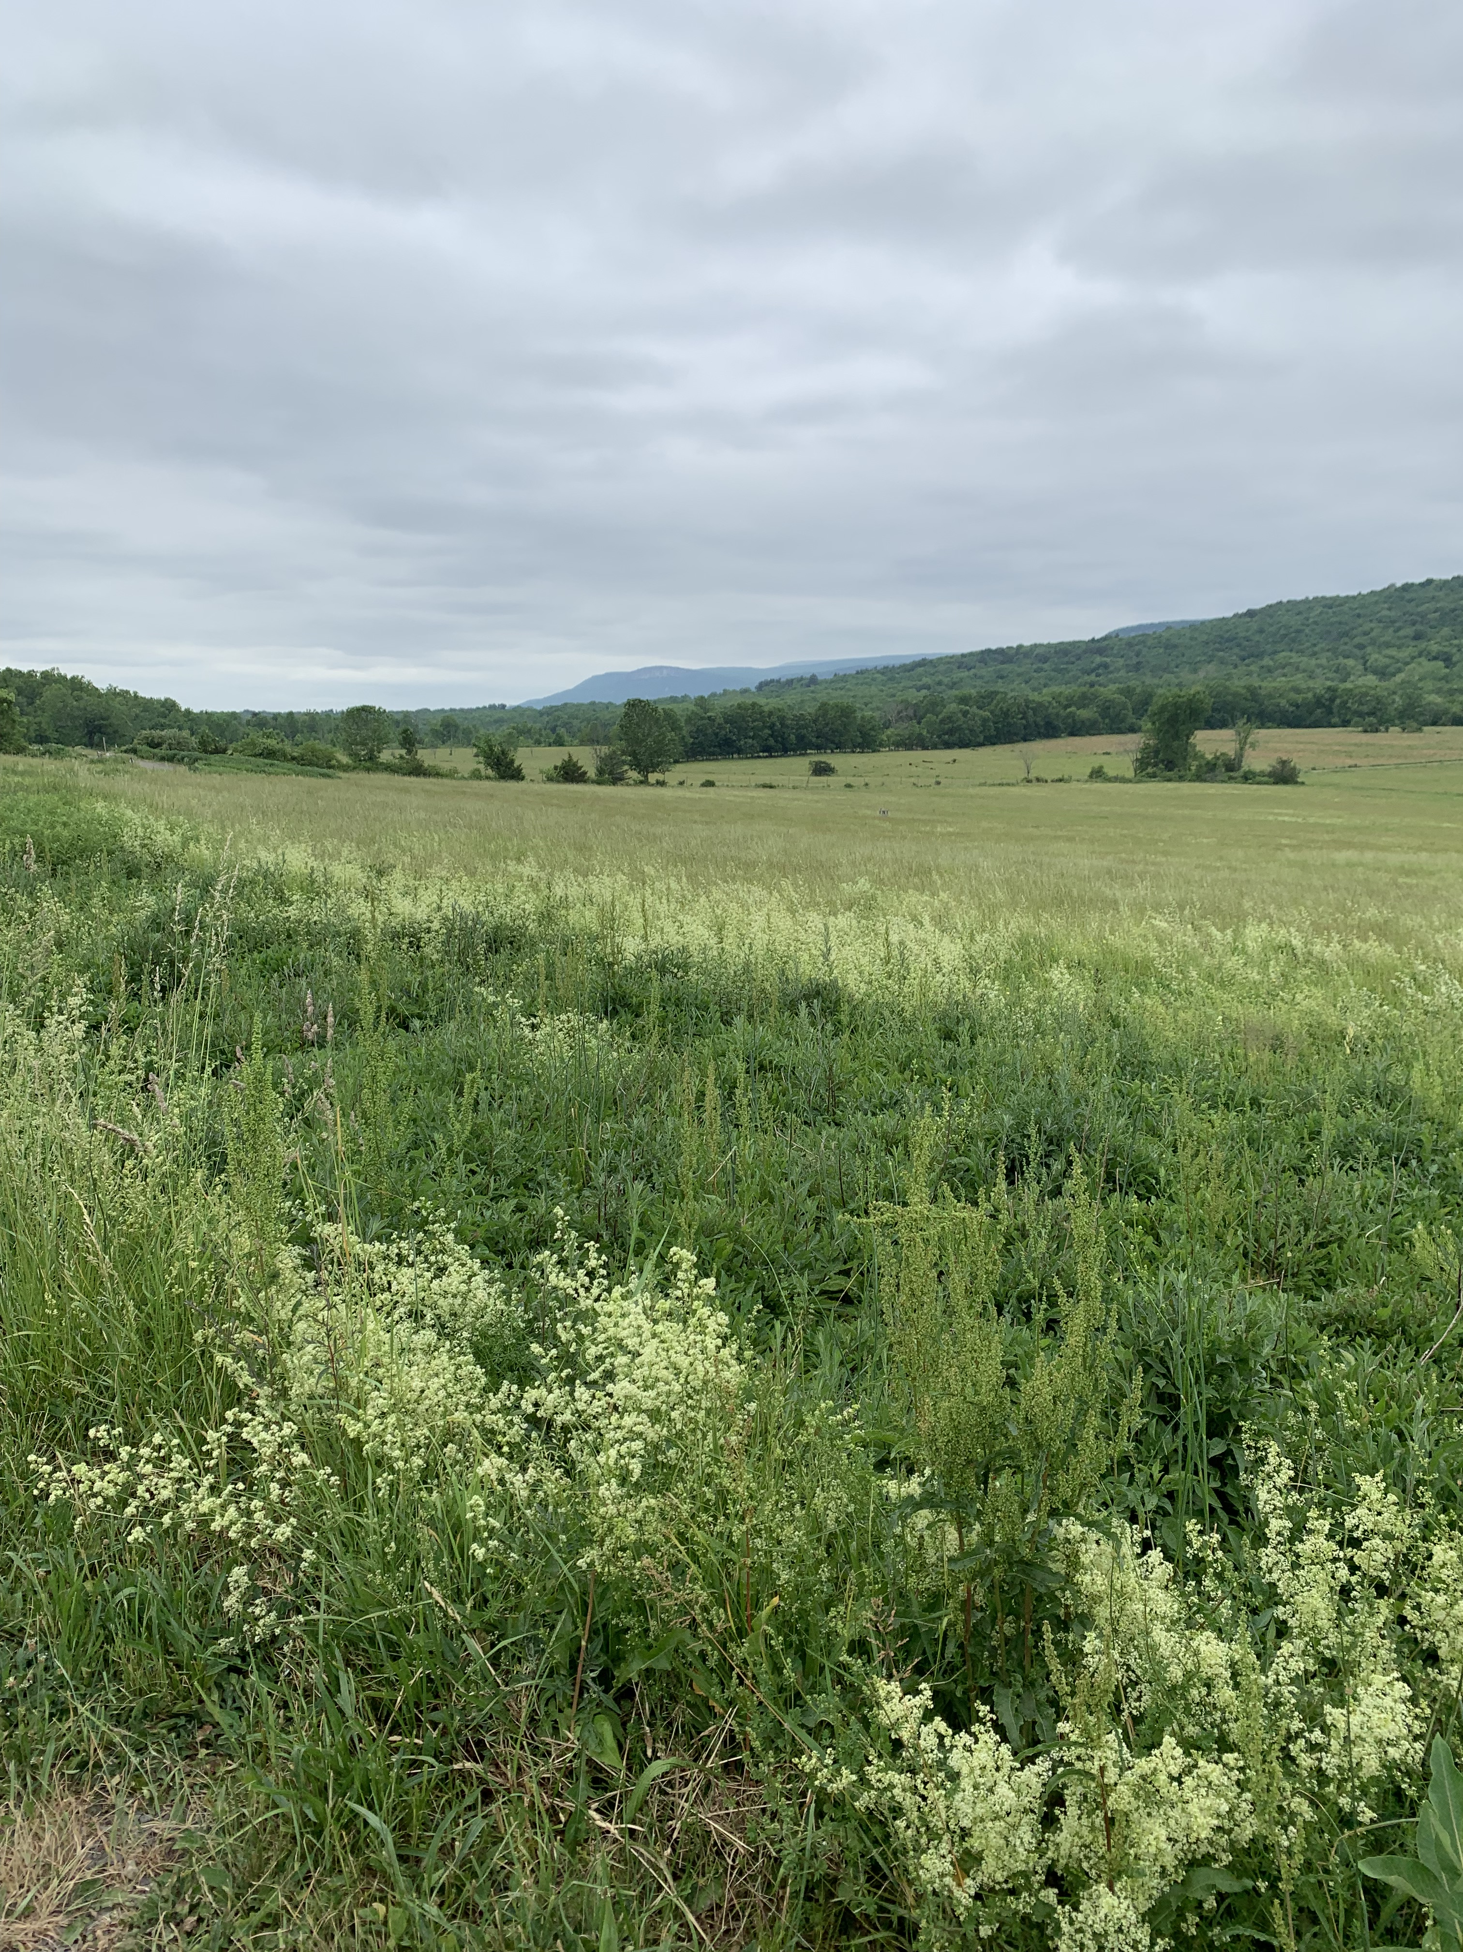

Sustainability Frameworks
Complied by
Sustainability Learning Community
SUNY New Paltz, USA
2026

Slide 2
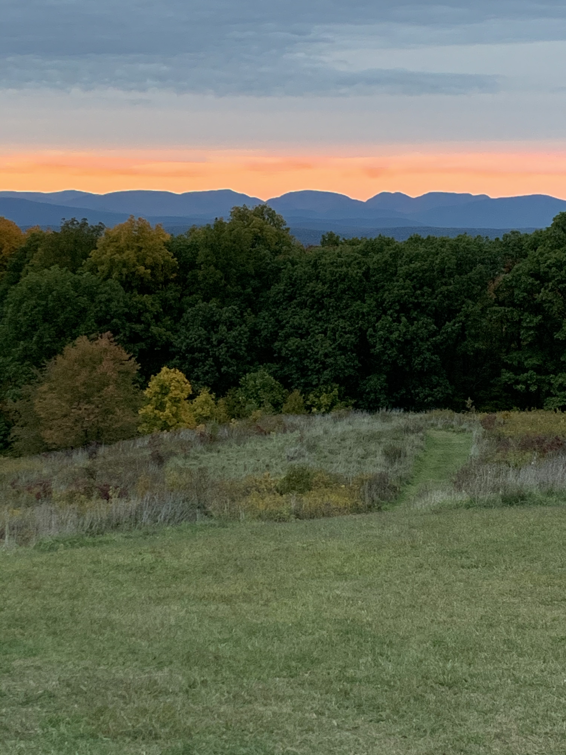
Ancestral lands Inhabited by the Lenni Lenape people, Esopus Munsee Territory
Notes:
We do this land acknowledgement to honor those who have lived and continue to live on this land for centuries and their histories which have often been submerged in the dominant discourse.

Slide 3
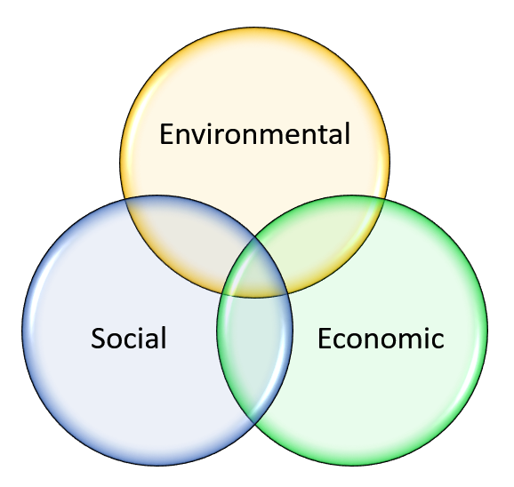
Three Dimensions of Sustainability

Slide 4
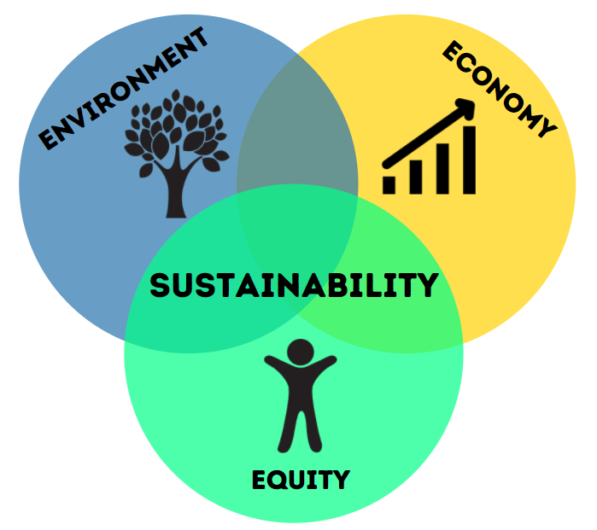
Version 2: The Three Es

Slide 5
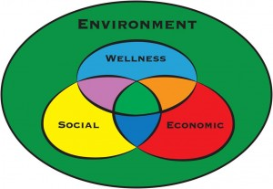
Bemidji State University Version
Notes:
https://www.bemidjistate.edu/offices/sustainability/

Slide 6

One Dish One Spoon Treaty (~1000 CE)
Earth is a Great Dish given to us that contains all that we need. How do we share this resource?
Only take what you need to feed yourself and make yourself well. 2. Always leave some for others to enjoy. 3. Keep the dish clean. Anishinabek & Potawatomi & Haudenosaunee

Slide 7
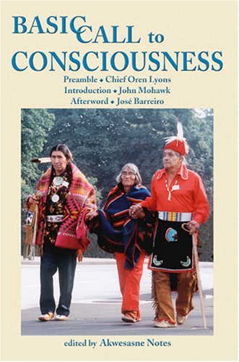
Open-Source Introduction
Basic Call to Consciousness
Notes:
Notes, Akwesasne, ed. Basic Call to Consciousness, “The Haudenosaunee Address to the Western World.” Native Voices, 2005.
This book, Basic Call to Consciousness, came about through a struggle that started forming during the Civil Rights Movement as American Indian Nations demanded Indian Rights, including treaty rights and land returns.
In the 1970s, the International Indian Treaty Council (IITC), and others requested a process to recognize the rights of Indigenous nations, peoples, and individuals at the United Nations.
This collection of papers detailing the economic, legal, and social realities of the various Indigenous nations was produced by John Mohawk a Haudenosaunee scholar, and refined by the Grand Council of the Chiefs for a UN conference, the 1977 International Non-Governmental Organization Conference on Discrimination Against Indigenous Populations in the Americas in Geneva, Switzerland.
It laid out a Vision of sovereign Native peoples.
Requested fundamental changes in policies
as well as an end to the destruction of the Natural World.
Reflected deep concern for the life of future generations.
It called for honoring the sacred Web of Life as well as Peacekeeping.
Things since moved along slowly, we now have a Permanent Forum on Indigenous Issues (a subsidiary organ of the United Nations’ Economic and Social Council).
This book is seminal in its scope and reach. Indigenous peoples have always known how to be in good relationship with earth, to honor mother earth. Their message seems more important than ever in my mind, several sustainability frameworks build on it.
------------------
This impassioned vision of sovereign Native peoples calls for fundamental changes in the policies of developed nations and an end to the destruction of the Natural World. In clear, direct terms leaders of the Haudenosaunee—the Six Nations Iroquois—discuss the importance of honoring the sacred Web of Life, and describe the spiritual roots of their traditional lifestyle which pioneered concepts of peacekeeping and government later embodied in the United States Constitution.
These position papers, describing the conditions of oppression suffered by Native peoples in the Americas, were originally delivered to the NonGovernmental Organizations of the United Nations in Geneva in 1977. John Mohawk’s new introduction gives a first-hand account of events leading up to Geneva. Chief Oren Lyons has added a preamble offering a historical perspective on the struggle for self-determination by Indigenous peoples. An afterword by José Barreiro, “Indigenous into the 21st Century,” looks to a new era of possibility for Native nations.
Now expanded and updated, this revised edition includes endnotes, bibliography, and an index. “The people who are living on this planet need to break with the narrow concept of human liberation, and begin to see liberation as something which needs to be extended to the whole of the Natural World. What is needed is the liberation of all the things that support life—the air, the waters, the trees—all the things which support the sacred Web of Life.” Haudenosaunee Address to the Western World.
Notes by Andrea Frank

Slide 8
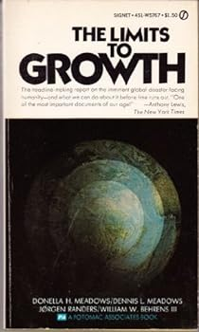
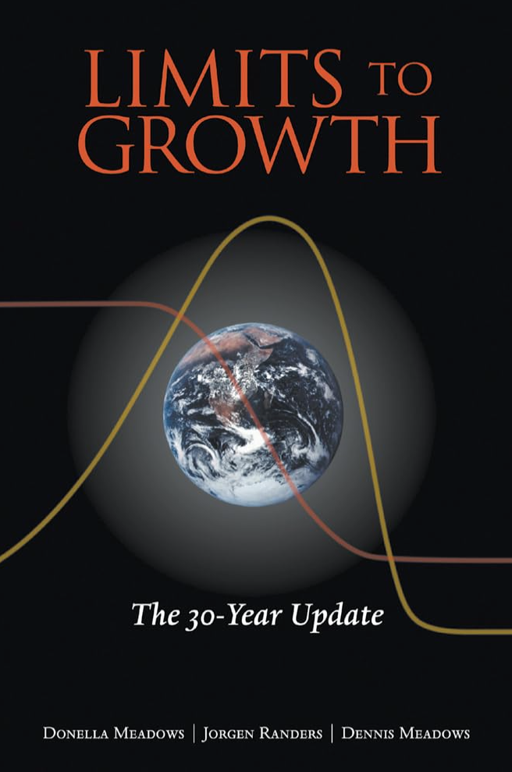
Limits to Growth
Notes:
Meadows, Donella and Jorgen Randers. Limits to Growth: The Thirty-Year Update. Chelsea Green, 2004.

Slide 9
“Brundtland Definition” of Sustainable Development
from the Brundtland Report, Our Common Future (1987)
"Development that meets the needs of the present
without compromising the ability of future generations
to meet their own needs"
Notes:
"A global agenda for change" - this was what the World Commission on Environment and
Development was asked to formulate (in 1983) in an urgent call by the General Assembly of the
United Nations.
Global Challenge: Interlocking Crises, Sustainable Development, Institutional Gaps
Policy: food security, species, energy, industry...
International Cooperation.
This Commission believes that people can build a future that is more prosperous, more just, and more secure. Our report, Our Common Future, is not a prediction of ever increasing environmental decay, poverty, and hardship in an ever more polluted world among ever decreasing resources. We see instead the possibility for a new era of economic growth, one that must be based on policies that sustain and expand the environmental resource base. And we believe such growth to be absolutely essential to relieve the great poverty that is deepening in much of the developing world.
Specifics:
to propose long-term environmental strategies for achieving sustainable development by the year 2000 and beyond;
to recommend ways concern for the environment may be translated into greater co-operation among developing countries and between countries at different stages of economical and social development and lead to the achievement of common and mutually supportive objectives that take account of the interrelationships between people, resources, environment, and development;
to consider ways and means by which the international community can deal more effectively with environment concerns; and
to help define shared perceptions of long-term environmental issues and the appropriate efforts needed to deal successfully with the problems of protecting and enhancing the environment.

Slide 10
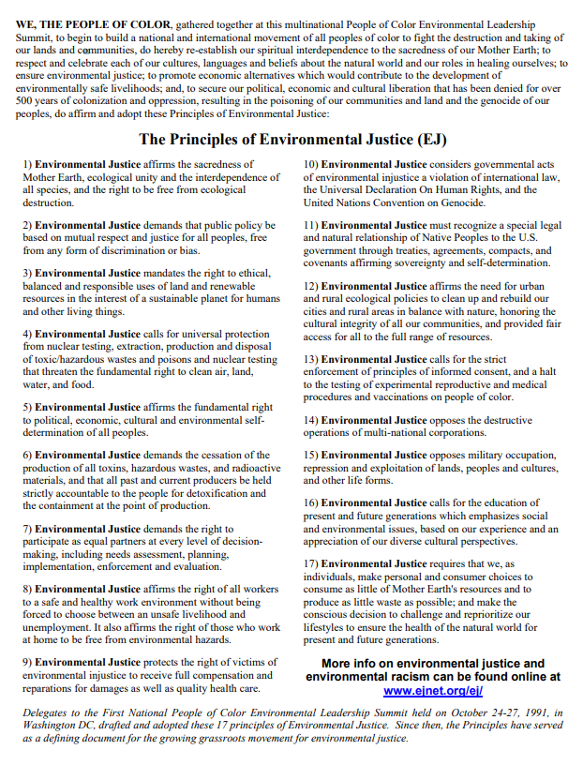
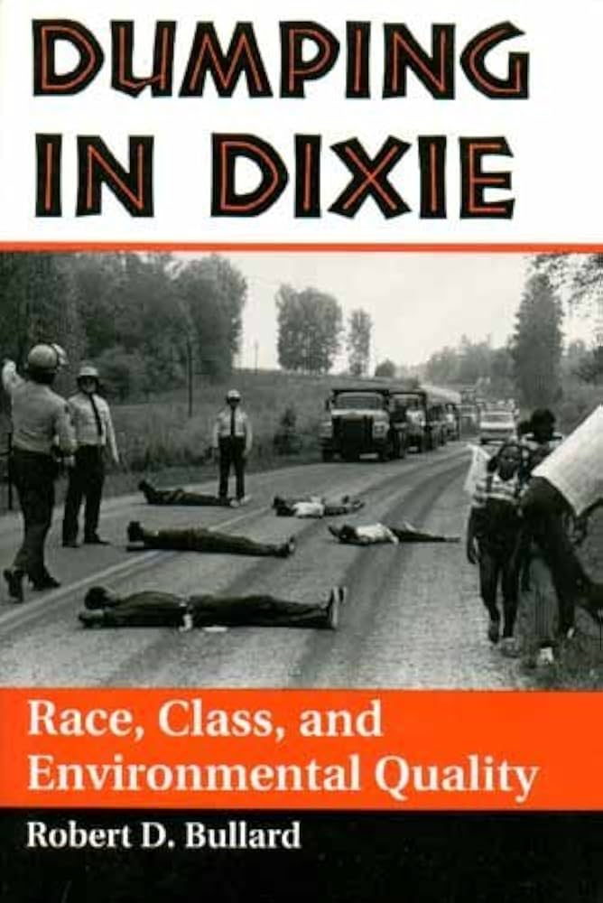
Principles of Environmental Justice
(1991)

Slide 11
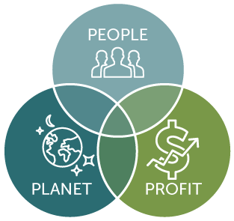
John Elkington’s
Triple Bottom Line or The Three Pillars (1997)
Notes:
https://www.johnelkington.com/archive/TBL-elkington-chapter.pdf

Slide 12
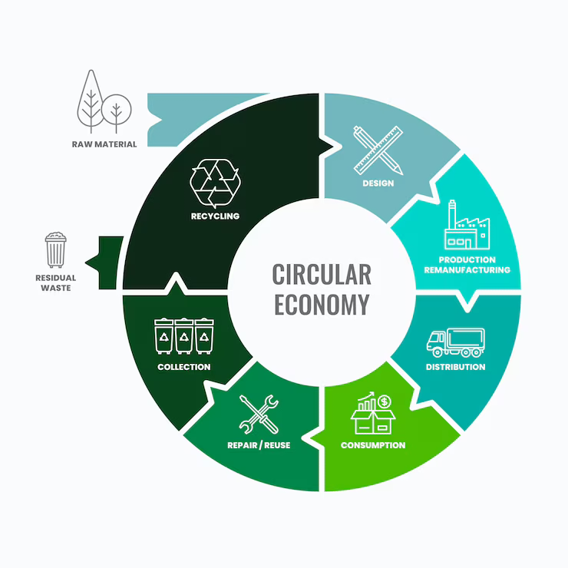
Circular Economy
&
ESG
(environmental,
social,
governance)
Investing

Slide 13
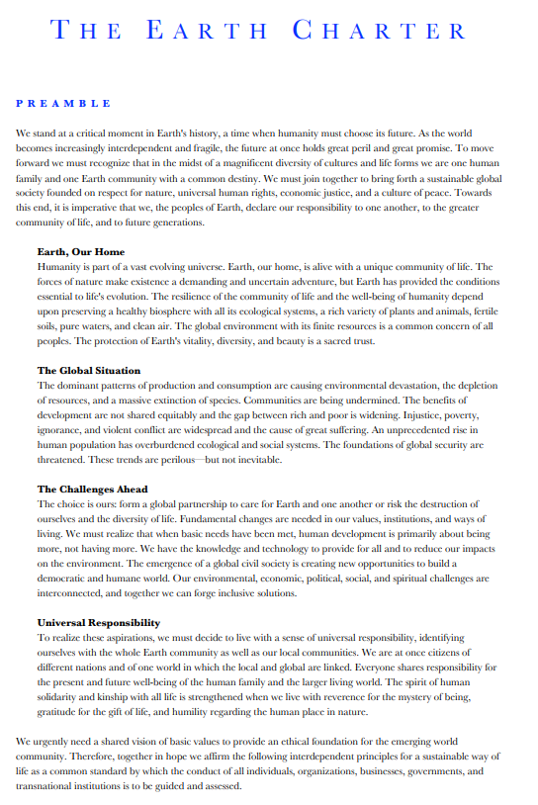
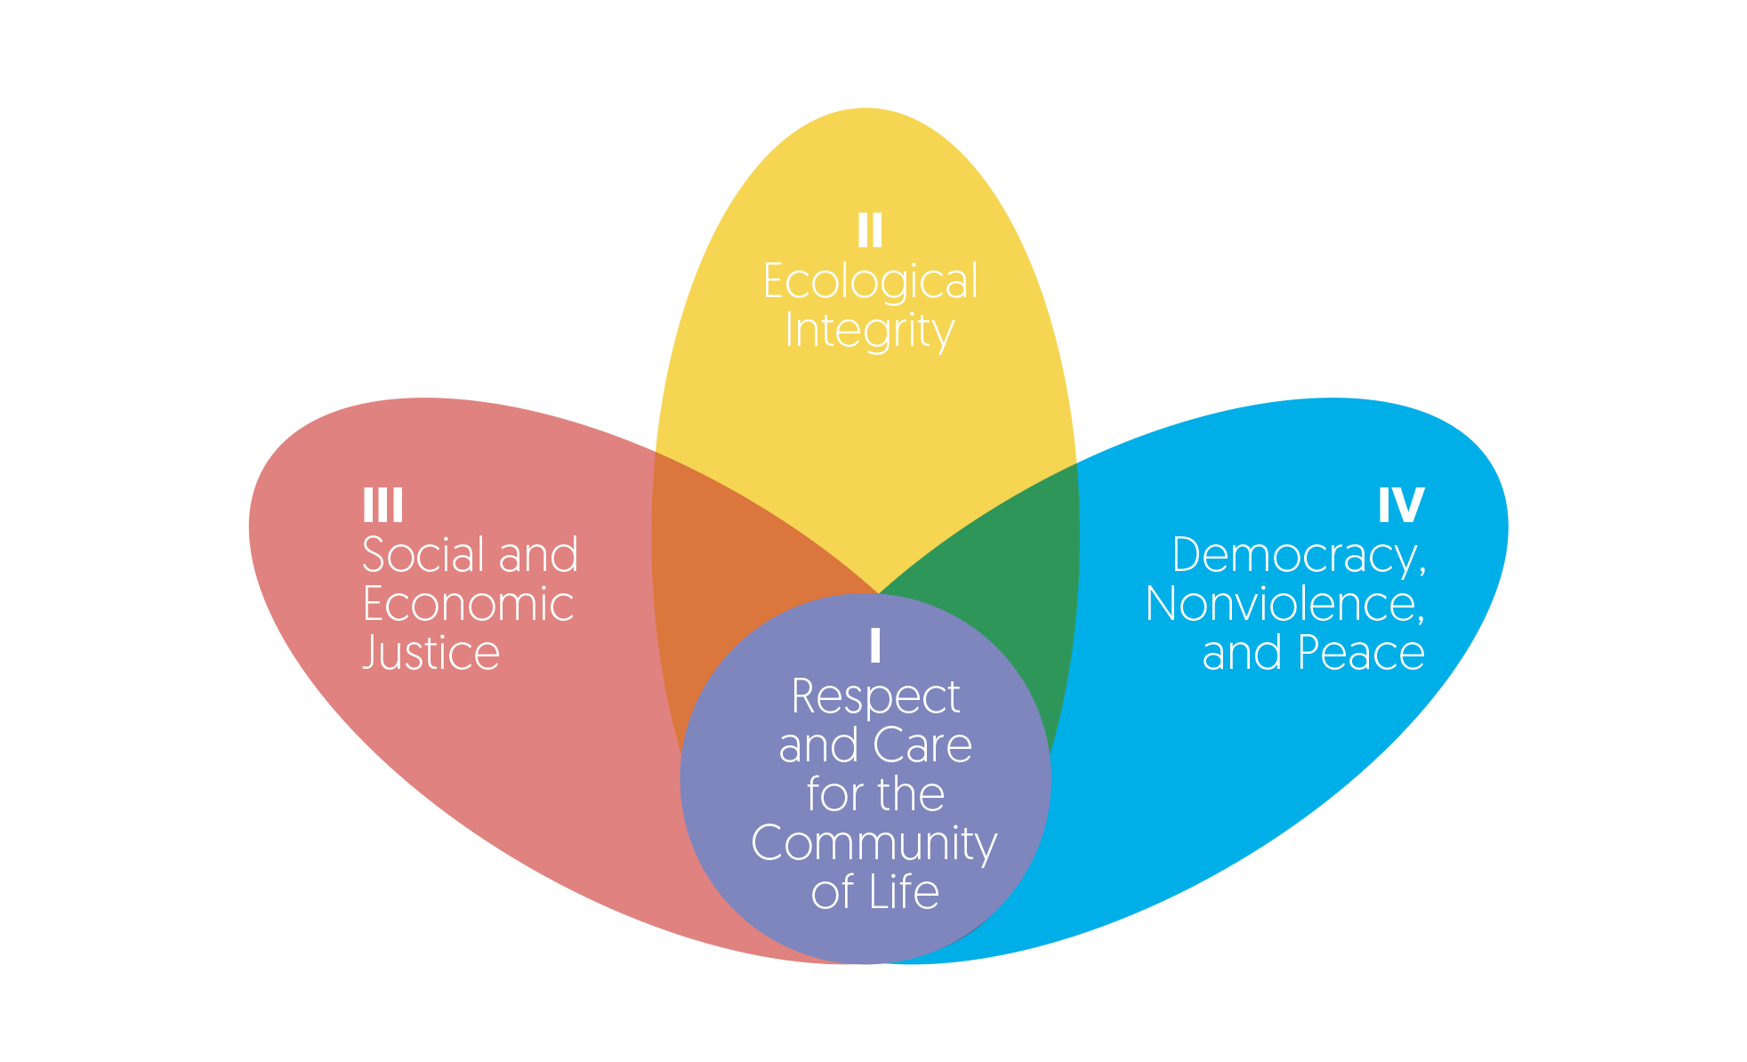
The Earth Charter
(2000)
https://www.youtube.com/watch?v=rfMtTpXjV78
Notes:
Watch one minute 20 seconds video https://www.youtube.com/watch?v=rfMtTpXjV78
Mirian Vilela explains the Earth Charter (16:03) https://www.youtube.com/watch?v=8mntNdNBPo4

Slide 14
Julian Agyeman’s Just Sustainabilities (2003)
Conditions of Just Sustainabilities (global perspective):
i) Improving our quality of life and well-being;
ii) Meeting the needs of both present and future generations (intra- and inter- generational equity);
iii) Justice and equity in terms of recognition (Schlosberg, 1999), process, procedure and outcome.
iv) Living within ecosystem limits (also called one planet living)

Slide 15
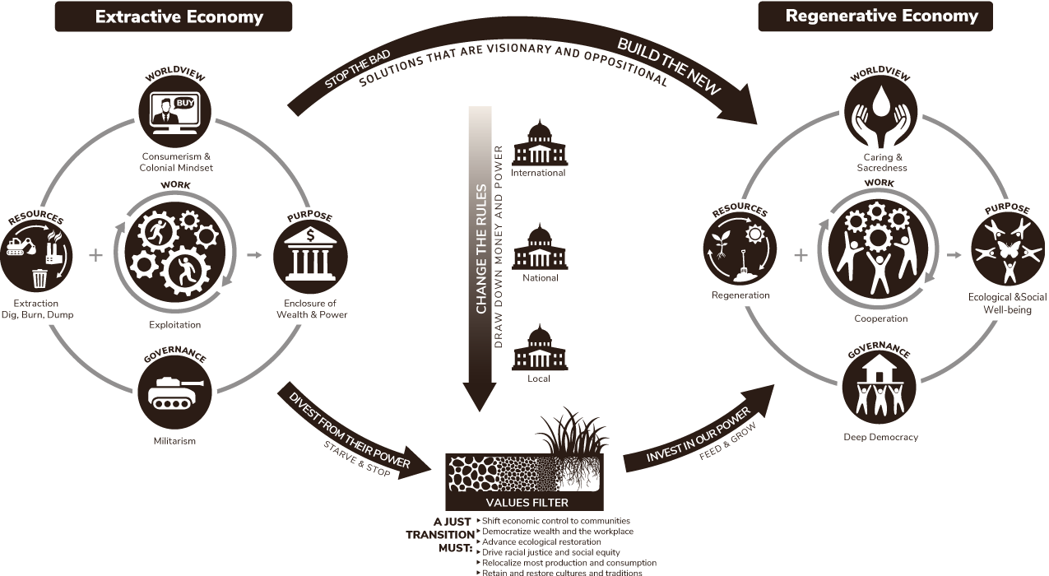
Just Transition / Movement Generation (2000s)
Notes:
Just Transition - Articulated by Movement Generation of Oakland, CA
Just Transition is a vision-led, unifying and place-based set of principles, processes, and practices that build economic and political power to shift from an extractive economy to a regenerative economy.
After centuries of global plunder, the profit-driven, growth-dependent, industrial economy – rooted in the myth of white supremacy, heteropatriarchy, consumerism, and ableism – is severely undermining the life support systems of the planet.
An economy based on extracting from a finite system faster than the capacity of the system to regenerate will eventually come to an end—either through collapse or through our intentional re-organization.
Transition is inevitable. Justice is not.
https://movementgeneration.org/
Just Transition Articulated by Movement Generation of Oakland, CA
Just Transition is a vision-led, unifying and place-based set of principles, processes, and practices that build economic and political power to shift from an extractive economy to a regenerative economy.
After centuries of global plunder, the profit-driven, growth-dependent, industrial economy – rooted in the myth of white supremacy, heteropatriarchy, consumerism, and ableism – is severely undermining the life support systems of the planet.
An economy based on extracting from a finite system faster than the capacity of the system to regenerate will eventually come to an end—either through collapse or through our intentional re-organization.
Transition is inevitable. Justice is not.
https://movementgeneration.org/

Slide 16
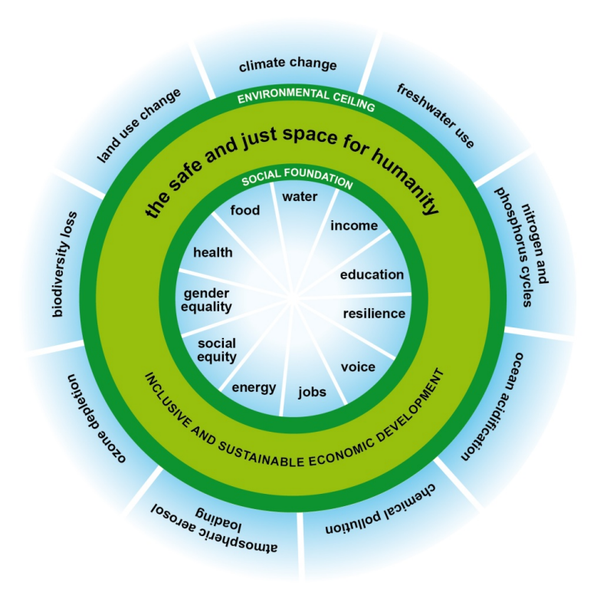
Kate Raworth’s
Doughnut of Social and Planetary Boundaries
(2012)
A safe and just space for humanity to thrive in
Notes:
https://www.nature.com/articles/s41586-025-09385-1

Slide 17
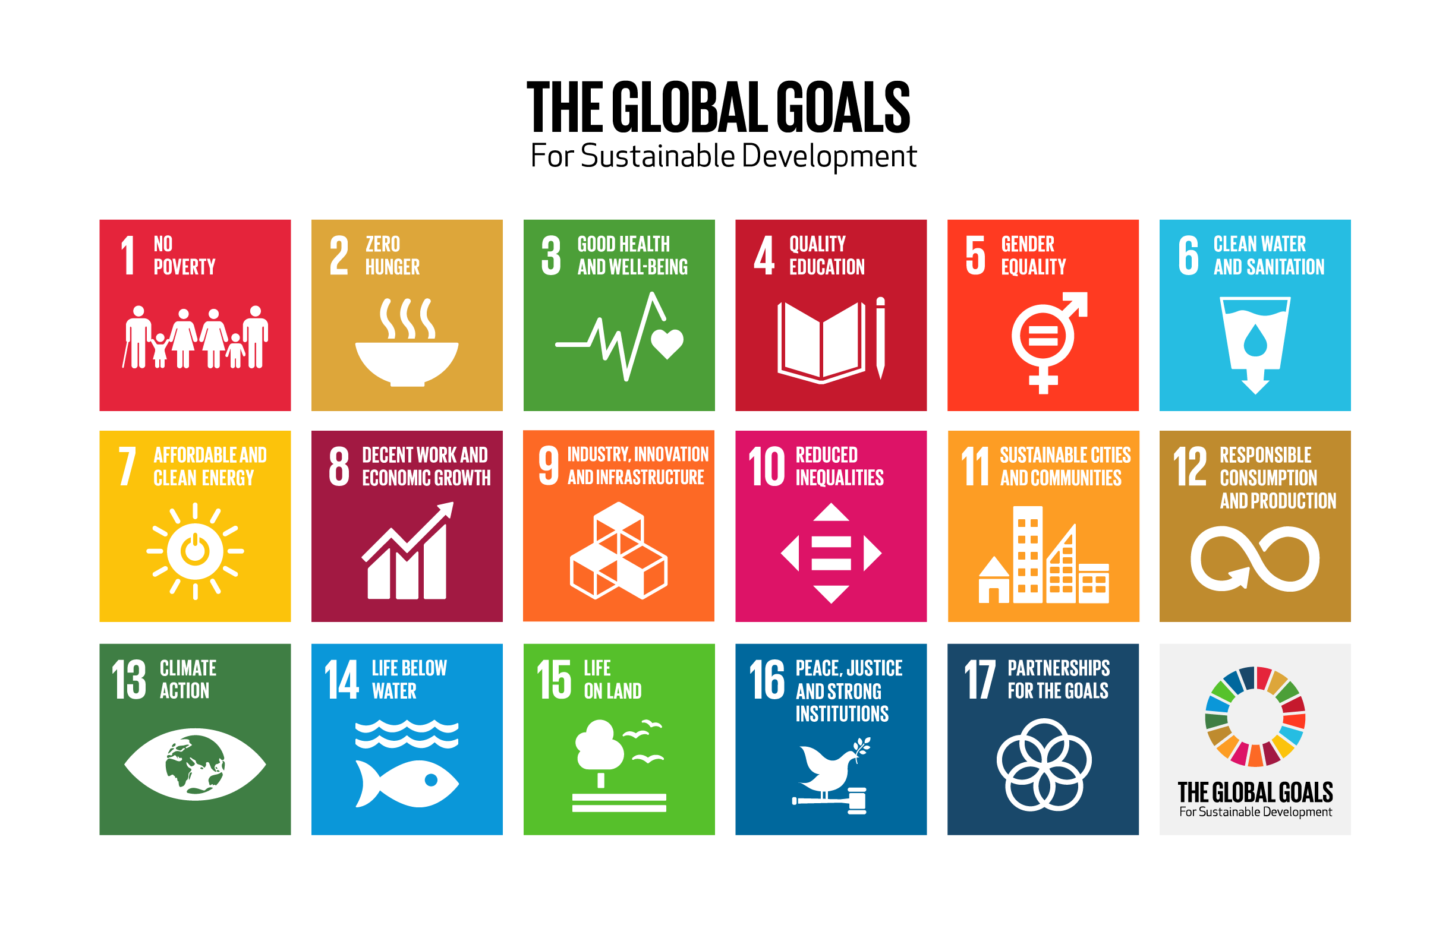
(2015)
Notes:
The Sustainable Development Goals (SDGs), adopted in 2015 by the United Nations, are a global framework comprising 17 interconnected goals aimed at ending poverty, protecting the planet, and ensuring peace and prosperity by 2030.
They are designed to address a broad range of global challenges, including economic inequality, climate change, and access to education and healthcare, while fostering collaboration among governments, businesses, and civil society. The SDGs emphasize inclusivity, leaving no one behind, and aim to balance economic growth, social equity, and environmental protection.
Critique: The SDGs have been critiqued for reflecting a neoliberal framework that promotes market-based solutions without fundamentally questioning the systems driving inequality and environmental degradation. This perspective suggests that economic growth and sustainability can coexist without significant sacrifices, fostering the illusion that technological innovation, corporate social responsibility, and private-sector investment will solve global challenges.
Critics argue that this approach downplays the need for systemic shifts, such as reduced consumption in affluent countries, redistribution of wealth, and stronger regulatory frameworks, which are essential for achieving true sustainability. By prioritizing voluntary partnerships and market mechanisms, the SDGs may inadvertently reinforce existing power imbalances and fail to address the root causes of global inequities.
From Sarah?:
As of Davos 2012 World economic forum: groups manage global problems (post-national model). Problem with this approach: puts markets over human rights; market issues over democratic process.
Some critics say that this post-national approach in which we do not look to governing bodies of nations but to a more cosmopolitan collective effort means that we are delivering our world into the hands of extra-national stakeholders, in other words, the multi-national corporations that are the 21st century seats of real power. [Doug Frantz, Huffington Post].
Critiques: extreme attackers contend that this is just another thinly disguised tool of the neo-liberals: it doesn't necessarily say we have to give up anything or produce LESS.

Slide 18

Critical Sustainabilities
"Critical sustainability, in many ways evolving from the inclusive concept of just sustainability, uses a critical theory lens to unmask intertwined social and economic systems of oppression enforced through global capitalism" (Cachelin 2019).
Example: Increase in electric cars and solarized houses is excellent for planet, but it adds yet another dimension of inequality in the unequal access various groups have to these “up” grades. Those sourcing the materials to create, deliver, dispose of these products typically do not benefit from them.
Example: With Green capitalism, individual consumers can purchase their conservation ethic (I recycle, I wear second-hand clothing, etc.) while “the true ecological costs of their purchases and lifestyles remain hidden from them.”
Notes:
Cachelin, A, A Darling, B Clark, and K Hackford-Peer, 2019. Weaving Equity and
Sustainability into the Fabric of Higher Education: The University of Utah Experience. Sustainability 12(6), 304-309.

Slide 19
Sustainability Education responds to a
“Crisis of Perception”
Focus on discourse: We tend to rely on simplified and unrealistic representations of nature and of social systems. We center the human in all approaches.
What is it we are trying to sustain?
Dualisms create "myths of separation"
Human / Nature
Nature / Culture
Me / not me…… leads to treating nature as other and eases destruction.
It’s not about students connecting with nature, (wrong and misleading) it’s about the interrelationship of all things. (David Clarke, “Becoming Rocked” )
Notes:
Sarah (keep?)

Slide 20
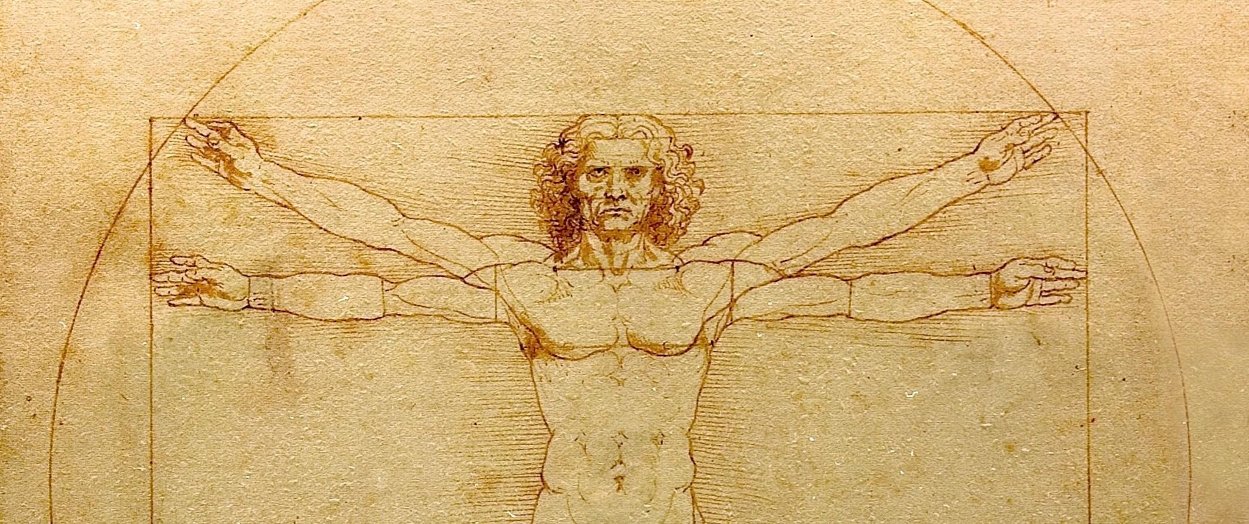
Donna Haraway (2015) decenters the “anthro” in Anthropocene
“no species, not even our own arrogant one pretending to be good individuals in so-called modern Western scripts, acts alone; assemblages of organic species and of abiotic actors make history, the evolutionary kind and the other kinds too” (159)
Notes:
https://www.environmentandsociety.org/sites/default/files/key_docs/environmental_humanities-2015-haraway-159-65.pdf

Slide 21
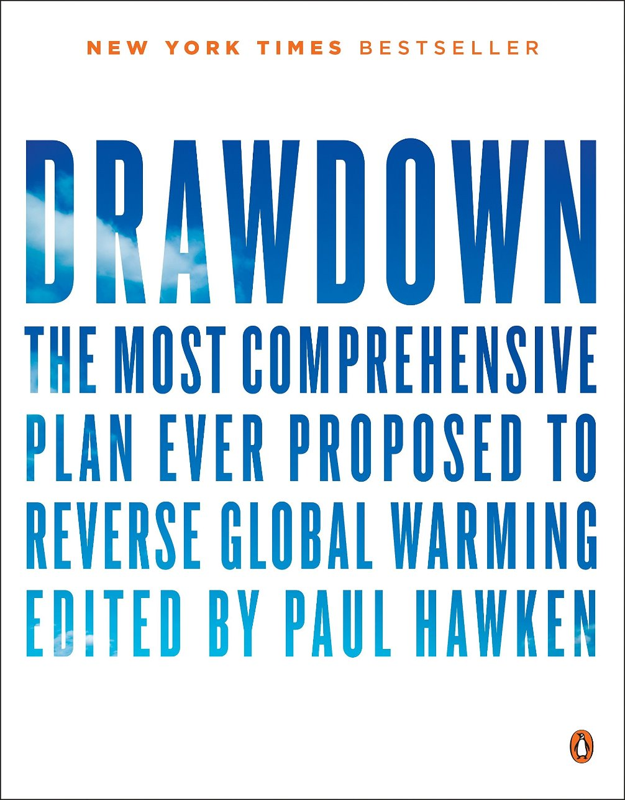
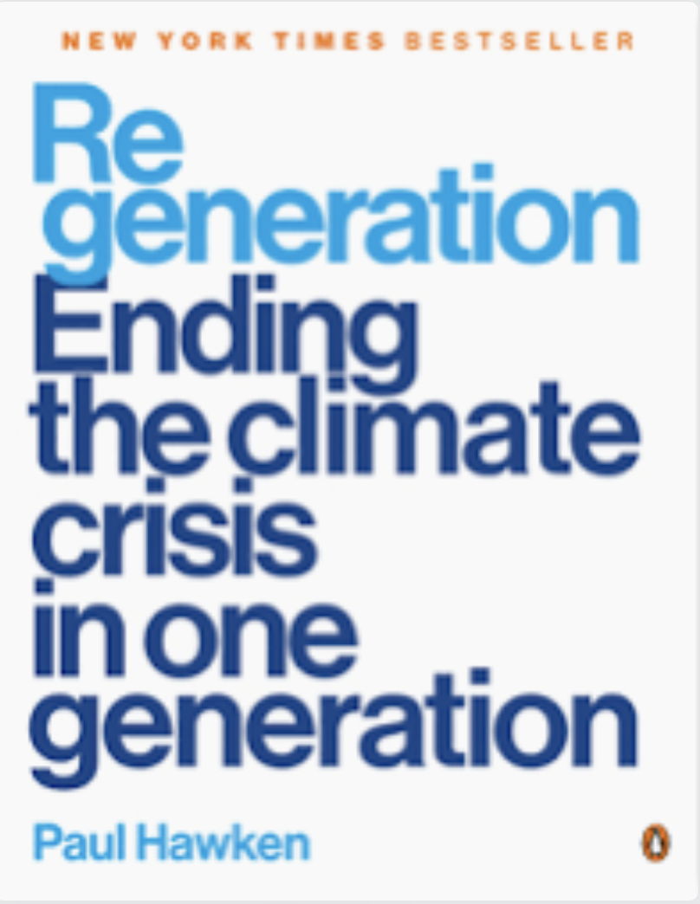
Climate Solutions Resources: Drawdown-Regeneration
https://drawdown.org/
https://regeneration.org/
Notes:
Project Drawdown’s network of scientists, researchers, and fellows has characterized a set of 93 technologies and practices that together can dramatically reduce concentrations of greenhouse gases in the atmosphere.
Regeneration is a comprehensive approach to the climate crisis, one that weaves justice, climate, biodiversity, and human dignity into a tapestry of action, policy, and transformation that can end the climate crisis in one generation.
Each Nexus entry explores what can be done on all levels of agency, including individual, community, classroom, city, company, and government. For each topic, we curate engaged organizations, describe actions that can be taken, highlight educational opportunities, and provide examples of transformation.

Slide 22
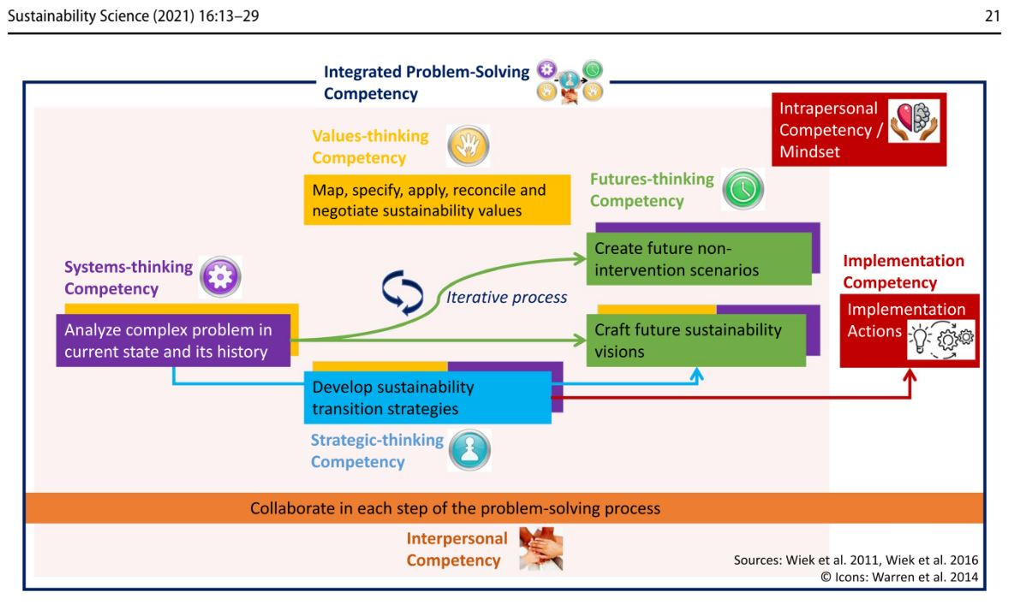
Notes:
Brundiers, K., et al. 2021. “Key Competencies in Sustainability Higher Education—Toward an
Agreed-Upon Reference Framework.” Sustainability Science 16, pp. 13-29.

Slide 23
Works Cited
Agyeman, Julian. Just Sustainabilities: Development in an Unequal World. MIT Press, 2003.
Bullard, Robert. Dumping in Dixie: Race, Class and Environmental Quality.
Boulder, CO: Westview Press, 1990.
Brundiers, Katja. Sustainability Science, vol. 16, 2021, pp. 13-29.
Cachelin, A, A Darling, B Clark, and K Hackford-Peer. “Weaving Equity and Sustainability into the Fabric of Higher Education: The University of Utah Experience.” Sustainability, vol. 12, no. 2, 2019, pp. 304-309.
Cachelin, A., Rose, J. & Paisley, K. (2014). “Disrupting Neoliberal Discourse in Critical Sustainability Education: A Qualitative Analysis of Intentional Language Framing.” Environmental Education Research, vol. 21, no. 8, 2014, pp. 1127-1142.
Clarke, David. “Becoming Rocked” in Practising Immanence. Routledge, 2023.
Elkington, John. “Enter the Triple Bottom Line.”

Slide 24
Works Cited Continued
Elkington, John. “The Triple Bottom Line: Sustainability’s Accountants.” In Environmental Management, 2nd ed, edited by Michael Russo. 1997, pp. 49-65.
Fanning, Andrew and Kate Raworth. “Doughnut of social and planetary boundaries monitors a world out of balance.” Nature, vol. 646, 2025, pp. 47–56. https://doi.org/10.1038/s41586-025-09385-1
Haraway, Donna. “Anthropocene, Capitalocene, Plantationocene, Chthulucene: Making Kin.” Environmental Humanities, vol. 6, 2015, pp. 159-165 ISSN: 2201-1919
Hawken, Paul. Drawdown: The Most Comprehensive Plan Ever Proposed to Reverse Global Warming. Penguin, 2017.
Hawken, Paul. Regeneration: Ending the Climate Crisis in One Generation. Penguin, 2021.
Meadows, Donella and Jorgen Randers. Limits to Growth: The Thirty-Year Update. Chelsea Green, 2004.
Notes, Akwesasne, ed. Basic Call to Consciousness, “The Haudenosaunee Address to the Western World.” Native Voices, 2005.
United Nations. The Earth Charter. 1997
United Nations. The Global Goals. Sustainable Development Goals, 2015.

