Slide 1
Multi Ark Secure Transmission Encrypted Data Routing
A stalwart mechanism in secure anonymity.

Slide 2
Multi-hop Routing
Multi hop routing is a military technique used as a fallback to their main systems. Another use case of this technique is its ability to mask its origin point after multiple routing.
This ability is put to use in ad-hoc network routing for various uses where masking the origin of a data packet is necessary.

Slide 3
Secure transmission
Secure transmission in this case is put in motion with the use of Tor’s Onion routing technique, TLS over TCP and SOCKS5 protocol.
Onion routing uses multiple stacked encryption to improve the security of the transmitted data packet by passing it through various relay nodes.
TLS over TCP is a superset of the TCP protocol where the data packets are encrypted with a key over the TCP channel, making the data packets have additional anonymity.
SOCKS5 is a tunnel-routing protocol where the transmission line is tunnelled between each node to ensure that no unauthorized activity and route hijacking happens when the data is transmitted.

Slide 4
Encrypted routing
In cryptography, a key is any string of predetermined length with subjects to specified constraints.
The generation of keys are of two types
Symmetric encryption
Asymmetric encryption
Although the security of data can be ensured by encryption, the effectiveness of the encryption can only be guaranteed if the passphrase of the user is secure.

Slide 5
MASTE(D)R
The main aim of MASTER is to improve the overall general security and anonymity of a user connection at and all time en masse.
This is done effectively by making the process streamlined and short without affecting the reliability of the connection.
An entirely new process built ground-up from scratch by using newer network standards could prove useful in both securing and anonymising the data transmitted.

Slide 6
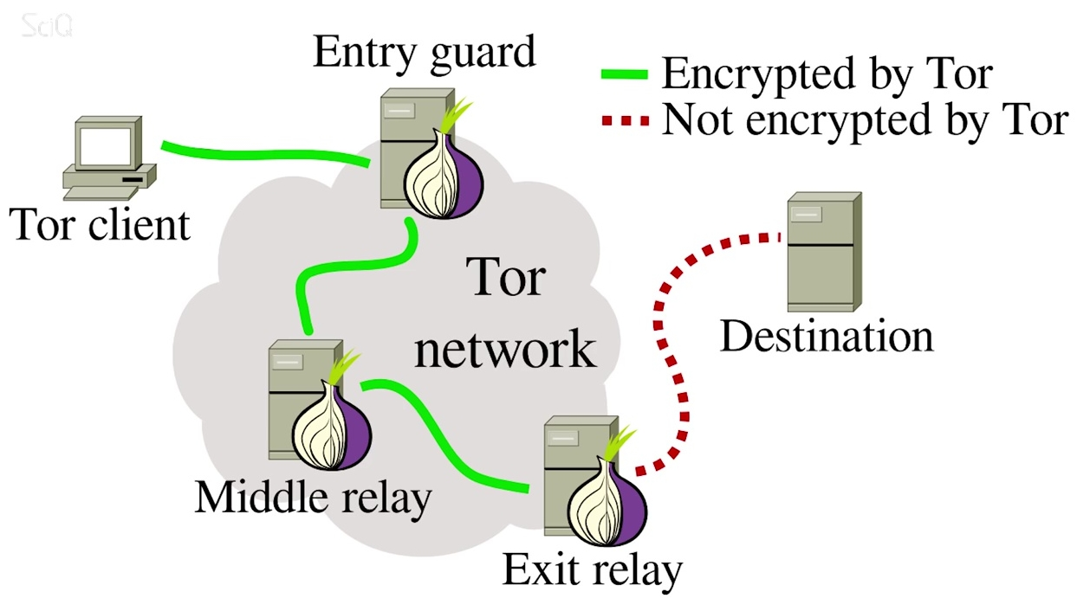
Existing TOR/Onion Routing

Slide 7
Existing TOR/Onion Routing
Existing Onion routing protocol uses multi-hop routing as a form of artificially inducing anonymity.
This can be traced back by newer technologies.
By default only certain browsers employ this as an optional feature, namely TOR Browser,I2P& Waterfox.

Slide 8
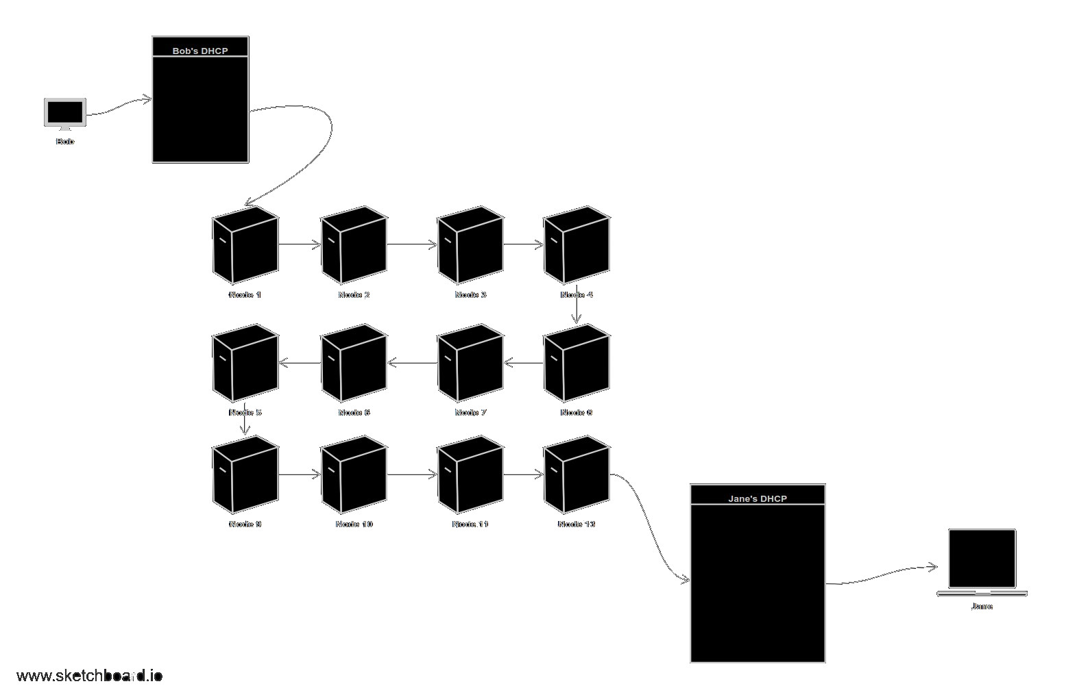
Streamlining the current protocols

Slide 9
MASTER Protocol
This newer protocols implements adding an additional layer of encryption at each node with a random key that changes on every hop node.
Implementing this will require additional processing capability by the node.
But the advantages far outweigh the additional overhead due to the packet changing its secure key at every hop node to a new unique random key unrelated to the previous nodes.

Slide 10
Multi Ark Secure Transmission Encrypted Data Routing
A project by team MASTERm!nd$

