Slide 1
Wi-Fi Enabled Accelerometer
George Dunson, Chris Harris

Slide 2


Organizational Chart
George Dunson
Engineer
Chris Harris
Engineer

Slide 3
Overview
Motivation
Design Description
Hardware
Software
Design Improvements
Timeline
Current Status
Immediate Tasks
Sources
Questions

Slide 4
Motivation
Low power
Bigger customer base
Affordability
Easily adaptable
Design Experience
Efficiency and optimization
Custom PCB

Slide 5
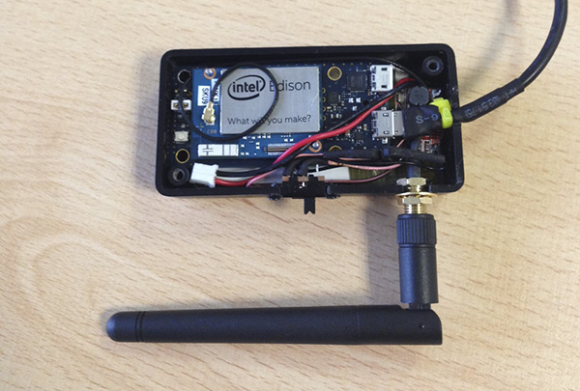
Design Description
Image Courtesy www.davidhunt.ie

Slide 6
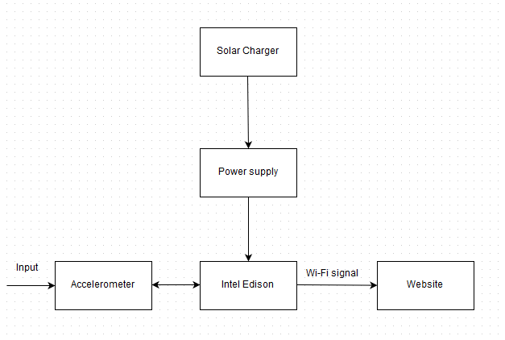
Design Description

Slide 7
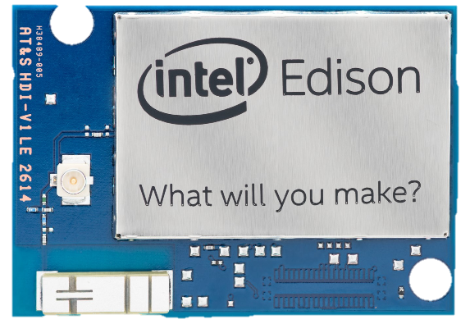
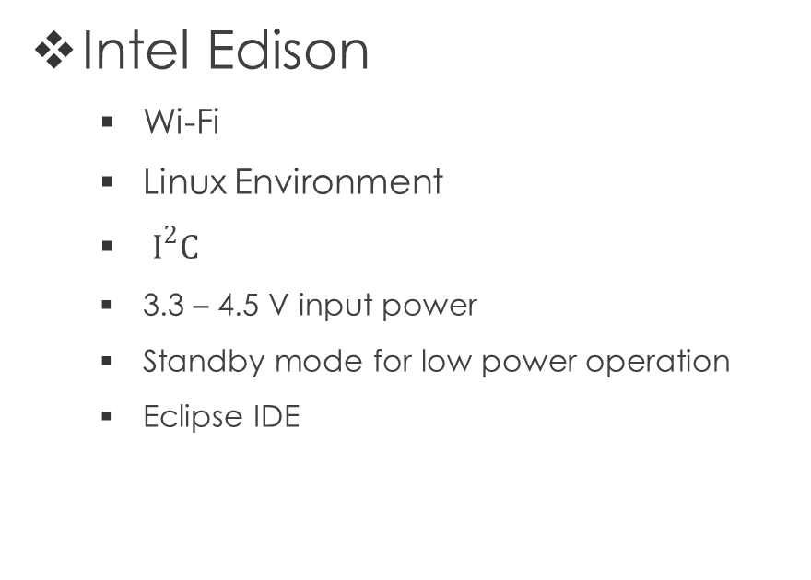
Design Description
Intel Edison
Wi-Fi
Linux Environment
$I^{2}C$
3.3 – 4.5 V input power
Standby mode for low power operation
Eclipse IDE
Image Courtesy Edison Datasheet

Slide 8
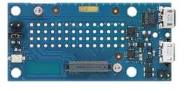
Design Description
Edison Breakout Board
Used to connect Edison to other devices
Micro USB
USB to device UART bridge
0.1 inch grid I/O array of through-hole solder points.
Battery Charger
Image Courtesy www.mouser.com

Slide 9
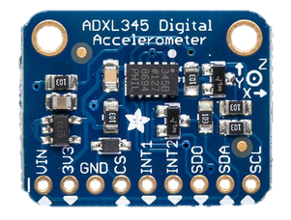

Design Description
ADXL345
3-axis Accelerometer
2g – 16g
$I^{2}C$
Connects to Edison
Image Courtesy www.mouser.com

Slide 10
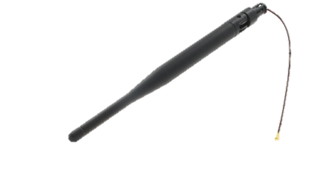
Design Description
External Antenna
2.4 GHz
Used with Edison to broadcast Wi-Fi signals
Image Courtesy www.mouser.com

Slide 11
Hardware
$59.19 Intel Edison
$24.00 Breakout Board for Intel Edison
$5.99 External 5dB 2.4GHz Antenna
$17.50 ADXL345 - Analog Devices 3-Axis Accelerometer
$2.81 BQ24073 – Texas Instruments Li-Ion Battery Charger
~$15 Li-Ion Rechargeable Battery Pack
~$10 Passive Components
~$40 Custom PCB (per spin)
~$20 Ruggedized Enclosure
~$10 Solar Panel
$204.49 Total
~ Denotes an estimated price based on minimal research.

Slide 12
Software
Eclipse
yocto Linux
ThingSpeak
git / github

Slide 13

Eclipse Integrated Development Environment
Used for C code development
Intel provided Eclipse Plug-In
Logo Courtesy www.eclipse.org

Slide 14

yocto Linux
An open source project backed by The Linux Foundation used to create custom Linux-based systems for embedded products…we’ll use this to create our own Linux Distribution rather than using one that either does more or less than we need.
Image Courtesy www.yoctoproject.org

Slide 15
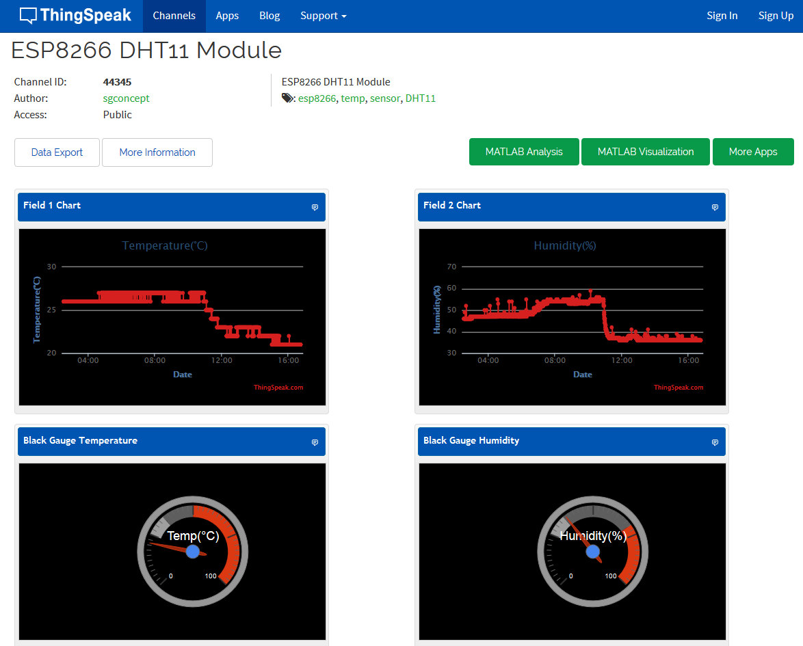
ThingSpeak
Image Courtesy https://thingspeak.com/channels/44345

Slide 16


Version Control with git via github
Git hosts the entirety of the project.
Github is one of many frontend user interfaces.
The source code available for public download.
Changes to the code can be viewed incrementally and/or by contributor.
Image Courtesy http://git-scm.com
Image Courtesy http://github.com

Slide 17
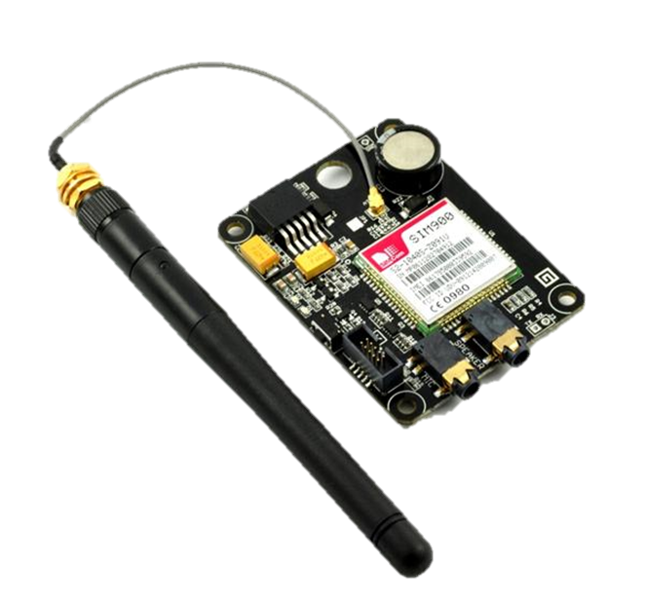
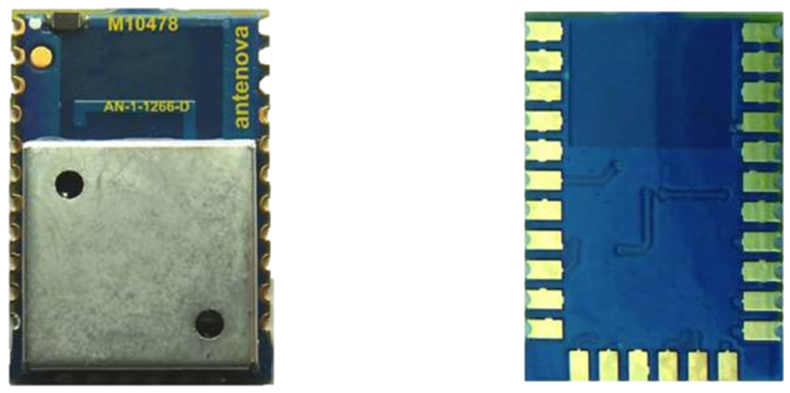
Design Improvements
Cellular Radio
GPS Radio
Additional Environmental Sensors
Temperature
Humidity
Image Courtesy GHI-Electronics
Image Courtesy Antenova

Slide 18
Timeline
09/2015 | 10/2015 | 11/2015 | 12/2015 | 01/2016 | 02/2016 | 03/2016 | 04/2016 | 05/2016
Research
Custom PCB Design
Prototyping
Firmware Development
Debug/Prepare Presentation
Complete
Documentation

Slide 19
Current Status
Fundamental parts ordered
Custom PCB in design phase
Software is abstract until hardware arrives
Getting familiar with GitHub and the expected design process

Slide 20
Immediate Tasks Goals for this Semester
Have Firmware proof of concept functional
Choose power management design
Select an enclosure
Complete PCB Design – Order boards and parts
Be aware of the Chinese New Year and plan accordingly

Slide 21
Sources
http://www.adafruit.com/datasheets/EdisonDatasheet.pdf
http://www.mouser.com
http://www.intel.com/content/www/us/en/do-it-yourself/edison.html

Slide 22

Questions?!

Slide 23
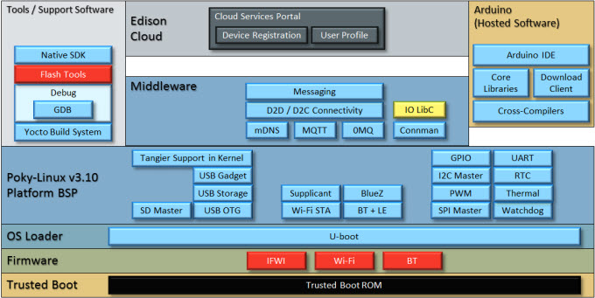
Auxiliary
Edison Software Stack
Image Courtesy www.mouser.com

Slide 24
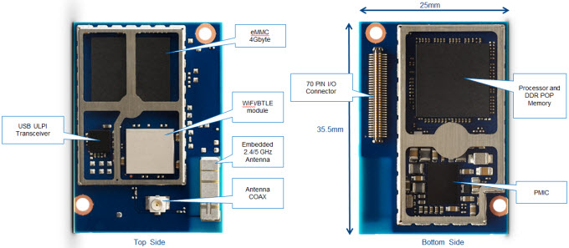
Auxiliary
Edison Mechanical Layout

