Slide 1

▪Research
▪Development
▪Manufacturing
Maxtena, Inc
1715 Pratt, Dr Suite 2800, Blacksburg VA, 24060
www.MAXTENA.com

Slide 2
WHO ARE WE
▪ Antenna Innovation Company est. 2006
▪ Leading experts in Antenna Innovation
▪ Focus on custom GPS antennas & solutions
▪ Antenna design for Military and Commercial use
▪ GPS Helical Quadrifilar & Patch Antennas

Slide 3
MANAGEMENT TEAM
Our Management Team consists with deep expertise in Technology Research, Product Development and Antenna Manufacturing.
Who Years Where
__________________________________________________________________
▪ Dr. Stanislav Licul 8 Co-founder Zylaya, Motorola, XM Radio
Founder & CEO Antenna design, Intellectual Property development
__________________________________________________________________________________
▪ Dr. Warren Stutzman 38 Founding Director of Virginia Tech Antenna Group
Founder & Chief Scientist Antenna design, Intellectual Property development
__________________________________________________________________________________
▪ Jeremy Marks 11 Motorola, Grey Labs, Metalink
Founder & CTO RF design, RFIC expert, RF manufacturing
__________________________________________________________________________________
▪ Dr. Nathan Cummings 10 Arinc, Sciperio,
Founder & VP Engineering Antenna design, Intellectual Property
__________________________________________________________________________________
▪ Dave Handy 22 Co-founder Zylaya, Visual Networks, Current Comm.,
VP of Operations Operations mgmt, services mgmt, offshore manufacturing

Slide 4
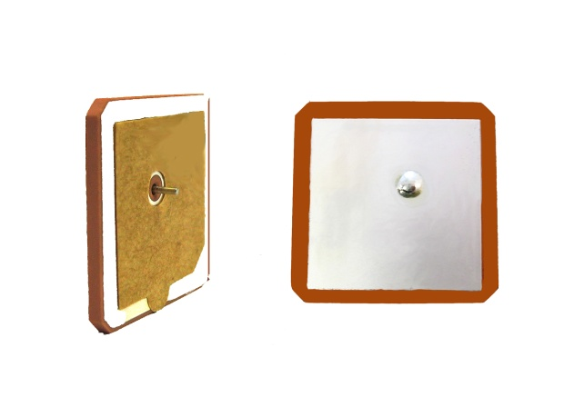
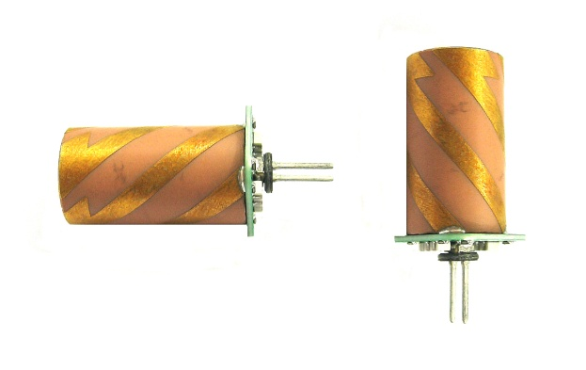
PRODUCTS
Microstrip Patch Antennas
▪ Available in 4 different sizes
▪ Simplified Integration Process
▪ Custom Tuning Kit
▪ Great Performance (Gain 6.1 dBic)
Helical M1575CQA Antennas
▪ Differential Interface
▪ 0.2 dB Axial Ratio
▪ >140° Cardioid Beamwith
▪ Minimized Hand Detuning
▪ Great Performance (Gain -1.3 dBic)

Slide 5

M1575CQA GPS ANTENNA
▪ Frequency: 1575.42 MHz ±10MHz
▪ Polarization: RHCP
▪ Efficiency: 38% (differential) -1.3 dBic
▪ Beamwidth: 140° (both axis)
▪ Axial Ratio: 0.2 dB (max)
▪ Front to back ratio: 12 dB
▪ VSWR: 1.3:1 (typical)
▪ Impedance: 100Ω (differential)
▪ Dimensions: 10mm diam. x 20mm length

Slide 6
M1575CQA GPS ANTENNA
Maxtena GPS quadrifilar antenna technology
▪ Separate balun and symmetric antenna windings
▪ Phase shifter board drives quadrature ➔ simplifies antenna tuning
▪ Excellent isolation between the ports, excellent amplitude and phase stability ➔ better Circular Polarization
▪ Differential interface reduces part count ➔ more gain and efficiency
Conventional GPS quadrifilar antenna technology
▪ Integrated balun
▪ Asymmetric (quadrature) antenna windings
▪ Lower efficiency and gain
▪ Lower Circular Polarization purity
▪ Single-ended design

Slide 7
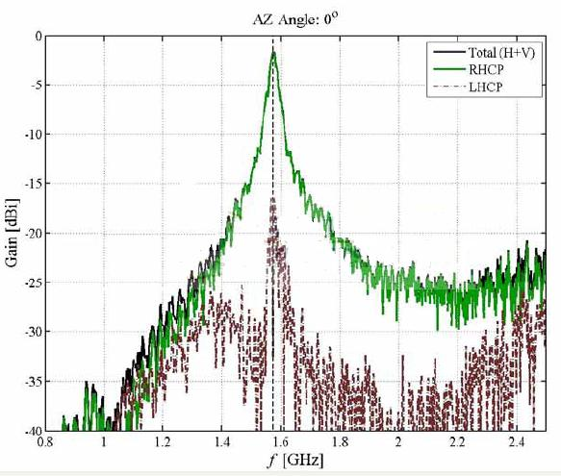
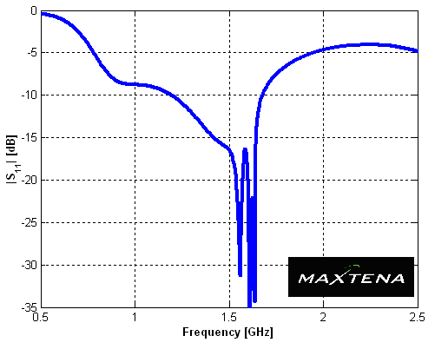
M1575CQA PERFORMANCE
M1575CQA Return Loss and Filtering

Slide 8
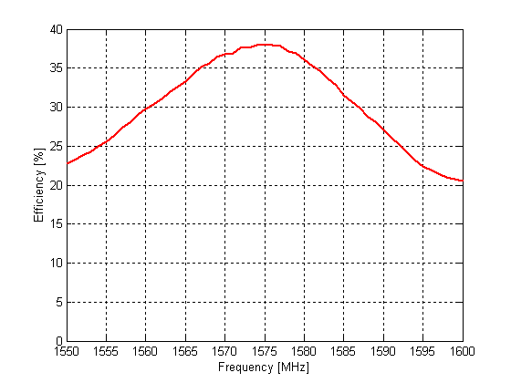
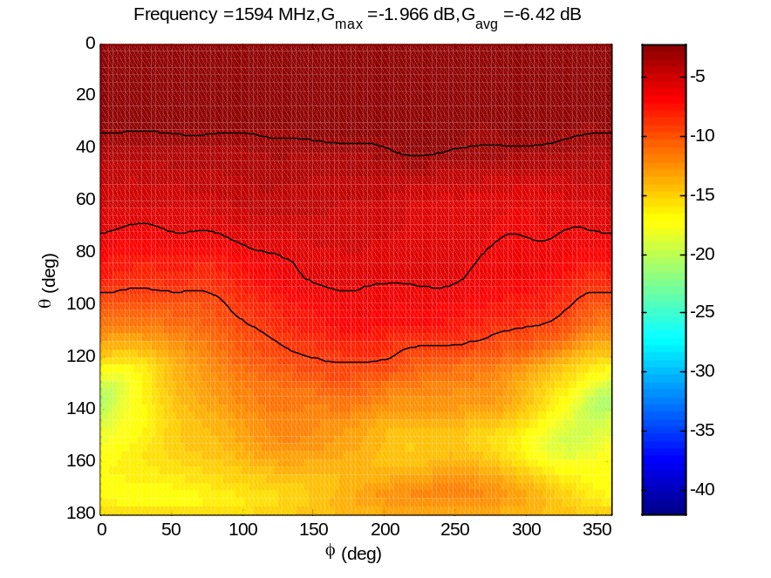
M1575CQA PERFORMANCE
Contour Plot- Outstanding Upper Hemisphere Symmetry

Slide 9
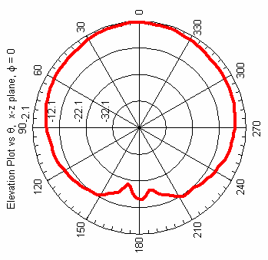
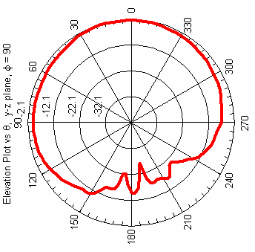
M1575CQA PERFORMANCE
Elevation Patterns
* Results Shown with a Balun (Loss -1.1 dB)

Slide 10
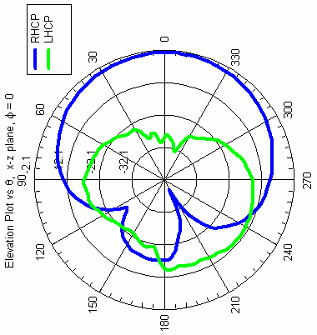
M1575CQA PERFORMANCE
RHCP vs. LHCP Rejection

Slide 11
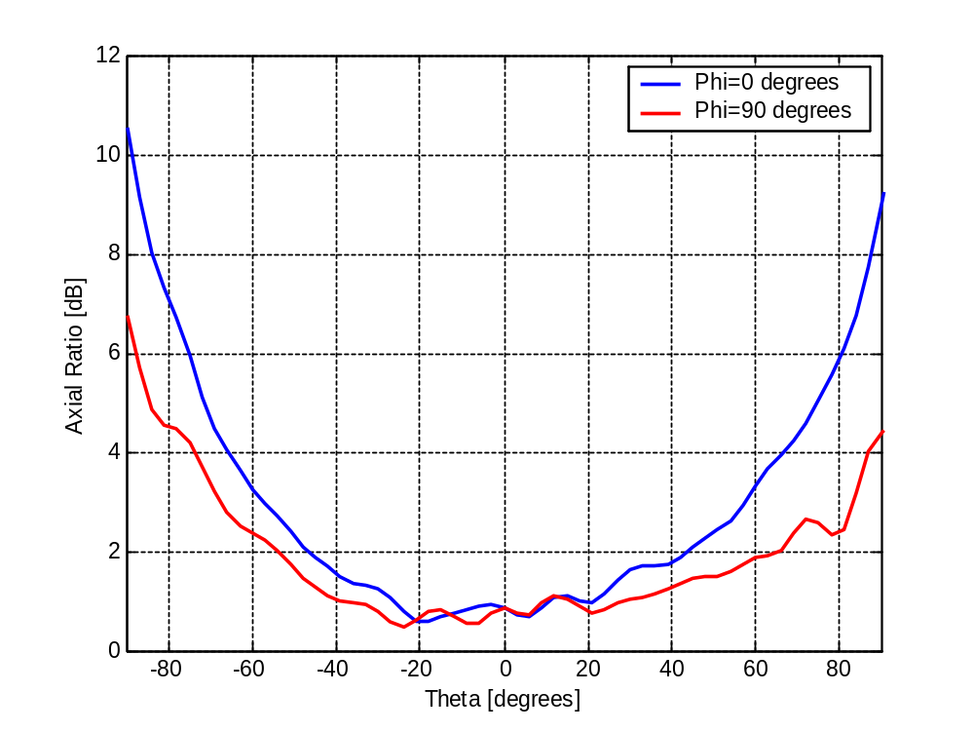
M1575CQA PERFORMANCE
Axial Ratio

Slide 12
M1575CQA CONCLUSION
Compact Antenna for Handheld & Mobile GPS/SATCom
▪ Advance Differential Material Technology
▪ Differential Interface Feed
▪ Reduced BOM
▪ Increased Efficiency and Bandwith
▪ Minimized Hand Detuning Effects
▪ 7 mm Design Possible

Slide 13
GPS PATCH ANTENNAS
▪ Frequency: 1575.42 MHz ±10MHz
▪ Polarization: RHCP
▪ Efficiency: 77% 6.1 dBic
▪ Beamwidth: 100° (both axis)
▪ Axial Ratio: 3.0 dB (max)
▪ Front to back ratio: 25 dB
▪ VSWR: 1.3:1 (typical)
▪ Impedance: 50Ω (single ended)
▪ Dimensions: 25mm x 25mm x 2mm
*Performances varies due to antenna size

Slide 14
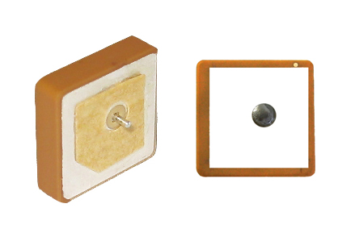
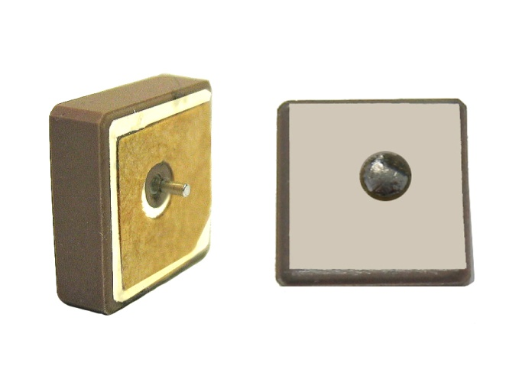
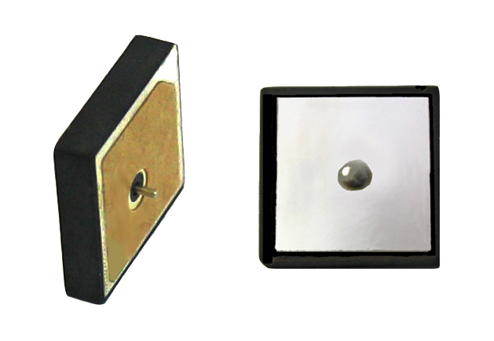
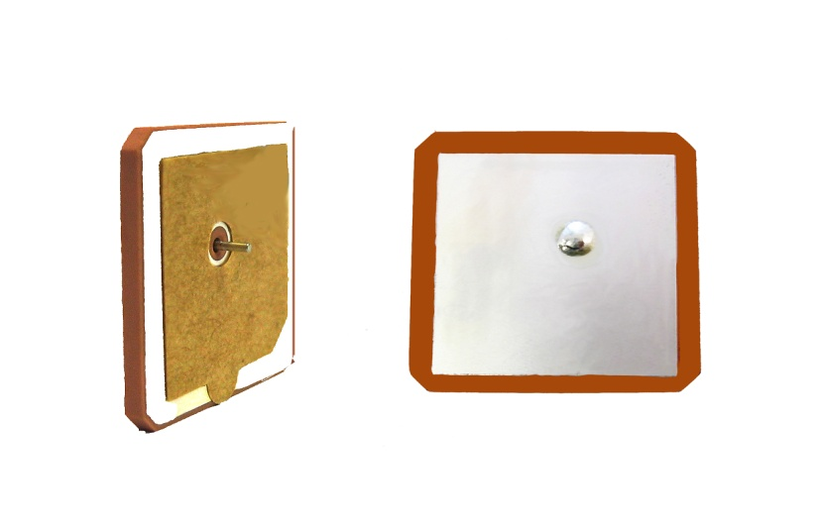
GPS PATCH ANTENNAS
▪ 13mm*13mm*4mm
▪ 65% Efficiency
▪ Gain of 4.8 dBic
←
▪ 15mm*15mm*4mm
▪ 72% Efficiency
▪ Gain of 5.3 dBic
→
▪ 18mm*18mm*2mm
▪ 77% Efficiency
▪ Gain of 5.7 dBic
←
▪ 25mm*25mm*2mm
▪ 88% Efficiency
▪ Gain of 6.1 dBic
→

Slide 15
PATCH ANTENNAS CONCLUSION
Compact patch antennas ideal for personal GPS systems
▪ Custom tuning kits available for rapid and precision antenna tuning
▪ Low profile compact ceramic antenna design available in 4 sizes (13mm,15mm,18mmm & 25mm).
▪ Rapid integration with expertise assistance
▪ Great performance/low cost
▪ L1/L2 design possible

Slide 16
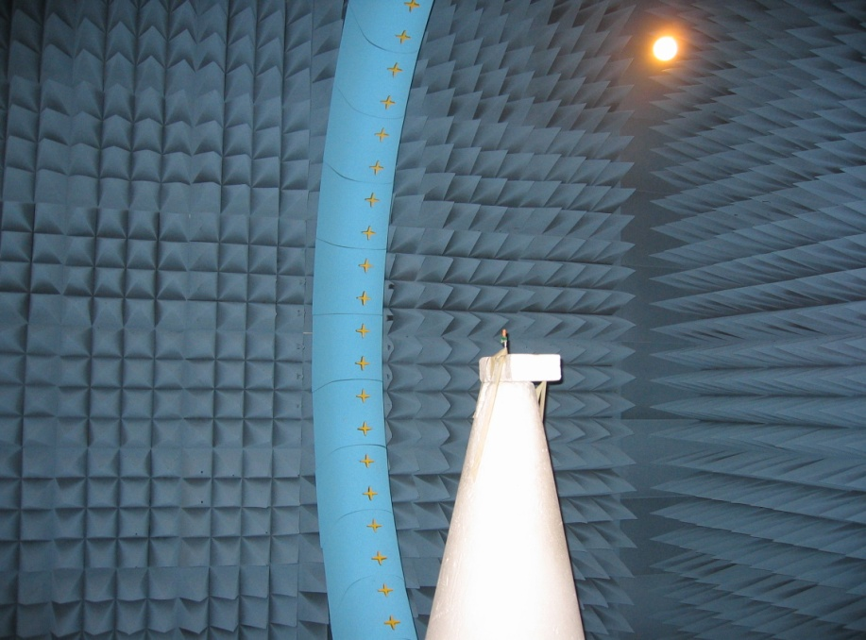
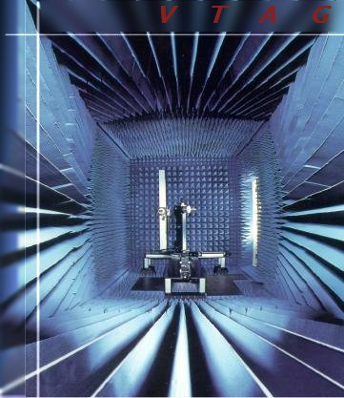
SERVICES
▪ MEASUREMENTS
Satimo Chamber
400 MHz to 6 GHz
Anechoic Chamber
100 MHz to 4 GHz

Slide 17
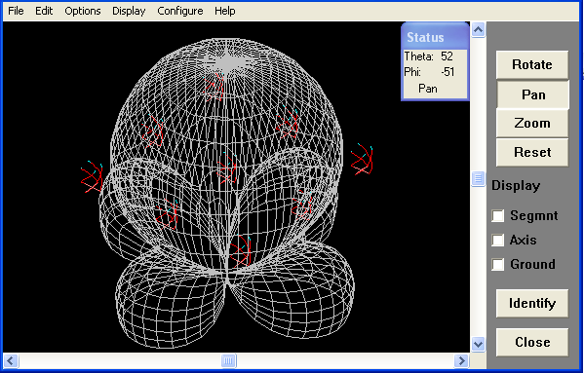
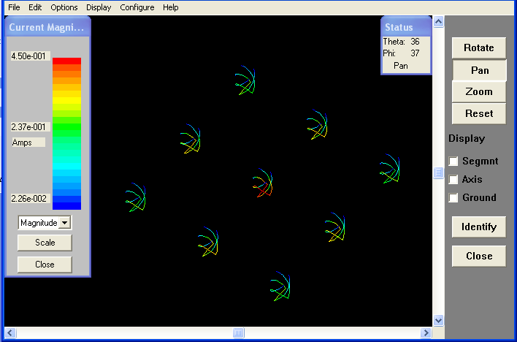
SERVICES
▪ SIMULATION CAPABILITIES
CST
MOM

Slide 18
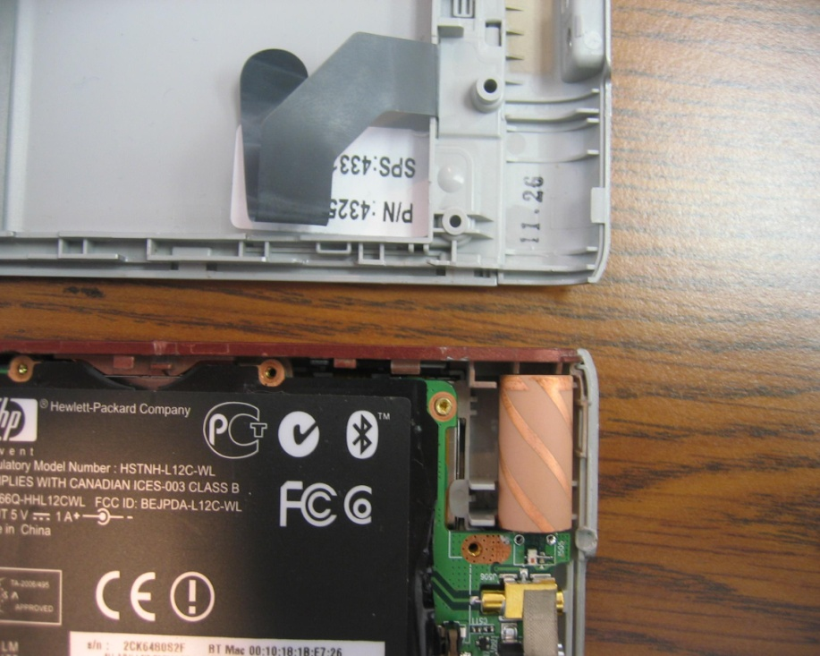
SERVICES
▪ EMBEDED SOLUTIONS
(CELL ANTENNA PIC)
M1575CQA INTEGRATION IN A HANDHELD GPS DEVICE
CELL PHONE EMBEDED ANTENNA

Slide 19
SERVICES
▪ ACTIVE SOLUTIONS
(LAYOUT PIC)
RFIC
(ANALYSER PIC)
PA

Slide 20
THANK YOU
QUESTIONS ?
MAXTENA, INC
1715 PRATT DRIVE, SUITE 2800
BLACKSBURG, VA 24060
WWW.MAXTENA.COM

