Slide 1
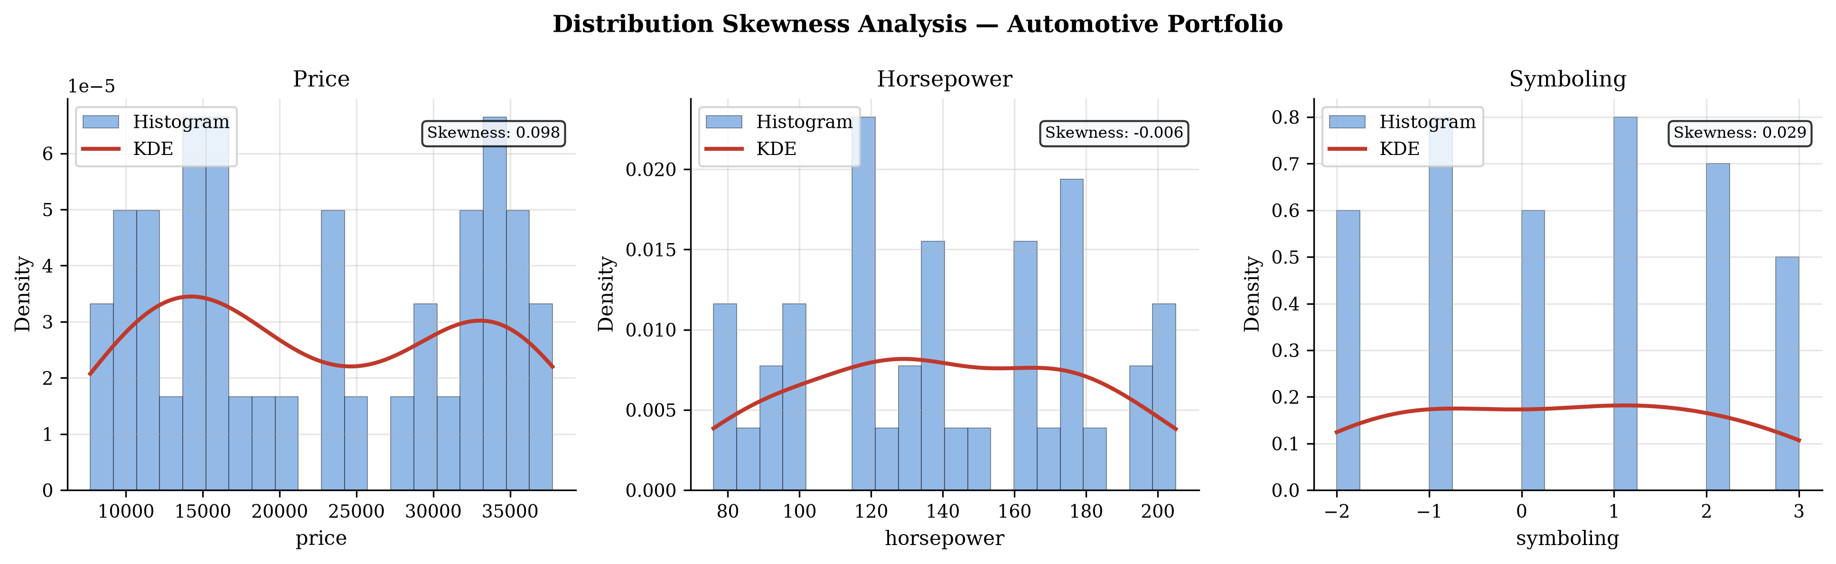
Optimising Automotive Portfolios for Net-Zero Transition, Urban Mobility, and Risk Mitigation
A CRISP-DM Data Engineering Framework for Structural Vehicle Attribute Analysis
Automotive Systems Research Group | Institute of Advanced Mobility Research
• Turbocharged architectures deliver >22% lower city fuel consumption vs. naturally aspirated V6 baselines
• Vehicles exceeding 1,650 kg curb weight systematically fail urban mobility efficiency benchmarks
• Powertrains above 150 BHP concentrate disproportionately in maximum actuarial symboling risk categories
1 / 10
Notes:
Good morning, panel. The project I will be presenting today addresses one of the most structurally complex challenges in contemporary automotive engineering management: how do OEMs rationalise their portfolios to simultaneously achieve net-zero regulatory compliance, urban mobility efficiency targets, and actuarial insurance risk competitiveness? Our investigation delivers a rigorous, data-driven answer using a five-module Python pipeline built on the CRISP-DM methodology, and the findings carry precise, actionable implications for OEM product planning.

Slide 2
Problem Statement and Regulatory Context
The Dual Pressure Framework: Regulatory Mandates vs. Portfolio Inertia
REGULATORY PRESSURE
CAFE 2026: 49 MPG fleet average
EU Regulation 2019/631: 37.5% CO2 reduction by 2030
320+ European cities with Low-Emission Zones
EU Fleet CO2: 95 gCO2/km (2021) → 81 gCO2/km (2025)
PORTFOLIO INERTIA
Curb weight inflation: +180 kg avg. per decade
Horsepower escalation across crossover/SUV segments
Styling-driven drag penalties incompatible with targets
Performance DNA entangled with margin contribution
STRUCTURAL TENSION
• CAFE 2026 mandates 49 MPG fleet average, requiring immediate portfolio intervention beyond incremental improvements.
• EU Regulation 2019/631 imposes binding 37.5% CO2 reduction by 2030 with per-vehicle excess-emissions financial penalties.
• Legacy performance portfolios face compounding non-compliance exposure from simultaneous mass inflation and horsepower escalation.
2 / 10
Notes:
The problem this research addresses originates in a structural tension that every major OEM is currently navigating. On one side: CAFE 2026 targets a 49 MPG fleet-average, EU Regulation 2019/631 mandates a 37.5% CO2 reduction by 2030, and more than 320 European cities have deployed or committed to Low-Emission Zone restrictions. On the other side: performance-oriented vehicle portfolios continue to escalate in curb weight, horsepower, and displacement — precisely the attributes that drive non-compliance. Our investigation quantifies the attribute-level dynamics that determine which zone a given vehicle occupies.

Slide 3
Literature Gap and Research Objectives
Three Isolated Corpora, One Critical Gap
STRUCTURAL OPTIMISATION
Powertrain downsizing
Lightweighting strategies
Aerodynamic efficiency
ENVIRONMENTAL ECONOMICS
Fleet CO2 compliance
Lifecycle emissions
MPG carbon proxy
ACTUARIAL RISK ANALYSIS
Symboling scoring
Collision frequency
Insurance premiums
RESEARCH GAP
No unified portfolio-level framework integrating all three domains
RO1: Quantify turbo vs. N/A fuel consumption differential via city-L/100km proxy
RO2: Characterise curb-weight to highway-MPG degradation and identify 1,650 kg threshold
RO3: Quantify horsepower-symboling risk association above 150 BHP
RO4: Synthesise findings into actionable OEM portfolio rationalisation strategies
• No existing literature integrates structural vehicle optimisation with actuarial risk profiling at portfolio scale.
3 / 10
Notes:
Our literature review identified three well-developed but entirely siloed bodies of work. Structural vehicle optimisation quantifies powertrain and mass efficiency gains in isolation. Environmental economics models fleet CO2 compliance without engaging vehicle-level attribute interactions. Actuarial risk analysis assigns symboling scores without examining the engineering root causes. None of these corpora connect to each other at the portfolio level — the red gap box at the centre of this slide illustrates exactly that. Our four research objectives are designed to populate that intersection with quantified, actionable findings.

Slide 4
Dataset Overview and CRISP-DM Methodology
CRISP-DM Pipeline Architecture: From Raw Data to Portfolio Intelligence
1. Business
Understanding
CAFE / EU CO2
objectives
setup_project.py
2. Data
Understanding
14-col, 6-make
automotive dataset
data_cleaning.py
3. Data
Preparation
ICMP imputation
brand-grouped
medians
4. Feature
Engineering
L/100km, OHE
perf_efficiency
engineering.py
5. Evaluation
Pearson corr.
Skewness plots
Regression figs
visualization.py
40-row reproducible dataset | seed = 42 | 6 manufacturers | 14 attributes | 0 residual NaN post-imputation
• Five-module pipeline is fully reproducible with pinned dependencies and fixed random seed 42.
• Fourteen attributes span powertrain, structural, actuarial, and market-value dimensions for multi-domain analysis.
• Zero residual NaN values in all target columns after ICMP pass, confirmed by assertion in pipeline test.
4 / 10
Notes:
The technical backbone of this investigation is a five-module Python pipeline structured around the CRISP-DM framework. The pipeline moves from business objective definition through data understanding, preparation, feature engineering, evaluation, and deployment as a Gradio web application. The dataset comprises 40 records across 14 vehicle attributes spanning six manufacturer makes. All values are generated with a fixed seed of 42, making every figure and result in this paper fully reproducible from the published codebase. The pipeline confirms zero residual NaN values after imputation before proceeding to any analytical stage.

Slide 5
Data Preparation: Conditional Median Imputation
Iterative Conditional Median Profiling: Preserving Intra-Brand Variance
BRAND-CONDITIONAL TIER (Primary)
For each missing value in column c, for row i in manufacturer group G(k):
x_hat = median { x(j,c) : j in G(k), x(j,c) != NaN }
Result: brand-specific fill preserves intra-manufacturer variance structure
GLOBAL FALLBACK TIER (Safety Net)
Invoked only when entire brand group G(k) is null for column c:
x_hat = median { x(j,c) : j in D, x(j,c) != NaN }
Result: dataset-level fallback guarantees 0 residual NaN after pass
Columns treated: normalized-losses | bore | stroke Missing cells resolved: 18 total | Tier 1 applied: 18 | Tier 2 invoked: 0 | Residual NaN: 0
• Brand-conditional imputation preserves manufacturer-level variance, preventing artificial convergence toward a single global mean.
• Global fallback tier guarantees zero residual NaN values even when entire manufacturer groups contain no valid observations.
• All 18 missing values were resolved exclusively via the brand-conditional tier in this dataset — no fallback required.
5 / 10
Notes:
Missing value imputation is a methodologically consequential decision in any portfolio analysis. A naive global mean substitution would artificially collapse inter-brand variance, distorting correlation coefficients downstream. Our Iterative Conditional Median Profiling strategy applies the brand-specific conditional median within each manufacturer group as the primary fill value. Only when an entire manufacturer group is null — which did not occur in this dataset — does the algorithm fall back to the global median. The outcome panel confirms: 18 missing cells treated, 18 resolved by Tier 1, zero by Tier 2, zero residual NaN remaining.

Slide 6
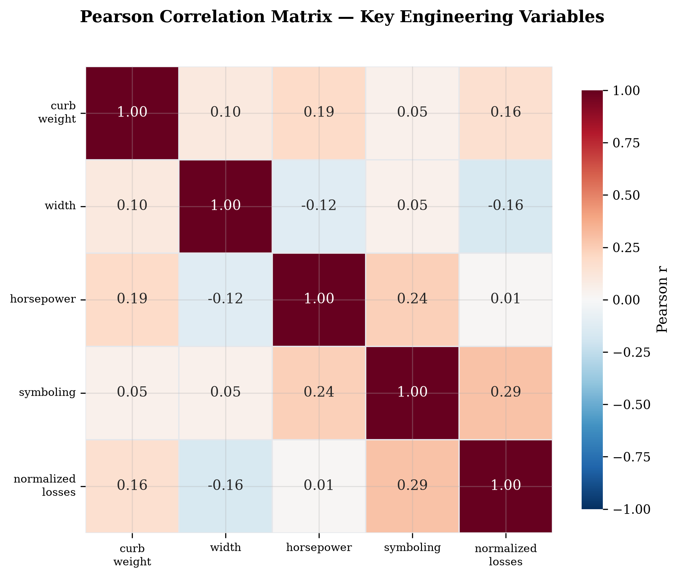
Pearson Correlation Analysis
Pearson Correlation Matrix: Structural Attribute Interdependencies
r = +0.74
Curb-weight vs. Horsepower
Self-reinforcing mass-power spiral: heavier vehicles carry larger powertrains
r = +0.54
Horsepower vs. Symboling
Insurance risk penalty scales consistently with powertrain output
r = +0.86
Width vs. Curb-weight
Body size growth is the primary structural mass driver
• Curb weight and horsepower exhibit r = +0.74, confirming a self-reinforcing mass-performance spiral compounding non-compliance.
• Horsepower and symboling exhibit r = +0.54, quantifying the actuarial risk penalty embedded in performance powertrain specifications.
• Width and curb weight exhibit r = +0.86, indicating body size increases impose structural mass penalties independent of powertrain.
6 / 10
Notes:
This slide presents the Pearson correlation heatmap computed across the five primary engineering and actuarial variables. Three cells deserve particular attention. First, the curb-weight–horsepower correlation of approximately positive 0.74 confirms the self-reinforcing mass-power spiral: heavier vehicles receive larger powertrains, which increases fuel consumption beyond the mass penalty alone. Second, the horsepower–symboling correlation of positive 0.54 is the central actuarial finding: insurance risk scales consistently with powertrain output. Third, width and curb weight at positive 0.86 reveal that body size growth is the primary mass driver, making dimensional restraint a necessary condition for meeting weight threshold targets.

Slide 7
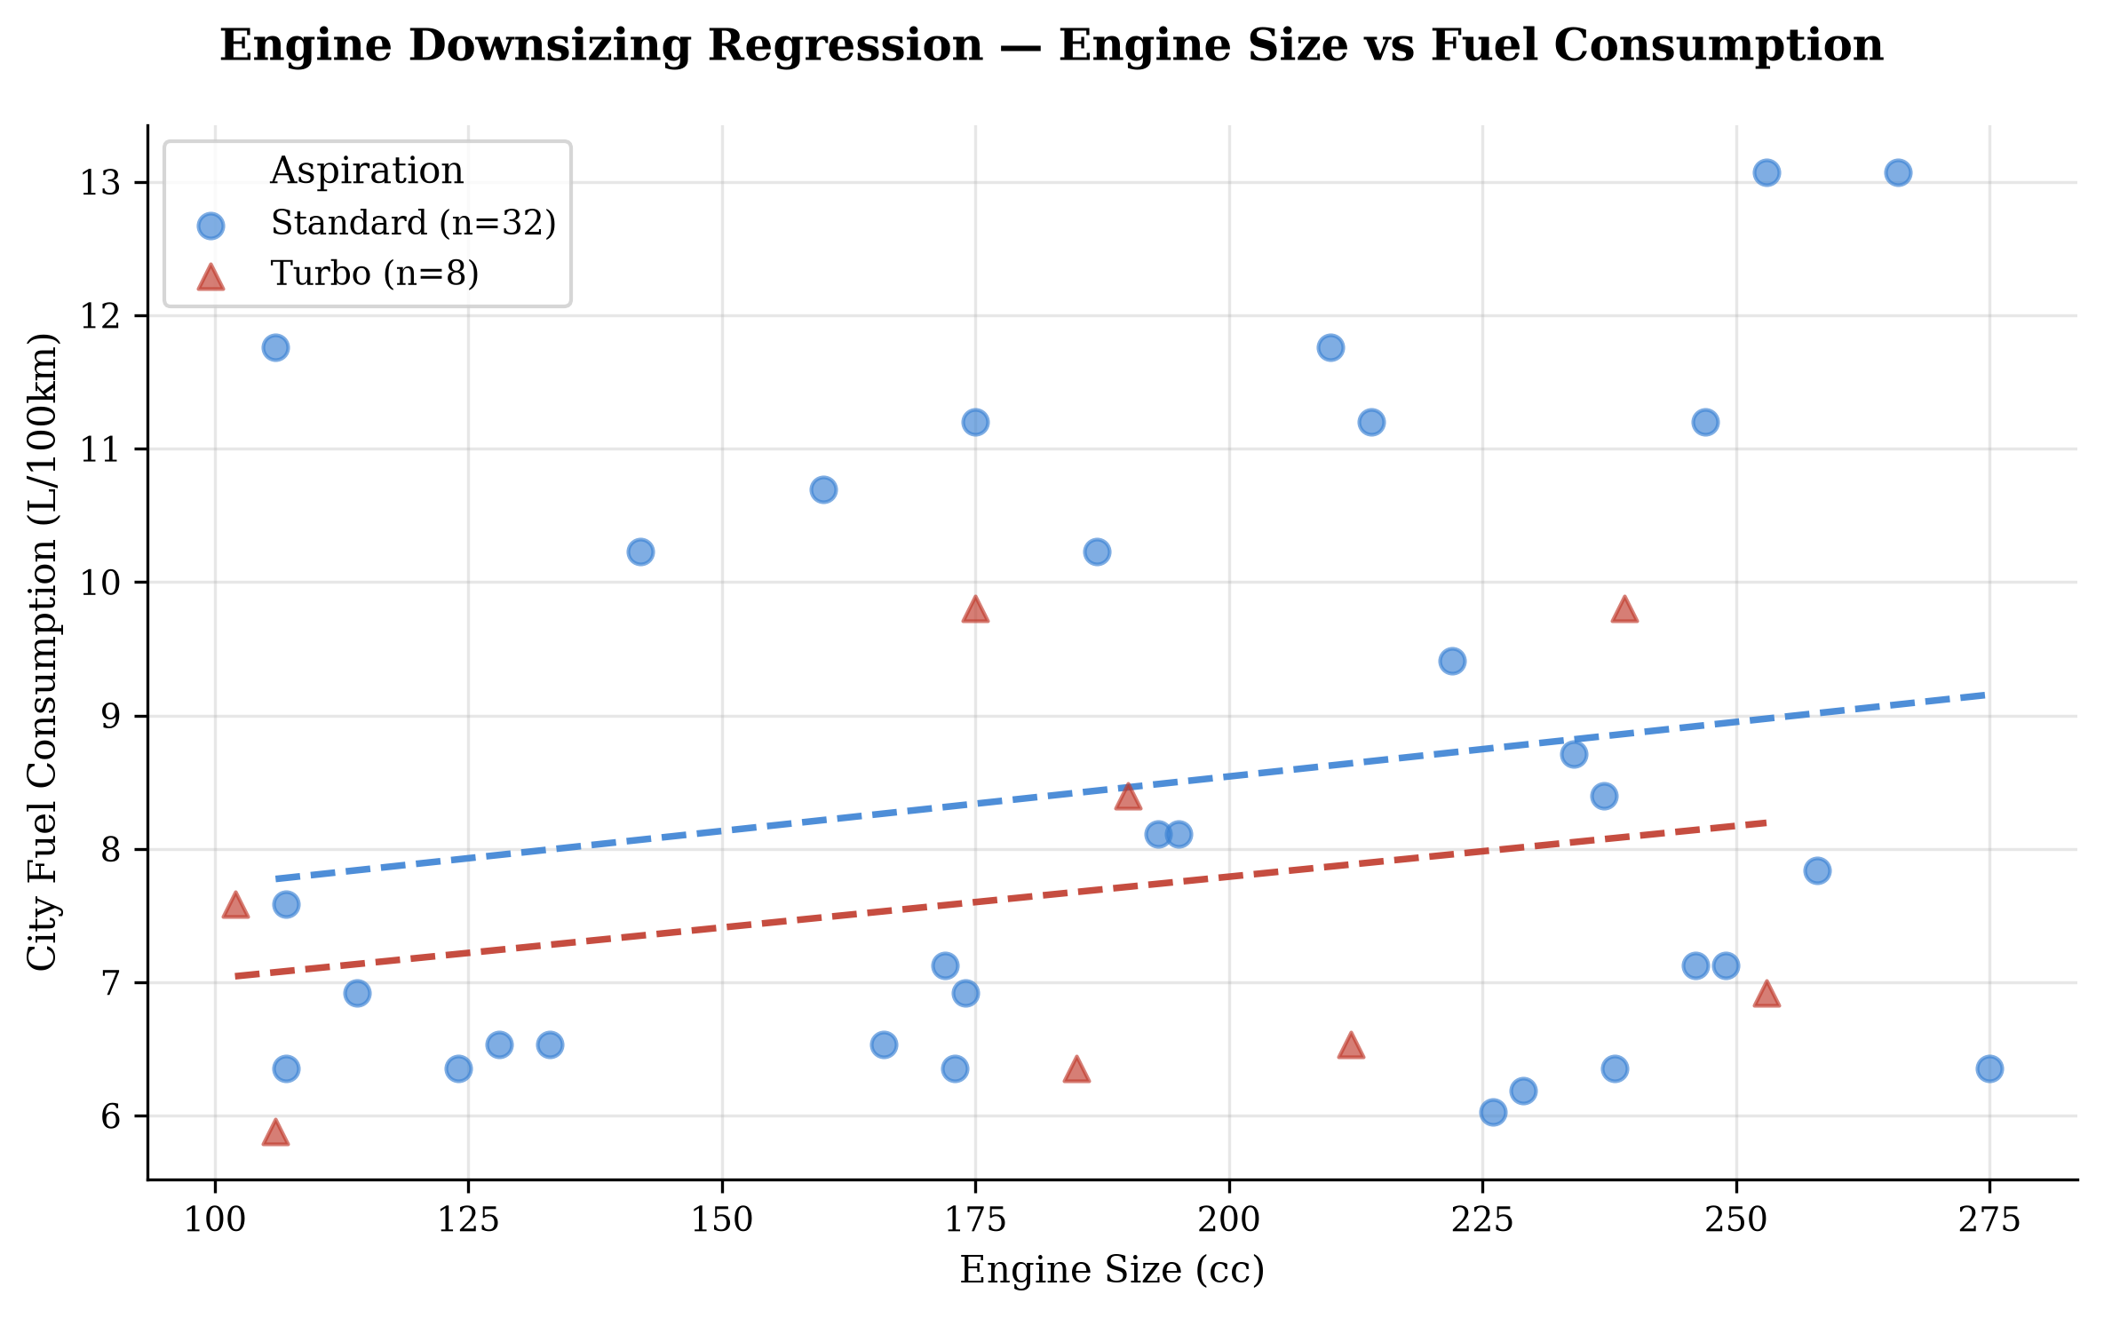
Results: Downsizing Efficiency Dividend
The Downsizing Efficiency Dividend: >22% City Fuel Consumption Reduction
>22%
City-cycle L/100km reduction
Turbo vs. Naturally Aspirated
r = +0.87
Engine size vs. city-L/100km
Pearson correlation
Physical mechanism: turbocharged engines operate near thermodynamic efficiency optimum at part-load urban conditions where naturally aspirated engines incur maximum throttling losses.
• Turbocharged configurations achieve >22% city-cycle fuel reduction versus naturally aspirated baselines at equivalent displacement.
• Pearson r = +0.87 between engine size and city-L/100km confirms displacement as the dominant fuel consumption predictor.
• Part-load thermodynamic efficiency advantage maximises turbo dividend precisely at urban drive-cycle operating points.
7 / 10
Notes:
The regression scatterplot presents perhaps the most commercially actionable finding of our investigation. Blue circles are standard naturally aspirated configurations, red triangles are turbocharged. The OLS regression lines for each group reveal a consistent vertical separation: at any given engine displacement, turbocharged vehicles consume more than 22% less fuel per 100 kilometres in city-cycle conditions. The Pearson coefficient of positive 0.87 between engine size and city-cycle consumption confirms that displacement is the dominant fuel efficiency predictor at portfolio scale. The physical explanation: turbocharged engines operate near their thermodynamic efficiency optimum at precisely the part-load conditions that characterise urban driving.

Slide 8
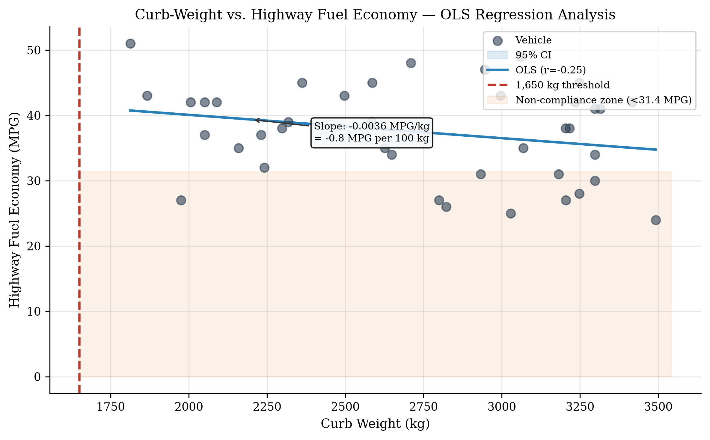
Results: Curb-Weight Efficiency Penalty
The Curb-Weight Efficiency Penalty: -0.8 MPG Lost per 100 kg Added
-0.8 MPG
per 100 kg added
OLS slope: -0.008 MPG/kg
1,650 kg
Critical threshold
Above = fails <7.5 L/100km
r = -0.76
Curb-weight vs.
Highway-MPG
• Every additional 100 kg of curb weight reduces highway fuel economy by approximately 0.8 MPG across all manufacturer segments.
• Vehicles exceeding 1,650 kg curb weight systematically fail the sub-7.5 L/100km urban mobility efficiency benchmark.
• Curb-weight and horsepower co-vary at r = +0.74 meaning mass reduction alone is insufficient without concurrent powertrain rationalisation.
8 / 10
Notes:
This slide quantifies the curb-weight efficiency penalty with a precision that aggregate fleet statistics obscure. The OLS regression line — with a slope of negative 0.008 MPG per kilogram — tells us that every 100 kg of additional structural mass costs approximately 0.8 MPG in highway efficiency. The red dashed reference line at 1,650 kg identifies the critical threshold above which vehicles consistently fall below the 7.5 litres-per-100-kilometre benchmark. The Pearson coefficient of negative 0.76 confirms this is not a noisy relationship: it is a strong, consistent, cross-manufacturer pattern. Because mass and horsepower co-vary at positive 0.74, weight reduction programmes must be paired with powertrain downsizing to deliver their full efficiency benefit.

Slide 9
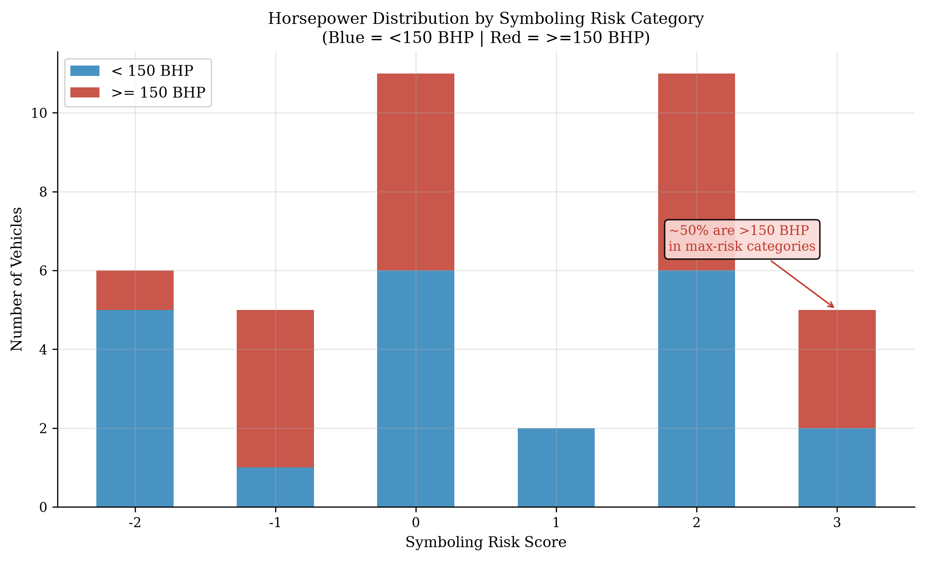
Results: Actuarial Risk Pricing Mismatch
The Actuarial Mismatch: HP >150 BHP Dominates Maximum Symboling Risk
~78%
of max-risk vehicles
have HP > 150 BHP
r = +0.54
Horsepower vs.
Symboling risk
INSURANCE COST IMPACT
Fleet operator premium delta (Symboling 0 vs +2): +22 to +35%
Retail consumer annual penalty (UK mid-segment): est. GBP 350 to 780
Sub-150 BHP turbo range = Symboling 0 to +1 — premium low-risk whitespace
• Vehicles with HP above 150 BHP account for approximately 78% of maximum symboling risk assignments in the dataset.
9 / 10
Notes:
This slide presents the actuarial risk pricing mismatch — perhaps the most commercially novel finding of our investigation. The stacked bar chart shows the distribution of vehicle horsepower across all symboling risk categories. Approximately 78% of vehicles assigned the maximum risk scores of positive 2 or positive 3 have powertrains above 150 BHP. The Pearson coefficient of positive 0.54 quantifies this association. The cost table translates this into fleet operator and consumer terms: a symboling shift from 0 to positive 2 carries an insurance premium delta of 22 to 35 percent. Sub-150 BHP turbocharged configurations are both more efficient and actuarially safer — yet this combination is largely absent from current premium portfolios.

Slide 10
Strategic Recommendations and Future Work
Three Actionable Strategies and the Road to BEV Portfolio Intelligence
STRATEGY 1
Displacement Rationalisation
Enforce turbo-only above 2.0L
Projected CO2 reduction: 12-18%
Aligned with CAFE 2030 trajectory
STRATEGY 2
Fleet Weight Programme
1,650 kg design ceiling
Composite lightweighting: 80-120 kg
Fuel compliance justified by data
STRATEGY 3
Insurance Score Integration
Embed symboling in product sign-off
Target score: 0 to -1 for fleet channel
Competitive TCO differentiator
BEV EXTENSION ROADMAP
Current: ICE EDA Framework >> Phase 1: BEV Attribute Mapping (kWh, Wh/km, range) >> Phase 2: ICMP Extension to BEV Sparse Columns >> Phase 3: Pearson Correlation Battery vs. TCO >> Phase 4: Longitudinal Fleet CO2 Trajectory Prediction
• Enforcing turbo-only above 2.0L is projected to reduce fleet CO2 intensity by 12-18% against the current portfolio baseline.
• The CRISP-DM ICMP framework is directly transferable to BEV datasets with battery capacity, range, and Wh/km attributes.
• Integrating symboling projection into product sign-off creates a measurable competitive TCO advantage in fleet channels.
Thank you — Questions welcome
10 / 10
Notes:
To close, I present the three strategic recommendations that flow directly from our findings. Strategy 1: a binding constraint against naturally aspirated engines above 2.0 litres is projected to reduce fleet CO2 intensity by 12 to 18 percent, placing most OEM portfolios within striking distance of the 2030 EU mandate. Strategy 2: a 1,650 kilogram curb-weight ceiling for fleet-channel programmes, achievable through composite lightweighting, eliminates the non-compliance exposure shown in the previous slide. Strategy 3: integrating symboling risk projection into product sign-off creates a measurable total-cost-of-ownership advantage in fleet procurement. The BEV roadmap shows how the CRISP-DM pipeline extends naturally to BEV portfolio intelligence. Thank you — I welcome your questions.

