Slide 1
Phishing Awareness Training
A Detailed Study on Phishing Attacks, Detection & Prevention
Prepared by E-Arvind Udiyar
Msc. Computer Science

Slide 2
Introduction to Phishing
Phishing is a type of cyber attack that relies on social engineering techniques to deceive individuals into revealing sensitive information such as usernames, passwords, banking details, and OTPs. Attackers typically impersonate trusted entities like banks, government agencies, or popular online platforms.
The primary objective of phishing is financial fraud, identity theft, or unauthorized system access. It remains one of the most common and effective cyber threats worldwide due to human error and lack of awareness.

Slide 3
How Phishing Attacks Work
A phishing attack generally begins when a victim receives a fraudulent email, SMS, or message that appears legitimate. The message often contains a malicious link or attachment designed to look authentic.
When the victim clicks the link, they are redirected to a fake website that closely resembles the original one. Once login credentials or personal information are entered, the attacker captures the data and uses it for malicious purposes.

Slide 4
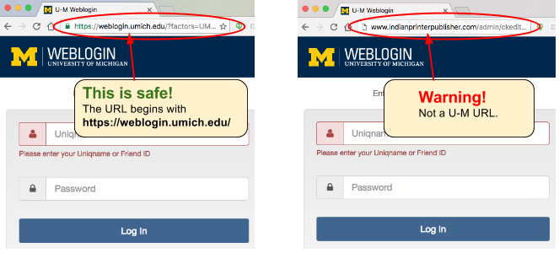

Slide 5
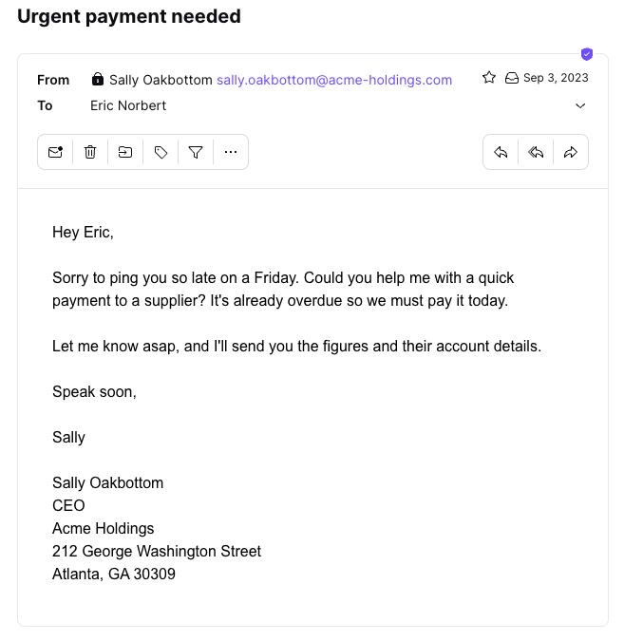

Slide 6
Types of Phishing Attacks
Email phishing involves sending bulk fake emails pretending to be from reputable organizations. Spear phishing is a targeted attack aimed at a specific individual or organization using personalized information.
Smishing refers to phishing via SMS messages, while vishing uses voice calls to trick victims. Clone phishing duplicates legitimate emails but replaces original links with malicious ones.

Slide 7
Identifying Phishing Emails
Phishing emails often contain urgent or threatening language such as warnings about account suspension. They may include suspicious sender addresses that slightly differ from official domains.
Other indicators include spelling and grammatical errors, unfamiliar URLs, unexpected attachments, and requests for confidential information like OTPs or passwords.

Slide 8
Social Engineering Techniques Used by Attackers
Phishing attackers manipulate human psychology by creating fear, urgency, authority, or greed. For example, they may claim that a bank account will be blocked unless immediate action is taken.
They may also impersonate government officials or offer fake rewards and prizes. These tactics pressure victims into acting quickly without verifying authenticity.

Slide 9
Impact and Consequences of Phishing
Phishing can result in severe financial losses, identity theft, and data breaches. Individuals may lose access to their bank accounts or social media profiles.
For organizations, phishing attacks can lead to compromised systems, loss of confidential data, reputational damage, and legal consequences.

Slide 10
Real-World Example
In India, many phishing attacks occur through fake KYC update messages or UPI payment alerts. Victims receive SMS messages claiming that their bank account requires immediate verification.
Upon clicking the link and entering credentials, attackers gain access to banking information and transfer funds fraudulently.

Slide 11
Prevention and Best Practices
Individuals should never share OTPs, passwords, or banking details through email or phone calls. Enabling two-factor authentication (2FA) adds an extra layer of security to online accounts.
It is important to verify website URLs carefully, avoid clicking suspicious links, keep systems updated, and report phishing attempts to the concerned organization.

Slide 12
Organizational Security Measures
Organizations should implement email filtering systems, spam detection tools, and regular cybersecurity awareness training programs for employees.
Strong password policies, multi-factor authentication, and incident response plans help reduce the risk and impact of phishing attacks.

Slide 13
Conclusion
Phishing attacks continue to evolve with advanced techniques and convincing impersonation strategies. Awareness and education are the first lines of defense against such threats.
By staying alert, verifying information before taking action, and following cybersecurity best practices, individuals and organizations can significantly reduce the risk of falling victim to phishing.

