Slide 1
RSA
PUBLIC KEY – ENCRYPT, DECRYPT, DIGITAL SIGNATURE

Slide 2
Public-Key Cryptography
Uses public keys (e, n) and private key (d)
Asymmetric since parties are not equal
Uses exponent and modulo (Kind of like Diffie Hellman)
Unlike Diffie Hellman, RSA encrypts and decrypts
Takes long time with software only due to large numbers

Slide 3
KEYS COMPONENTS
a public-key, which can be used to encrypt messages, and verify signatures
a private-key used to decrypt messages, and create signatures
asymmetric because those who encrypt messages or verify signatures cannot decrypt messages or create signatures.
Each parties must come up with own sets of keys
Computationally lengthy to find decryption key knowing only algorithm & encryption key
computationally doable to en/decrypt messages when (en/decrypt) key is known

Slide 4
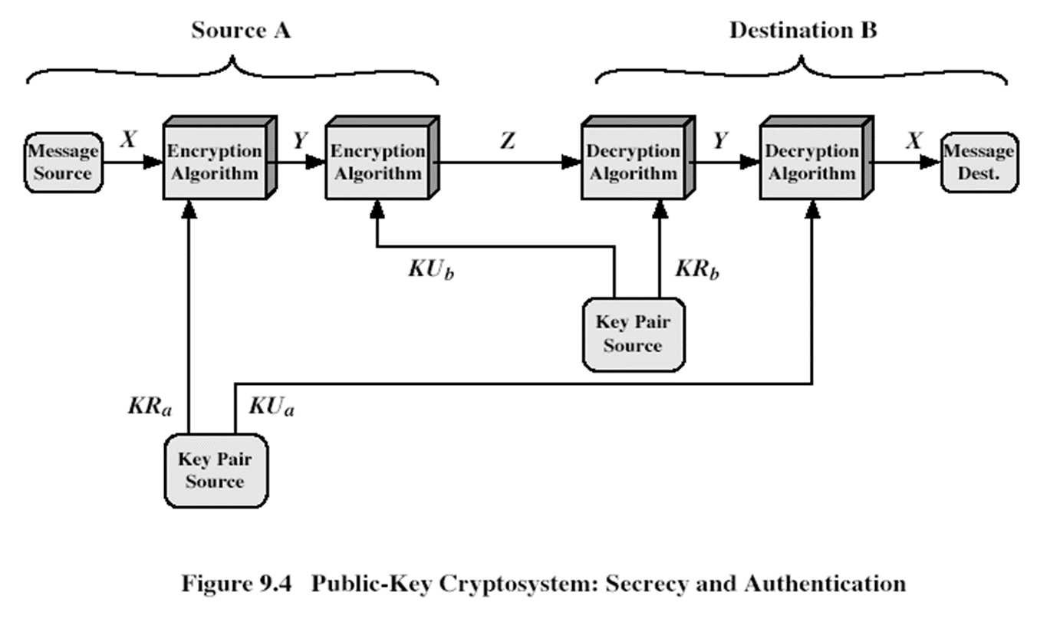
DIAGRAM

Slide 5
APPLICATIONS
Encrypt/decrypt
Digital Signatures
Key exchange

Slide 6
RSA KEY GENERATION FOR PARTY WANTING OTHER TO ENCRYPT DATA TO HER/HIM
selecting two large primes p, q
compute N=p.q
Compute Euler’s Totient Function ø(N)=(p-1)(q-1)
selecting at random the encryption key e such that
1<e<ø(N), gcd(e,ø(N))=1
solve for decryption key d using Inverse GCD (you figure out Inverse GCD) such that
(e.d) mod ø(N) =1 and 0≤d≤N
publish public keys {e,N}
keep secret private key and prime pairs used to generate everything {d,p,q}

Slide 7
ENCRYPT DECRYPT
The sender encrypts message M (M must be smaller than the modulus N) by:
obtains public key of recipient e and N
computes: C=Me mod N
The key generator decrypts the ciphertext C by:
uses private key {d}
computes: M=C^{d} mod N

Slide 8
Digital Signature
The signer comes up with a signature message S (S must be smaller than the modulus N) by:
uses private key {d}
computes: C=S^{d} mod N
The signature receiver authenticates signature by:
obtains public key of recipient e and N
computes: S=Ce mod N

