Slide 1


Easegress Source Code Review
MAKING SOFTWARE ARCHITECTURE ALIVE
MegaEase
Eagress
企业云化架构解决方案提供商/用技术推动商业进步
Notes:
Easegress 六月份开源以后，收到了不少外部报告的bug，和提交的 PR。今天借这个机会，我来向大家介绍一下 Easegress 的主要代码逻辑，希望能够帮助大家更好的使用 Easegress，向我们报告更多的 bug。皓哥在微信群里说当外部贡献者的代码超过 50% 的时候，我们会捐出 Easegress ，让它真正成为“民主化”的开源软件，所以，我们也希望，通过今天的分享，能有更多的外部贡献者贡献更多、更好的代码。

Slide 2
1
Overview
2
Key Components
目录
3
Q&A
CONTENT
Video (Chinese 2021-12-19):
https://www.youtube.com/watch?v=B2s57QP1C0w
https://www.bilibili.com/video/BV15g411A72G/

Slide 3
PART ONE
Overview

Slide 4





Overview
262
Files
58000
LoC
1500
Commits
310 + 451
Pull Request

Slide 5



Coding Guidelines
https://golang.org/doc/effective_go.html
https://github.com/golang/go/wiki/CodeReviewComments
https://github.com/uber-go/guide/blob/master/style.md
Coding Standards
We support the two most recent Go versions.
Features of Go 1.17 can not be used by now.
Never overwrite existing commit of a PR (unless after a rebase).
We use ‘Squash & Merge’ for pull requests to keep a clean history.
Golang Versions
Go Report Cards
go fmt
go lint
go cyclo
misspell
Github Actions
MegaEaseBot for Test
Test Coverage > 80%

Slide 6


Architecture
Cluster
(Raft)
Controller
(No Traffic)
Traffic Gate
Pipelines Orchestration
(Filters Chain)
Status Sync
HTTP1/2/3
Validator
APIAggregator
RateLimiter
Push Status
MQTT
TimeLimiter
Proxy
CircuitBreaker
Command
WebSocket
OAth2 / HMAC
Retryer
CORSAdaptor
Administration
Monitoring
Operation
Service Discovery
Manage TrafficGate&Pipeline in All Namespaces
Sync Data
Traffic Controller (Namespaced)
Monitor Controller
Mange Traffic in or across Namespaces
Controller
(Traffic)
Restful API
RawConfig
Mesh
Fallback
FaaS
Manage All Controllers
Manage All Controllers
Pull Config
Supervisor

Slide 7
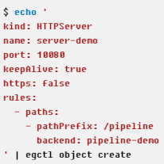
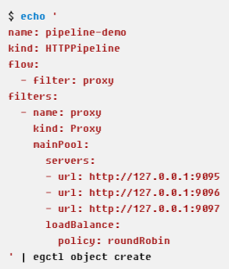
HTTP Pipeline
HTTP Server
Backend
HTTP Pipeline
:9095
:9096
/pipeline
Proxy
:9097
Backend
HTTP Pipeline
:10080
:9095
/customer
Validator
Proxy
Backend
:9095
HTTP Pipeline
Backend
/
…
…
Proxy
Backend
Backend
Notes:
线程模型

Slide 8
Concepts & Code Structure
Cluster
HA & Storage
HTTPContext
TCPContext
MQTTContext
…
Context
Request, response and etc.
Validator
CircuitBreaker
Proxy
WasmHost
…
Filters
Traffic processor
RawTrafficController
ServiceRegistry
StatusSyncController
TrafficController
SystemController
MeshController
IngressController
TCPServer
MQTTProxy
…
Objects
Traffic orchestration,
observability…
BusinessController
TrafficGate
HTTPServer
…
Pipeline
Supervisor
Manages the life-cycle of other objects
HTTPPipeline
…

Slide 9
PART TWO
Key Components

Slide 10


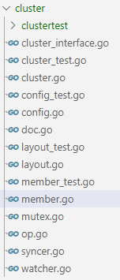
Cluster
Wrapper of ETCD
Storage operations
Get, Put, Delete
Watcher
Syncer
Mutex
Cluster Management
Primary (ETCD Server)
Secondary (ETCD Client)

Slide 11
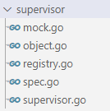


Supervisor
Objects Management
Create System Controllers at Startup
Create/Delete/Update Business Controllers on Configuration Change
APIs to Get an Object by Name
Defines the Interfaces for:
Object
Controller
TrafficGate
Pipeline

Slide 12
System Controllers
Singleton, One Node One Instance
Not Configurable (we are planning to change this, see issue #397)
Controls Essential System-level Stuff
ServiceRegistry: service hub for all service registries
Consul
Etcd
Eureka
Zookeeper
Nacos
TrafficController
Handles the lifecycle of HTTPServer and HTTPPipeline in a namespaced way

Slide 13
Business Controllers
For various business requirements
MeshController
IngressController
EaseMonitorMetrics
FaaSController
AutoCertManager*
ConsulServiceRegistry
GlobalFilter
EtcdServiceRegistry
NacosServiceRegistry
…
Could Be Created, Updated, Deleted by Admin Operation

Slide 14
Code Example: IngressController
INGRESS CONTROLLER
Watch Resources
INGRESSES
SERVICES
Generate
ENDPOINTS
Spec for HTTPServer & HTTPPipeline

Slide 15
TrafficObject: Processor of Traffic

Slide 16
HTTP Pipeline
HTTP Server
Backend
HTTP Pipeline
:9095
:9096
/pipeline
Proxy
:9097
Backend
HTTP Pipeline
:10080
:9095
/customer
Validator
Proxy
Backend
:9095
HTTP Pipeline
Backend
/
…
…
Proxy
Backend
Backend

Slide 17
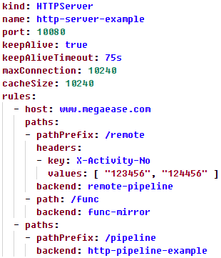
Code Example: HTTP Server
HTTP Server
Client
Cache
Mux
Pipeline
Request
Cache Hit
Cache Match
Not Found
Mux Match
Mux Match
IP Black List
Match Host
Match Path
Match Method
Match Headers
Request Processing
Response
Response

Slide 18
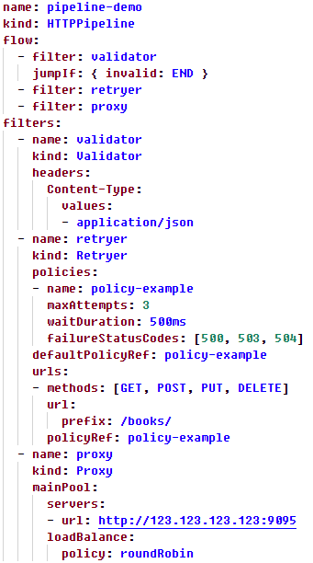
Code Example: HTTPPipeline
HTTPPipeline
END
invalid
exceed retry limit
HTTPContext
try/retry
HTTP Server
Validator
Retryer
Proxy
failed
Request
Response
Backend Service

Slide 19

Context
Design Pattern
Embedding
(Delegation)
https://coolshell.cn/articles/21214.html

Slide 20
Filters
APIAggregator
Bridge
CORSAdaptor
Fallback
Mock
Proxy
RateLimiter
RemoteFilter
RequestAdaptor
ResponseAdaptor
Retryer
TimeLimiter
Validator
WasmHost

Slide 21
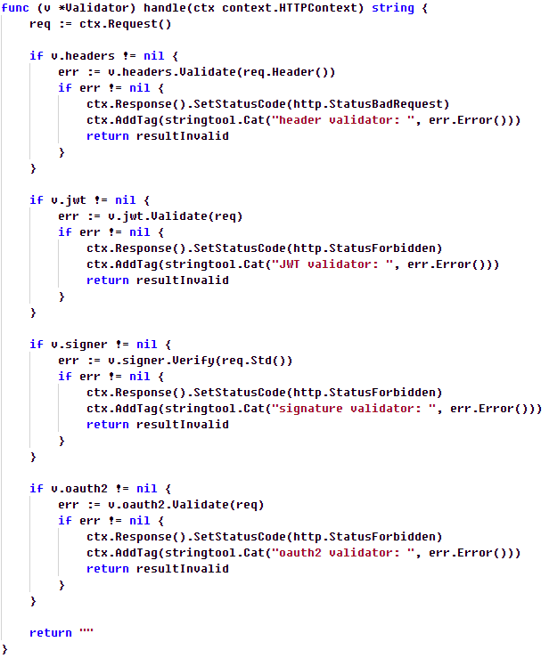
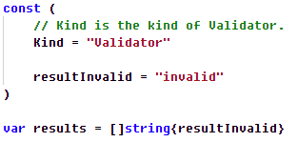


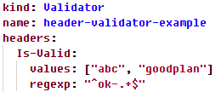
Code Example: Validator

Slide 22
PART THREE
Q&A

Slide 23



THANKS
用技术推动商业进步
Slack
云原生技术交流群
https://megaease.com

