Slide 1
Cryptography for Djangonauts
Erik LaBianca
WiserTogether, Inc.

Slide 2
Background
Who am I? Just a developer
Should you trust me? Probably not
Should you pay attention anyway? Probably
Notes:
Before we get started, let me give you just a bit of background. I’m Erik. I work at a software company here in DC called WiserTogether. We try to provide peace of mind to medical consumers by giving them the information they need to make good decisions. I’m not a cryptographer. Even if I was, honestly, you shouldn’t take what I say at face value. There’s simply no substitute for understanding what you’re doing, which is why I’m going to try and help you understand and make your own decisions.
Regardless, I’ve been working with cryptography in various capacities for a while. Most recently, I’ve had the opportunity to build out a soup-to-nuts information security management system, which has given me the chance to look at our existing and proposed use of cryptography with a more critical eye. We’ve had to learn a few thing by trial and error. Today, I’m going to try and help you avoid doing that.

Slide 3
TL;DR
Analyze your risks
Don’t write your own
Operate correctly
Commit to keeping up
(please use a password manager)
Notes:
Before we go on, let me give you a summary you can write down before going back to IRC. If you leave with nothing else, I hope you leave with these 4 points. First, you have to analyze your risks. It may sound a bureaucratic to say “risk analysis”, but the fact is, you have to understand your risks in order to counter them. On the flip side, if you don’t think about your risks, you’re likely to find yourself vulnerable, and embarrassed.
Moving on, crypto is complicated. You do not want to write your own unless you really know what you’re doing.
Assuming you need to use crypto, assemble your crypto from components that are known good and operate it correctly. Most of these tools are very good, but without proper operation they lose a lot of their effectiveness.
Finally, commit to keeping up. Technology, and crypto in particular, are complicated and the landscape changes all the time. Once you’ve gone down this road, you need to commit to keeping up-to-date.
Oh, and please use a password manager!

Slide 4
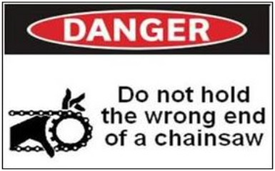
Why you care
Doing it wrong is easy. And common.
OWASP Top-10 A7: Insecure Cryptography
Notes:
So, here I am telling you not to, it’s hard, you have to keep up, blah blah blah. Why do you care?
There’s one big reason. It’s really easy to do it wrong. And apparently it happens a lot. If you haven’t, you really need to be familiar with the OWASP Top 10. You’ll be interested to see that rule number A7 is “Insecure Cryptographic Storage”.
Unfortunately, for crypto, the correct usage is … a little … harder than for a chainsaw. But chainsaws still come with these cool warning decals. Hmm.
So, let’s look at a few recent events.

Slide 5
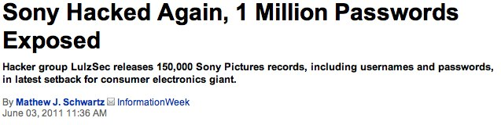
Risk analysis helps
(unique passwords are cool)
Notes:
Some of you are probably gamers. If not, you probably heard about this anyway. Sony got owned. Hard. Over and over again. I’m not sure if they even estimated the cost of the damage, but I’m sure it was huge.
The particularly ironic thing about this story is that in at least some of the leaks they hadn’t even attempted to obscure the passwords. This is what risk analysis is supposed to help with.
James Sokol from Mozilla did a great introduction to security best practices talk yesterday and said they expect their database dumps to end up on the internet. So should you.
(This just in, this week anonymous posted over a million apple udid records, with names. They are claiming they got them from the FBI).
Oh, by the way. You should be using a password manager!

Slide 6
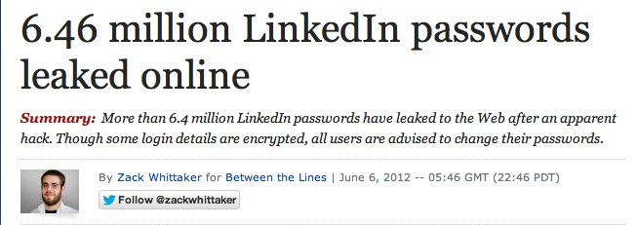
Roll-your-own is hard
(try out a password manager)
Notes:
Again, perhaps a few of you guys have heard of linked-in. At least they actually TRIED to obscure their passwords with a hash. The problem is, they didn’t really do it right, and so their entire database is susceptible to brute force in one pass.
The good news is if they’d been using Django, this wouldn’t have been an issue!
By the way, try out a password manager!

Slide 7
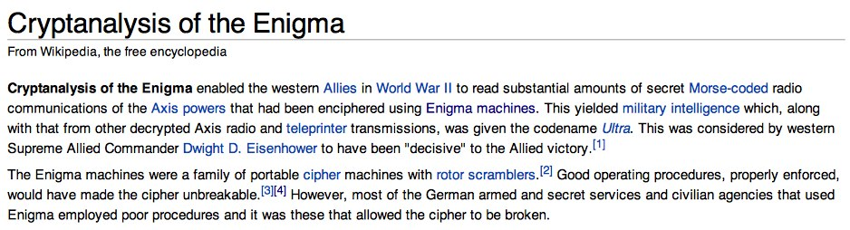
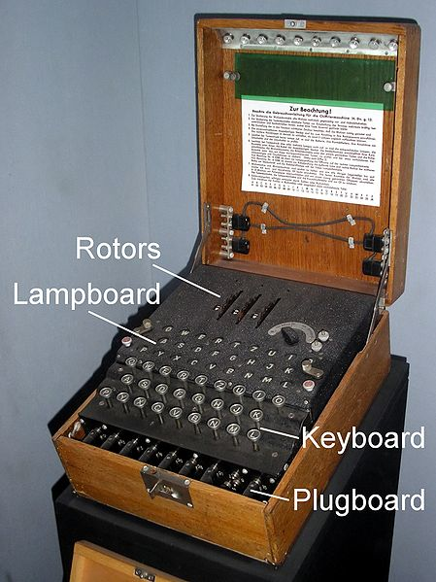
The details are hard
Extra Credit:
http://en.wikipedia.org/wiki/Cryptanalysis_of_the_Enigma
Notes:
Lest we assume that all these issues are modern and, take a look this fascinating article at Wikipedia. The enigma machine was cracked, basically, because of lack of training and carelessness on the part of the german operators.
re-used message keys (initialization vectors)
re-used messages

Slide 8
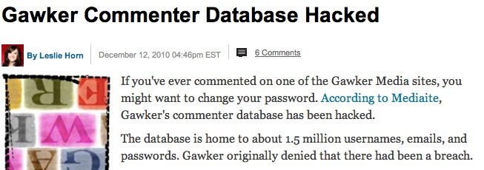
Keeping up is hard
(please use a password manager)
Notes:
So, I’m not entirely sure what platforms gawker was using, but where they got burned was that they didn’t keep up. They got stuck with an outdated hash algorithm and key size (crypt), which made it very easy to brute-force the list once somebody had gotten ahold of it.
Inertia can be really tough to overcome, but if you don’t, rest assured that moore’s law will catch up to you.
Again, this is a good reason to use Django and keep up..

Slide 9
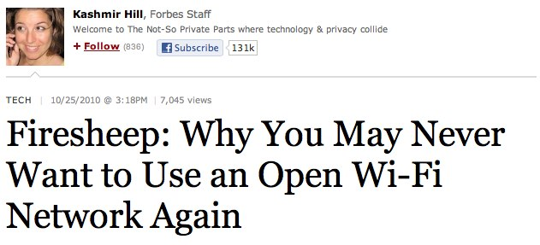
Attacks are mechanized
(please use a password manager)
Notes:
Finally, all of this stuff counts because there are a lot of smart people out there making it REALLY easy to exploit any flaws that are found. FireSheep is perhaps the most egregrious example of this, at least, lately, but it’s going on all the time. It’s an arms race, and if you’re on the internet, you’re in it.

Slide 10
Show of Hands
How many of you have:
Used hashlib, md5sum, or another hash function?
Set up truecrypt, luks, filevault, bitlocker, or another symmetric cryptography system?
Configured a web server to serve HTTPS, or another SSL/TLS service?
Used PGP or S/MIME?
Configured a Certificate Authority?
Notes:
So, just to give me a little context here, before I go into some background info, can I get a show of hands?

Slide 11
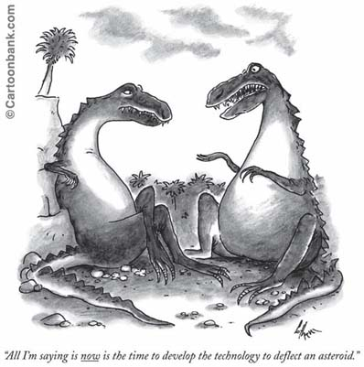
Analyze your Risks
Inventory your Assets
Data (PII/PHI?)
Systems
Identify your Vulnerabilities
Lost Backups
Lost Laptops
Compromised Systems
Insecure Networks
Employees and Customers
Analyze Controls
Destruction (or stop collecting)
Locked safe
Cryptography
Extra Credit:
http://csrc.nist.gov/publications/nistpubs/800-30/sp800-30.pdf
ISO 27005
Notes:
I had a few “CISSP 101” slides in here but I cut them down to one. And this one has a cartoon. You can thank me later.
The cartoon says “All I’m saying is NOW is the time to develop the technology to deflect an asteroid”. That’s basically the point of risk analysis. You need to be AHEAD of the game.
If you’re writing code on the internet, you need to be thinking in terms of analyzing your risks. If you’re not subject to regulator compliance, you don’t necessary have to document it, but you should still be thinking about your risk exposure. It will give you context that will help you determine what controls you can afford to implement.
Risk analysis isn’t necessarily easy, but it’s pretty simple.
First, figure out what you’re trying to protect. Think of terms of things you don’t want to lose, and things that other people might want.
Then, identify your threats and vulnerabilities. So you have a main system database with a bunch of user passwords. Do people want it? How might they get it? Accidentally restoring a backup? Losing a laptop? Hacking into your system? Wifi sniffing? What about a disgruntled employee who quits and issues an rm –rf on their way out the door?
Finally, identify which of these vulnerabilities need to be countered. Chances are you have a few decent controls already (ssh administrative access, firewalls, running your app as a non-privileged user, separate database users).
Anyway, you may well determine you need some cryptography to keep things copacetic. Let’s look at what’s on the table.

Slide 12
Cryptographic Hash Functions
Plaintext
Fixed Length Hash
4aef0ceec93c3c95b09e39674527bd22364808c29390db01fd63d163
>>> import hashlib
>>> hashlib.sha224(’Plaintext').hexdigest()
'95c7fbca92ac5083afda62a564a3d014fc3b72c9140e3cb99ea6bf12'
$ openssl dgst -sha224 ~/Pictures/hashbrowns.png
SHA224(~/Pictures/hashbrowns.png)= 4aef0ceec93c3c95b09e39674527bd22364808c29390db01fd63d163
Notes:
So, what’s cryptography. Well, it’s a pretty robust field, but in the context of a web or django application, it basically breaks down to three things. The first of these are cryptographic hash functions. At least on the surface, they’re pretty simple. Take a “thing”, preferably large, and represent it with a fixed string of bytes.
No Keys
One way (destroys data)
Comparatively fast (still not ideal for hash tables)

Slide 13
Cryptographic Hash Properties
No Keys
Easy to compute the hash value (digest) of any message
Very hard to
generate a message for a known hash value
modify a message without changing the hash
find two messages with the same hash
Used for
Verifying integrity of files or messages
Django Session and Cookie signing
SSL / TLS / HTTPS - Keyed Hashing for Message Authentication (HMAC)
Password verification (caveats apply!)
django.contrib.auth
Reliable identification of unique files (git, hg)
Pseudorandom bit generation
Extra Credit:
http://en.wikipedia.org/wiki/Cryptographic_hash_function
http://tools.ietf.org/html/rfc2104

Slide 14
Symmetric Encryption Algorithms
AKA “Secret Key Encryption”
2-way (encrypt and decrypt)
1 key (must be shared, and kept secret)
Fast
Secret Message
Sekrit
U2FsdGVkX1+2QF4DGdCCn2VO9fB+1lbQJKvmhONkNMM=
$ echo "Secret Message" | openssl enc -aes-256-cbc -k Sekrit -a
U2FsdGVkX1+2QF4DGdCCn2VO9fB+1lbQJKvmhONkNMM=
$ echo "U2FsdGVkX1+2QF4DGdCCn2VO9fB+1lbQJKvmhONkNMM=" | openssl enc -d -aes-256-cbc -k Sekrit –a
Secret Message
Notes:
The 2nd class of cryptography you’ll run into frequently is symmetric key encryption. This is simple, reversible encryption. Obviously, the devil is in the details, but you can actually make an unbreakable cipher simply by using an old fashioned one-time pad. With symmetric encryption, you have only one key, which is used for both encryption. That means you have to share it with anybody else you want to share with.

Slide 15
Symmetric Encryption Properties
Reversible (both encrypt and decrypt)
Requires a Shared Secret
Uses
Encrypting files, backups, etc
Encrypting file systems (filevault, bitlocker, truecrypt, luks)
Encrypting transmission (SSL, TLS, IPSec)
Algorithms
DES (out of date)
One Time Pad (inconvenient)
AES (NIST certified, hardware optimized)
Blowfish
Implementations
M2Crypto (OpenSSL Wrapper)
PyCrypto (Pythonic)

Slide 16


Public Key Cryptography
Asymmetric
N-way (encrypt, decrypt, sign and verify for N parties)
2+ keys (public and private for each party
Bob
Signature
Alice
Bob’s Private Key
Bob’s Public Key
Sign
Verify
Alice’s Public Key
Alice’s Private Key
Encrypt
Verified Cleartext
Original
Cleartext
Decrypt
Ciphertext
Notes:
Finally, the last “class” of cryptography we’re going to talk about is public key cryptography. It’s a pretty big breakthrough in crypto, in that it allows for asymmetric trust. Bob can give Alice a copy of his “public key” and she can send messages to bob that only he can decrypt. If he chooses, he can use Alice’s public key to verify that she was actually the sender. Obviously, this works both ways.

Slide 17
Asymmetric Encryption Properties
Lots of Complex Keys
Slow
Algorithms
RSA, DSA
Uses
Key Validation
Certificate Authorities, Web of Trust
Key Exchange
SSL, TLS, HTTPS
Secure Asynchronous Transfer
S/MIME, PGP/MIME, PGP
Notes:
The fundamental premise of PKC is that there are mathematical problems which are much harder to reverse than they are to compute. RSA uses determining prime factors, DSA uses exponentiation and logarithms.

Slide 18


Putting it all together: HTTPS
SSL Settings
SSL Settings, Public Key
Client (Browser)
Server (HTTPD)
Verify Key against Trust Roots
Encrypt Pre-Key with Public Key
Create Session Key
Create Session Key
Encrypt (Cipher)
Verify (Hash)
Extra Credit:
http://tools.ietf.org/html/rfc5246
http://technet.microsoft.com/en-us/library/cc781476

Slide 19
Doing it Right: Table Stakes
Django does Crypto right
Use Django 1.4 if you can
Keep settings.SECRET_KEY a secret
Enable HTTPS
Enforce use of HTTPS via redirects
Inform Django you’re using HTTPS
Check request.is_secure
Set settings.SESSION_COOKIE_SECURE=True
Set settings.CSRF_COOKIE_SECURE=True
Set settings.SECURE_PROXY_SSL_HEADER
Notes:
So we’ve talked about the tools on the table. Let’s level set on some basic best practice. I don’t claim to be an authority here, so feel free to add to the list.
This is the stuff you shouldn’t be writing in any way, shape or form. This is why you use a framework.
I can say, however, that looking over the crypto-related code in Django 1.4, things have improved a lot. Kudo’s to whoever was responsible. Use Django 1.4.
Secondly. Enable HTTPS. Just do it. Force redirects, and use secure cookies.
For most scenarios, this is all you need.

Slide 20
Doing it Right: The Hard Part
Protect private data via SKC
Support encrypted payloads via PKC.
How will you unlock the secret keys?
Use full-disk (boot volume) encryption
How will you provide the symmetric key?
Extra Credit
FIPS certified implementations
FIPS / NIST configurations
Notes:
So let’s talk about stuff beyond the basics.
What if you need to encrypt your data records? Say you’re storing somebody’s financial history?
What about exchanging information with third parties? Perhaps you need to batch process a bunch of bank transactions every night? Or receive a list of the latest 0-day exploits. In either case, you want to transfer this stuff securely.

Slide 21
User Passwords: Naïve Code
from hashlib import sha224
users = ([1, 'bob', 'secret'],
[2, 'alice', 'sekrit'],
[3, 'eve', 'secret'])
for user in users:
user[2] = sha224(user[2]).hexdigest()[:8]
print users
$ python naive_hash.py
([1, 'bob', '95c7fbca'],
[2, 'alice', '034f4966'],
[3, 'eve', '95c7fbca'])
Please do not do this!
Same password results in the same hash. Bad!
Entire list can be bruteforced in one pass.
Notes:
So, I don’t really want to belabor this point, but this is kinda the table stakes use case, so lets talk about it for a minute. You really shouldn’t need to manage your own passwords, but if you do, don’t do it like this. See the problem? We can just call this the “linked-in method”.

Slide 22
User Passwords: Done Right
# see django/contrib/auth/hashers.py
from django.utils.crypto import (pbkdf2,
constant_time_compare, get_random_string)
def encode(password, salt=None, iterations=10000):
if not salt:
salt = get_random_string()
hash = pbkdf2(password, salt, iterations)
hash = hash.encode('base64').strip()
return "%s$%d$%s$%s" % ('pbkdf2', iterations,
salt, hash)
def verify(password, encoded):
alg, iterations, salt, hash = encoded.split('$', 3)
encoded_2 = encode(password, salt, int(iterations))
return constant_time_compare(encoded, encoded_2)
for user in users:
user[2] = encode(user[2])
Notes:
Here’s how it’s done right. You might recognize this code from somewhere… hmm.
I want to draw your attention to two key details. The first is get_random_string(). That’s a great function, and appears to be introduced in django 1.4. It uses random.SystemRandom if possible, and then falls back to the default mersenne twister algorithm if it can’t find it. For crypto, entropy is good, and it needs hardware support to do well. This is an easy way to get it with django.
The second thing is that hashing algorithm. That’s a “key derivation function” called pbkdf2. There are other options such as bcrypt, scrypt, and friends. The key takaway here is that it’s computationally expensive. Coupled with a per-record has, that makes brute forcing these passwords computationally infeasible. That’s what we want!

Slide 23
Password Hashing: Done Right
$python password_hash.py
([1, 'bob', 'secret'],
[2, 'alice', 'sekrit'],
[3, 'eve', 'secret'])
([1, 'bob',
'pbkdf2$10000$cNTDFLN3M6wQ$' \
'YaLSp47KyS197VKNkAD6A0LYO2ZSc2EcWb07b7NBw+M='],
[2, 'alice',
'pbkdf2$10000$w7JZjGibBuvf$’ \
'dVlM9aP8b5SCf/hJwqB47nDBIBbKw955yJfN+82BFV0='],
[3, 'eve',
'pbkdf2$10000$P4X6u9IL2a9P$’
'2EGFbYELD1azOK3Xhon6s9rW9sRs2LZP9xLp9ekbvIU='])
Bob and eve’s passwords hash to radically different values
The algorithm and counter is stored in the password string so it can be updated in the future
The random salt is stored so we can still verify successfully
Extra Credit:
Add HMAC: check out https://github.com/fwenzel/django-sha2

Slide 24
Example: Hashed Record Lookup
from hashlib import sha224
salt = 'aNiceLongSecret'
users = ([1, 'bob', '123456789'],
[2, 'alice', '123456780'],
[3, 'eve', '123456781'])
for user in users:
user[2] = sha224(salt + user[2]).hexdigest()[:8]
Better than nothing.
Makes brute-force infeasible without the salt value
Salt should be stored separately from values
Still allows you to “look up” values by their hashed value, such as an ID#.
Notes:
So let’s look at a real use case. We receive lists of “known” people and need to allow people to authenticate against the list. Unfortunately, sometimes the only data we have to identify people with are pieces of information we don’t want to have – PII/PHI. Hashing that information with a salt adds a measure of security, but still allows us to do the lookups.
The technical term for this is HMAC, which specifies a specific method for combining the salt and the record itself. The code you see here is a bit more naïve, but the point still stands.

Slide 25
Example: Symmetric Encryption
from base64 import b64encode, b64decode
from M2Crypto.EVP import Cipher
from django.utils.crypto import get_random_string
def encrypt(key, iv, cleartext):
cipher = Cipher(alg='aes_256_cbc', key=key, iv=iv, op=1) # 1=encode
v = cipher.update(cleartext) + cipher.final()
del cipher # clean up c libraries
return b64encode(v)
def decrypt(key, iv, ciphertext):
data = b64decode(ciphertext)
cipher = Cipher(alg='aes_256_cbc', key=key, iv=iv, op=0) # 0=decode
v = cipher.update(data) + cipher.final()
del cipher # clean up c libraries
return v
(key, iv) = ('nicelongsekretkey', get_random_string(16))
ciphertext = encrypt(key, iv, 'a very long secret 1message')
cleartext = decrypt(key, iv, ciphertext)
Notes:
Another use case is storing information on a user record or some such. In an ideal scenario, you’d get the key from the user and store it in memory. Here I’m just stuffing it into the code. Key management is definitely the hard problem here, but what I want to point out first is the presence of the initialization vector.
This is a pit I’ve seen a few of our customers fall into. “Oh that’s just the IV, it’s like another key”. Wrong! If you don’t have a random IV, you’ve basically downgraded your cipher to an electronic codebook, which can be cracked via known plaintext pretty easily. Check out the wikipedia article on initiatialization vectors.
This code actually runs, and uses m2crypto to run openssl. Take it for what it is.

Slide 26
Example: Shared Secret SSO
from django.contrib.auth import models, login, logout, authenticate
from django.core.urlresolvers import reverse
from django.http import HttpResponseRedirect
from django.utils import simplejson as json
from django.views.decorators.csrf import csrf_exempt
@csrf_exempt
def sso_token_handler(request):
init_vector = request.GET.get('iv', None)
token = request.GET.get('token', None)
token_data = json.loads(decrypt('sekrit', init_vector, token))
user = User.objects.get(token_data['user'])
if user is None:
user = create_user(token_data)
authuser = authenticate(user=user)
login(request, authuser)
return HttpResponseRedirect(reverse('home'))
Notes:
So, here’s a django use case for that symmetric encryption code. This is semi-pseudo code, you need a ton of exception handling and error checking for this to be legit, so don’t just copy it.
But the premise stands. This is a simple view, it receives and IV and a ciphertext. It decrypts it, and uses the encrypted json record to create a new user record and sign them in. This is cool because it’s safe to accept via a get request since you can trust the sender, and it’s super easy to implement from any programming language.
SAML does the same stuff. It also doesn’t fit on one slide.

Slide 27
Final Thought: Key Management
How will you make keys available to your application?
Keys on local disk
Useful for encrypting backups
Useful for encrypting transmission
Not so useful for encryption-at-rest
Keys on physical device (smartcard or HSM)
Great idea! Good luck in the “cloud”.
Keys in memory
Still potentially exploitable, but requires compromise of a running machine.
How do they get there?
Must be provided at boot or initialization time somehow
Notes:
Finally, I want to talk about key management. Even after this talk.

Slide 28
Examples: Public Key Encryption
import gnupg
gpg_handler_parameters = { 'use_agent': True, }
gpg_handler = gnupg.GPG(**gpg_handler_parameters)
ciphertext = gpg_handler.encrypt(
'Secret Message',
'erik.labianca@gmail.com',
always_trust=True,
)
cleartext = gpg_handler.decrypt(ciphertext)
Exercise:
Configure gpg keyring and unlock secret keys with gpg-agent
Load symmetric keys via PGP
Notes:
Here’s some very very basic code using python-gnupg and the gpg-agent to load cleartext from ciphertext on disk using an in-memory key. I’m working on building this out into a more re-usable system, but I hope it gives you some ideas.

Slide 29
Questions?
Work With Us
http://wisertogether.com/careers/
https://github.com/WiserTogether/
Contact Me
mailto:erik.labianca@gmail.com
https://twitter.com/easel/
https://github.com/easel/
https://easel.github.com/talks/django-cryptography.pdf
Other Resources
http://www.kyleisom.net/downloads/crypto_intro.pdf
http://www.garykessler.net/library/crypto.html
http://code.google.com/p/python-gnupg/
http://chandlerproject.org/Projects/MeTooCrypto
https://www.dlitz.net/software/pycrypto/
Notes:
Thanks!

