Slide 1
Cryptography for Djangonauts
Erik LaBianca
WiserTogether, Inc.

Slide 2
Background
Who am I? Just a developer
Should you trust me? Probably not
Should you pay attention anyway? Probably
Notes:
Before we get started, let me give you just a bit of background. I’m Erik. I work at a software company here in DC called WiserTogether. We try to provide peace of mind to medical consumers by giving them the information they need to make good decisions. I’m not a cryptographer. Even if I was, honestly, you shouldn’t take what I say at face value. There’s simply no substitute for understanding what you’re doing, which is why I’m going to try and help you understand and make your own decisions. I’ve been working with cryptography in various capacities for a good long while. Most recently, I’ve had the opportunity to build out a soup-to-nuts information security management system, which has given me the chance to look at our existing and proposed use of cryptography with a more critical eye. We’ve had to learn a few thing by trial and error. Today, I’m going to try and help you avoid doing that.

Slide 3
TL;DR
Analyze your risks
Don’t write your own
Operate correctly
Commit to keeping up
(please use a password manager)
Notes:
Before we go on, let me give you a summary you can write down before going back to IRC. If you leave with nothing else, make sure you leave with these 4 points. First, you have to analyze your risks. It may sound a bureaucratic to say “risk analysis”, but the fact is, you have to understand your risks in order to counter them. On the flip side, if you don’t think about your risks, you’re likely to find yourself vulnerable, and embarrassed. Moving on, crypto is complicated. You do not want to write your own unless you really know what you’re doing. Assuming you need to use crypto, assemble your crypto from components that are known good and operate it correctly. Most of these tools are very good, but without proper operation they lose a lot of their effectiveness. Finally, commit to keeping up. Technology, and crypto in particular, are complicated and the landscape changes all the time. Once you’ve gone down this road, you need to commit to keeping up-to-date.

Slide 4

Why you care
Doing it wrong is easy. And common.
OWASP Top-10 A7: Insecure Crypto Storage

Slide 5
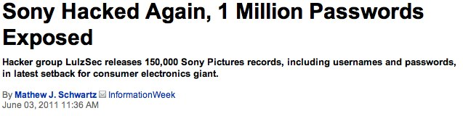
Risk analysis helps
(please use a password manager)

Slide 6
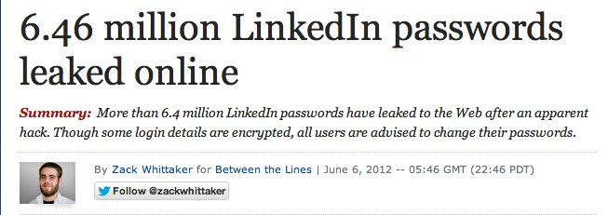
Roll-your-own is hard
(please use a password manager)

Slide 7
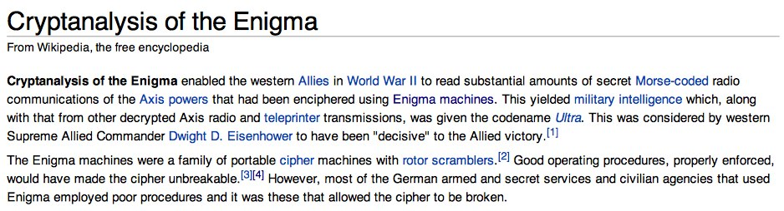
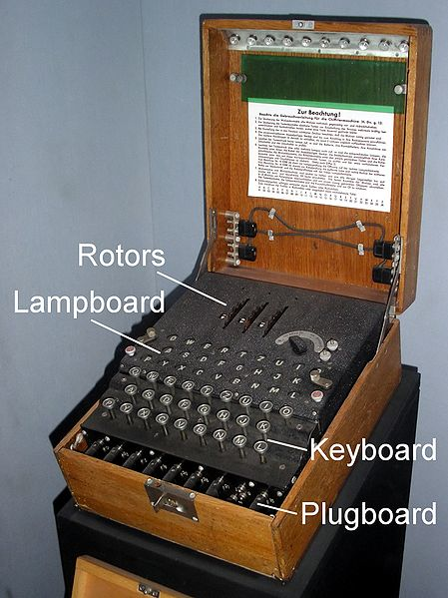
The details are hard
Extra Credit:
http://en.wikipedia.org/wiki/Cryptanalysis_of_the_Enigma
Notes:
Lest we assume that all these issues are modern and, take a look this fascinating article at Wikipedia. The enigma machine was cracked, basically, because of lack of training and carelessness on the part of the german operators.
re-used message keys (initialization vectors)
re-used messages

Slide 8
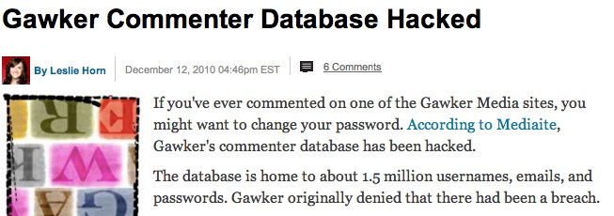
Keeping up is hard
(please use a password manager)
Notes:
Didn’t use Django. Stuck with an outdated hash algorithm and key size (crypt).

Slide 9
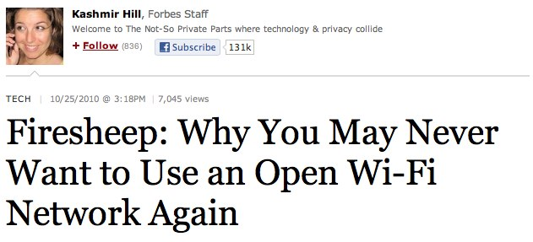
Attacks are mechanized
(please use a password manager)

Slide 10
Show of Hands
How many of you have:
Used hashlib, md5sum, or another hash function?
Set up truecrypt, luks, filevault, bitlocker, or another symmetric cryptography system?
Configured a web server to serve HTTPS, or another SSL/TLS service?
Used PGP or S/MIME?
Configured a Certificate Authority?

Slide 11
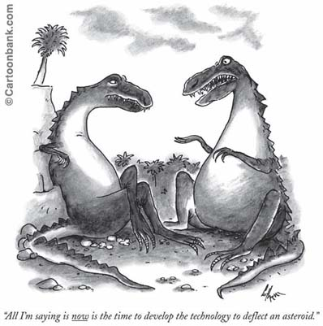
Analyze your Risks
Inventory your Assets
Data (PII/PHI?)
Systems
Identify your Vulnerabilities
Lost Backups
Lost Laptops
Compromised Systems
Insecure Networks
Employees and Customers
Analyze Controls
Destruction (or stop collecting)
Locked safe
Cryptography
Extra Credit:
http://csrc.nist.gov/publications/nistpubs/800-30/sp800-30.pdf
ISO 27005

Slide 12
Cryptographic Hash Functions
Plaintext
Fixed Length Hash
4aef0ceec93c3c95b09e39674527bd22364808c29390db01fd63d163
>>> import hashlib
>>> hashlib.sha224(’Plaintext').hexdigest()
'95c7fbca92ac5083afda62a564a3d014fc3b72c9140e3cb99ea6bf12'
$ openssl dgst -sha224 ~/Pictures/hashbrowns.png
SHA224(~/Pictures/hashbrowns.png)= 4aef0ceec93c3c95b09e39674527bd22364808c29390db01fd63d163
Notes:
N0 Keys
One way (destroys data)
Comparatively fast (still not ideal for hash tables)

Slide 13
Cryptographic Hash Properties
No Keys
Easy to compute the hash value (digest) of any message
Very hard to
generate a message for a known hash value
modify a message without changing the hash
find two messages with the same hash
Used for
Verifying integrity of files or messages
Django Session and Cookie signing
SSL / TLS / HTTPS - Keyed Hashing for Message Authentication (HMAC)
Password verification (caveats apply!)
django.contrib.auth
Reliable identification of unique files (git, hg)
Pseudorandom bit generation
Extra Credit:
http://en.wikipedia.org/wiki/Cryptographic_hash_function
http://tools.ietf.org/html/rfc2104

Slide 14
Symmetric Encryption Algorithms
AKA “Secret Key Encryption”
2-way (encrypt and decrypt)
1 key (must be shared, and kept secret)
Fast
Secret Message
Sekrit
U2FsdGVkX1+2QF4DGdCCn2VO9fB+1lbQJKvmhONkNMM=
$ echo "Secret Message" | openssl enc -aes-256-cbc -k Sekrit -a
U2FsdGVkX1+2QF4DGdCCn2VO9fB+1lbQJKvmhONkNMM=
$ echo "U2FsdGVkX1+2QF4DGdCCn2VO9fB+1lbQJKvmhONkNMM=" | openssl enc -d -aes-256-cbc -k Sekrit –a
Secret Message

Slide 15
Symmetric Encryption Properties
Reversible (both encrypt and decrypt)
Requires a Shared Secret
Uses
Encrypting files, backups, etc
Encrypting file systems (filevault, bitlocker, truecrypt, luks)
Encrypting transmission (SSL, TLS, IPSec)
Algorithms
DES (out of date)
One Time Pad (inconvenient)
AES (NIST certified, hardware optimized)
Blowfish
Implementations
M2Crypto (OpenSSL Wrapper)
PyCrypto (Pythonic)

Slide 16


Public Key Cryptography
Asymmetric
N-way (encrypt, decrypt, sign and verify for N parties)
2+ keys (public and private for each party
Bob
Signature
Alice
Bob’s Private Key
Bob’s Public Key
Sign
Verify
Alice’s Public Key
Alice’s Private Key
Encrypt
Verified Cleartext
Original
Cleartext
Decrypt
Ciphertext

Slide 17
Asymmetric Encryption Properties
Lots of Complex Keys
Slow
Algorithms
RSA, DSA
Uses
Key Validation
Certificate Authorities, Web of Trust
Key Exchange
SSL, TLS, HTTPS
Secure Asynchronous Transfer
S/MIME, PGP/MIME, PGP

Slide 18


Putting it all together: HTTPS
SSL Settings
SSL Settings, Public Key
Client (Browser)
Server (HTTPD)
Verify Key against Trust Roots
Encrypt Pre-Key with Public Key
Create Session Key
Create Session Key
Encrypt (Cipher)
Verify (Hash)
Extra Credit:
http://tools.ietf.org/html/rfc5246
http://technet.microsoft.com/en-us/library/cc781476

Slide 19
Doing it Right: Table Stakes
Django does Crypto right
Use Django 1.4 if you can
Keep settings.SECRET_KEY a secret
Enable HTTPS
Enforce use of HTTPS via redirects
Inform Django you’re using HTTPS
Check request.is_secure
Set settings.SESSION_COOKIE_SECURE=True
Set settings.CSRF_COOKIE_SECURE=True
Set settings.SECURE_PROXY_SSL_HEADER

Slide 20
Doing it Right: The Hard Part
Protect private data via SKC
Support encrypted payloads via PKC.
How will you unlock the secret keys?
Use full-disk (boot volume) encryption
How will you provide the symmetric key?
Extra Credit
FIPS certified implementations
FIPS / NIST configurations

Slide 21
User Passwords: Naïve Code
from hashlib import sha224
users = ([1, 'bob', 'secret'],
[2, 'alice', 'sekrit'],
[3, 'eve', 'secret'])
for user in users:
user[2] = sha224(user[2]).hexdigest()[:8]
print users
$ python naive_hash.py
([1, 'bob', '95c7fbca'],
[2, 'alice', '034f4966'],
[3, 'eve', '95c7fbca'])
Please do not do this!
Same password results in the same hash. Bad!
Entire list can be bruteforced in one pass.

Slide 22
User Passwords: Done Right
# see django/contrib/auth/hashers.py
from django.utils.crypto import (pbkdf2,
constant_time_compare, get_random_string)
def encode(password, salt=None, iterations=10000):
if not salt:
salt = get_random_string()
hash = pbkdf2(password, salt, iterations)
hash = hash.encode('base64').strip()
return "%s$%d$%s$%s" % ('pbkdf2', iterations,
salt, hash)
def verify(password, encoded):
alg, iterations, salt, hash = encoded.split('$', 3)
encoded_2 = encode(password, salt, int(iterations))
return constant_time_compare(encoded, encoded_2)
for user in users:
user[2] = encode(user[2])

Slide 23
Password Hashing: Done Right
$python password_hash.py
([1, 'bob', 'secret'],
[2, 'alice', 'sekrit'],
[3, 'eve', 'secret'])
([1, 'bob',
'pbkdf2$10000$cNTDFLN3M6wQ$' \
'YaLSp47KyS197VKNkAD6A0LYO2ZSc2EcWb07b7NBw+M='],
[2, 'alice',
'pbkdf2$10000$w7JZjGibBuvf$’ \
'dVlM9aP8b5SCf/hJwqB47nDBIBbKw955yJfN+82BFV0='],
[3, 'eve',
'pbkdf2$10000$P4X6u9IL2a9P$’
'2EGFbYELD1azOK3Xhon6s9rW9sRs2LZP9xLp9ekbvIU='])
Bob and eve’s passwords hash to radically different values
The algorithm and counter is stored in the password string so it can be updated in the future
The random salt is stored so we can still verify successfully
Extra Credit:
Add HMAC: check out https://github.com/fwenzel/django-sha2

Slide 24
Example: Hashed Record Lookup
from hashlib import sha224
salt = 'aNiceLongSecret'
users = ([1, 'bob', '123456789'],
[2, 'alice', '123456780'],
[3, 'eve', '123456781'])
for user in users:
user[2] = sha224(salt + user[2]).hexdigest()[:8]
Better than nothing.
Makes brute-force infeasible without the salt value
Salt should be stored separately from values
Still allows you to “look up” values by their hashed value, such as an ID#.

Slide 25
Example: Symmetric Encryption
from base64 import b64encode, b64decode
from M2Crypto.EVP import Cipher
from django.utils.crypto import get_random_string
def encrypt(key, iv, cleartext):
cipher = Cipher(alg='aes_256_cbc', key=key, iv=iv, op=1) # 1=encode
v = cipher.update(cleartext) + cipher.final()
del cipher # clean up c libraries
return b64encode(v)
def decrypt(key, iv, ciphertext):
data = b64decode(ciphertext)
cipher = Cipher(alg='aes_256_cbc', key=key, iv=iv, op=0) # 0=decode
v = cipher.update(data) + cipher.final()
del cipher # clean up c libraries
return v
(key, iv) = ('nicelongsekretkey', get_random_string(16))
ciphertext = encrypt(key, iv, 'a very long secret 1message')
cleartext = decrypt(key, iv, ciphertext)
Notes:
The initialization vector is a key piece here.

Slide 26
Example: Shared Secret SSO
from django.contrib.auth import models, login, logout, authenticate
from django.core.urlresolvers import reverse
from django.http import HttpResponseRedirect
from django.utils import simplejson as json
from django.views.decorators.csrf import csrf_exempt
@csrf_exempt
def sso_token_handler(request):
init_vector = request.GET.get('iv', None)
token = request.GET.get('token', None)
token_data = json.loads(decrypt('sekrit', init_vector, token))
user = User.objects.get(token_data['user'])
if user is None:
user = create_user(token_data)
authuser = authenticate(user=user)
login(request, authuser)
return HttpResponseRedirect(reverse('home'))

Slide 27
Final Thought: Key Management
How will you make keys available to your application?
Keys on local disk
Useful for encrypting backups
Useful for encrypting transmission
Not so useful for encryption-at-rest
Keys on physical device (smartcard or HSM)
Great idea! Good luck in the “cloud”.
Keys in memory
Still potentially exploitable, but requires compromise of a running machine.
How do they get there?
Must be provided at boot or initialization time somehow

Slide 28
Examples: Public Key Encryption
import gnupg
gpg_handler_parameters = { 'use_agent': True, }
gpg_handler = gnupg.GPG(**gpg_handler_parameters)
ciphertext = gpg_handler.encrypt(
'Secret Message',
'erik.labianca@gmail.com',
always_trust=True,
)
cleartext = gpg_handler.decrypt(ciphertext)
Exercise:
Configure gpg keyring and unlock secret keys with gpg-agent
Load symmetric keys via PGP

Slide 29
Questions?
Email: erik.labianca@gmail.com
Twitter: @easel
Github: @easel, WiserTogether
http://easel.github.com/talks/django-cryptography.pdf
Work with us
http://wisertogether.com/careers/
Other Resources
http://www.kyleisom.net/downloads/crypto_intro.pdf
http://www.garykessler.net/library/crypto.html
http://code.google.com/p/python-gnupg/
http://chandlerproject.org/Projects/MeTooCrypto
https://www.dlitz.net/software/pycrypto/

