Slide 1
Derek Westjohn, Elizabeth Stephan
Predicting Pandemic Outbreaks using Socio-Economic Factors

Slide 2
Predicting Covid
Covid 19 has proven to be one of the worlds deadliest viral pandemics since the Spanish Flu in 1918. This project is looking to see various geographical aspects and socio-economic aspects in US counties that could be causing more infections/deaths. US Counties could use this information for future outbreaks by addressing certain patterns that can be uncovered here.
What variables have a positive co-relation to Covid-19 infected areas.
Can we predict breakout areas and areas that are more vulnerable to future outbreaks
H0 = that covid is an equal opportunity striker.
Ha = covid outbreaks can be predicted by specific socioeconomic markers. Allowing one to predict future viral outbreaks.

Slide 3
Steps
Data Retrieval
Data Cleaning
Machine Learning
Dashboard

Slide 4
Machine Learning

Slide 5
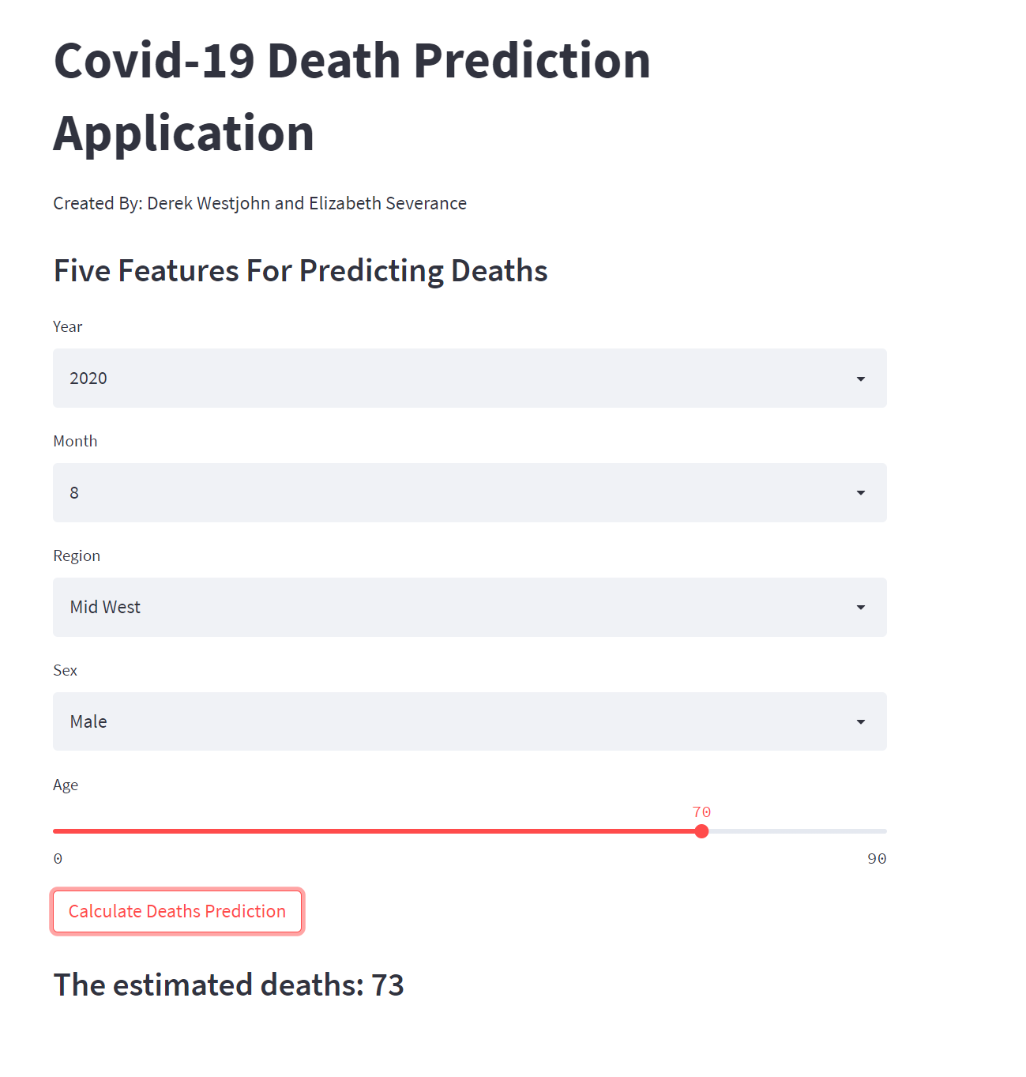
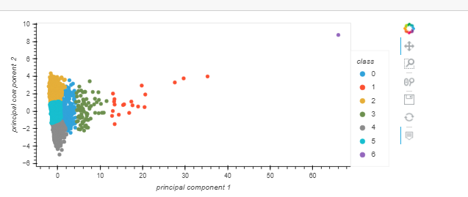
Predictions
Both supervised and unsupervised models were used in this project. Unsupervised learning was used to see if there is a co-relation between socio-economic factors and the likely hood of death from Covid. Supervised learning was used to create an actual death predictor.

Slide 6
Machine Learning
Models Chosen
Processing of Data
Processing of data was similar for both models. The data was cleaned by removing an obsolete columns, and addressing any null values. For the unsupervised model the data was then scaled using the StandardScaler.
Unsupervised learning was chosen because we were looking for any groupings or trends with the selected data.
Supervised learning was then implemented in an effort to validate the unsupervised model.

Slide 7
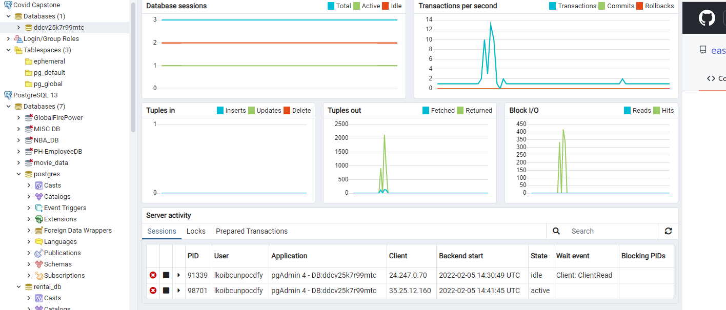
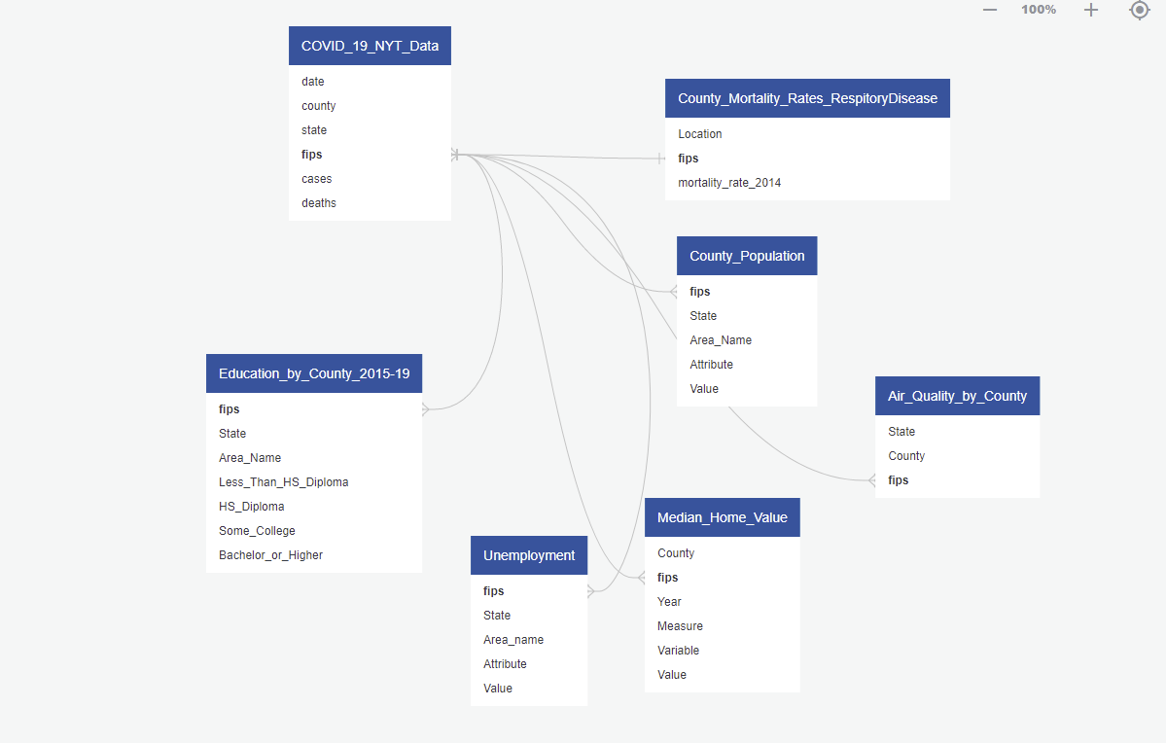
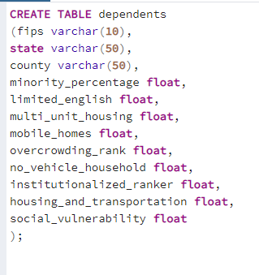
Database
Database storage is on Heroku tied to PgAdmin.

Slide 8
Dashboard
Using Predictor model
Map - of unsupervised learning

