Slide 1
Cross-Project Bug Localisation
TRANP-CNN Phase 1 — Experimental Results
Can a bug localisation model trained on one project
transfer to another?
20 Projects • 94 Source→Target Pairs • 4 Scenarios • 5 Metrics
PhD Study | TRANP-CNN Reranking Model | Python & Java Codebases

Slide 2
Research Problem & Experimental Setup
What are we testing and how?
▸ Bug localisation: given a bug report, rank source files by likelihood of containing the bug
▸ Challenge: collecting labelled bug data (bug report → file mappings) is expensive
▸ CPL hypothesis: a model trained on project A can transfer to project B with limited target data
Scenario
Training Data
Research Question
WP-small
20% target bugs only
Baseline: limited within-project
WP-large
80% target bugs only
Upper bound: maximum within-project
CP-cold-start
100% source, 0% target
Can zero-shot transfer work?
CP-transfer
100% source + 20% target
Does CPL beat WP-small?
Pipeline: BAAI/bge-code-v1 embeddings → FAISS top-300 retrieval → TRANP-CNN reranking
TRANP-CNN Phase 1 — CPL Results | PhD Study

Slide 3
Evaluation Metrics
Five complementary lenses on performance
Top-1 / Top-5 / Top-10
MAP
MRR
Recall@K
Mean Average
Precision
Mean Reciprocal
Rank
Fraction of bugs where the GT file appears
in rank position ≤ K.
Top-10 = 0.80 means 80% of bugs
found in top 10 candidates.
Precision averaged over all rank positions
where a relevant file appears.
Higher = better ranked, not just retrieved.
Range: (0, 1].
Mean of 1/rank across all bugs.
MRR=0.5 → GT file at rank 2 on average.
MRR=0.25 → rank 4 on average.
Range: (0, 1].
Key insight: Top-K recall and MAP/MRR can disagree. A model may retrieve the file (high Top-10) but rank it 9th, not 1st (low MRR). We report all five metrics throughout.
TRANP-CNN Phase 1 — CPL Results | PhD Study

Slide 4
Overall Results — All 5 Metrics
Mean across 92–94 source→target pairs
Scenario
Top-1
Top-5
Top-10
MAP
MRR
WP-large
0.081
0.200
0.258
0.218
0.248
CP-transfer
0.064
0.189
0.251
0.197
0.226
WP-small
0.056
0.167
0.223
0.176
0.202
CP-cold-start
0.005
0.021
0.040
0.038
0.042
▸ CP-transfer consistently sits between WP-small and WP-large across ALL metrics
▸ Top-K gap to WP-large is small (0.007–0.017) — recall is nearly matched
▸ MAP/MRR gap is larger (0.021–0.022) — ranking precision still lags
▸ CP-cold-start is very low — zero-shot transfer without fine-tuning is limited
TRANP-CNN Phase 1 — CPL Results | PhD Study

Slide 5
Finding 1: CPL Significantly Improves Ranking Quality
CP-transfer vs WP-small — Wilcoxon signed-rank test
📐 Wilcoxon Signed-Rank Test
Metric
Win Rate
Mean Gain
p-value
A non-parametric paired statistical test.
Use case: we have 92 paired observations
(CP-transfer MRR, WP-small MRR) for the
same project pairs. We ask: is CP-transfer
systematically higher?
Null hypothesis H₀: no difference.
Alternative H₁: CP-transfer > WP-small.
p < 0.05 → reject H₀ → difference is real.
★ ★ ★ = p < 0.001 ★ ★ = p < 0.01 ★ = p < 0.05 ns = not significant
Top-1
37.0%
+0.007
0.118 (ns)
Top-5
43.5%
+0.021
0.007 ★★
Top-10
47.8%
+0.026
0.001 ★★
MAP
64.1%
+0.020
0.006 ★★
MRR
67.4%
+0.022
0.005 ★★
▸ MAP and MRR: CP-transfer wins significantly (p < 0.01) in 64–67% of pairs
▸ Top-1 improvement is NOT significant — CPL improves ranking, not pinpoint precision
▸ Interpretation: cross-project pre-training gives a better relative ordering of files
TRANP-CNN Phase 1 — CPL Results | PhD Study

Slide 6
Finding 2: CP-transfer Matches WP-large on Recall
Top-K and MAP/MRR tell different stories
Metric
CP-transfer ≥ WP-large
Within 10% of WP-large
Mean gap
Top-1
54.3% (50/92)
62.0% (57/92)
−0.018
Top-5
52.2% (48/92)
57.6% (53/92)
−0.012
Top-10
53.3% (49/92)
63.0% (58/92)
−0.010
MAP
30.4% (28/92)
41.3% (38/92)
−0.023
MRR
32.6% (30/92)
47.8% (44/92)
−0.025
▸ For RECALL (Top-K): CP-transfer matches or beats WP-large in 52–54% of pairs
▸ For RANKING (MAP/MRR): WP-large retains advantage (~70% of pairs)
▸ Practical implication: for tools showing a shortlist of 10 files, CP-transfer ≈ WP-large
▸ CP-transfer uses the same 20% target data as WP-small — no extra annotation cost
TRANP-CNN Phase 1 — CPL Results | PhD Study

Slide 7
Finding 3: CPL Benefit is 3–4× Larger for Data-Scarce Targets
CPL is most valuable exactly where it is most needed
Target group
Top-5 gain
Top-10 gain
MAP gain
MRR gain
Few bugs (≤228 bugs, n=48)
+0.034
+0.043
+0.029
+0.032
Many bugs (>228 bugs, n=46)
+0.007
+0.007
+0.011
+0.012
Ratio (few / many)
4.9×
6.1×
2.6×
2.7×
▸ Split at median target bug count (228 bugs) — roughly equal group sizes
▸ CPL gain = CP-transfer MRR − WP-small MRR for the same pair
▸ For data-scarce targets: mean Top-10 gain = +0.043 (significant improvement)
▸ For data-rich targets: gain drops to +0.007 — WP-large is already adequate
▸ Deployment recommendation: prefer CPL when target has < 200 historical bugs
TRANP-CNN Phase 1 — CPL Results | PhD Study

Slide 8
Finding 4: Target Codebase Size is the Dominant Predictor
Spearman correlation analysis across all 5 metrics
📐 Spearman Rank Correlation (ρ)
Feature
Top-10 ρ
MAP ρ
MRR ρ
Sig.
Measures how monotonically two variables
are related — without assuming linearity.
ρ = +1.0 → perfect positive relationship
ρ = −1.0 → perfect negative relationship
ρ = 0.0 → no relationship
Significance: p < 0.05 needed to claim the
correlation is not due to chance.
Example: ρ(tgt_LoC, Top-10) = −0.855***
means: as target codebase gets larger,
Top-10 recall drops very consistently.
tgt_LoC (target size)
−0.855
−0.652
−0.667
★★★
tgt_bug_verbosity
+0.333
+0.383
+0.297
★★/★★★
tgt_n_bugs
+0.134
+0.311
+0.319
ns / ★★
src_LoC (source size)
+0.274
+0.252
+0.259
★★ / ★
src_n_bugs (source bugs)
−0.045
+0.016
+0.070
ns all
domain_gap
+0.116
+0.012
+0.038
ns all
▸ tgt_LoC dominates: ρ = −0.855 for Top-10 — large codebase = harder localisation
▸ Source features (bugs, LoC) are weak / non-significant for MRR and MAP
▸ Domain gap has NO significant predictive power — dissimilar projects still transfer
TRANP-CNN Phase 1 — CPL Results | PhD Study

Slide 9
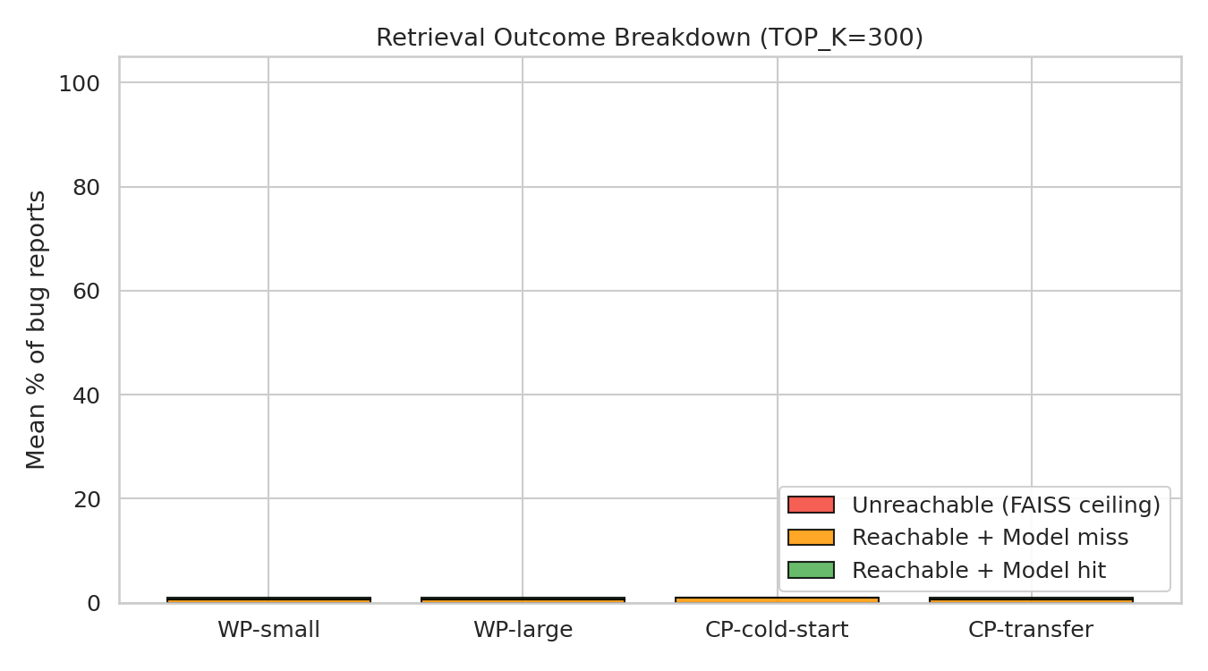
Finding 5: FAISS Retrieval is Not the Bottleneck
pct_unreachable = 0% — every failure is a model ranking failure
pct_unreachable = 0.00% across all 94 pairs
Every ground-truth file was present in FAISS top-300 candidates
▸ Pipeline: FAISS retrieves top-300 files → TRANP-CNN reranks them
▸ If GT file is NOT in top-300: model cannot fix it (unreachable)
▸ If GT file IS in top-300 but ranked below top-10: that is a model ranking failure
▸ Our result: 0% unreachable → ALL failures are ranking failures, not retrieval failures
▸
▸ Implication: improving the reranking architecture directly improves all metrics
▸ Increasing TOP_K_CANDIDATES beyond 300 will not help — embeddings are already sufficient
▸ This validates the research direction: better reranker (transformer, GNN) = better results
TRANP-CNN Phase 1 — CPL Results | PhD Study

Slide 10
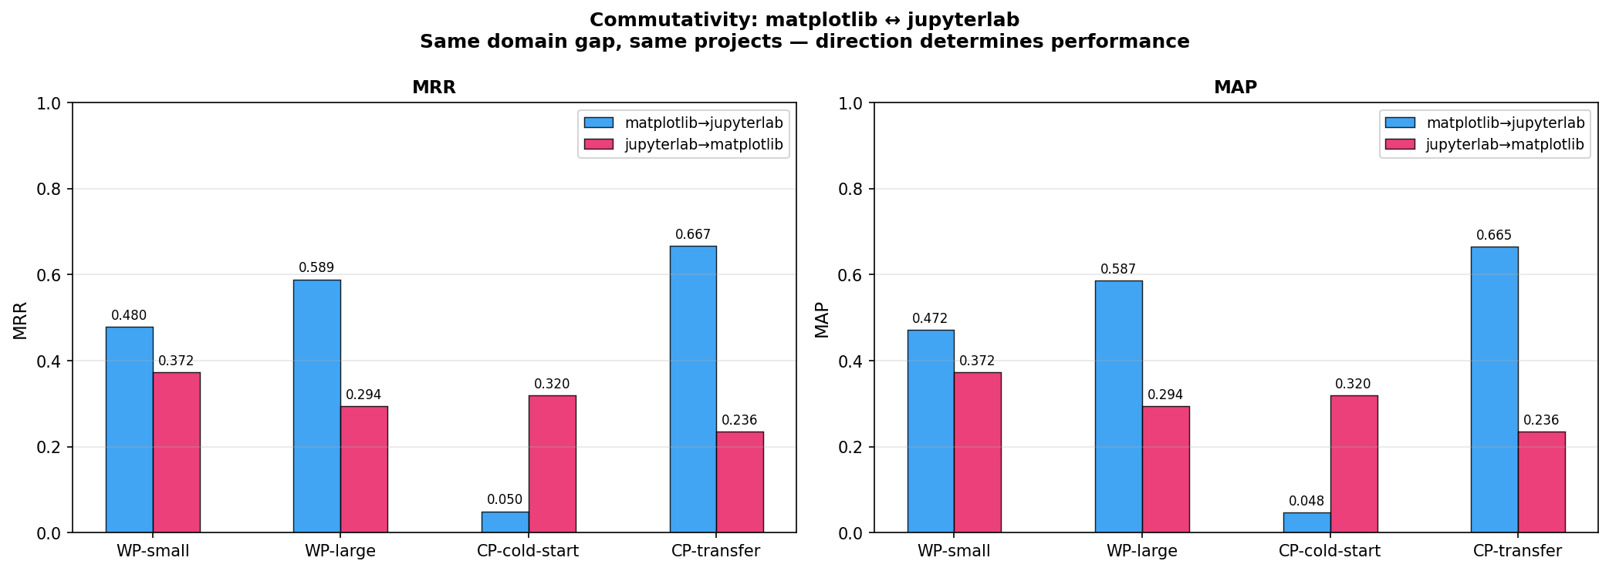
Finding 6: CPL is Not Commutative — Direction Matters
Showcase Pair A: matplotlib ↔ jupyterlab
Direction
WP-small
WP-large
CP-cold-start
CP-transfer
matplotlib → jupyterlab
0.438
0.554
0.045
0.614 ★
jupyterlab → matplotlib
0.372
0.294
0.320
0.236
▸ Same domain gap (0.972), same two projects — just swapped
▸ Forward: jupyterlab = 39K LoC target → easy to rank → CPL wins
▸ Reverse: matplotlib = 249K LoC target → correct file buried → CPL hurts
▸ WP-large even loses to WP-small for jupyterlab→matplotlib
▸ Rule: TARGET codebase size determines difficulty, not source
TRANP-CNN Phase 1 — CPL Results | PhD Study

Slide 11
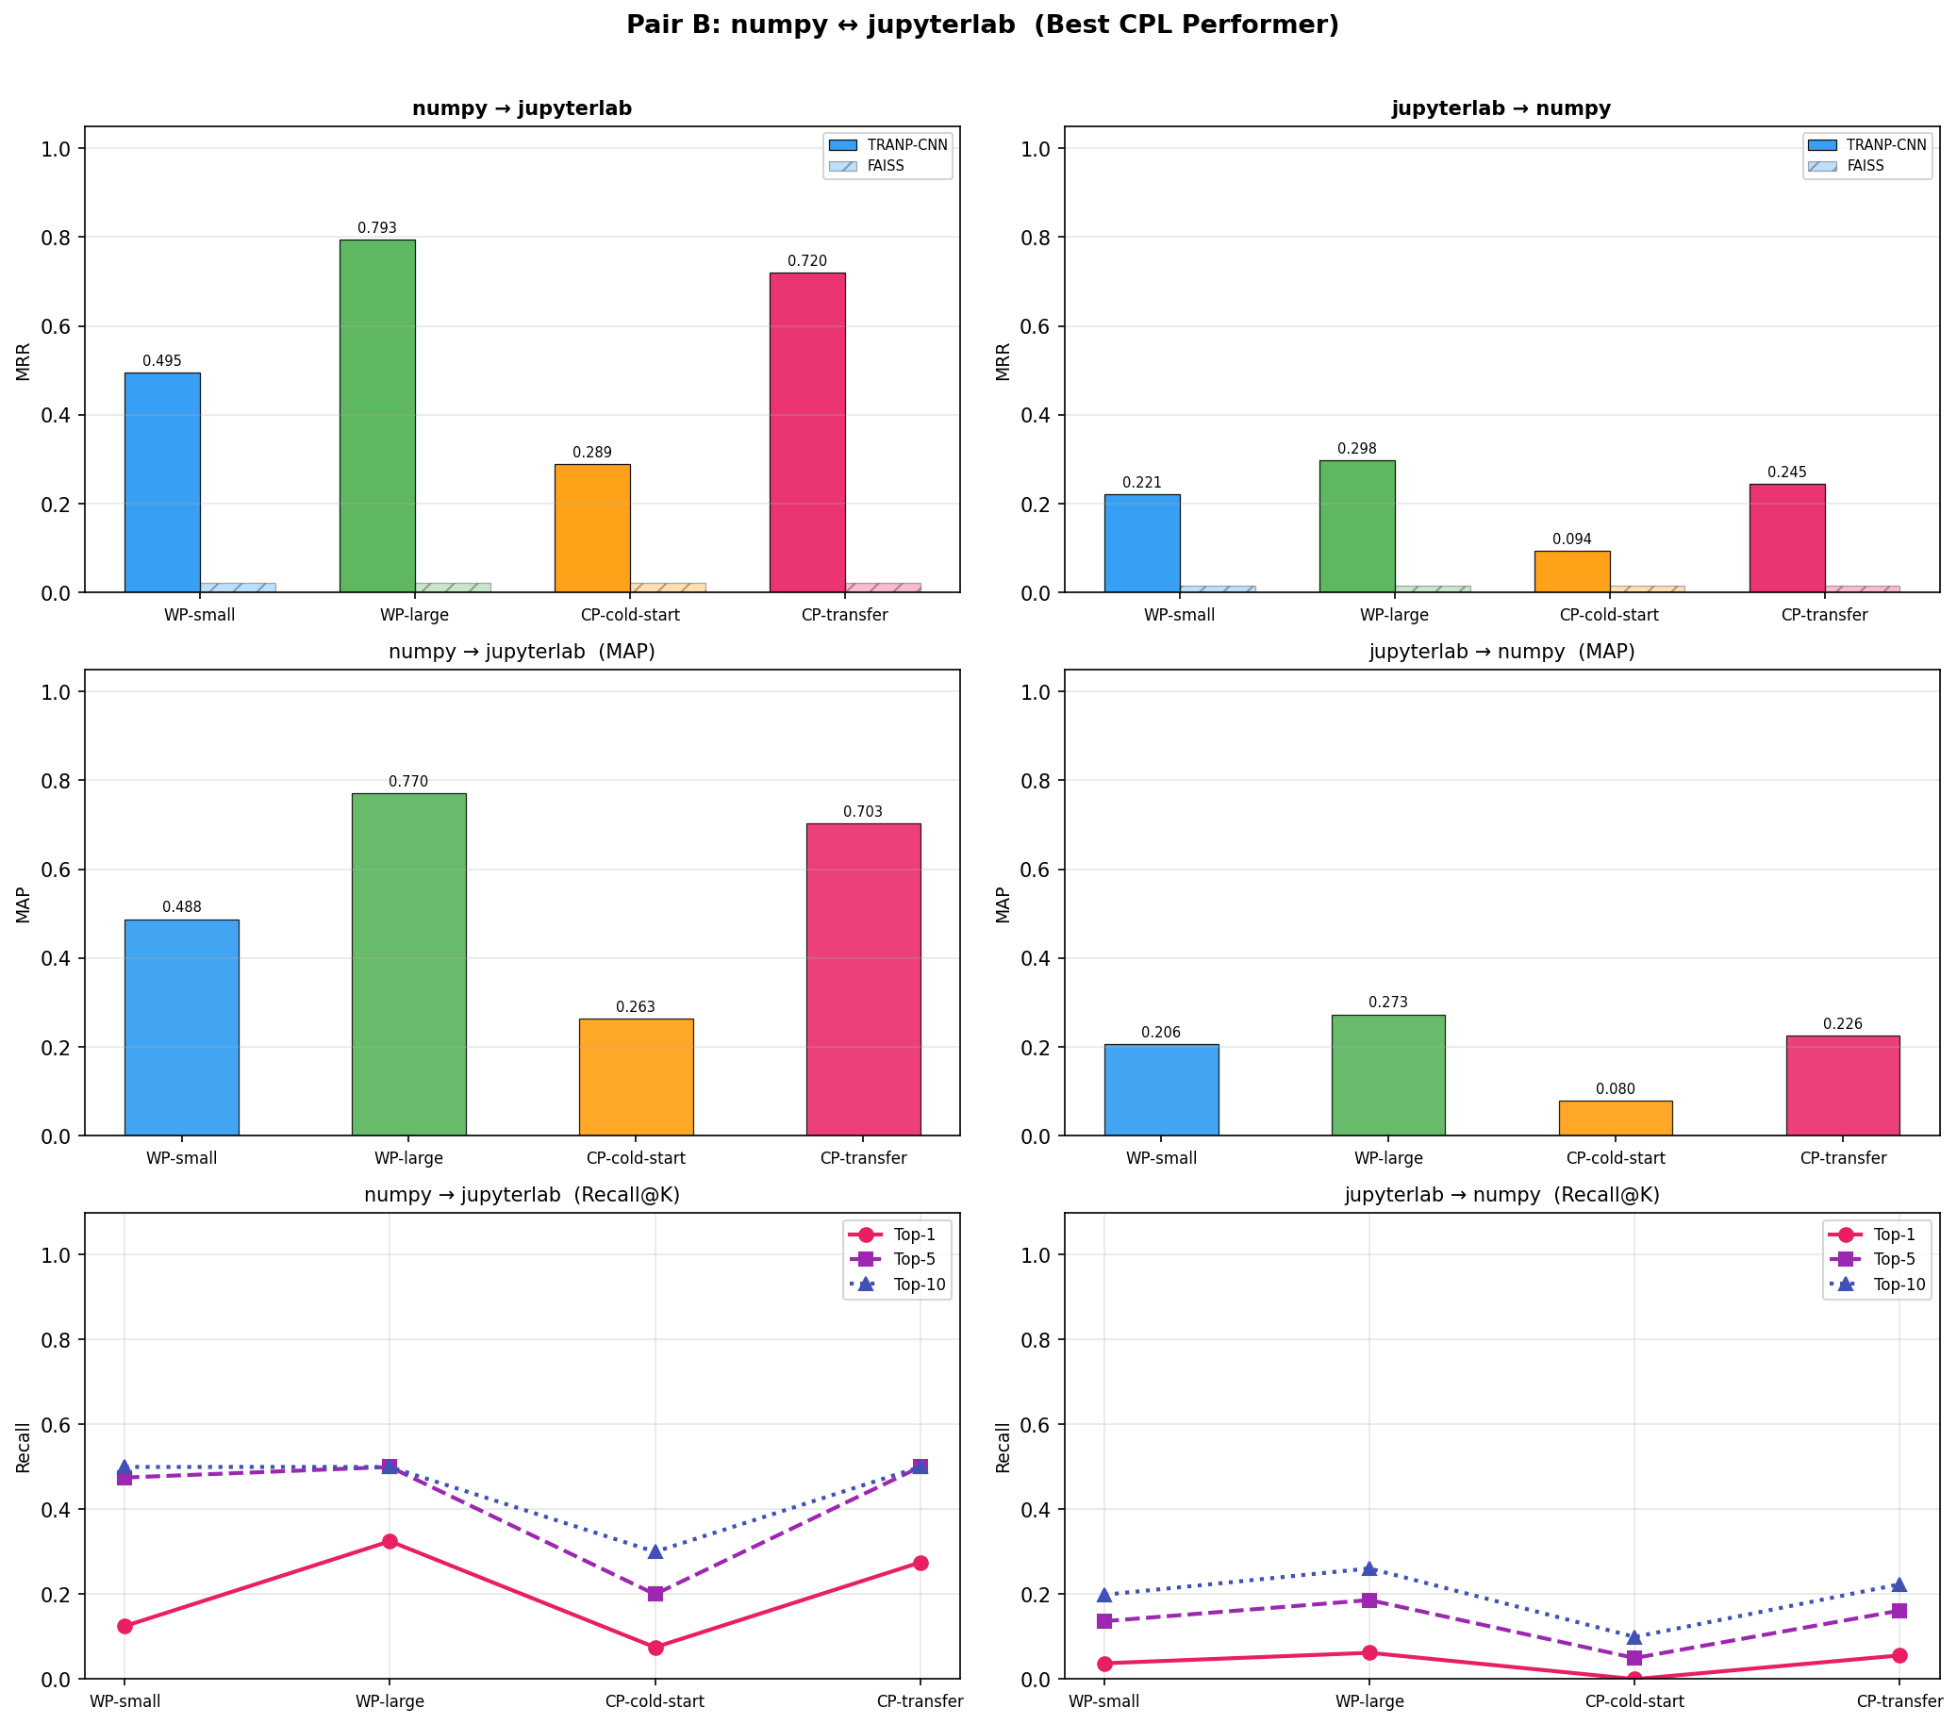
Showcase Pair B: numpy → jupyterlab (Best CPL Performer)
Top-10 recall = 100% for WP-large and CP-transfer; 33× improvement over FAISS
Scenario
Top-1
Top-5
Top-10
MAP
MRR
WP-large
0.565
1.000
1.000
—
0.724
CP-transfer
0.478
1.000
1.000
—
0.666
WP-small
0.217
0.870
1.000
—
0.464
CP-cold-start
0.130
0.348
0.565
—
0.258
FAISS baseline
—
—
—
—
0.022
▸ CP-transfer MRR 0.666 ≈ WP-large 0.724 (gap = 0.058, ~8%)
▸ FAISS MRR = 0.022 → model achieves 33× improvement
▸ jupyterlab: 39K LoC, 197 bugs — ideal CPL target
▸ Zero-shot (cold-start): MRR = 0.258 — non-trivial transfer
TRANP-CNN Phase 1 — CPL Results | PhD Study

Slide 12
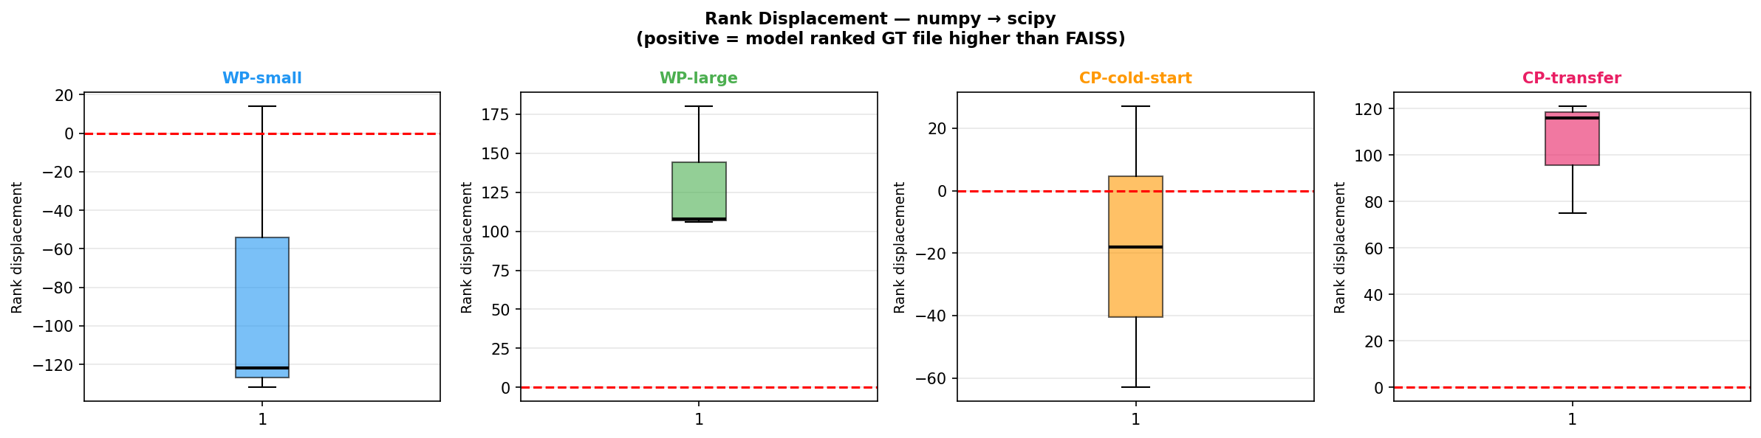
Showcase Pair C: numpy → scipy (Hard Target Ceiling)
438K LoC codebase — model improves ranks but cannot break top-10
Scenario
Top-1
Top-5
Top-10
MRR
WP-large
0.000
0.000
0.000
0.029
CP-transfer
0.000
0.000
0.000
0.024
WP-small
0.000
0.000
0.000
0.004
CP-cold-start
0.000
0.000
0.000
0.006
▸ scipy: 438,217 LoC — largest codebase in our dataset
▸ pct_unreachable = 0% — GT file IS in FAISS top-300
▸ Mean rank displacement = +131 (WP-large) — model IS improving ranks
▸ But: moving from rank 167 to rank 36 is still outside top-10
▸ This is a TARGET VIABILITY failure, not a source selection failure
▸ No source project can fix a 438K LoC target — architecture must improve
TRANP-CNN Phase 1 — CPL Results | PhD Study

Slide 13
Source Project Selection — Can We Pick the Best Source?
Kendall τ analysis across 12 targets with ≥3 source candidates
📐 Kendall Rank Correlation (τ)
Strategy
Hit@1 (MRR)
Hit@1 (MAP)
Mean τ (MRR)
Measures whether one ranking agrees with
another. For each target project:
• Sort sources by heuristic score
• Sort sources by actual CP-transfer MRR
• τ = agreement between these two orderings
τ = +1 → heuristic perfectly matches oracle
τ = −1 → heuristic is perfectly reversed
τ = 0 → heuristic is random
We also use Hit@1: did the top-ranked source
by heuristic turn out to be the best source
by actual performance?
Oracle (upper bound)
100%
100%
+1.00
Most-bugs heuristic
41.7%
41.7%
+0.253
Random (lower bound)
~15%
~15%
~0.00
▸ Most-bugs = pick the source with the most bug reports
▸ Hit@1 = 41.7%: correct in fewer than half of cases
▸ τ = +0.253: positive ordering signal — larger sources tend to be better
▸ Captures ~53% of the gap between random and oracle selection
▸ Source selection is PARTIALLY solved — not an algorithm, a useful heuristic
TRANP-CNN Phase 1 — CPL Results | PhD Study

Slide 14
Practical Decision Framework for CPL Deployment
Two-phase strategy: target viability first, then source selection
Phase 1 — Target Viability Check
Phase 2 — Source Selection Heuristics
Target LoC > 200K?
→ CPL will underperform regardless of source (ρ = −0.855)
Bug report verbosity very low (< 30 words)?
→ Insufficient signal for any model
Target has > 300 historical bugs?
→ WP-large may be more reliable; CPL gain smaller
✓ If target passes: proceed to source selection
S1: Default — pick source with MOST bug reports
(Hit@1 = 41.7%, Kendall τ = +0.25)
S2: Among tied sources — prefer larger codebase
(src_LoC has weak positive signal: ρ ≈ +0.27)
S3: DO NOT use domain gap as filter
(ρ < 0.12, non-significant for all metrics)
S4: DO NOT use bug/code similarity as ranking signal
(no significant correlation in our dataset)
This is a set of strategies, not an algorithm. Hit@1 = 41.7% means the heuristic fails 58% of the time. Learned source selection is an open research problem.
TRANP-CNN Phase 1 — CPL Results | PhD Study

Slide 15
Research Contributions & Implications
What this study establishes for the CPL literature
Contribution
Evidence
Metric support
CPL improves ranking over WP-small
67.4% win rate, p=0.005
MRR, MAP
CPL achieves WP-large recall
53% pairs Top-10 match
Top-10
CPL most valuable for data-scarce targets
3–4× gain, few-bug targets
Top-10, MRR
Target LoC is dominant predictor
ρ = −0.855 for Top-10
All metrics
Source selection: most-bugs heuristic
Hit@1=41.7%, τ=+0.25
MRR, MAP
Architecture is the bottleneck
pct_unreachable = 0%
Diagnostic
▸ For new projects (< 200 historical bugs): CPL is the recommended default strategy
▸ Domain gap filtering is NOT needed — dissimilar projects can still transfer well
▸ Better reranking architecture is the clearest path to higher MRR/MAP
▸ Source selection remains an open problem — 58% of the time the heuristic misses
TRANP-CNN Phase 1 — CPL Results | PhD Study

Slide 16
Limitations & Future Work
Honest framing + what comes next
Limitations
Future Work
▸ Mean MRR 0.20–0.25 is low vs within-project SOTA (> 0.5) — but correct comparison is our FAISS baseline, not cross-study
▸ Results include Python and Java; generalisation to C++, JS, polyglot unknown
▸ Large targets (scipy, 438K LoC) dominate the low-performance tail — stratified reporting is more informative than overall means
▸ CP-cold-start (MAP=0.038) is not practically useful — zero-shot still needs fine-tuning
▸ Source selection Hit@1 = 41.7% — heuristic works in fewer than half of cases
▸ Learned source selection meta-model: train on pair outcomes to predict source quality for unseen targets
▸ Multi-source ensembling: combine all sources rather than picking one — may outperform selection
▸ Transformer/GNN reranker: replace TRANP-CNN CNN architecture to reduce the ranking gap vs WP-large
▸ COOBA comparison: run same Phase 1 analysis for COOBA (GNN-based) and compare transfer behaviour
▸ Large-codebase architecture: hierarchical or retrieval-augmented reranker for > 200K LoC targets
Core message: CPL is the right strategy for data-limited targets. The bottleneck is now the reranking architecture, not the retrieval or the transfer mechanism.
TRANP-CNN Phase 1 — CPL Results | PhD Study

Slide 17
Key Takeaways
CP-transfer beats WP-small
Top-K recall matches WP-large
1
67.4% of pairs (p=0.005) — ranking quality improves significantly
2
53% of pairs on Top-10 — same recall, 4× less target data
Most valuable when data is scarce
Target size governs performance
3
3–4× gain for targets with < 228 bugs
4
tgt_LoC ρ = −0.855 for Top-10 — largest predictor by far
Source selection = heuristic, not algorithm
Architecture is the remaining challenge
5
Most-bugs heuristic: Hit@1 = 41.7%, τ = +0.25
6
pct_unreachable = 0% — improve reranker, not retrieval

