Slide 1

Custom Connectors in Azure Logic Apps
Emad Alashi
@emadashi
Telstra Purple

Slide 2
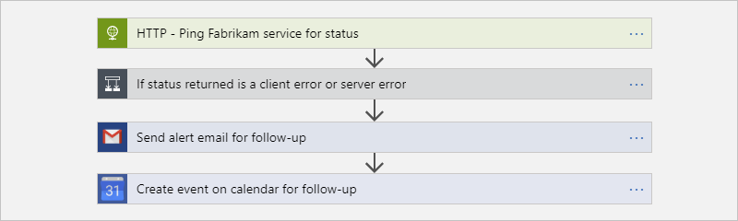
Notes:
Connectors are integral part of Logic Apps. Once you create an Action from a, you can receive data from a previous Action, execute the Action, and provide new data/result to the next Action

Slide 3
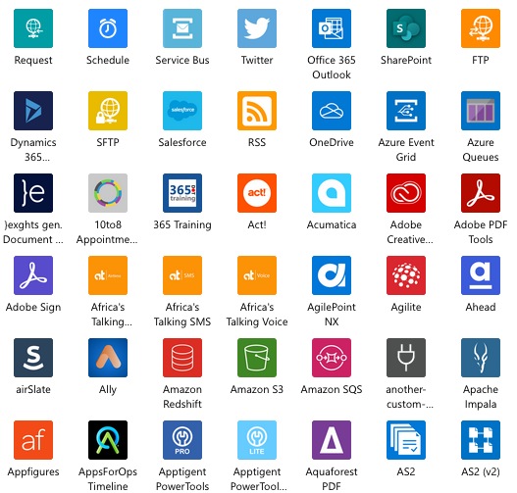
Notes:
There are hundreds of connectors,

Slide 4
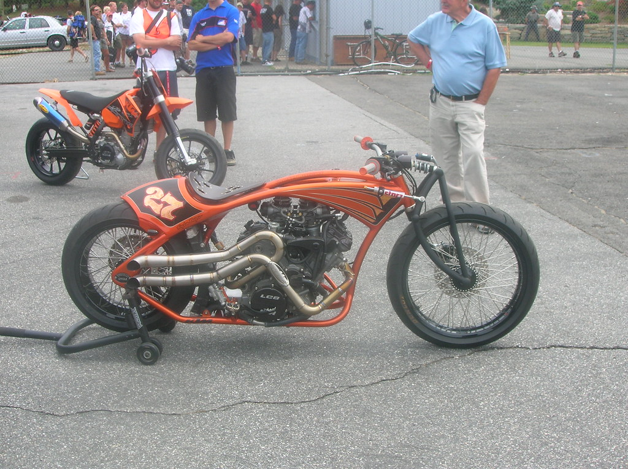
"Custom Bike" by HowdeeDoodat is licensed under CC BY-SA 2.0

Slide 5
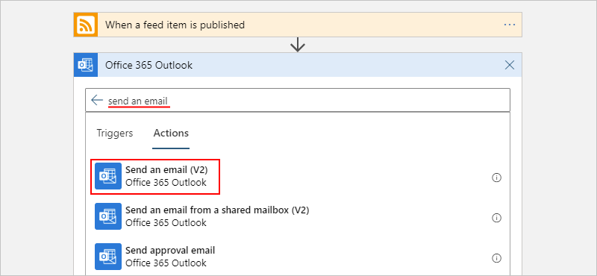
https://docs.microsoft.com/en-nz/azure/logic-apps/quickstart-create-first-logic-app-workflow

Slide 6
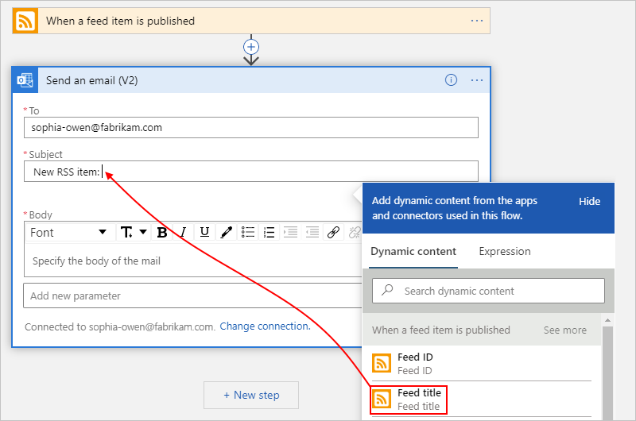
https://docs.microsoft.com/en-nz/azure/logic-apps/quickstart-create-first-logic-app-workflow

Slide 7

API
Notes:
In reality, all what we are dealing with in Logic Apps is APIs

Slide 8
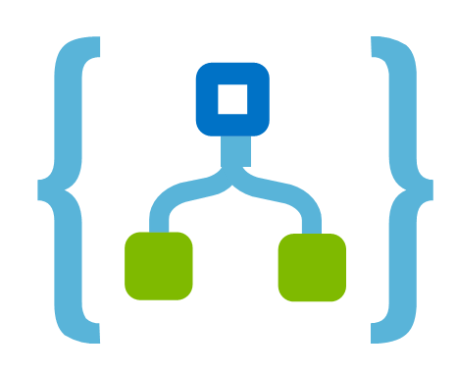
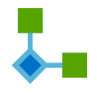
Action
API
API
Trigger
Notes:
We either invoke an action, which an http request
Or we are checking for status change through polling
Or we are waiting to be invoked as a trigger through webhook

Slide 9

Notes:
If that’s the case. Then what is the best way to facilitate these calls: Actions, Polling and Webhooks?
We already have a great tool: OpenAPI
It’s the same as Swagger

Slide 10
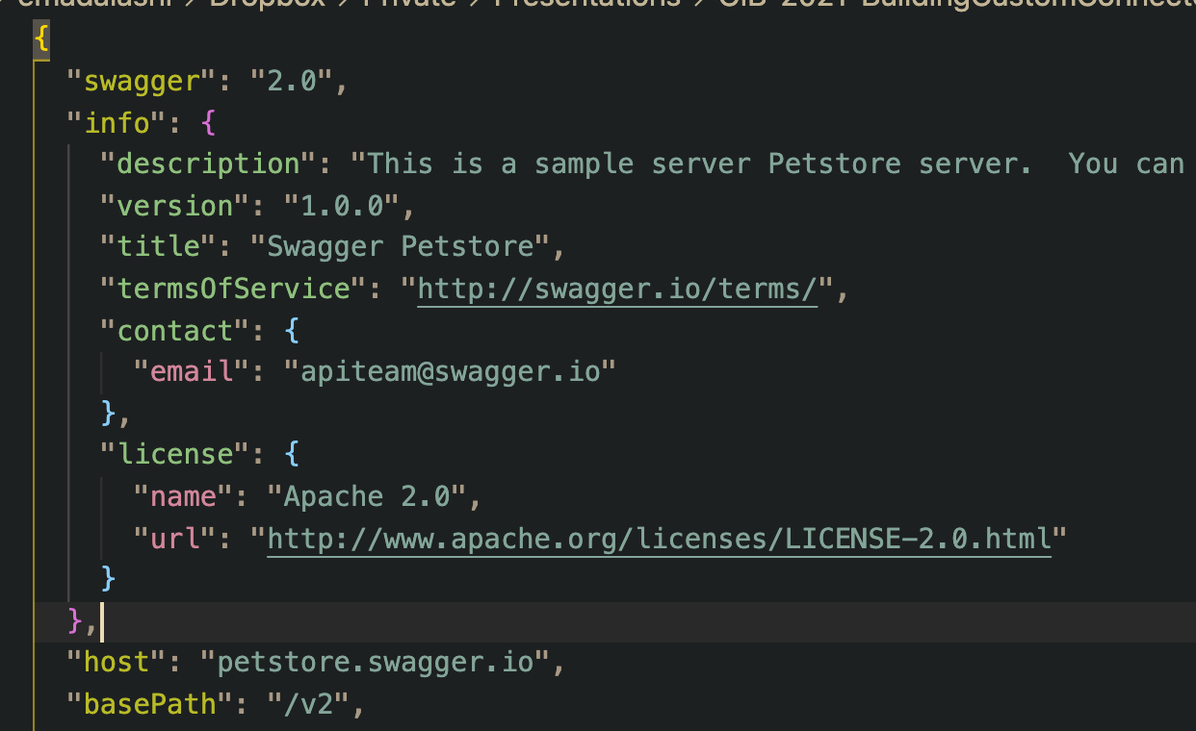
Notes:
Here is a glimpse of OpenAPI . This shows the general information about the API.

Slide 11
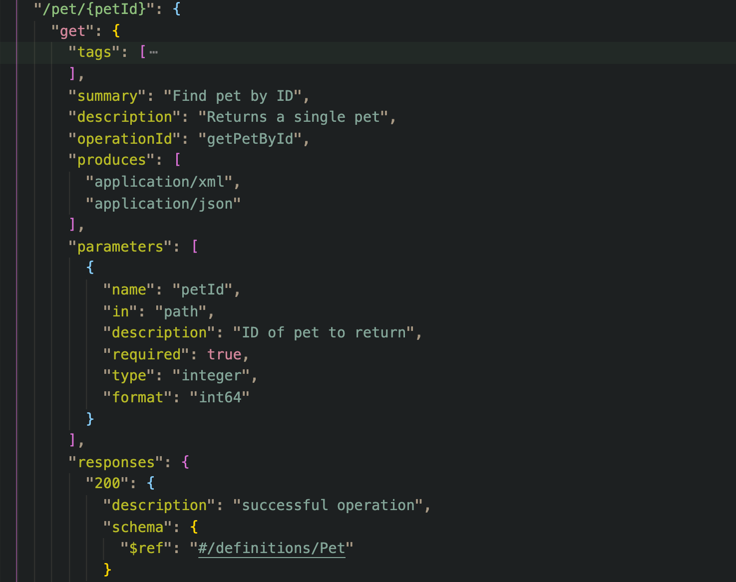
Notes:
This shows the path “/pet/{petId}”
The parameters it receives and where to extract their values from
And the response using $ref

Slide 12
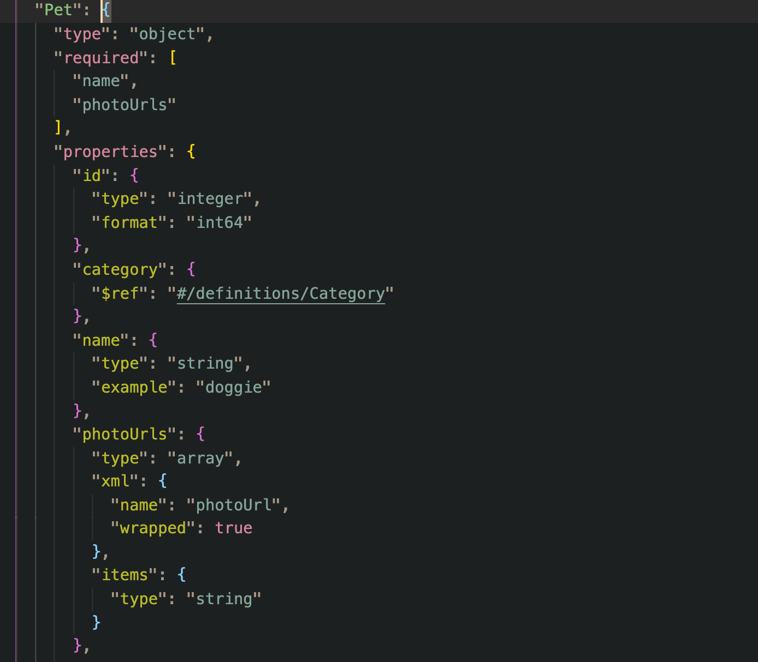
Notes:
Here is a definition of what the object Pet is, defining its properties and their types

Slide 13
Demo Time!

Slide 14
Create Shipment
API
API
Notes:
Let’s imagine a scenario: Your organisation wants to create a logic app that creates a shipment.

Slide 15
Let’s see!

Slide 16
Action
API
Webhook
Registration
API
Trigger
Notes:
We either invoke an action, which an http request
Or we are checking for status change through polling
Or we are waiting to be invoked as a trigger through webhook

Slide 17
Let’s see!

Slide 18
Conclusion
It’s OpenAPI
Either an Action or Trigger
https://docs.microsoft.com/en-us/connectors/custom-connectors/
https://github.com/eashi/custom-connectors-presentation

Slide 19

Thank You
EmadAshi.com
@EmadAshi

