Slide 1
Pub/sub in Dapr
Emad Alashi
EmadAshi.com
Insight

Slide 2

Notes:
What is Dapr?
Dapr is runtime for distributed applications that makes it easy for any developer to build event-driven, resilient, stateless and stateful applications in a micro-services world.

Slide 3
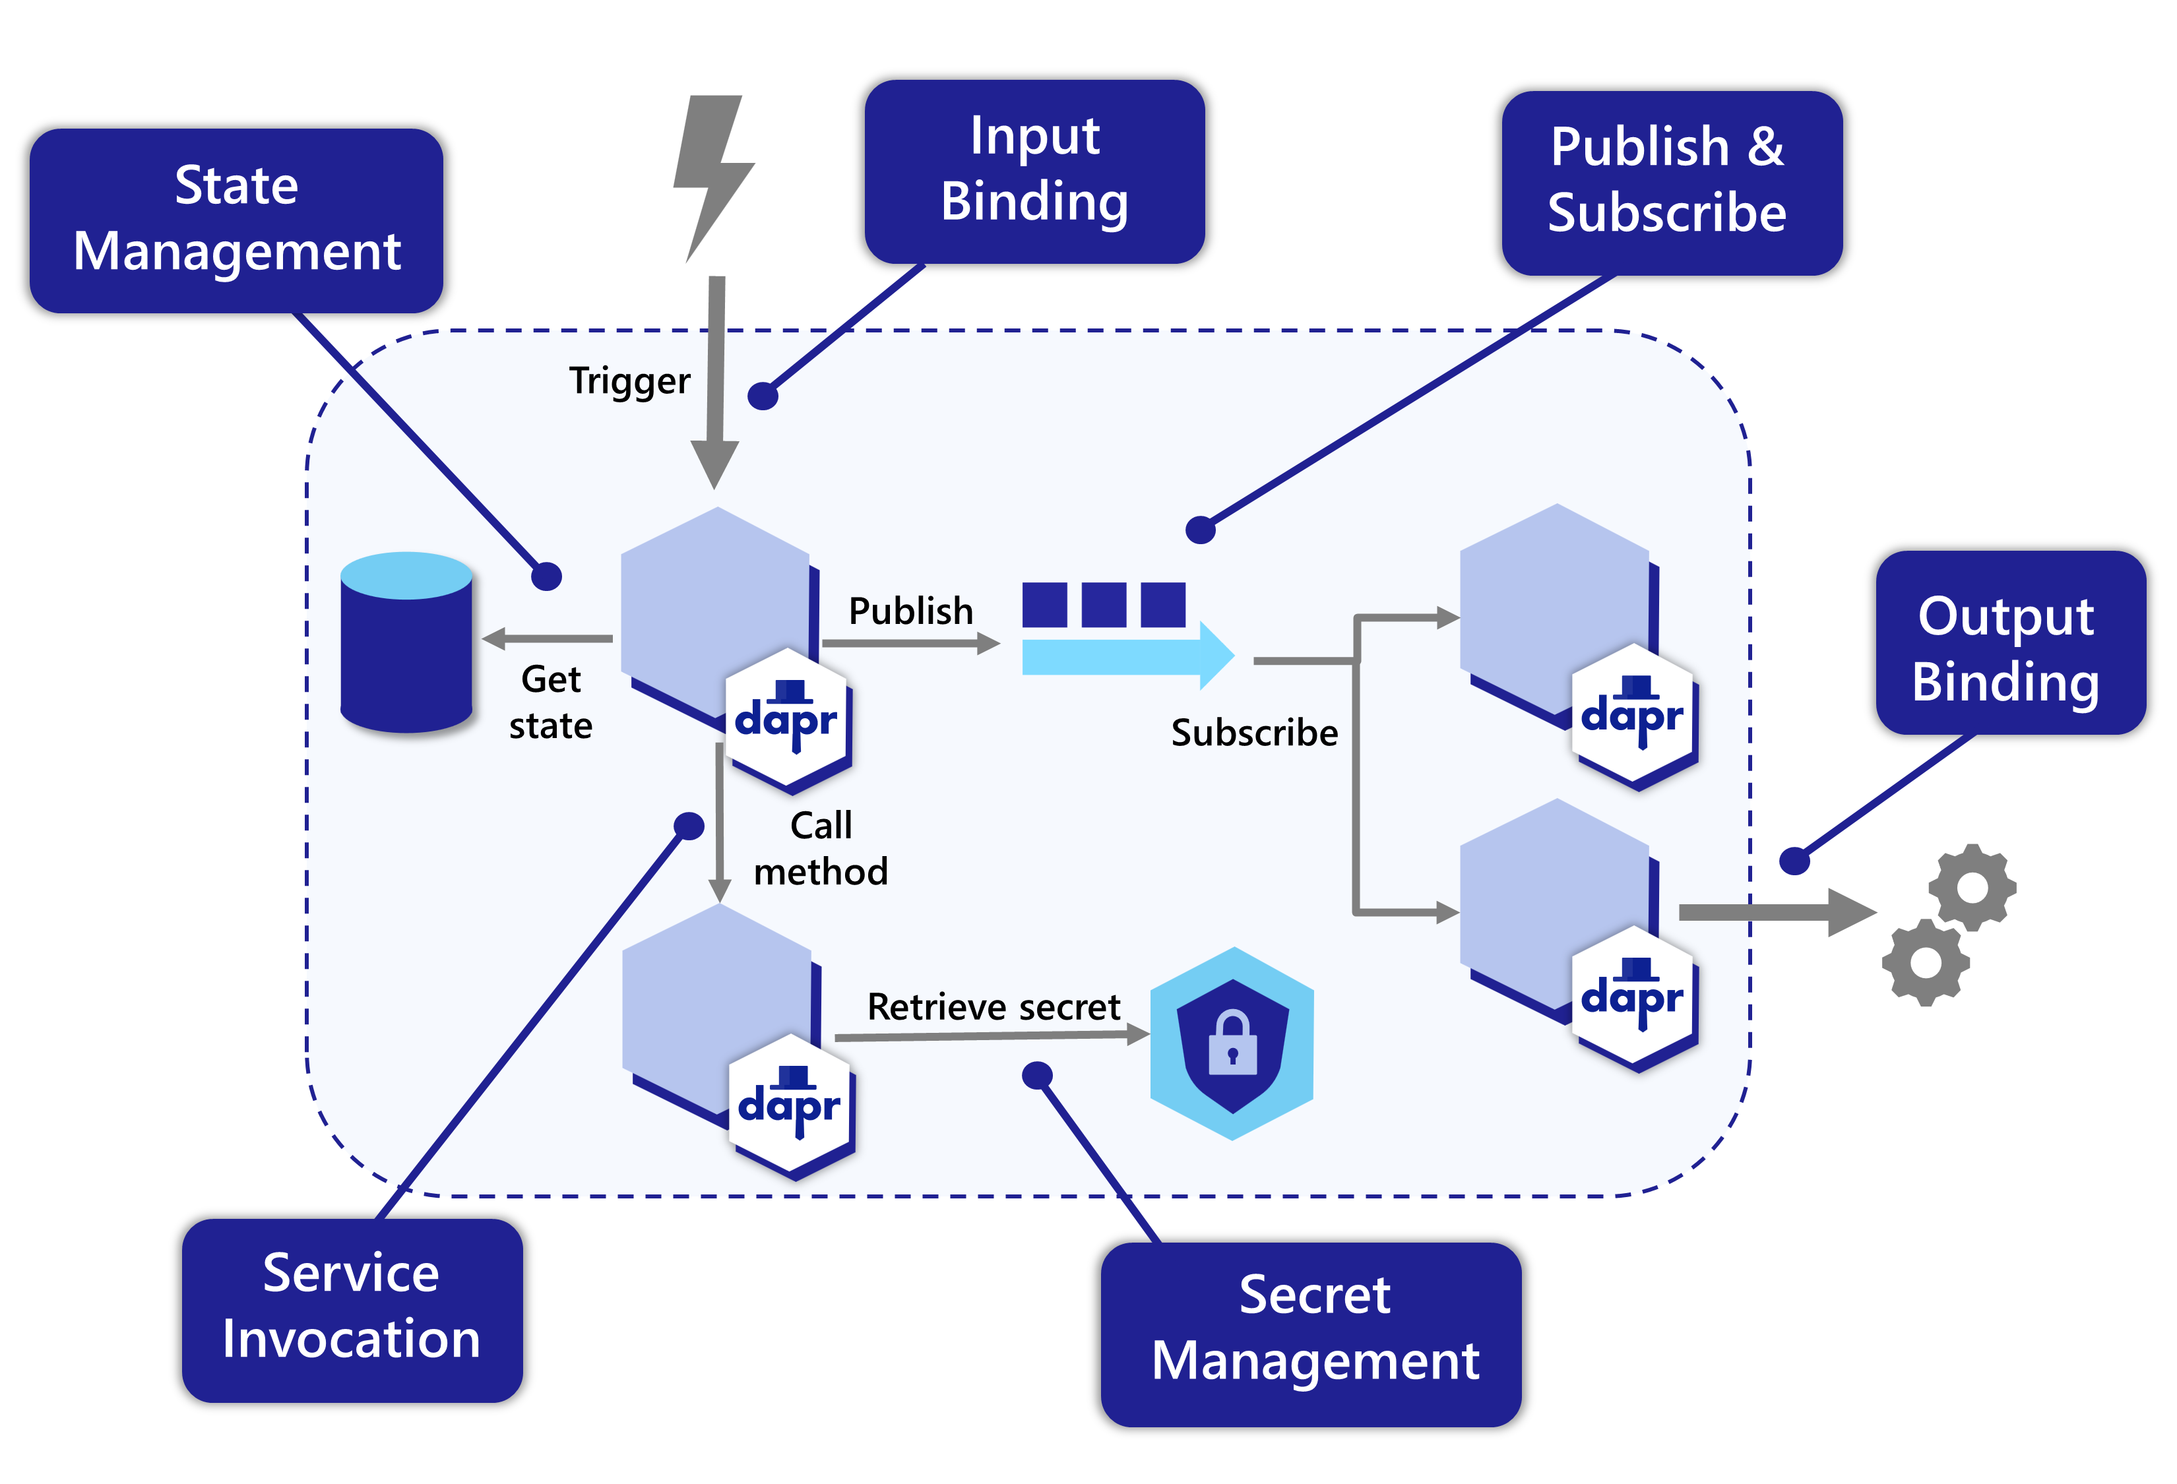
Notes:
The Distributed Application Runtime (Dapr) provides APIs that simplify microservice connectivity

Slide 4

Notes:
What is Dapr?
Dapr is runtime for distributed applications that makes it easy for any developer to build event-driven, resilient, stateless and stateful applications in a micro-services world.

Slide 5
Pub/Sub

Slide 6
Pub/Sub Traditionally
Notes:
Show the files in eShopOnContainers

Slide 7

Business
Plumbing

Slide 8

Business
Abstraction
Plumbing
RabbitMQ
Plumbing
Service Bus

Slide 9
Pub/Sub with Dapr

Slide 10
Configuration
Business

Slide 11
http://localhost:${appPort}/dapr/subscribe
http://localhost:${daprPort}/publish/${pubsubName}/${topic}
subscriber
Configuration
Configuration
publisher
[
{
"pubsubname": "pubsub",
"topic": "A",
"route": ”routeA"
},
{
"pubsubname": "pubsub",
”topic": "B",
"route": ”routeB"
}
]

Slide 12
Demo
Notes:
Show the code of the subscriber
Start Dapr on the subscriber
Show the endpoint of the subscribe, and demonstrate calling it
Show the code of the publisher
Start Dapr on the publisher and send a message on the terminal, and show the message on the subscriber
Show that you can send the message directly also to Dapr
Show the message on the message broker to show how it is Cloud Event message format
Change the configuration so that it’s not Cloud Event

Slide 13
TTL & DLQ

Slide 14
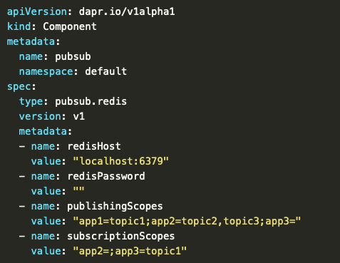
Scoping

Slide 15
Challenges
Abstraction means less control
Troubleshooting
Notes:
Abstraction and losing a bit of control
Troubleshooting

Slide 16

Q & A
EmadAshi.com

Slide 17
Thank you!
EmadAshi.com
@EmadAshi

