Slide 1
KEDA, Scale Your Kubernetes Workload on Your Own Terms
Emad Alashi
@emadashi

Slide 2
Kubernetes Without KEDA

Slide 3
KEDA’s Role

Slide 4
How KEDA Works

Slide 5
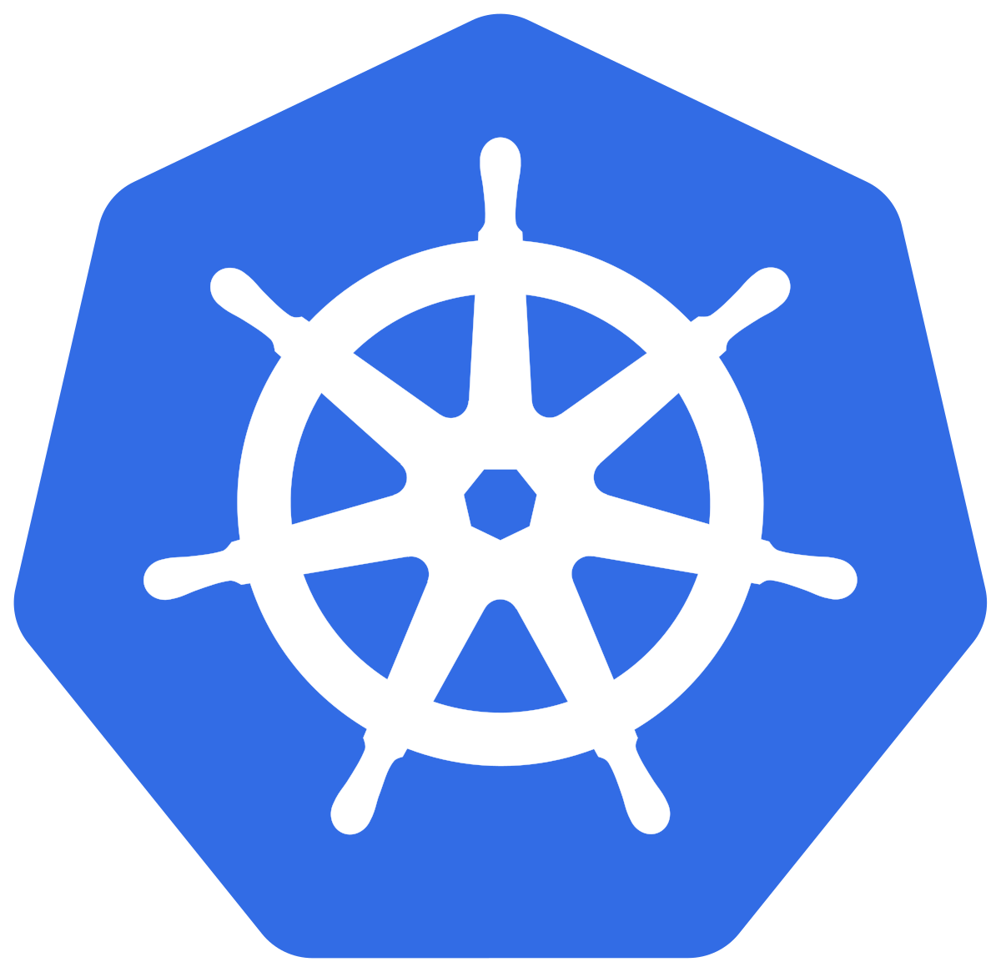



Kubernetes Controllers
1 to more / more to 1
Target
HPA
0 to 1 / 1 to 0
Operator
ScaledObject

Slide 6
How External Scalers Work

