Slide 1
KEDA, Scale Your Kubernetes Workload on Your Own Terms
Emad Alashi
@emadashi
https://www.emadashi.com

Slide 2

https://github.com/eashi/keda-workshop

Slide 3
Kubernetes Without KEDA

Slide 4
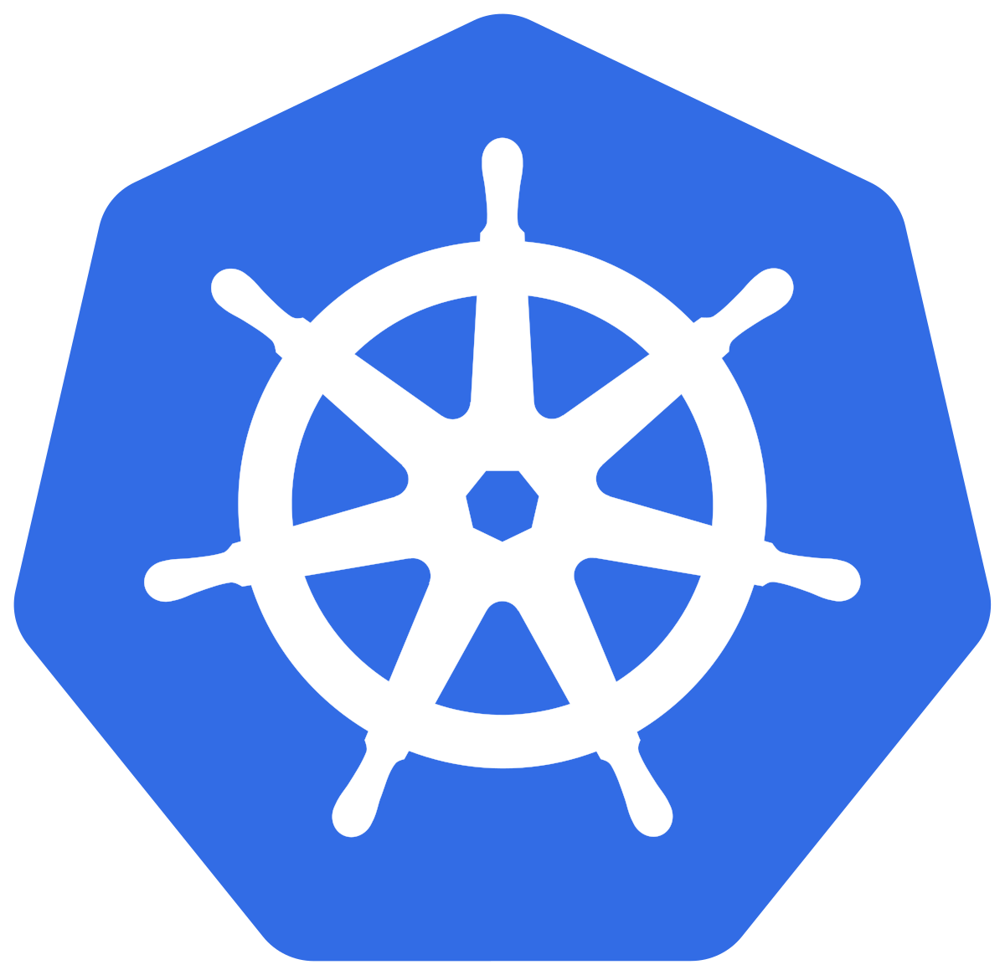

?
Kubernetes Controllers
Target
HPA
Operator
Notes:
There isn’t a lot o talk about autoscaling in Kubernetes because it’s not too straightforward.

Slide 5
Problems with HPA only
No “0 to 1” and “1 to 0”
Only CPU and Memory by default
Notes:
There are two problems with HPA

Slide 6
KEDA’s Role

Slide 7
KEDA brings in
Acts as a metric server for many scalers (22)
Kafka
AWS (SQS, CoudWatch, Kinesis)
Azure (Storage Queue, Blob, Events Hub, Monitor, Service Bus…)
RabbitMQ
Redis
…
Support for “0 to 1” and “1 to 0”
Build your own scaler

Slide 8
How KEDA Works

Slide 9


Kubernetes Controllers
1 to more / more to 1
Target
HPA
0 to 1 / 1 to 0
Operator
ScaledObject

Slide 10
How External Scalers Work

Slide 11
Kubernetes Controllers
My Scaler
1 to more / more to 1
gRPC
Target
HPA
0 to 1 / 1 to 0
Operator
ScaledObject

Slide 12
Let’s do it!

