Slide 1
KEDA, Scale Your Kubernetes Workload on Your Own Terms
Emad Alashi
@emadashi
emadashi.com
Telstra Purple

Slide 2
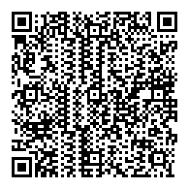
https://github.com/eashi/keda-workshop

Slide 3

What’s our plan?
Photo by fauxels from Pexels

Slide 4
What will we do?
Presentation
Hands on
10 minutes breaks
Photo by fauxels from Pexels

Slide 5

Kubernetes Without KEDA
Photo by Daria Shevtsova from Pexels

Slide 6
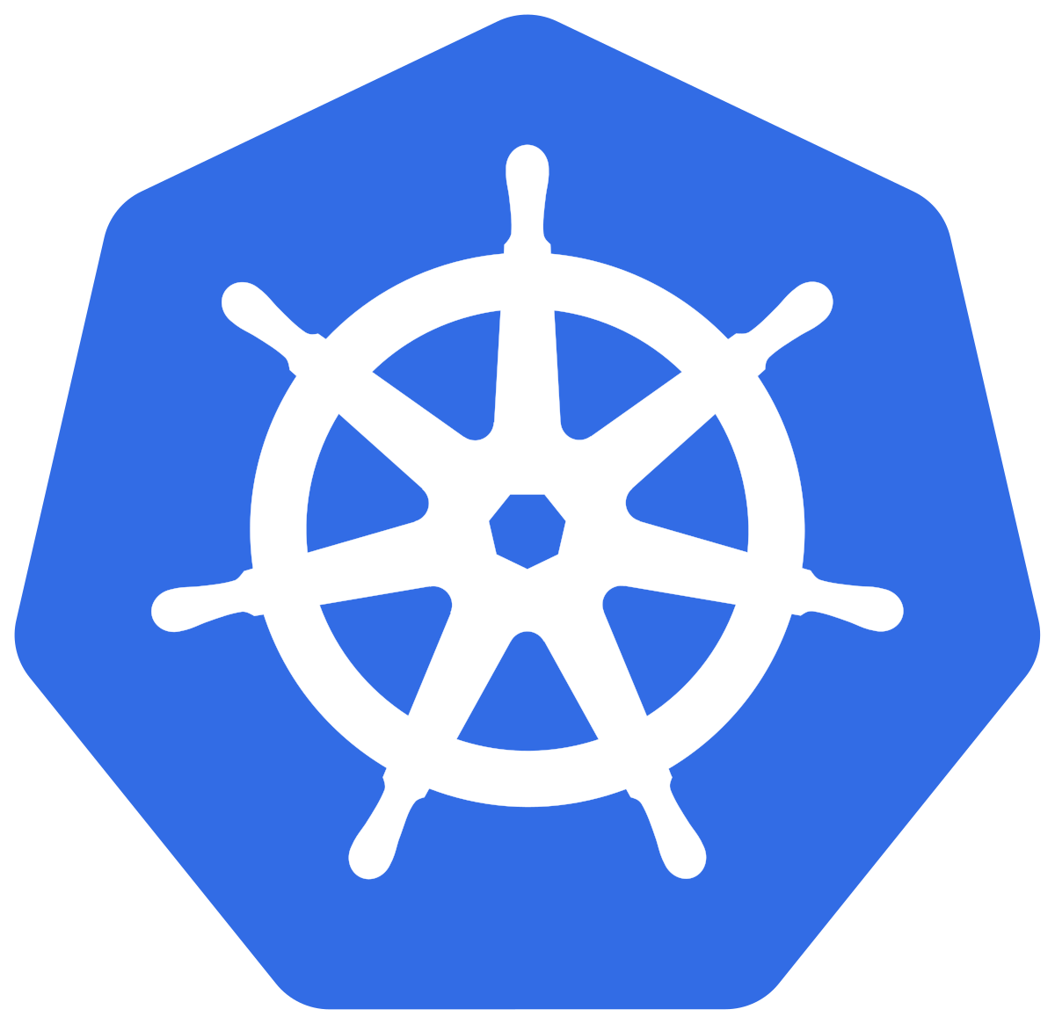

?
Kubernetes Controllers
Target
HPA
Operator
Notes:
There isn’t a lot o talk about autoscaling in Kubernetes because it’s not too straightforward.

Slide 7
Challenges with HPA only
Only CPU and Memory by default
No “0 to 1” and “1 to 0”
Notes:
There are two problems with HPA

Slide 8


Slide 9
KEDA brings in
Acts as a metric server for many scalers (22)
Kafka
AWS (SQS, CoudWatch, Kinesis)
Azure (Storage Queue, Blob, Events Hub, Monitor, Service Bus…)
RabbitMQ
Redis
…
Build your own scaler
Support for “0 to 1” and “1 to 0”

Slide 10
How KEDA Works

Slide 11

Kubernetes Controllers
1 to more / more to 1
Target
HPA
0 to 1 / 1 to 0
Operator
ScaledObject

Slide 12
currentReplicas + desiredReplicas = currentMetricValue / targetMetricValue
4
1 + = / 2
10

Slide 13
How External Scalers Work

Slide 14
Kubernetes Controllers
My Scaler
1 to more / more to 1
gRPC
Target
HPA
0 to 1 / 1 to 0
Operator
ScaledObject

Slide 15

Workshop plan
Deploy KEDA
Create target deployment
Create External scaler
Deploy External scaler (and service)
Create Mockserver (fake metrics)
Create ScaledObject
Enjoy ☺
Photo by energepic.com from Pexels

Slide 16
Let’s do it!

Slide 17
References
Horizontal Pod Autoscaler
Horizontal Pod Autoscaler Walkthrough
https://keda.sh/
KEDA on GitHub
KEDA Samples
Https://emadashi.com ☺
Mock-server

