Slide 1
KEDA, Scale Your Kubernetes Workload on Your Own Terms
Emad Alashi
@emadashi

Slide 2
Kubernetes Without KEDA

Slide 3
KEDA’s Role

Slide 4
How KEDA Works

Slide 5
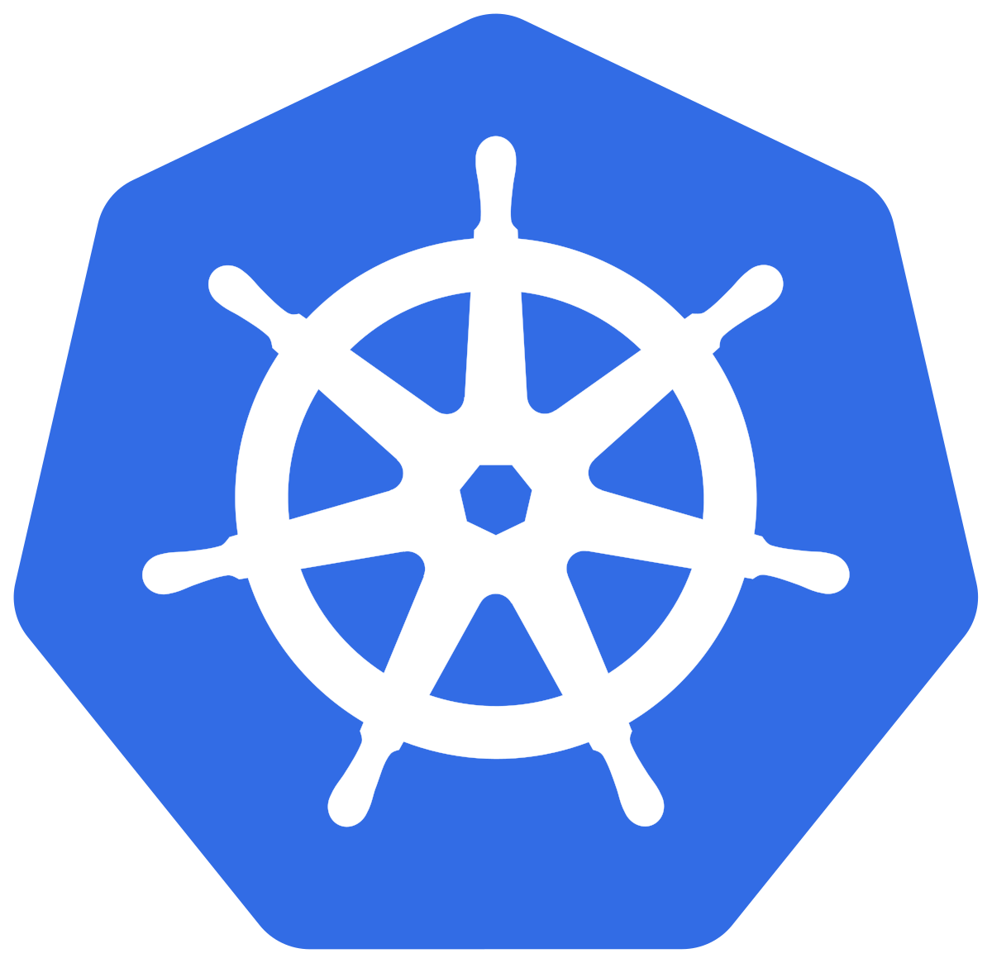



Kubernetes Controllers
Target
0->1 OR 1->0
HPA
Operator
ScaledObject

Slide 6
How External Scalers Work

