Slide 1
Bluestock
Mutual Fund Analytics Platform
Final Capstone Project | Deliverables D1 – D7
28 June 2026 | Bluestock Fintech Private Limited
INR 62.74L Cr
46,000+
32,778
D1 – D7
Platform AUM
NAV Records
Transactions
Deliverables
Bluestock Mutual Fund Analytics Platform | Capstone Project
Slide 1 / 13

Slide 2
Problem Statement
Why does this platform matter?
India's mutual fund industry manages INR 50+ Lakh Crore, yet retail investors lack professional-grade tools for risk analysis, portfolio diversification, and personalised guidance.
Our Solution
• Fragmented data across CSVs — no single source of truth
• No risk-adjusted metrics (Sharpe, VaR, Drawdown) for retail investors
• Absence of personalised fund recommendation tools
• No interactive dashboard for exploration and comparison
• Missing portfolio correlation and diversification analytics
+ End-to-end ETL pipeline
+ Relational SQLite DB
+ 7 EDA charts
+ Risk analytics engine
+ Interactive dashboard
+ Recommender system
Bluestock Mutual Fund Analytics Platform | Capstone Project
Slide 2 / 13

Slide 3
Dataset Description
10 curated AMFI-sourced CSV datasets
01 Fund Master
02 NAV History
03 AUM by AMC
41 schemes, categories, risk grades, fund managers
46,000+ daily NAV records, 2022–2025
90 monthly AUM records by fund house
04 SIP Inflows
05 Category Flows
07 Performance
48 months of industry-wide SIP trends
144 net inflow records by category
41 schemes with Sharpe, Beta, Alpha, Drawdown
08 Transactions
09 Portfolio
10 Benchmarks
32,778 investor transaction records
322 stock holdings with sector weights
8,050 index closing prices (Nifty 50, 100, etc.)
Bluestock Mutual Fund Analytics Platform | Capstone Project
Slide 3 / 13

Slide 4
ETL Pipeline (D1)
Extract → Transform → Load
EXTRACT
TRANSFORM
LOAD
data_ingestion.py
data_cleaning.py
database_loading.py
• Reads 10 raw CSVs
• Forward-fills missing NAV dates
• Creates 11 SQLite tables
→
→
• Validates AMFI code integrity
• Standardises date formats to ISO 8601
• Validates foreign key constraints
• Fetches live NAV from mfapi.in API
• Normalises portfolio weights
• Zero violations confirmed
46,002
11
0
100%
Bluestock Mutual Fund Analytics Platform | Capstone Project
Slide 4 / 13
Records Loaded
DB Tables
FK Violations
Completeness

Slide 5
Database Design (D2)
SQLite Star Schema – 11 Tables
DIMENSION TABLES
dim_fund 40 rows
dim_date 1,297 rows
FACT TABLES
fact_nav
fact_portfolio
fact_sip_industry
46,000 rows
322 rows
48 rows
fact_performance
fact_aum
fact_cat_inflows
40 rows
90 rows
144 rows
fact_transactions
fact_benchmarks
fact_folios
32,778 rows
8,050 rows
21 rows
Bluestock Mutual Fund Analytics Platform | Capstone Project
Slide 5 / 13

Slide 6
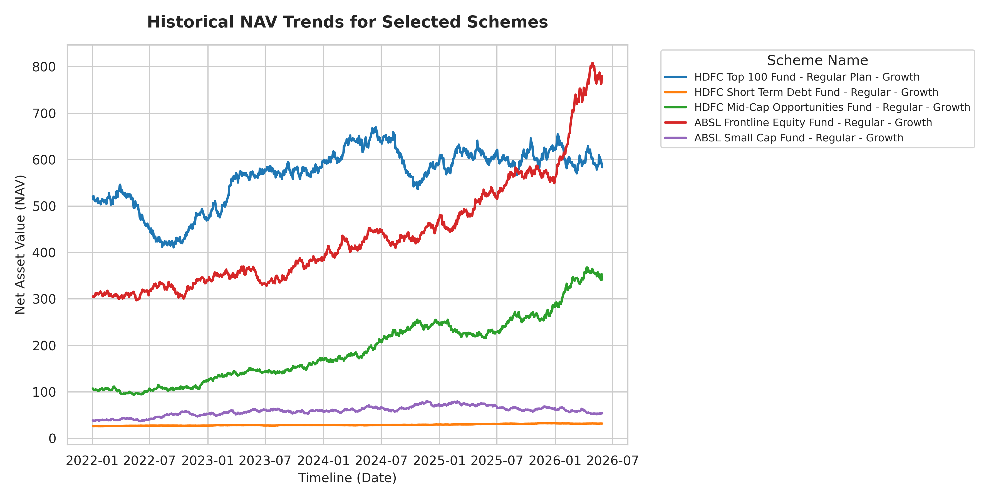
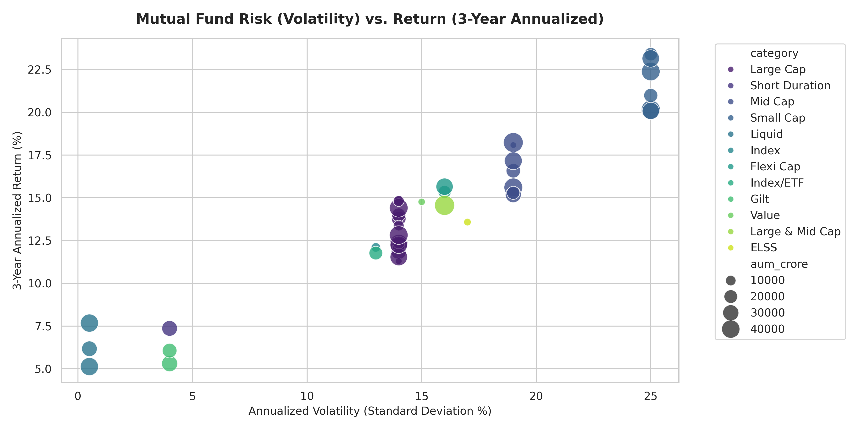
Exploratory Data Analysis (D3)
7 premium charts revealing key market trends
NAV Trends: Equity vs Debt
Risk vs Return Scatter (3-Year)
• Equity Large-Cap: 12–15% CAGR | Volatility 13–19%
• SIP accounts grew 91% in 3 years (4.9 Cr → 9.35 Cr)
• Financial Services & IT dominate sector allocation (30-48%)
• Liquid/Gilt funds: < 5% volatility, 5–8% returns
Bluestock Mutual Fund Analytics Platform | Capstone Project
Slide 6 / 13

Slide 7
Performance Analytics (D4)
Institutional-grade risk-adjusted metrics for 40 schemes
CAGR
Alpha
Annualised NAV growth
Skill above CAPM expectation
Small Cap: 21-24% | Large Cap: 12-15%
Best: HDFC Short Term (1.98%)
Sharpe
VaR (95%)
Excess return / total risk
Max 1-day loss at 95% conf.
Best: HDFC Top 100 & Mirae (1.06)
Small Cap: ~2% | Liquid: < 0.05%
Sortino
Max Drawdown
Excess return / downside risk
Largest historical decline
Gilt funds excel (2.1-2.8)
Small Cap: -13 to -33% | Gilt: < -3%
Beta
Market sensitivity
Liquid funds: 0.1-0.5 | Equity: 0.8-1.1
Bluestock Mutual Fund Analytics Platform | Capstone Project
Slide 7 / 13

Slide 8

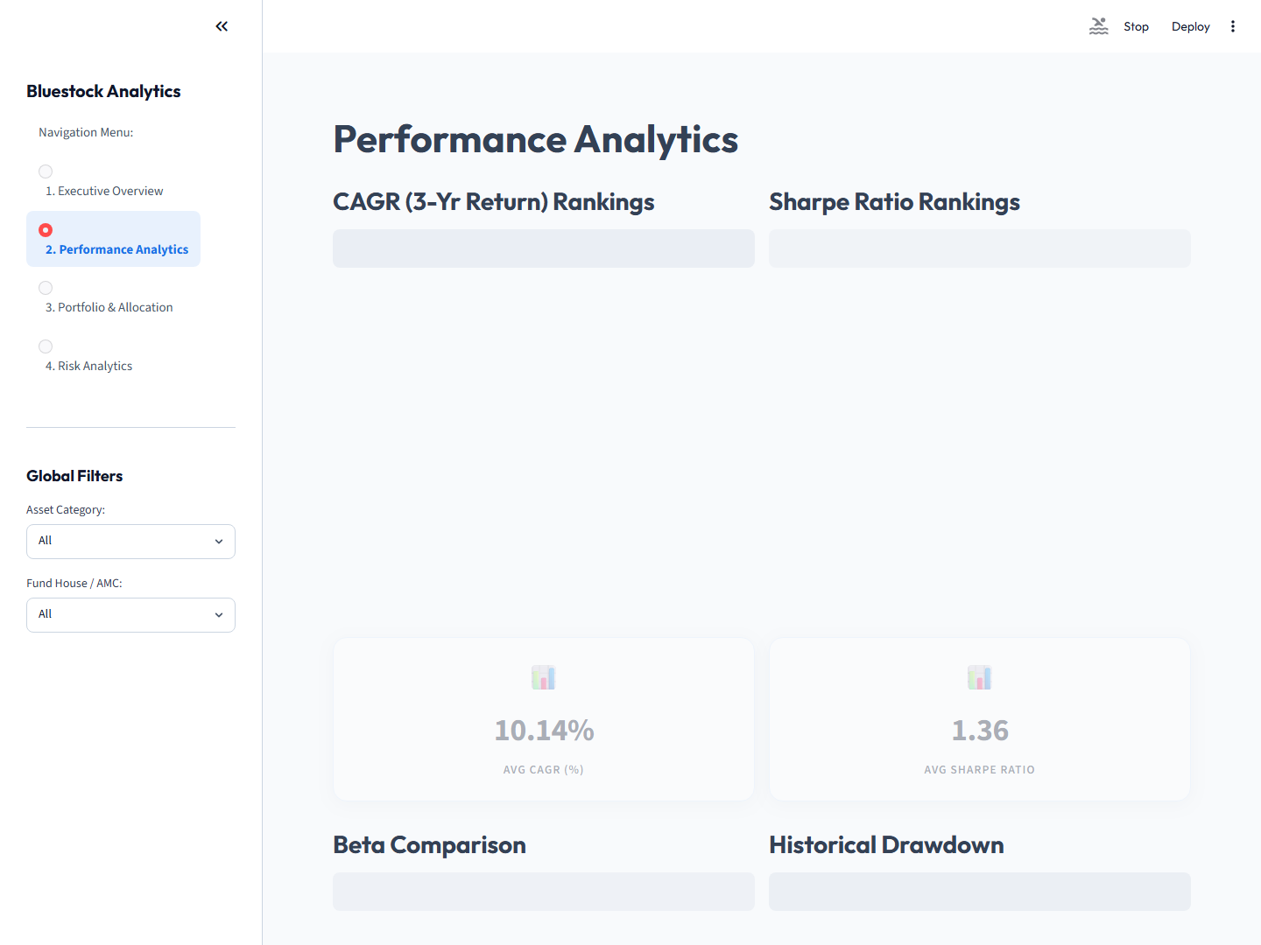
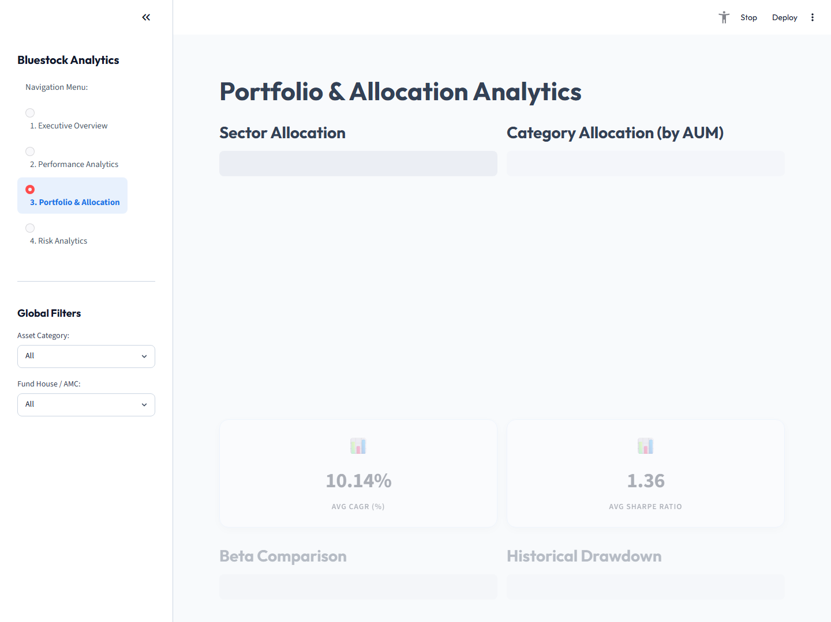
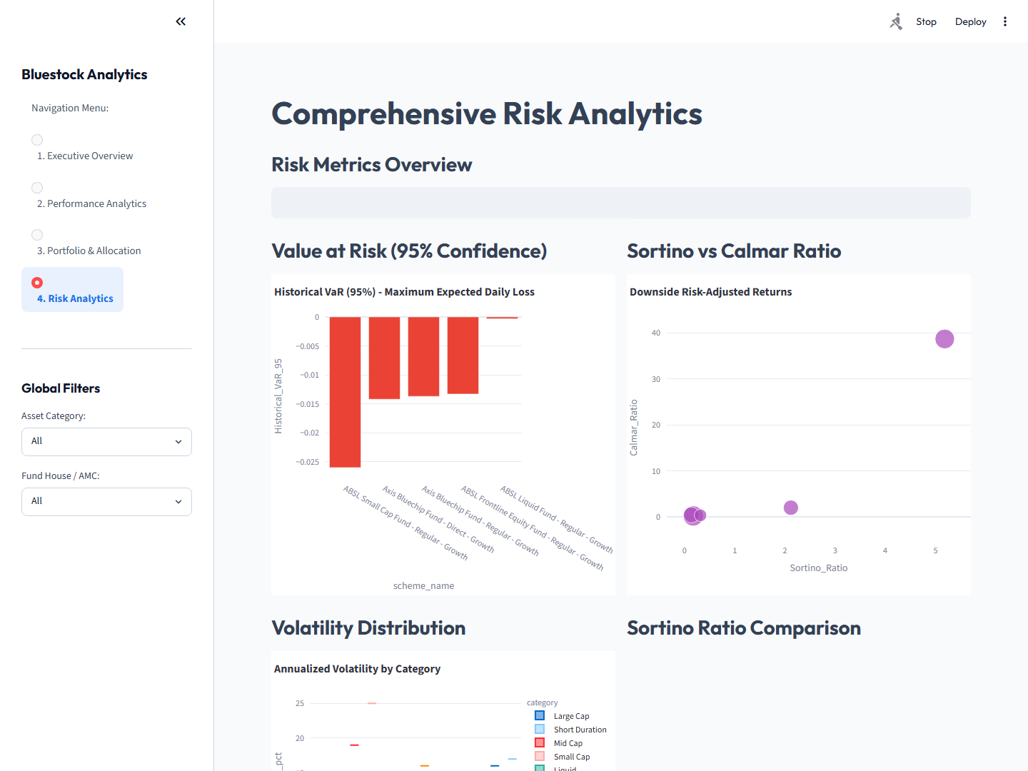
Interactive Dashboard (D5)
Multi-page Streamlit app with live filtering and analytics
Executive Overview & KPIs
Performance Analytics
Bluestock Mutual Fund Analytics Platform | Capstone Project
Slide 8 / 13
Portfolio Allocation
Risk Analytics (Bollinger)

Slide 9
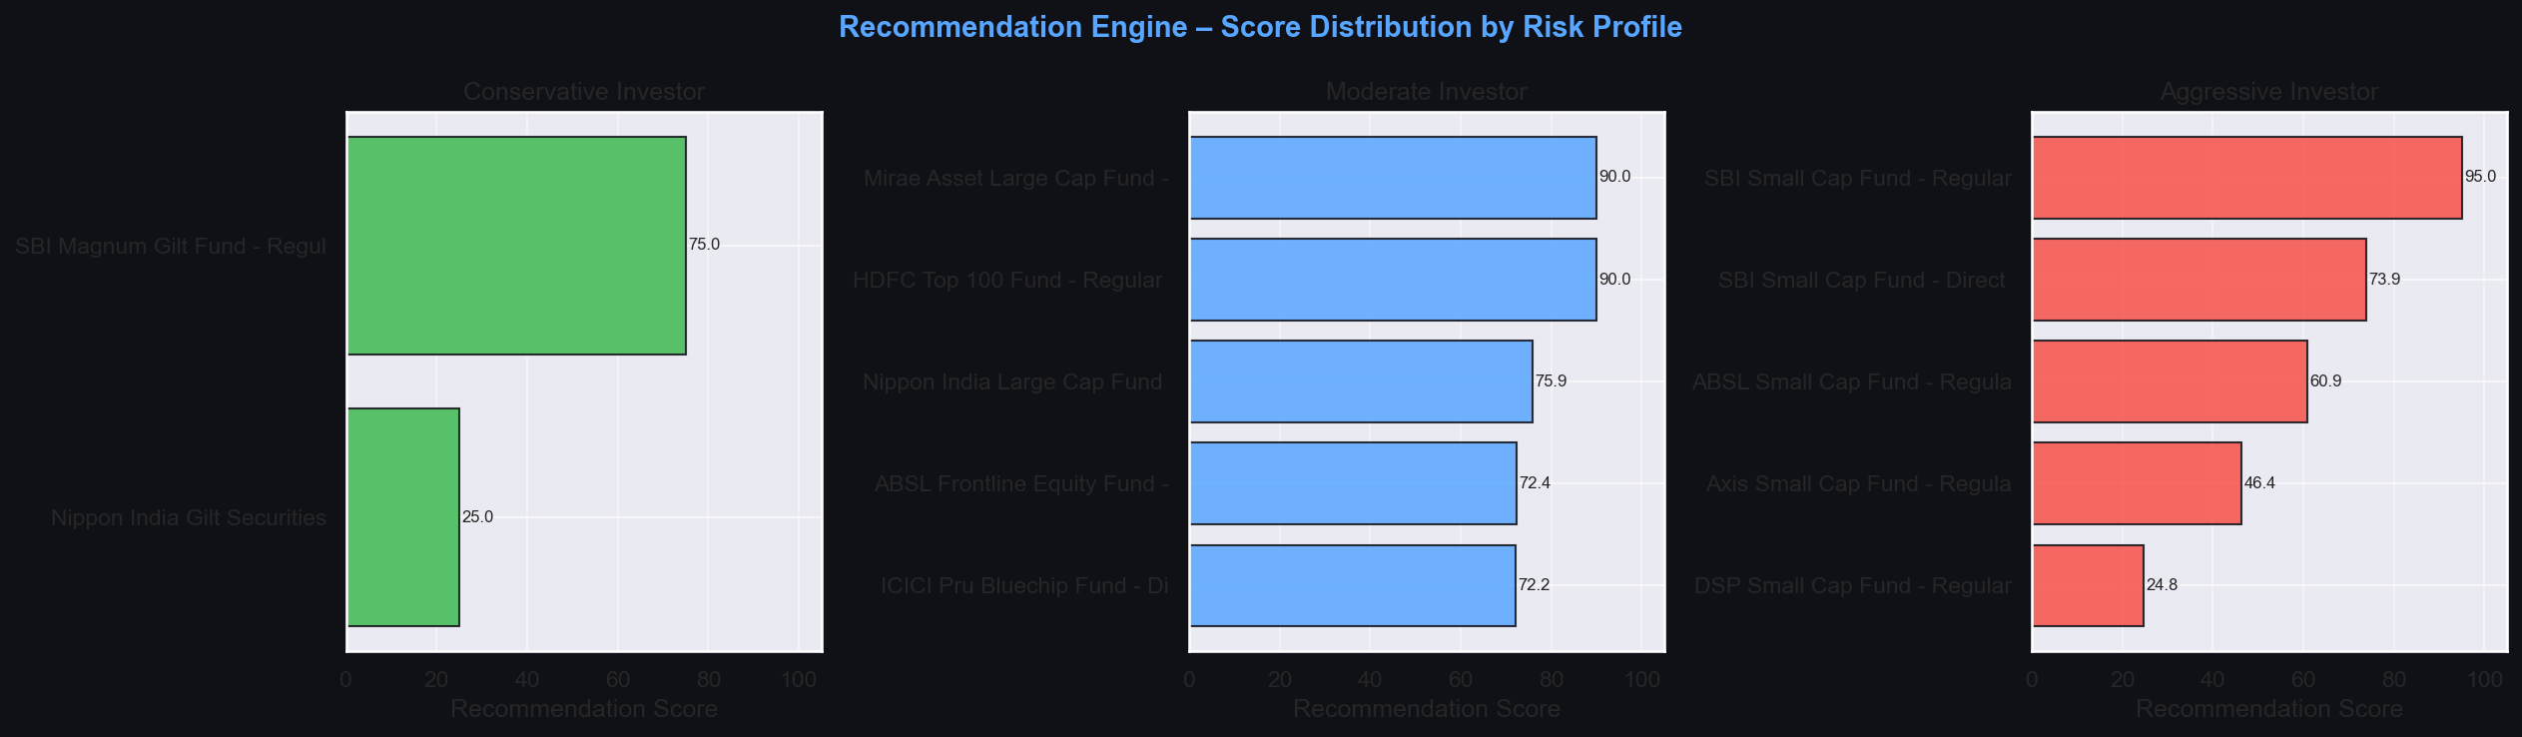
Recommendation Engine (D6)
Rule-based fund matching by risk profile
INPUT Risk + Horizon + Category
FILTER Risk grade & horizon checks
SCORE Weighted composite 0–100
RANK & EXPLAIN Top-N with NL explanation
→
→
→
Scoring Weights by Risk Profile
Metric
Conservative
Moderate
Aggressive
Sharpe Ratio
40%
30%
20%
3-Year CAGR
25%
35%
45%
Volatility (inv.)
20%
15%
10%
Max Drawdown (inv.)
15%
20%
25%
27 recommendations generated across 5 investor profiles
Bluestock Mutual Fund Analytics Platform | Capstone Project
Slide 9 / 13

Slide 10
Key Business Insights
10 data-driven observations from the analytics pipeline
Small Cap Risk-Return
AMC Concentration
Highest CAGR (21-24%) but ~25% volatility — 7+ year horizon required
SBI + ICICI + HDFC control 52%+ of platform AUM
Direct vs Regular Plans
SIP Momentum
Direct outperforms by 60-120 bps p.a. — compounding amplifies gap
Active SIP accounts grew 91% in 3 years (4.9 Cr → 9.35 Cr)
Large Cap / Index Overlap
Flexi-Cap Optimal
rho > 0.9 — holding both provides minimal diversification
Best risk-adjusted anchor holding for moderate investors (Sharpe >0.9)
Gilt as Hedge
Sector Concentration
Near-zero to negative correlation with equity during stress periods
Banking/IT: 30-48% weight creates hidden correlated risk
Fat Tails in Equity
Liquid Fund Reality
Hist. VaR > Parametric VaR — Gaussian models understate risk
Post-tax returns barely beat savings accounts — cash-parking only
Bluestock Mutual Fund Analytics Platform | Capstone Project
Slide 10 / 13

Slide 11
Challenges & Solutions
Engineering challenges encountered and resolved
Missing NAV Dates
SQLite Thread Concurrency
Weekends/holidays created gaps in daily NAV
Streamlit multi-threading caused DB errors
Solution: pandas ffill() grouped by scheme
Solution: @st.cache_resource + check_same_thread=False
Weight Anomalies
VaR Assumption Mismatch
Portfolio weights summed > 100% or were negative
Equity returns violate Gaussian distribution
Solution: Normalisation & outlier-dropping rules
Solution: Compute both methods; document fat-tail risk
nbformat Cell IDs
Correlation Alignment
Jupyter 5.1+ requires unique IDs per cell
NAV pivots had different date ranges per fund
Solution: UUID-based IDs added to all notebook cells
Solution: dropna() on returns pivot for common ranges
Bluestock Mutual Fund Analytics Platform | Capstone Project
Slide 11 / 13

Slide 12
Future Scope
Enhancements planned for production release
+ AI/ML Forecasting
+ Mobile App
LSTM/ARIMA models with macroeconomic indicators (inflation, RBI repo rate)
React Native/Flutter mobile app with push notifications
+ User Portfolios
+ ESG Integration
Authentication + virtual watchlists + rebalancing alerts via SMS/email
Environmental, Social, Governance ratings alongside financial metrics
+ Live Market Data
+ Multi-Asset Platform
NSE/BSE WebSocket feeds for real-time NAV and portfolio re-valuation
Bonds, ETFs, REITs, and international funds coverage
+ Portfolio Overlap Tool
+ Automated Reporting
Alert when two selected funds share > 75% sector allocation
Cron-scheduled monthly PDF reports emailed to registered users
Bluestock Mutual Fund Analytics Platform | Capstone Project
Slide 12 / 13

Slide 13
Conclusion
The Bluestock Mutual Fund Analytics Platform delivers a complete, production-ready data engineering and financial analytics solution — from raw CSV ingestion to institutional-grade risk metrics, interactive visualisation, and personalised investment recommendations.
D1–D2
D3–D4
D5
D6
D7
ETL + Star-Schema Database
EDA + Performance Analytics
Interactive Streamlit Dashboard
VaR + Cohort + Recommender
Final Report & Presentation
All 7 deliverables completed, validated, and documented.
Thank You
Bluestock Fintech Private Limited | github.com/eashita2409/bluestock-internship

