Slide 2
Welcome

Slide 3
You will see
1. What is easiway? 2. How easiway works?
3. What is your benefit? 4. Where are we going?
5. Team introduction

Slide 4
1.1
What is easiway?
It is an application and web for the premium private van
service between SZ and HK.
Easy use for the reservation for global users and Chinese users
Easy to pay
Easy share your ride with friends and family

Slide 5
1.2
What is easiway?
It is a schedule tool for drivers and management.
Easy use for the driver’s schedule management
Easy to track how much you earned weekly
Easy increase travel numbers efficiently
Easy to use web tool

Slide 6

1.3
Symbol of easiway
Bird, Wing
Notes:
붕정만리 鹏程萬里 : 장자(莊子) 소요유편(逍遙遊篇 )에 나오는 말로 붕이라는 상상 속의 새가 날아가는데 거대한 붕이 날아가니 그 거리는 상상을 뛰어 넘는다. 원대한 사업이나 계획, 분발해 큰 일을 성취하려는 것을 비유한다

Slide 7
2.1
How easiway works?
TRI-manage system makes the reservation process
easy and efficient.
Driver will receive reservations from the user app and web company tool
Simple process for the reservation
Easy to add schedules for VIP-callers

Slide 8
2.2
How easiway works?
Max-ride algorithm will help you to reduce empty van
rides and waste of GAS.
Max-ride algorithm is working based on the driver’s
schedule and location for efficiency.
Pick up signal and location of van bring efficiency and relief
for the customer.

Slide 9
System overview
RESERVATION / CANCEL
PASSENGER
APP
DRIVER
WEB
CALL CENTER
RESERVATION
DISPATCH
CANCEL
CANCEL
TOOL
APP
APP
WEB

Slide 10
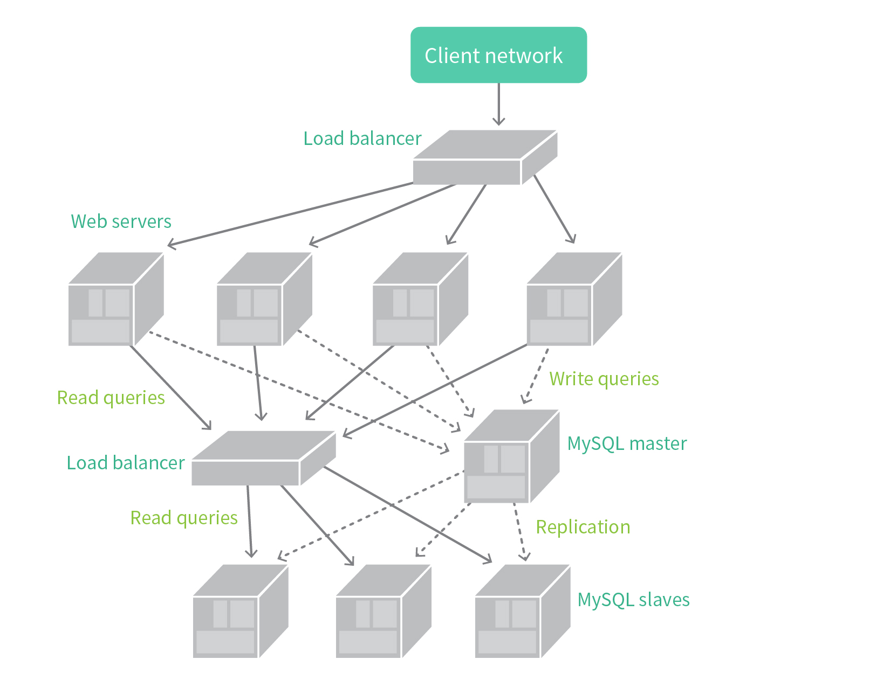
Tech specs:
Horizontal scale

Slide 11
3.1
What is your benefit?
Maximise sales by increasing customer rides and reducing
empty van rides.
Max-ride algorithm makes more rides by reducing empty van rides
Easy reservation would bring loyal users to you.
Increase your average ride number from 3 upto 5
Riding coupon

Slide 12
3.2
What is your benefit?
Easy management for your Drivers and VIP through web tool.
Easy to add schedule and manage drivers through Web tool
Easy to manage your VIPs
Easy to check your sales and expense trend through CEO tool

Slide 13
3.3
What is your benefit?
Attract Global Customers
Multi language service will bring you foreign customers
and foreign company
customers such as Samsung, LG, Toshiba Etc.
Easy usage will help to retain those foreign customers.

Slide 14
기사 이미지

Slide 15
4.1
Where are we going?
We see an opportunities from the easy connection to
Multi-hotels.
By covering many hotels, we can expand our customers spectrum
from only riders to multipurpose riders
Earned commission from hotels and malls will be shared
with participants like you.

Slide 16
4.2
Where are we going?
Expand your premium van service to other regions of China.
We are going to make a success in SZ. You may have an idea
what you can do for the next.
New bridge construction between HK and Macao may bring
another opportunities.

Slide 17
4.3
Even bigger picture
Why not using your asset? Micro rental service for city people
who don’t have a car!
User joins as a member and receive a membership card
with IC chip inside(Apple watch/NFC of phone,etc).
When they need to use a car, they reserve a car between several hours.
By connecting rental car company, user can use the car
for one way if they want.

Slide 18
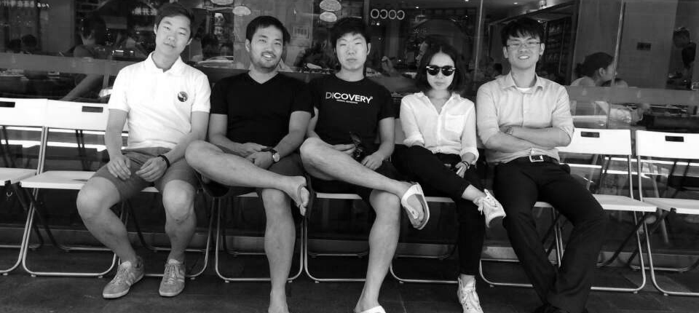
Your team

Slide 19
Your team
CEO / Kyeongsik Kay Woo
Columbia University MS Financial Math/STAT
Seoul National University BS Electrical Engineering
CTO / Jaehwa Han
Seoul National University BS/MS Computer Science
Visiting scholar at IBM Research Lab, Austin, TX
Lead designer / Kyungsun Sunny Hong
Senior Designer at Landor in New York office
School of Visual Art BFA Graphic Design/ NY
Developer / Daewon Kim
Seoul National University BS/MS Electrical Engineering
Developer / Myungyu Park
Seoul National University BS Computer Science
Developer / Taekmin Kim
Seoul National University BS Computer Science

Slide 20
Thank you

