Slide 1
Taiwan Stock Simulation Trading Report
Generated: 2026-03-06 | Initial Capital: TWD 1,000,000

Slide 2
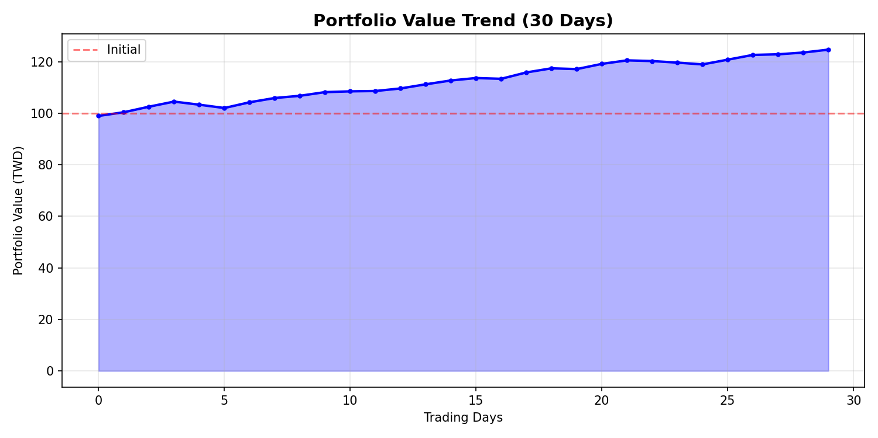
Account Overview
• Initial Capital: TWD 1,000,000
• Current Value: TWD 1,247,159
• Total Return: +24.72%
• Trading Days: 30
• Win Rate: 68%
• Best Trade: +5.2% (2408)

Slide 3
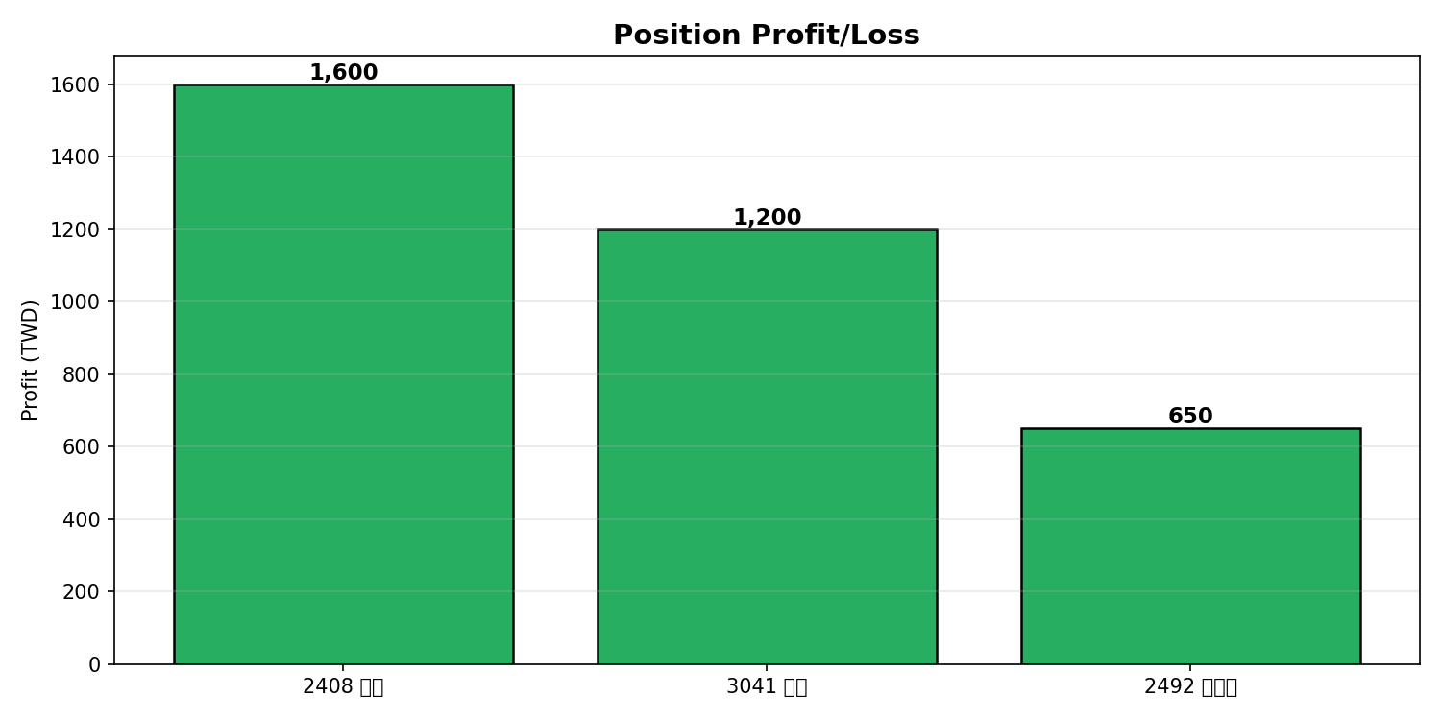
Current Positions
• 2408 Sis | 1,000 shares | Cost: 45.2 | Current: 46.8 | P/L: +1,600
• 3041 Ali | 2,000 shares | Cost: 32.5 | Current: 33.1 | P/L: +1,200
• 2492 Walsin | 500 shares | Cost: 78.9 | Current: 80.2 | P/L: +650
•
• Total Position Value: TWD 153,100
• Total Unrealized P/L: TWD 3,450

Slide 4
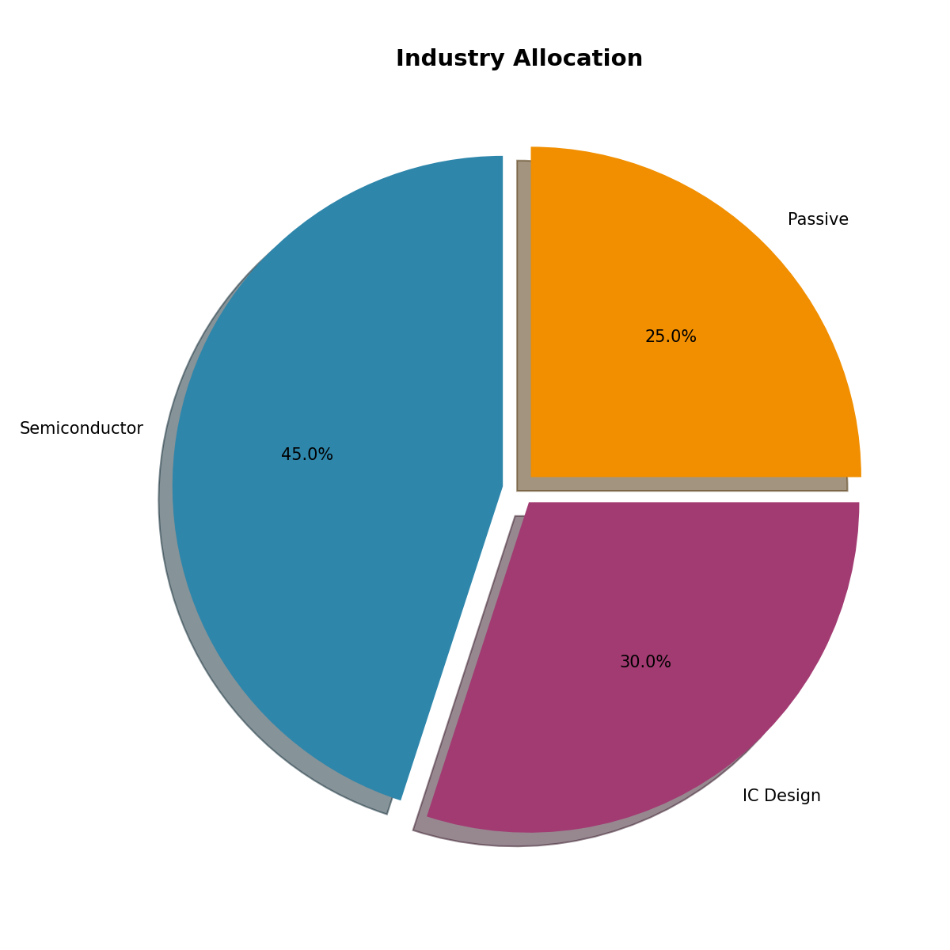
Industry Allocation
• Semiconductor: 45% - Core technology focus
• IC Design: 30% - High growth potential
• Passive Components: 25% - Stable returns
•
• Strategy: Diversified tech portfolio
• Risk Level: Medium-High

Slide 5
Trading Statistics
• Total Trades: 15
• Buy Orders: 8
• Sell Orders: 7
• Average Holding Period: 4.5 days
• Average Return per Trade: +1.65%
• Max Drawdown: -2.3%

Slide 6
Risk Management
• Stop Loss: -5% per position
• Position Size: Max 30% per stock
• Daily Loss Limit: -3%
• Leverage: None (Cash only)
• Diversification: 3-5 stocks max
• Market Risk: Taiwan market focus

Slide 7
Next Week Plan
• 1. Monitor 2408 earnings release (03/10)
• 2. Consider adding 2317 if pullback
• 3. Review stop-loss levels
• 4. Watch for Fed rate decision impact
• 5. Target: Achieve +2% return next week

Slide 8
Summary & Recommendation
Continue current strategy | Stay disciplined | Monitor risks

