Slide 1
OptMolCom
v1

Slide 2
Simulation Setting
Simulation runs = 5
Runs/evaluation = 10
Population size = 50
Generations = 100
INF ACT / ACK ACT
Distance 30
Two objectives: RTT and SR
Three decision variables: # retrans, # molecules, and RTO
No constraints

Slide 3
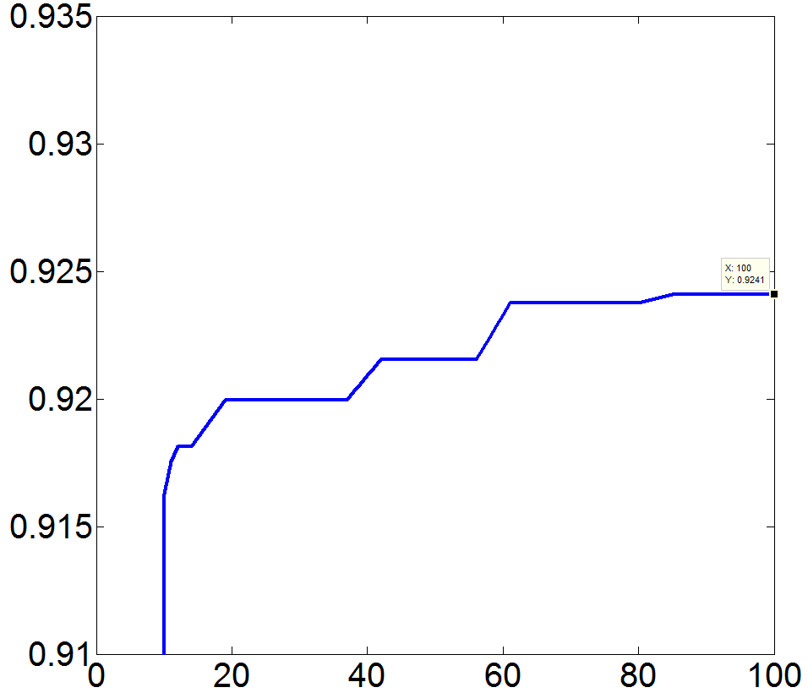
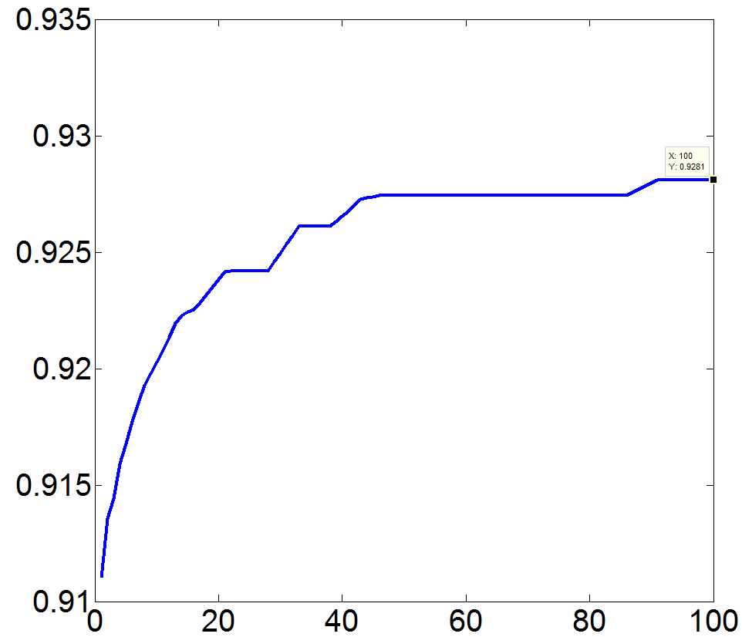
EGT NSGAIII
Max HV = 0.924
Exe Time / run = 43min
Average RTT = 266
Average SR = 100%
Average HV = 0.921
Max HV = 0.928
Exe Time / run = 1.21h
Average RTT = 283
Average SR = 100%

