Slide 1
Diabetic Retinopathy Detection
統計所碩一 林奕勳

Slide 2
Task
Introduction data
Preprocessing
Model
conclusion

Slide 3
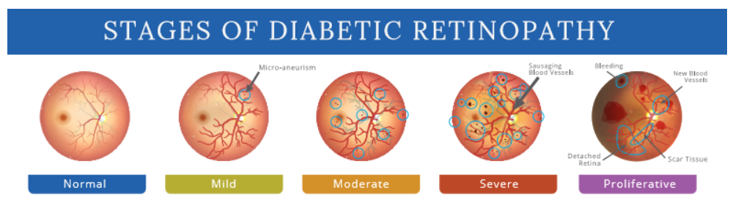
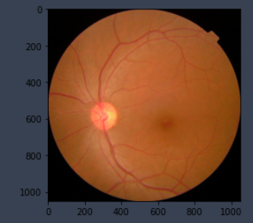
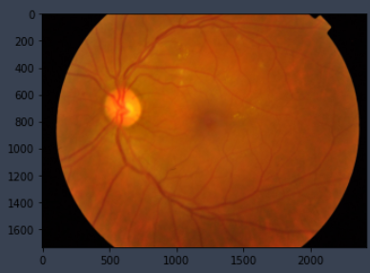
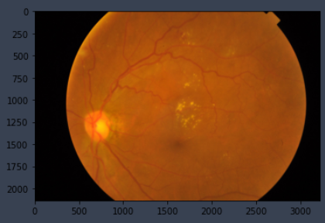
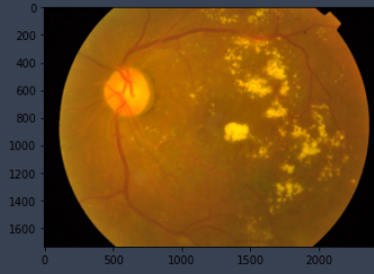
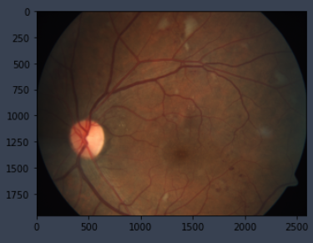
Introduction data
Given an image (fundus photographs), You have to predict which class does the given image belongs to , Images may contain artifacts, be out of focus, underexposed, or overexposed.

Slide 4
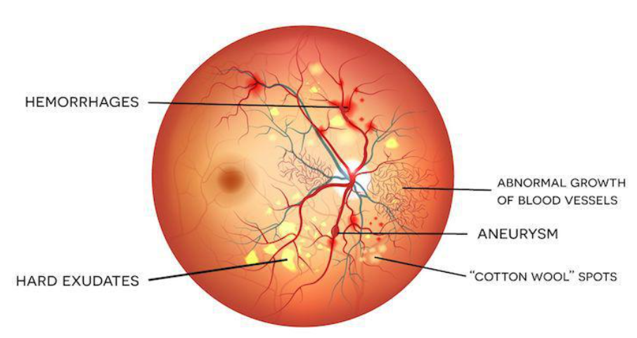
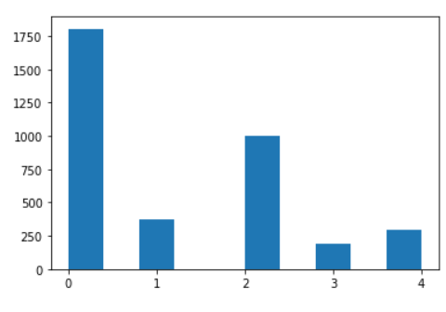
Introduction data
Train dataset : 3662 (8.01GB)
Test dataset : 1928 (2.21GB)

Slide 5
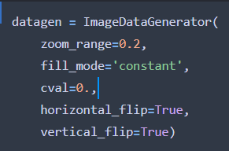
Preprocessing
crop and Resize to 224 x 224
Ben Graham's preprocessing method
(Contrast Limited Adaptive Histogram Equalization (CLAHE) algorithm)
Data augmentation

Slide 6
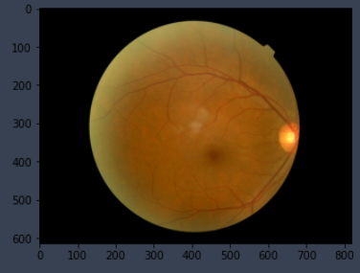
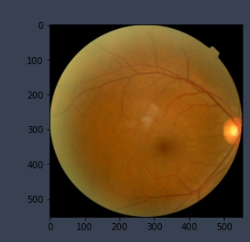
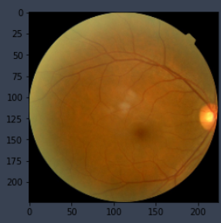
crop and Resize to 224 x 224

Slide 7
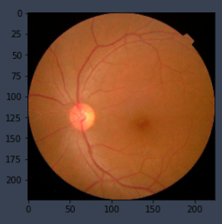
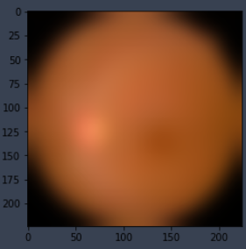
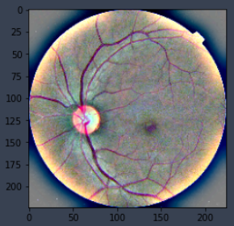
Ben Graham's preprocessing method
GaussianBlur
brightness
128
4
4

Slide 8
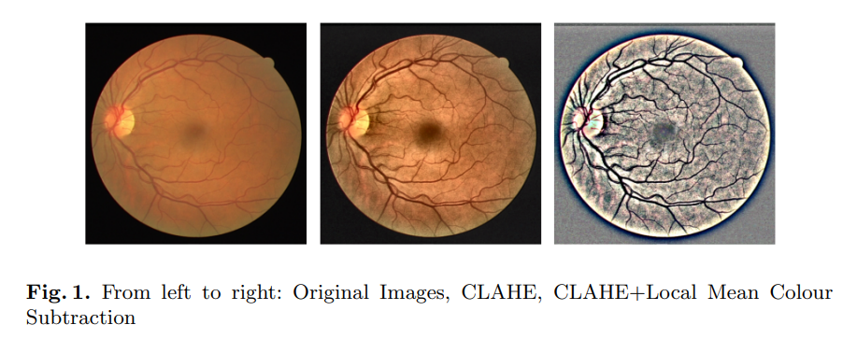
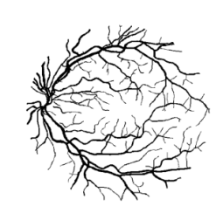
Ben Graham's preprocessing method
Perform CLAHE on original image.
Perform Ben Graham’s preprocessing of subtracting the local average color from the CLAHE preprocessed image from step 1.
Concatenate the preprocessed images from step 1 and step 2 along the channels

Slide 9
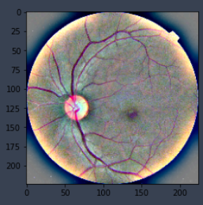
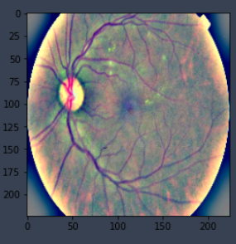
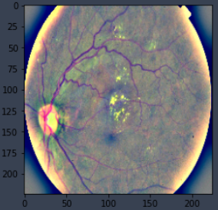
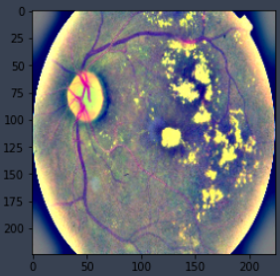
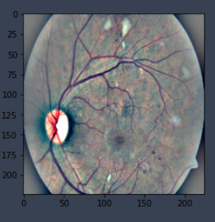

Slide 10
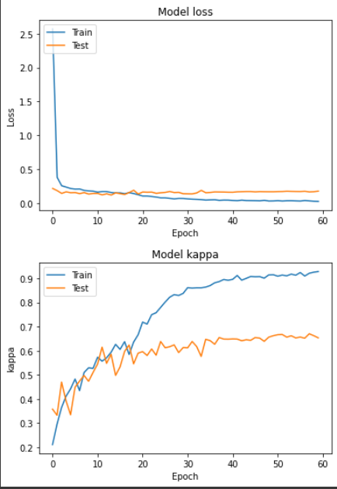
Model
EfficientNetB2
Weights = "imagenet"
Optimizer = Adam(learning_rate=0.0001)
Loss = focal loss
batch_size = 32
epochs = 50
metrics = kappa
trainable = True
class_weight={0: 0.4057617728531856, 1: 1.9794594594594594, 2: 0.7331331331331331, 3: 3.7948186528497407, 4: 2.4827118644067796}

Slide 11
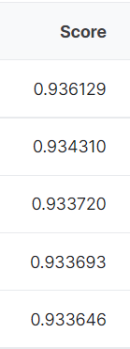
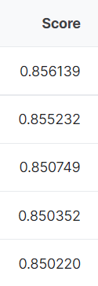
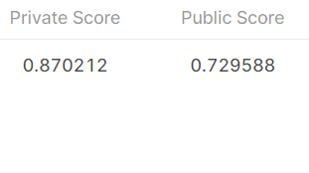
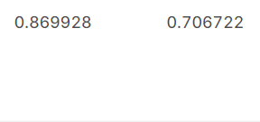
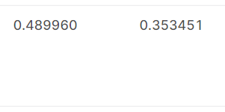
EfficientNetB2
EfficientNetB0
EfficientNetB0
No preprocessing

Slide 12
Conclusion
imbalance data
Ben Graham’s (CLAHE)
image size
Add 2015 dataset and use complex model

Slide 13
Thanks for your attending

