Slide 1
Relation Extraction
Team 7

Slide 2
What is a Relation Extraction?
The idea is to link two entities, such as the owner of a company, or the someone's company position and a person in unstructured text sources.
An example would be to extract Bill Gates and Microsoft from the following unstructured text:
"<PERSON> Bill Gates </PERSON>, the founder of <ORG> Microsoft </ORG>, hosted a party last night".

Slide 3
Supervised Feature Extraction
Entities:
Gazetteers (i.e. dictionaries of organization names etc)
Features based on
Parts of speech tags
Regular expressions
Word length
Word shape
Substring
Capitalized letters
Bigrams
Sequencing modeling - especially for the words between the two sequences.

Slide 4
Semi-Supervised Seeding
We can also proceed in semi-supervised manner, where if we know certain relationships, say Bill Gates and Microsoft, we can learn the rule:
"<PERSON> X </PERSON>, the founder of <ORG> Y </ORG>, hosted a party last night".
With a large dataset, we can apply this exact sentence pattern to find new Person-Organization relations. Then, say we find X' and Y' entities, we can then find different sentence structures, and bootstrap this until we have found them all.

Slide 5
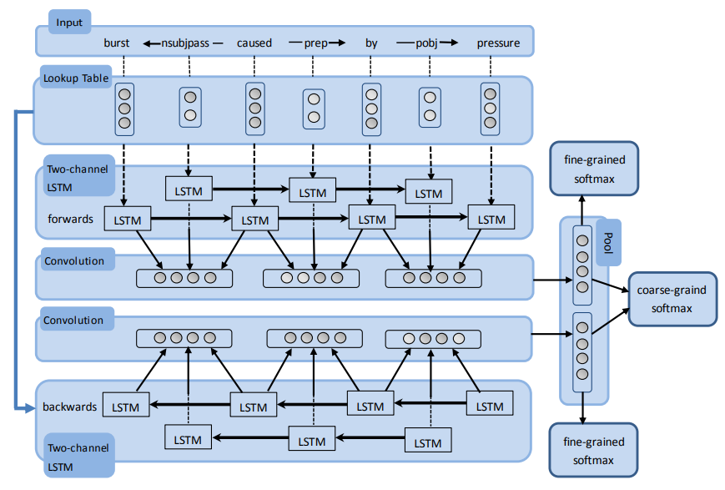
Related Work
Rui Cai, Xiaodong Zhang and Houfeng Wang. 2016. Bidirectional Recurrent Convolutional Neural Network for Relation Classification

Slide 6
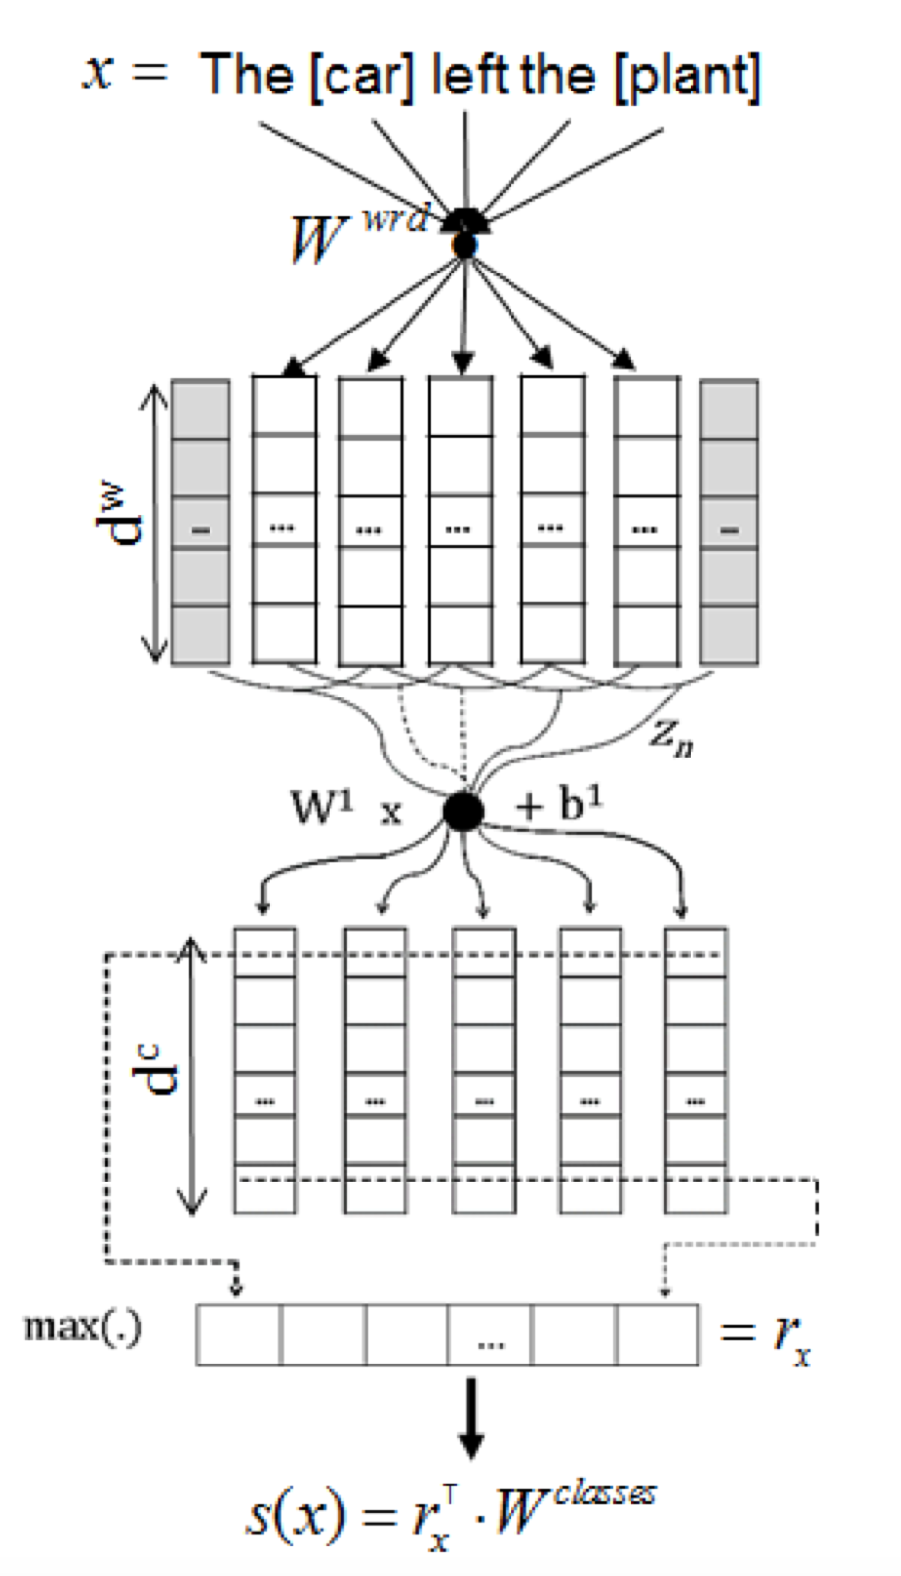
Related Work
Cicero Nogueira dos Santos, Bing Xiang, Bowen Zhou. 2015. Classifying Relations by Ranking with Convolutional Neural Networks

Slide 7
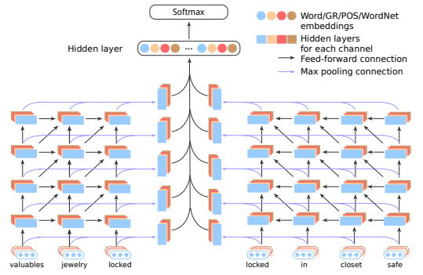
Related Work
Yan Xu, Ran Jia, Lili Mou, Ge Li, Yunchuan Chen, Yangyang Lu, Zhi Jin. 2016. Improved Relation Classification by Deep Recurrent Neural Networks with Data Augmentation

Slide 8
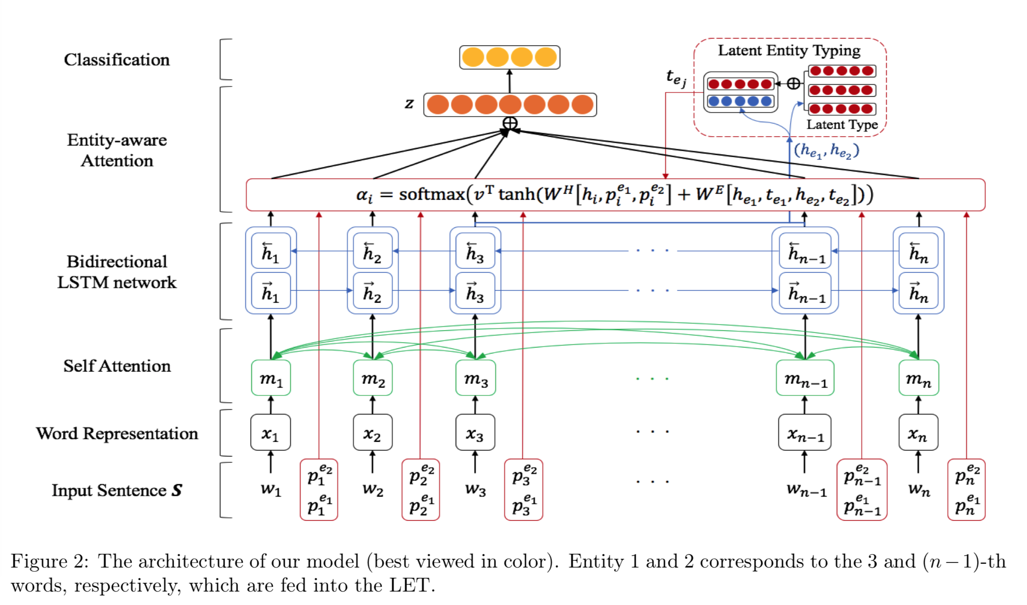
Related Work
Joohong Lee, Sangwoo Seo, Yong Suk Choi. 2019. Semantic Relation Classification via Bidirectional LSTM Networks with Entity-aware Attention using Latent Entity Typing

Slide 9
Prototype Implementation
Entity Attention Bi-LSTM (Lee et al., 2019)
CNN (Zeng et al., 2014)

Slide 10
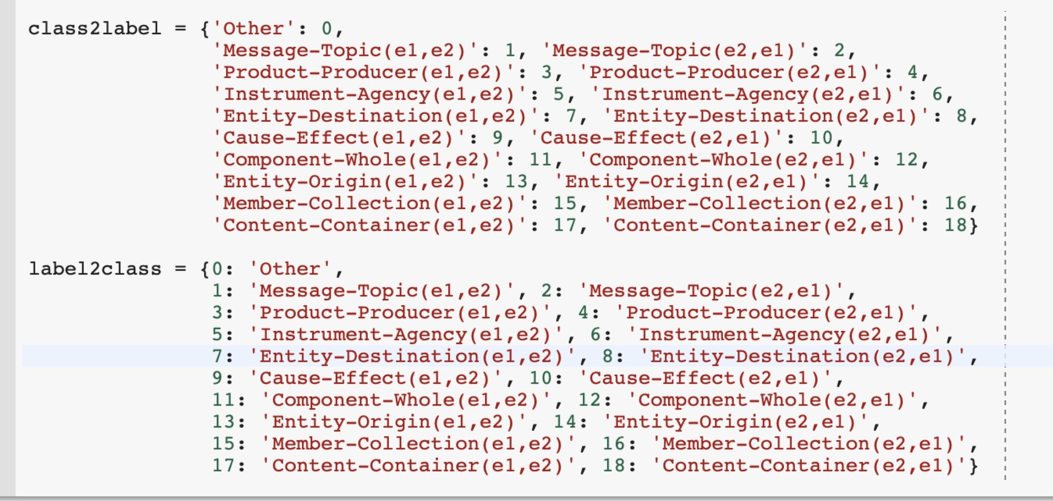
Entity Attention LSTM
Labels:

Slide 11
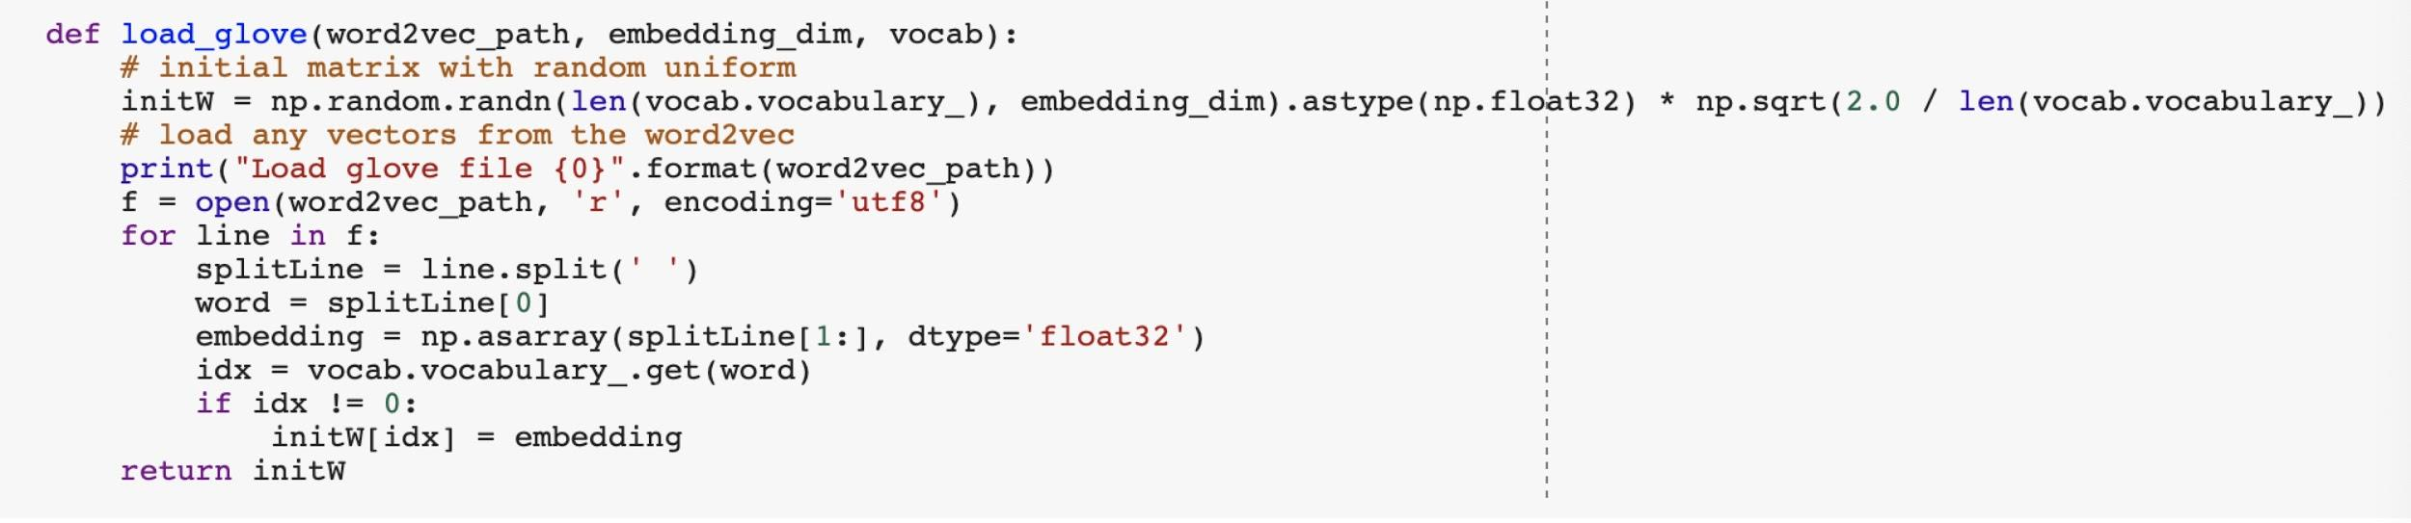
Entity Attention LSTM
Word embedding:

Slide 12
Entity Attention LSTM
Attention:
In traditional encode-decode model, the effect of each input on each output is equivalent, which is obviously unreasonable. To solve this problem, The attention mechanism is usually used between encode and decode.
The basic idea: each time the model predicts an output word, it only uses parts of an input where the most relevant information is concentrated instead of an entire sentence.

Slide 13
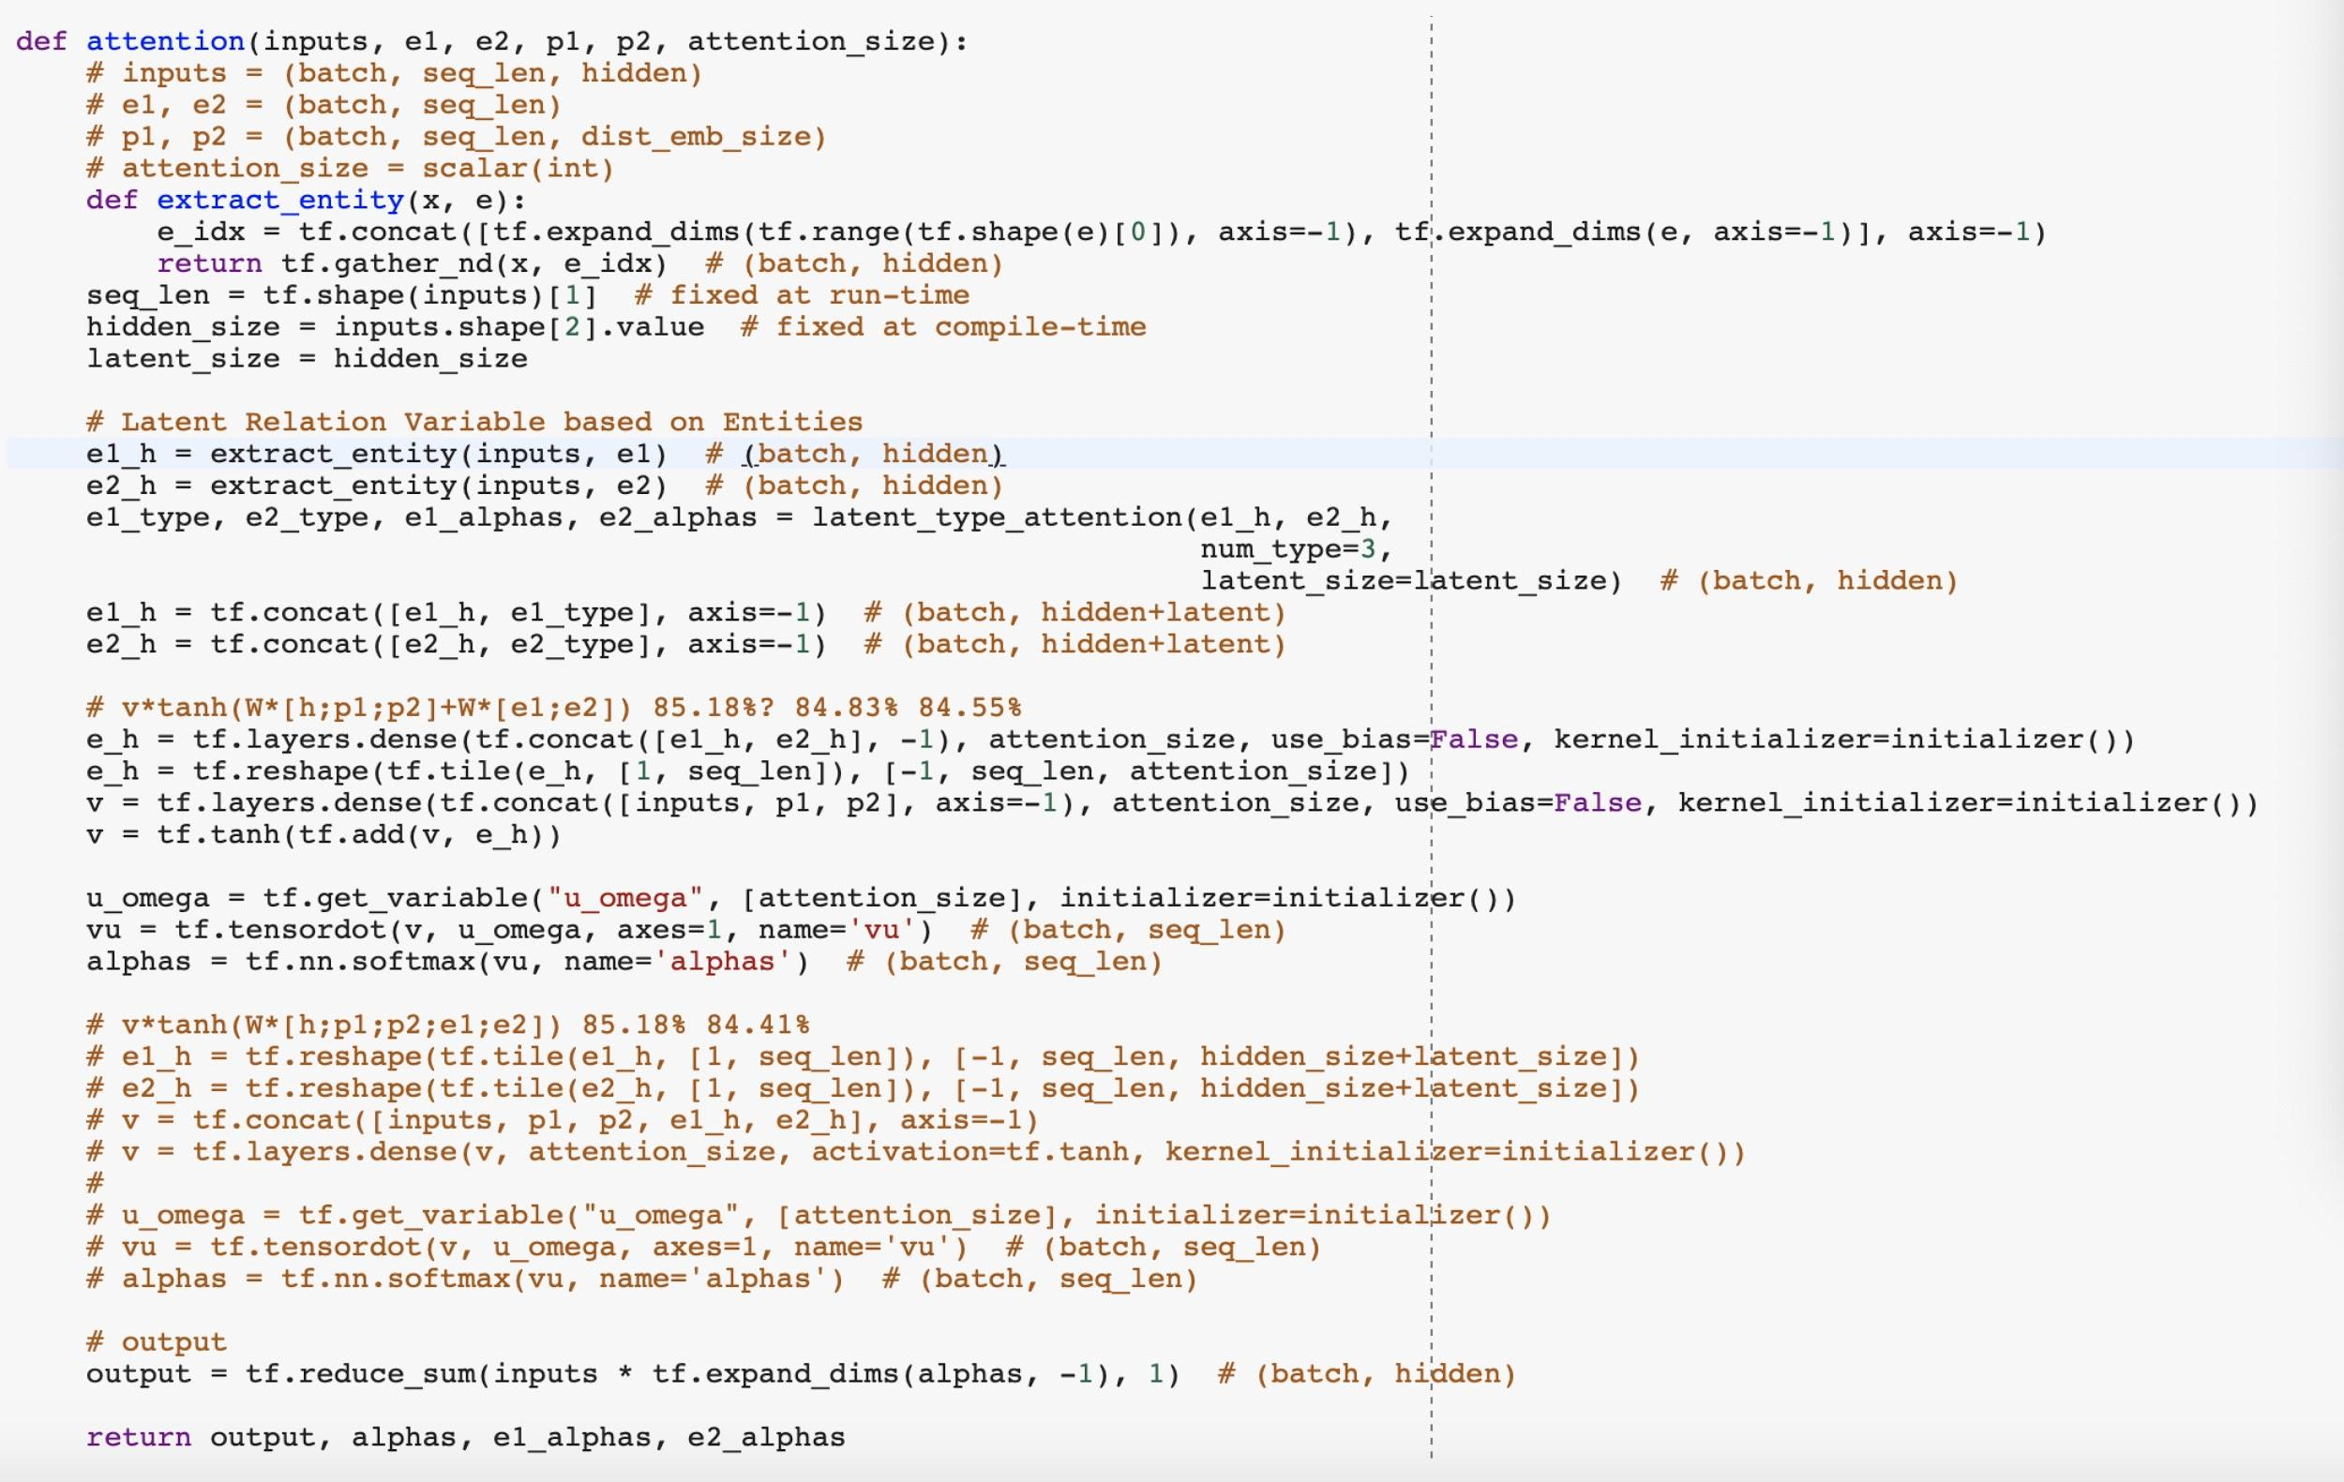
Entity Attention LSTM
Attention:

Slide 14
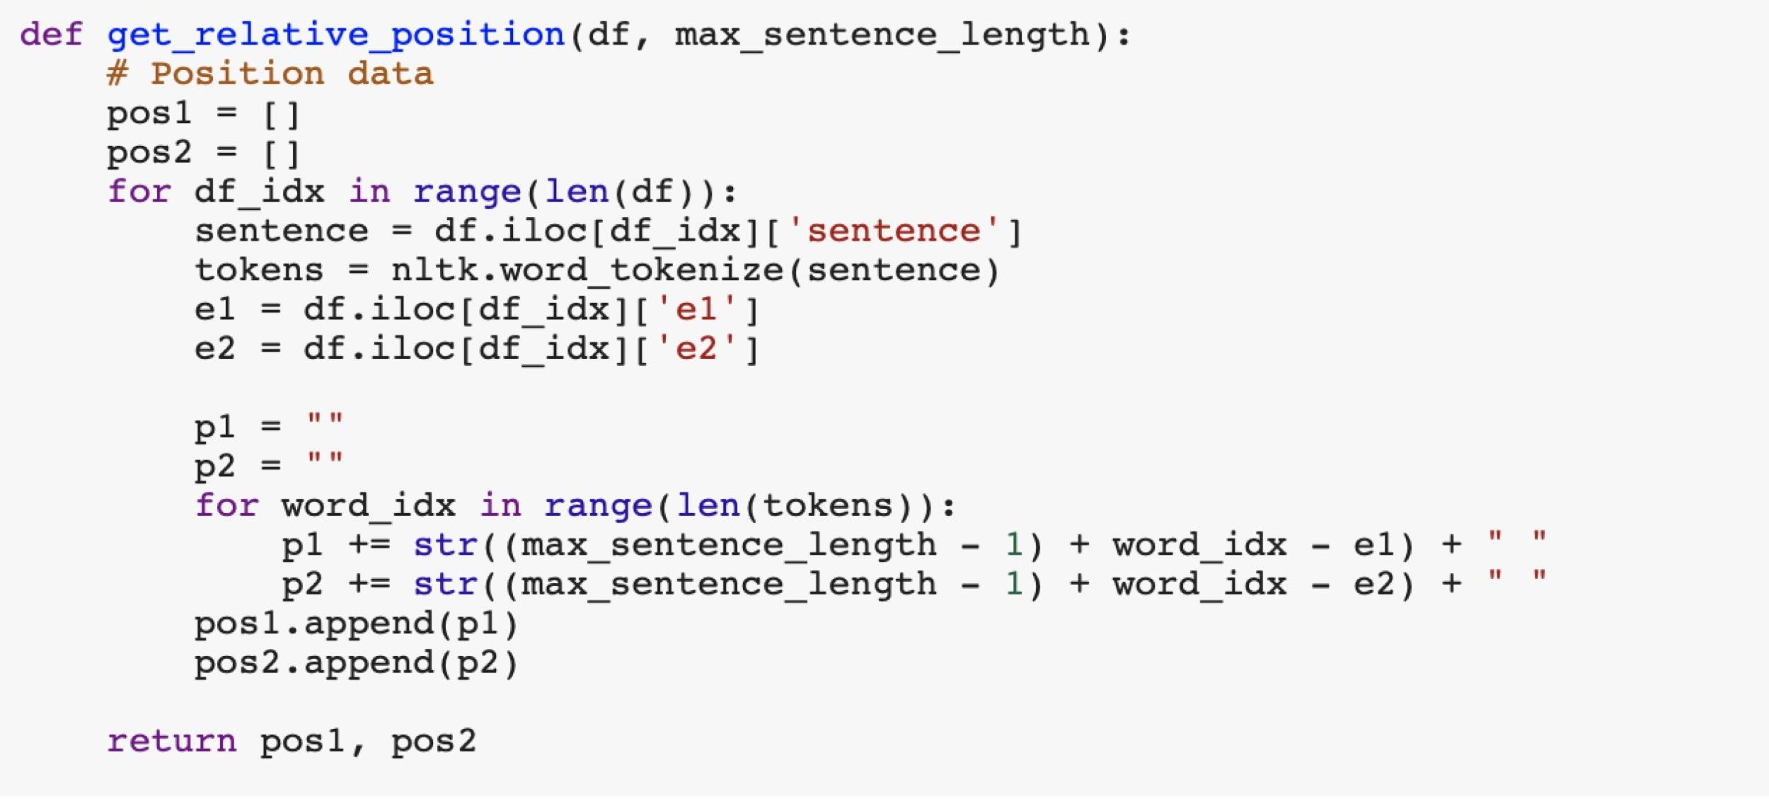
Entity Attention LSTM
In 2018, considering the distance between words, Google’s machine translation team presented the essay “Self-Attention with Relative Position Representations.” and optimized Position encoding.

Slide 15
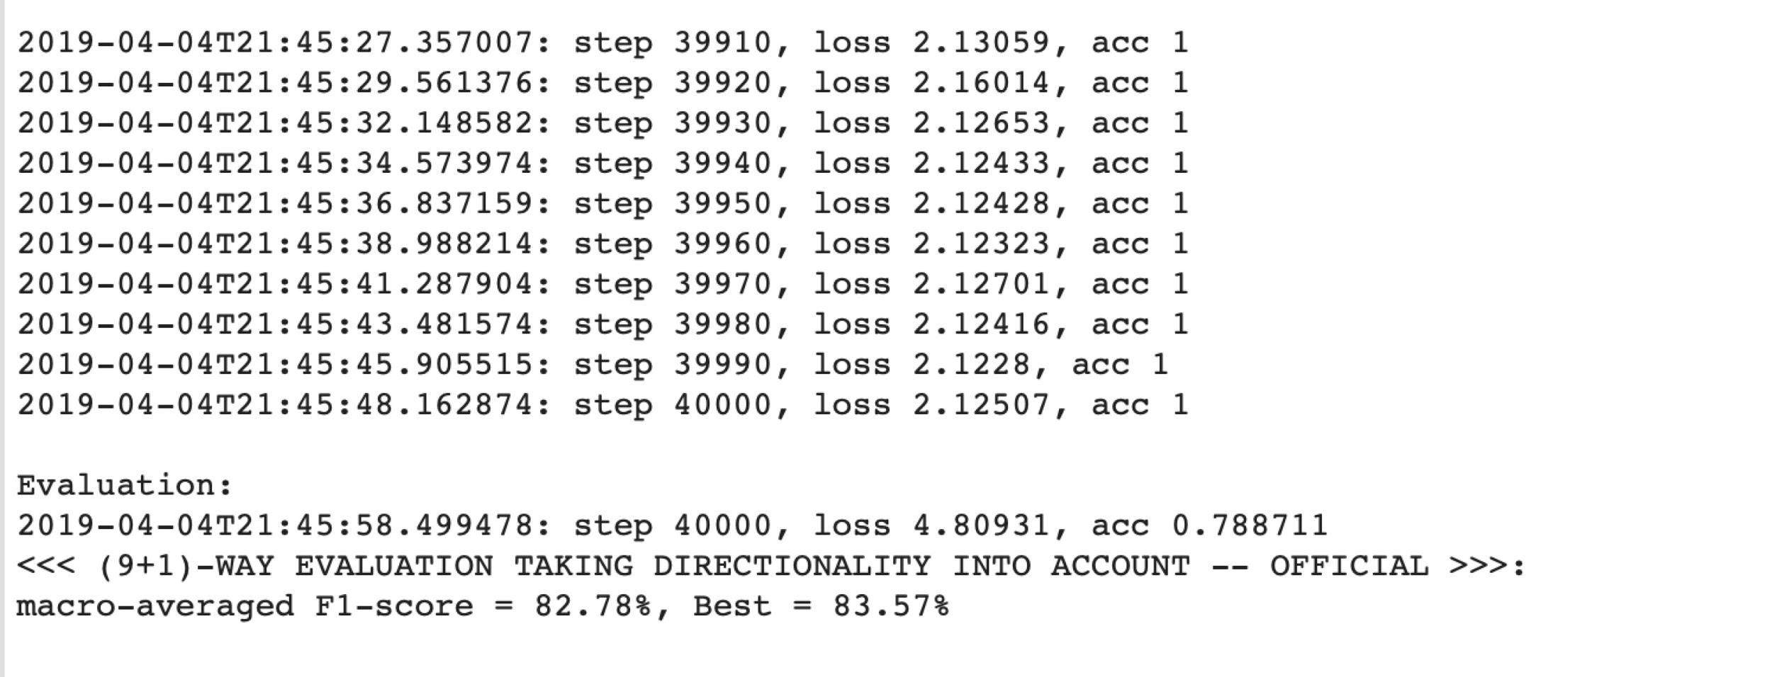
Entity Attention LSTM
Result Using Glove 6B:

Slide 16
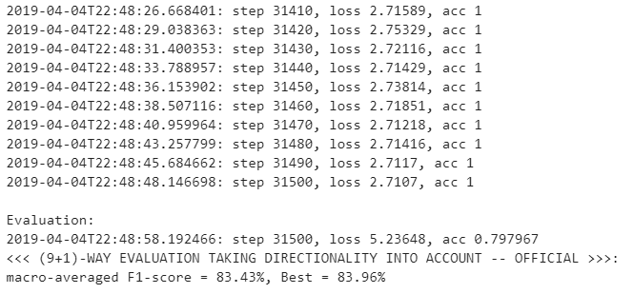
Entity Attention LSTM
Result Using Glove 840B:

Slide 17
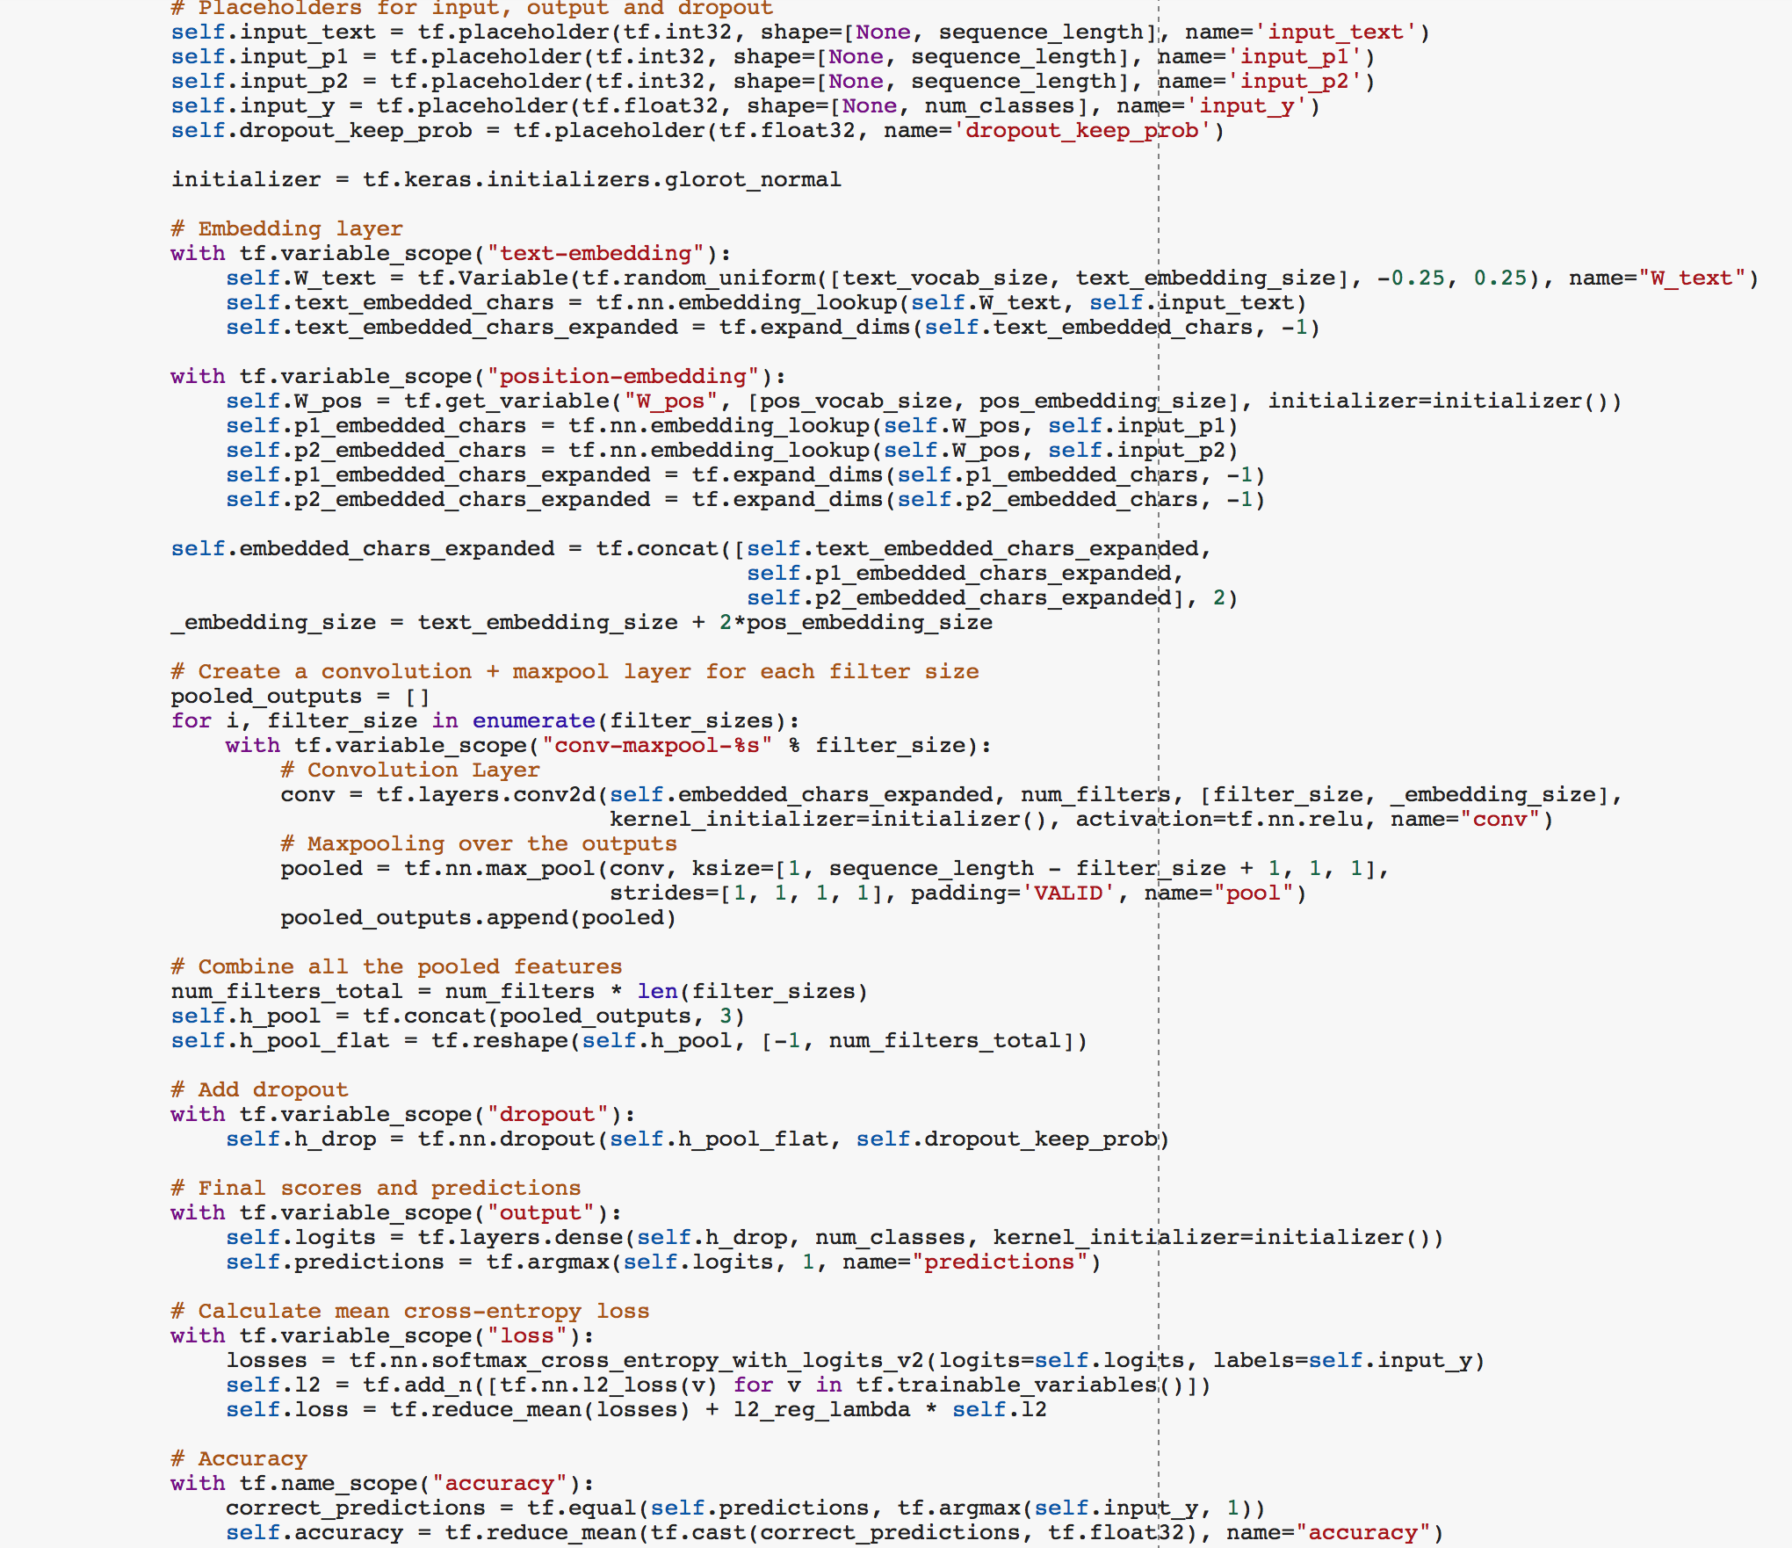
CNN
Our TextCNN Model
Text-Embedding
Position-Embedding
Convolution+maxpool
FC

Slide 18
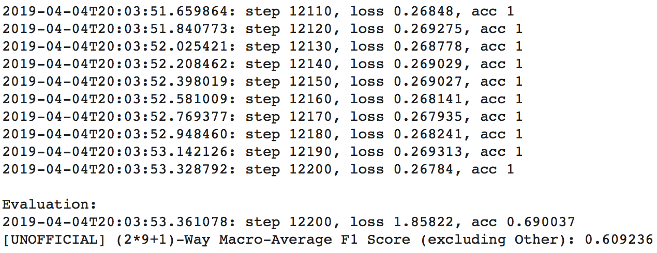
CNN
Result:

Slide 19
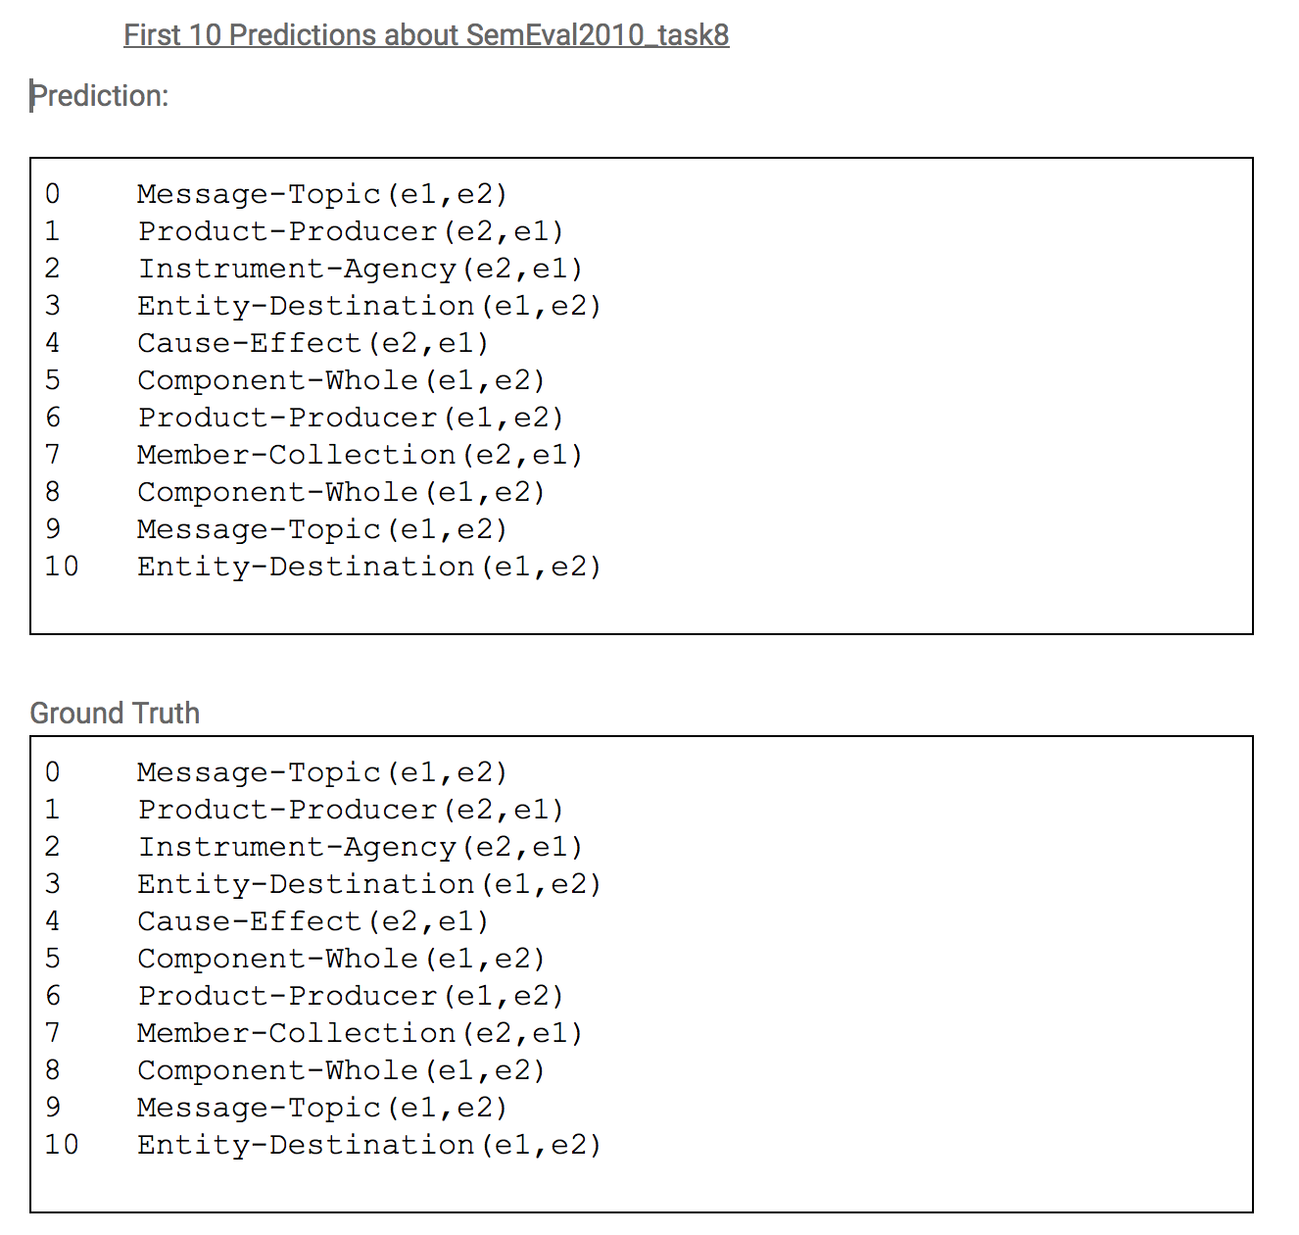
CNN
Prediction based on
SemEval2010_task8

Slide 20
Thank you

