Slide 1


BloodChain
Making a blood-safety rule impossible to skip
Deep Dive into Blockchain '26 · Final Group Project
Group XX · Yichun Shi · Moemen · [Name 3] · [Name 4] · [Name 5]
Built on Hedera testnet ·
Notes:
[SPEAKER 1 - 20s]
Good morning. We are Group XX, and this is BloodChain. Our project asks one question: what would it take to make a blood-safety rule impossible to skip - not discouraged, not logged, impossible? Everything we will show you in the next ten minutes is built, deployed, and running on Hedera testnet right now.

Slide 2
Vein to vein
The full journey of one donated unit — collection, testing, transport, transfusion
Donor
Collection
centre
Testing
laboratory
Transport
company
Hospital
Patient
four separate organisations · four record systems · four owners · no shared owner
For any single unit, at any moment, can you answer:
where is it, who has touched it, and is it still safe to use?
Today, no one organisation can answer that question — each of them holds only its own fragment.
DDiB '26 · Final Group Project · BloodChain
23.07.2026 | 4
Notes:
[SPEAKER 1 - 45s]
Follow one donated unit of blood. It passes through four organisations - a collection centre, a testing laboratory, a transport company, a hospital - and each one keeps its own records, in its own system, under its own control. There is no shared owner of the truth. That structure produces four real failure modes: untested units that move anyway because a policy step was skipped; recalls that take hours or days of phone calls when one donation turns out to be contaminated; diversion, where a unit quietly leaves the legitimate chain; and records that can be edited after the fact by exactly the party that has something to hide. For any single unit, at any moment, nobody today can answer: where is it, who touched it, is it safe?

Slide 3
What already exists — and what it does not do
 | Unit identity | Shared across organisations | No single administrator | Enforces the safety rule
ISBT 128 barcode labelling | yes | no | no | no
Blood-bank IT systems (BECS) | yes | no | no | logged only
RFID / IoT cold-chain tracking | yes | partly | no | no
Permissioned-chain pilots (Hyperledger-style consortia) | yes | yes | consortium admin | logged only
BloodChain | yes | yes | yes — public | ENFORCED
Everything on this list records the rule after the fact.
We are the only row that makes breaking it impossible.
DDiB '26 · Final Group Project · BloodChain
23.07.2026 | 7
Notes:
[SPEAKER 1 - 45s]
This problem has attracted solutions before. ISBT barcodes give every unit an identity - but stop at each organisation's door. Blood-bank IT systems log the safety rule - inside one party's software. RFID cold-chain tracking watches temperature - not custody. And permissioned-chain pilots share records across organisations - but a consortium administrator still sits above the ledger, and the safety rule is still only logged. Look at the last column: every row records the rule after the fact. We are the only row where breaking it is mechanically impossible. That is the gap BloodChain fills.

Slide 4
2.1 / 2.2
Market Size, and Regulatory Fit
A government set tariff, not a market to win share of
263,702
Since 1951
~$0.04
units collected nationally in 2023, across Swiss Transfusion SRC and 11 regional services
the umbrella organization and regional services have operated as non profit
network fee per unit, small enough to sit inside existing cost recovery pricing
MARKET STRUCTURE
REGULATORY FIT
Blood is sold to hospitals at cost price, set directly by the Swiss government for the most important blood products.
There is no market price to win share of, only a tariff that already pays the existing supply chain.
Any BloodChain related cost must fit inside that tariff, not add a new line on top of it.
Traceability is a legal obligation, not a goal to be reached. A look back procedure can be triggered years after a transfusion.
Blood services already sit under three layers of control: Swissmedic audits, cantonal pharmacists, and the Haemovigilance unit.
BloodChain does not replace the mandate. It replaces manual, service by service cross referencing with one shared, append only history.
Sources: Swiss Transfusion SRC, 2024 • European Blood Alliance, n.d. • Swissmedic, 2022 • Hedera, 2026
Notes:
[SPEAKER 2 - 45s]
Is there a market for this? In Switzerland, about 264,000 units were collected in 2023, across eleven regional services under Swiss Transfusion SRC. Blood is sold to hospitals at a government-set tariff - so this is not a market where you win share; any solution must fit inside the existing cost structure. Ours does: the network fee is about four cents per unit. Our customers are the four organisation types you saw, plus the regulator downstream, who gets audit-grade traceability for free. And the whitespace is real: no blockchain deployment for blood exists in Switzerland today. The closest comparable is EY's work with Canadian Blood Services - which tokenises units and tracks temperature, but does not verify the custodian's reported outcome, and has no Swiss presence.

Slide 5


Why not just build a shared database?
A shared database
A public distributed ledger
Fixes fragmentation — everyone sees one record
Fixes fragmentation — everyone sees one record
Somebody must own and administer it
No owner: entries cannot be edited or deleted
That somebody can edit any row
Order of events agreed by consensus, not claimed
Rules live in application code they control
Rules run as contract code nobody can bypass
A database fixes fragmentation. It does not fix control.
DDiB '26 · Final Group Project · BloodChain
23.07.2026 | 9
Notes:
[SPEAKER 2 - 45s]
The obvious counter-question: why not just build one shared database? A shared database genuinely fixes fragmentation - everyone sees one record. But somebody must own and administer it, and that somebody can edit any row, and the safety rule lives in application code they control. You have not removed the problem; you have relocated it. A public distributed ledger fixes the same fragmentation - and removes the owner. Entries cannot be edited or deleted by anyone. The order of events is agreed by network consensus, not claimed by a participant. And rules run as contract code that no single party can bypass. A database fixes fragmentation. It does not fix control.

Slide 6



Three Hedera services, three different jobs
Each one exists because the previous one is not enough
HTS — identity
HCS — the record
HSCS — the gate
One non-fungible token per physical unit. The network assigns the serial; that serial is the unit's identity for life.
"Who holds unit #5" is answered by the network, not by anyone's database.
Limit: 100 bytes of metadata.
An append-only, consensus-ordered message topic. One JSON message per custody event, public and permanent.
Nothing can be edited or deleted, by anyone, ever.
Limit: it records — it cannot refuse.
A Solidity contract that reverts. If the unit has no passing test on record, the call aborts.
Code is public, state is public, and no party can make it skip a check after deployment.
This one refuses.
HCS is the security camera. HSCS is the turnstile.
DDiB '26 · Final Group Project · BloodChain
23.07.2026 | 11
Notes:
[SPEAKER 2 - 45s]
We build on Hedera, and we use three of its services for three different jobs. The Token Service gives each physical unit a non-fungible token - the network assigns the serial, and 'who holds unit five' is answered by the network, not by anyone's database. The Consensus Service gives us the record: an append-only topic, one message per custody event, ordered and timestamped by consensus - nothing can ever be edited. And the Smart Contract Service holds the gate - the part that can refuse. Why Hedera specifically? Finality in seconds with no forks, asynchronous Byzantine fault tolerance, and fees fixed in dollars - a consensus message costs a fraction of a cent, which is what makes logging every single event economically boring.

Slide 7
What is unique in our approach?
Three claims no logging system makes — each demonstrated live on testnet, not asserted
Enforced, not logged
Silence is a signal
Verifiability is the product
The gate contract physically prevents an untested or failed unit from moving. The refusal is a network revert — not a policy, not an if-statement on a server anyone controls.
Every existing alternative records the rule. We are the row that makes breaking it impossible.
Proven live: TRANSFER_BLOCKED, seq #6.
Every unit must end with TRANSFUSED or DISPOSED. A unit held past its window with no closing event raises an automatic, permanent STALE_ALERT.
We detect what the chain cannot see — from the event that should exist and does not.
Proven live: STALE_ALERT, seq #12.
Each bag carries a QR code to its public history page. A grader can check us without trusting us.
Code is public, state is public, and no party can make it skip a check after deployment.
This one refuses.
HCS is the security camera. HSCS is the turnstile.
DDiB '26 · Final Group Project · BloodChain
23.07.2026 | 11
Notes:
[SPEAKER 3 - 50s]
The course asks us directly: what is unique in your approach? Three things - and each one is demonstrated on-chain, not claimed on a slide. First: we enforce, we don't log. Our gate contract physically prevents an untested or failed unit from moving. The refusal is a network revert - you can see it on HashScan at sequence six of our topic. Second: silence is a signal. A ledger cannot see a physical hand-off - so we watch for the event that should exist and doesn't. A unit held past its window with no closing event raises an automatic, permanent stale alert - sequence twelve, also on-chain. Third: verifiability is the product surface. Reads bypass our servers entirely - the browser queries Hedera's public mirror node, every event links to HashScan, and every bag carries a QR code to its public history. You can check everything we say today without trusting us once.

Slide 8
Architecture
Two paths out of the browser — and only one of them touches our servers
React frontend
(browser)
READ
Public mirror node
REST API
no keys · no account · no fees
anyone can verify our claims
HTS BLOOD NFT · 0.0.9663839
WRITE
Local API server
(Express · holds the keys)
HCS topic · 0.0.9663848
HSCS gate + oversight contracts
data/index.json
local cache
Disposable. `npm run rebuild-index` replays the whole topic in consensus order and reconstructs this file from chain history alone.
Private keys never reach the browser. Reading never reaches our server.
DDiB '26 · Final Group Project · BloodChain
23.07.2026 | 13
Notes:
[SPEAKER 3 - 45s]
The architecture has exactly two paths out of the browser - and only one touches our infrastructure. Writes go through a small local server that holds the signing keys - because private keys must never live in a browser - and it signs each action as the correct party: the lab signs verdicts, the current holder signs transfers. Reads never touch that server at all: the front end queries Hedera's public mirror node directly - no keys, no account, no fees. On-chain sit the token, the topic, and the gate contract. And our local cache is deliberately disposable: one command replays the whole topic in consensus order and rebuilds it from chain history alone. The chain is the source of truth - operationally, not rhetorically.

Slide 9
The gate
BloodUnitGate.sol — one line does the work
function requireClearance(int64 serial) public {
require(testStatus[serial] == Status.Passed, "blocked: test missing or failed");
}
Passed
Unknown or Failed
The transfer transaction is built, signed by the current holder, and the NFT moves. CUSTODY_TRANSFER written to the log.
The call reverts. The transfer is never constructed — the refusal happens before the token is touched. TRANSFER_BLOCKED written to the log, permanently.
The JavaScript never decides pass or fail — it relays the contract's verdict.
An if-statement on a server can be edited by whoever runs the server. The deployed contract cannot.
DDiB '26 · Final Group Project · BloodChain
23.07.2026 | 15
Notes:
[SPEAKER 3 - 45s]
Here is the heart of the whole system, and it is one line of Solidity. Require: test status equals Passed - otherwise revert. When a unit has a passing verdict, the transfer is built, signed by the current holder, and the token moves. When it doesn't, the contract reverts - and the transfer is never even constructed. The refusal happens before the token is touched, and it is written to the log permanently as TRANSFER_BLOCKED. Note what our JavaScript does: nothing. It never decides pass or fail - it relays the contract's verdict. An if-statement on a server can be edited by whoever runs the server. A deployed contract cannot.

Slide 10
Batch recall: days become seconds
flagBatch() — one sweep over every sibling sharing a donorBatchId
The flagged unit
Siblings still open
Siblings already transfused
FLAGGED
BATCH_ALERT
POST_USE_ALERT
Quarantined immediately.
Quarantined wherever they are. In our run this caught a unit that had already been transferred to the lab.
You cannot quarantine blood that is already in a patient. You can permanently record that follow-up is required.
seq #7
seq #8
—
What a recall team does in hours to days by telephone happens in one transaction sweep —
and the alerts land on a ledger every organisation in the chain is already watching.
DDiB '26 · Final Group Project · BloodChain
23.07.2026 | 16
Notes:
[SPEAKER 3 - 40s]
One donation becomes several products - so one bad unit means siblings, possibly already elsewhere. Today, finding them is a phone-call process measured in hours to days. For us it is one sweep. Flag a unit, and every sibling sharing its donor batch is handled in seconds: the flagged unit is quarantined; open siblings get a batch alert wherever they are - in our live run that caught a unit that had already been transferred to the lab; and siblings already transfused get a post-use alert - you cannot quarantine blood inside a patient, but you can permanently record that follow-up is required. The alerts land on a ledger every organisation is already watching.

Slide 11
Characterising the token
BLOOD — HTS non-fungible token 0.0.9663839
Type
Non-fungible registry / utility token. One NFT ≡ one physical unit. Not a payment token, not an investment instrument.
Supply numbers
No cap, no pre-mine, no initial allocation, no founder allocation. Circulating supply ≡ the number of blood units physically in circulation.
Supply policy
Minted on collection under the supply key; burned on transfusion or disposal under the wipe key. Supply is determined by physical reality, never by a schedule.
Pricing
Deliberately none. The token is not listed, not priced and not transferable outside a cleared custody hand-off.
A priced, tradeable blood token would manufacture exactly the black market we are trying to close.
This is a provenance token, not a value token — and that refusal is the design choice.
DDiB '26 · Final Group Project · BloodChain
23.07.2026 | 18
Notes:
[SPEAKER 4 - 40s]
The course asks us to characterise our token, so precisely: it is a non-fungible registry token - one NFT per physical blood unit - not a payment token, not an investment. Supply policy: minted on collection, burned on transfusion or disposal. No cap, no pre-mine, no allocation to anyone - circulating supply equals the number of physical units in circulation, always. And pricing: deliberately none. It is not listed, not priced, and cannot move outside the gated custody path. That is a design choice motivated by the business case: this token carries provenance, not speculation - a unit of blood must never become a tradable financial asset.

Slide 12



Where the economics actually live: bonds
BloodOversight.sol — 10 HBAR bonds · total ledger cost < $0.05 per unit, ~0.02% of a unit’s ≈ $214 hospital cost
Skin in the game
Graduated slashing
Suspension needs a pattern
Every organisation posts a bond at registration, from its own account. This turns punishment from a note in somebody's database into an automatic economic consequence that needs nobody's cooperation to execute.
A guilty verdict slashes at most 20% of the remaining bond. Each successive slash is therefore smaller in absolute terms, so one verdict — even a mistaken one — never destroys a participant.
Five guilty verdicts, or a bond ground below 2.5 HBAR. A hospital removed from the blood supply over a single finding would hurt patients more than the fraud did. There is a road back.
Our live run: guilty · 2 HBAR requested = exactly the 20% cap · bond 10 → 8 · scandals 0 → 1 · not suspended
Punishment is a gradient, not a cliff.
DDiB '26 · Final Group Project · BloodChain
23.07.2026 | 19
Notes:
[SPEAKER 4 - 50s]
So where do the economics actually live? In bonds. Every organisation posts ten HBAR at registration, from its own account - skin in the game. A guilty verdict slashes the bond automatically - punishment stops being a note in somebody's database and becomes an economic consequence that needs nobody's cooperation. And it is deliberately graduated: at most twenty percent of the remaining bond per verdict, and suspension only after a pattern - five verdicts, or a bond ground below a quarter of the minimum. A hospital removed from the blood supply over one finding would hurt patients more than the fraud did. In our live run: a guilty verdict slashed the hospital exactly at the cap, ten to eight HBAR, one scandal, not suspended. And the whole ledger layer costs under five cents per unit - about zero point zero two percent of what a unit already costs a hospital.

Slide 13


Limits, governance, and the law
Process problems, named rather than hidden — cryptography cannot solve these, and we do not claim it can.
The oracle problem
The chain proves a record was not altered after it was written. It does not prove the record was true when it was written. A lab can submit a wrong verdict, and our gate will faithfully enforce the wrong verdict.
In place: every result is signed by an authorised lab key and tagged to a registered staff hash — so wrongness is never anonymous. Production: independent re-testing samples, multiple attesting labs, random audits.
The diversion gap
A hospital that fakes a TRANSFUSED event and diverts the unit defeats our stale-unit monitor entirely — the chain sees a perfectly legitimate-looking closure.
The countermeasure is off-chain reconciliation against patient records — a chain event with no matching patient record is the signature of a faked closure. Production: real EHR integration plus random physical audits.
DDiB '26 · Final Group Project · BloodChain
23.07.2026 | 23
Governance today: the oversight authority is centralised in this POC — held by the deployer. A natural extension is a DAO-style election, so authority itself becomes contestable.
Law & platform: no personal data on-chain (staff appear as SHA-256 hashes) · EU Regulation 2024/1938 already mandates 30-year traceability · Hedera trade-off, accepted knowingly: public to read and write, permissioned to validate.
Notes:
[SPEAKER 4 - 55s]
Now the part the rubric rightly demands: what we cannot do. First, the oracle problem: the chain proves a record was never altered - not that it was true when written. A lab can submit a wrong verdict and our gate will faithfully enforce the wrong verdict. Our answer is attribution: every result is signed by an authorised lab key and tied to a staff hash - wrongness is never anonymous. Second, the diversion gap: a hospital that fakes a transfusion event defeats our stale monitor completely. The countermeasure is reconciliation against patient records - real EHR integration is future work, and we say so. On governance: the oversight authority is centralised in this proof of concept - held by the deployer. The natural extension is a DAO-style election so authority itself becomes contestable. Legally: nothing personal touches the ledger, and EU regulation already mandates thirty-year traceability - we fit an existing duty. And our platform trade-off, accepted knowingly: Hedera is public to read and write, but permissioned to validate.

Slide 14
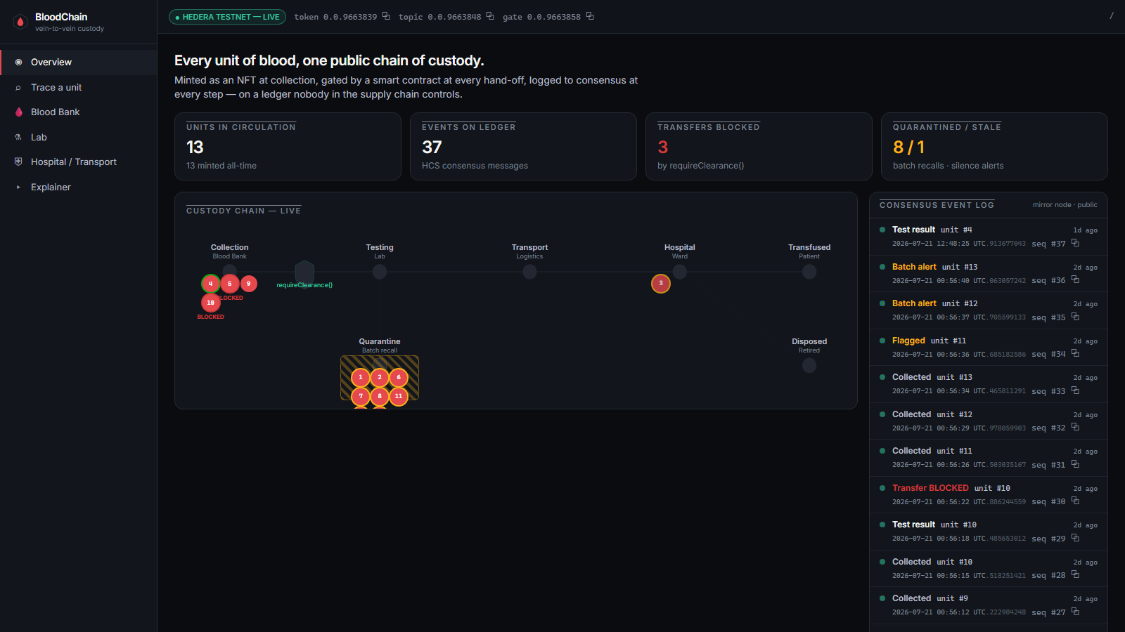
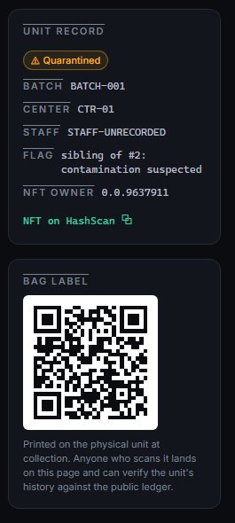
The live demo
Hedera testnet, right now — every number on screen is checkable on hashscan.io
DDiB '26 · Final Group Project · BloodChain
23.07.2026 | 15
Left: live overview — flow map, blocked transfers, real consensus feed (37 events, topic 0.0.9663848). Right: a unit's public record + the QR that goes on the physical bag.
Notes:
[MOEMEN - DEMO - 75s]
Let me show you the system itself. This is our application, connected to Hedera testnet - the green badge at the top is not a mock-up; those are our real token, topic, and contract IDs, and every one of them opens on HashScan. On the left, the custody chain, live: each chip is one unit positioned by its on-chain status. You can see two units at collection marked BLOCKED - those are failed-test units the gate refused to move - and the quarantine bay holding an entire recalled batch. On the right, the consensus event log: real events with nanosecond timestamps assigned by the network. Read it bottom-up and you can watch the story happen: unit ten collected, test result, transfer BLOCKED - the contract refusing, permanently recorded at sequence thirty. Then unit eleven flagged, and batch alerts sweeping its siblings in seconds. Thirteen units, thirty-seven events on the ledger. And on the far right - a single unit's public record with the QR code that would be printed on the physical bag: scan it, and you land on this unit's full history, served by Hedera's public mirror node, with zero trust in us required. Everything you just saw, you can verify yourself, tonight, from your own laptop.

Slide 15
Thank you
Questions?
Everything is public and checkable on hashscan.io BLOOD token 0.0.9663839 · HCS topic 0.0.9663848
BloodUnitGate 0.0.9663858 · BloodOversight 0.0.9663881
github.com/MoemenF-03/bloodchain-poc · branch claude-buildout
Notes:
[MOEMEN - 10s]
That is BloodChain. Everything is public and checkable - the IDs are on screen, the code is on GitHub. Thank you - we are happy to take questions.

