Slide 1

Business Analysis on Shipment Issue Diagnosis
Yi-Sheng, Yang
015263625

Slide 2
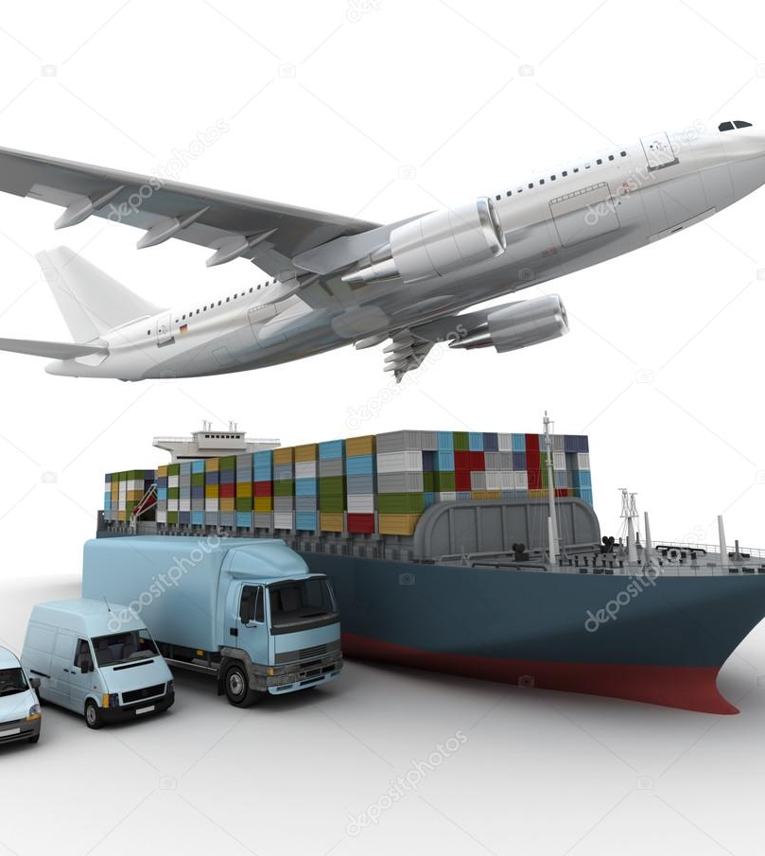
Abstract
Data originated from Flexport Logistics & Supply Chain Cooperation
5 Tables and 1 data dictionary
7581 rows in total
Targeting on Shipment file

Slide 3






Background Information
Consignee purchases goods from a Supplier to then sell them to another party
Unexpected loss appear
Flexport platform optimizes the logistics procedure
Supplier
Departure Port
Arrival Port
Final Destination

Slide 4
Data Relationship
Shipment
Bookings
Shipment_ID
Consignee_Company_ID
Supplier_Company_ID
Purchase_Order_ID
Container_ID
Shipment_ID
Product_ID
Consignee_Company_ID
Supplier_Company_ID
Suppliers
Consignees
Supplier_Company_ID
Consignee_Company_ID
Containers
Containers_ID
Shipment_ID

Slide 5
What are the possible reasons that freight profits are not as good as expected?

Slide 6

Funnel Pyramid
1
Assumptions
Business Partner
2
Exploration
Main Factor to Target
3
Details
Shipping Content
Suggestions and Diagnosis for Key Component
4

Slide 7
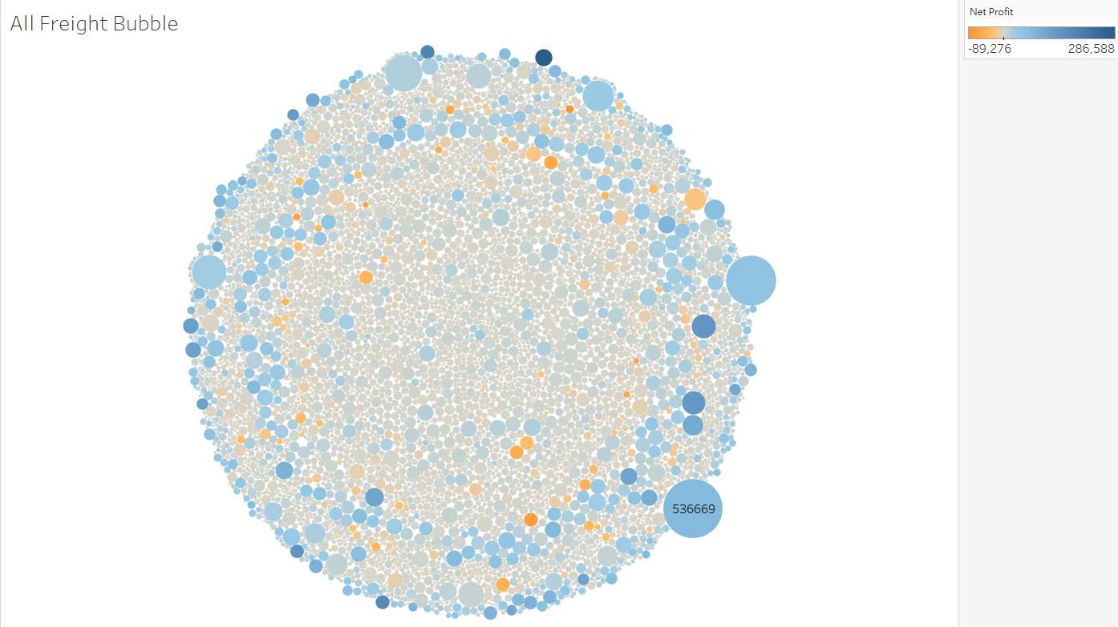
1

Slide 8
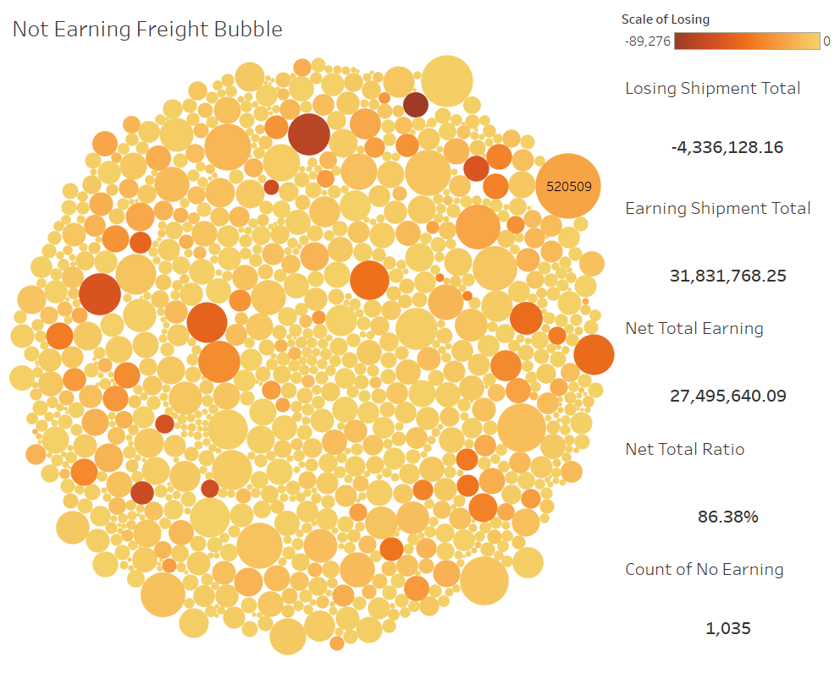
1

Slide 9
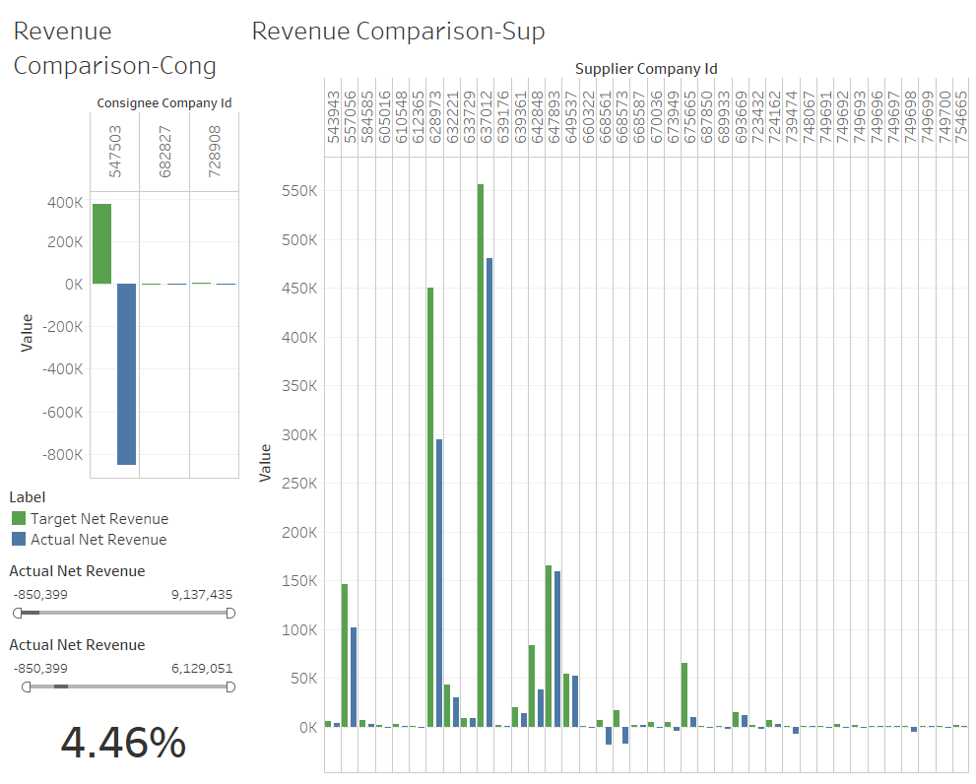
2

Slide 10
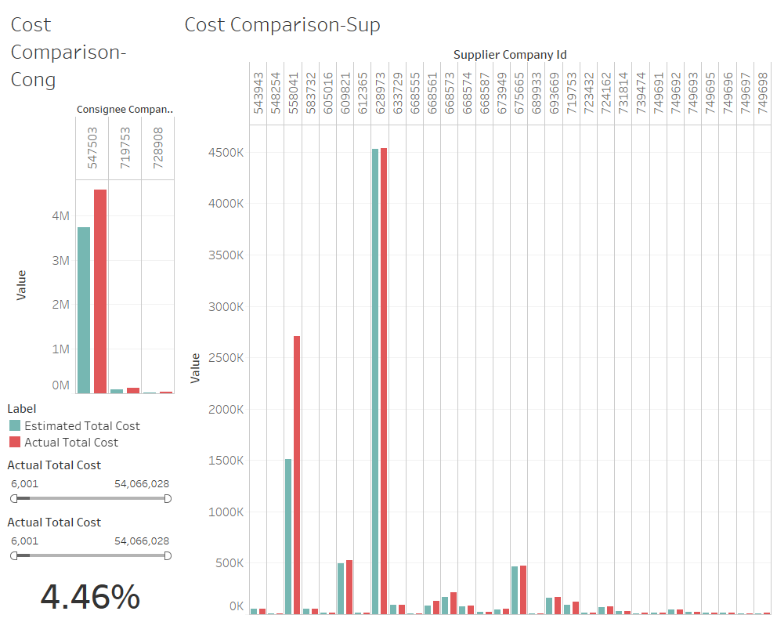
2

Slide 11
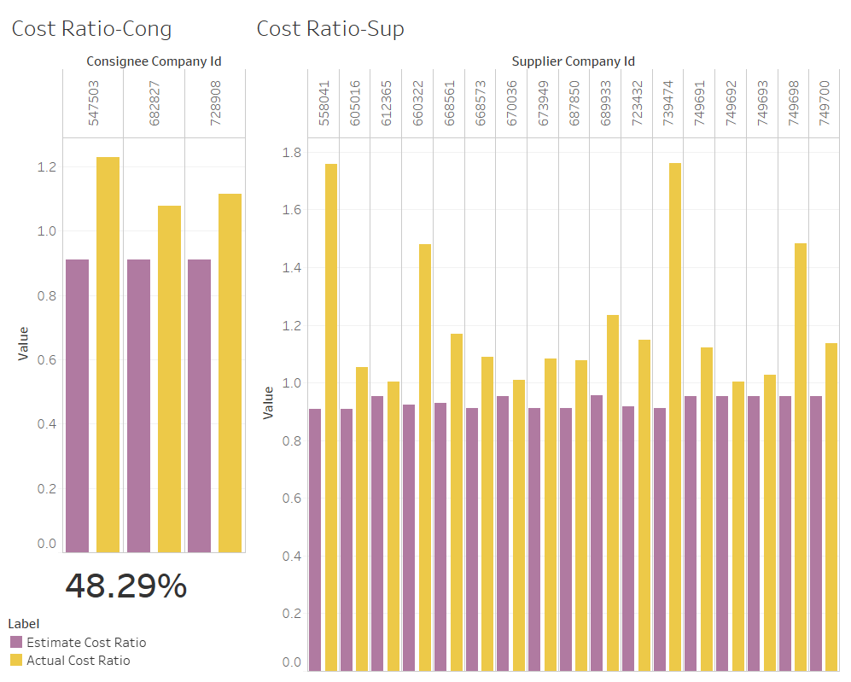
3

Slide 12
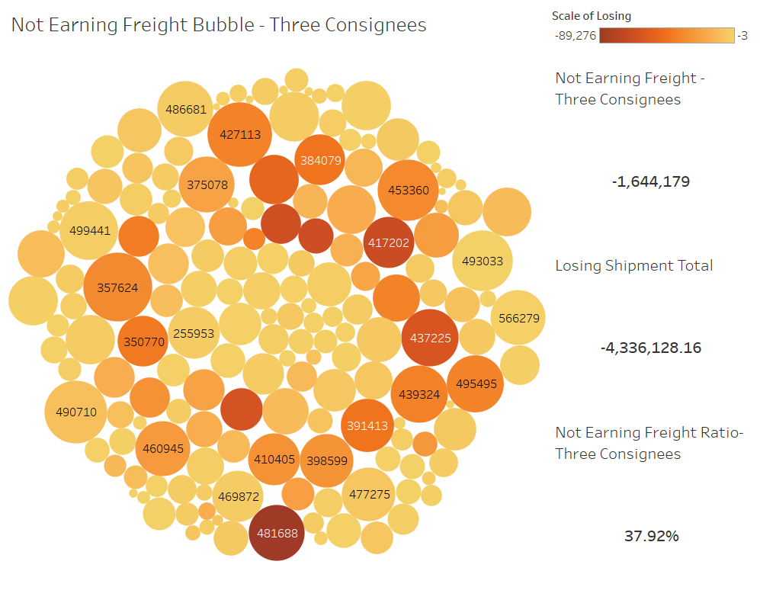
3

Slide 13
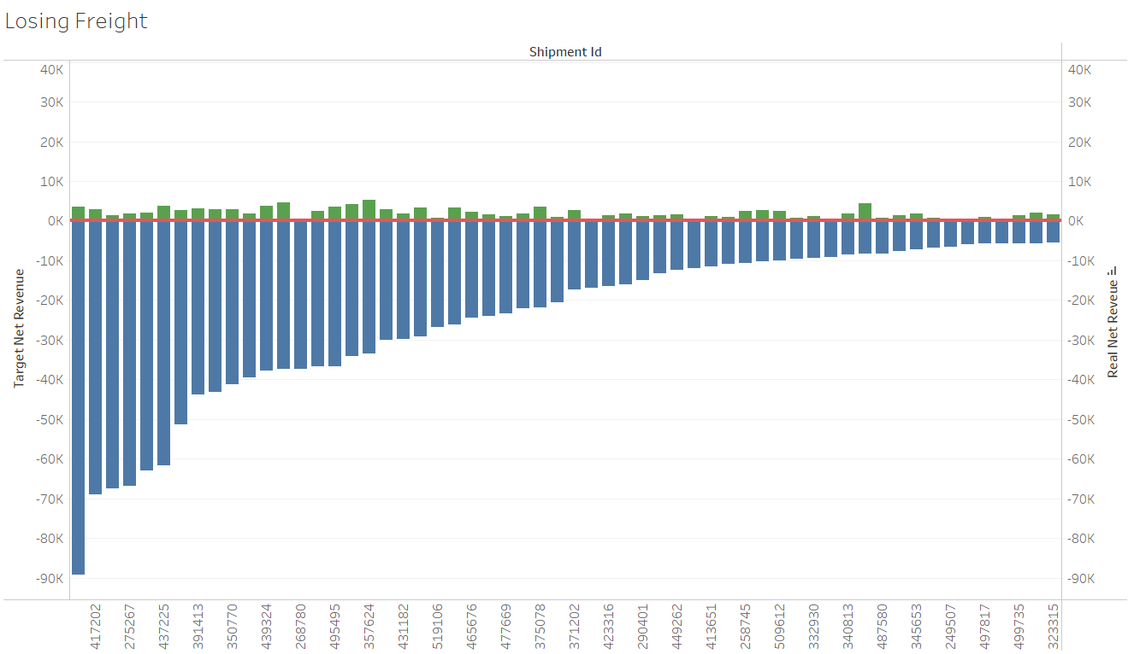
4

Slide 14
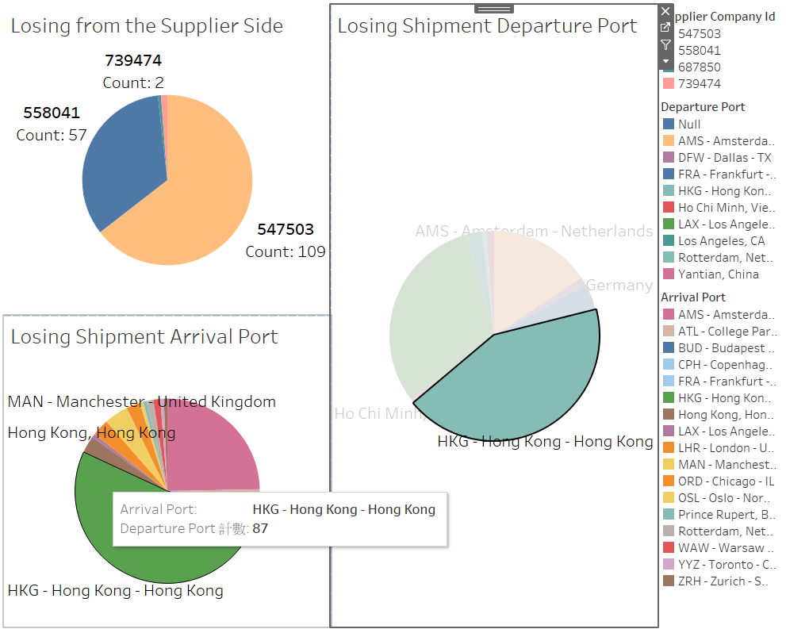
4

Slide 15
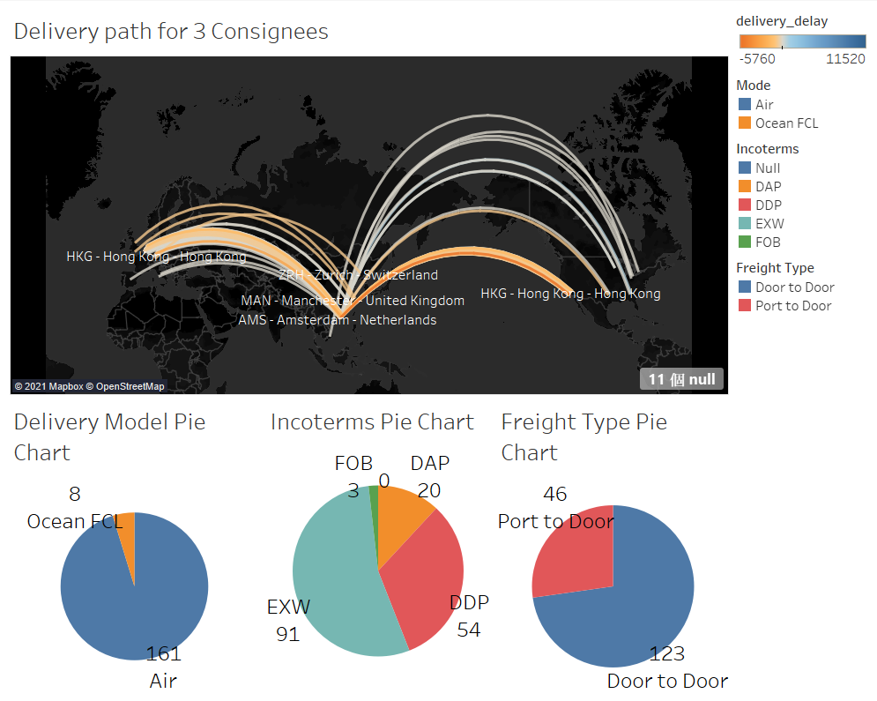
4

Slide 16
Suggestions
For stage 1, if it is possible to avoid the instance of freight losing money, the company can recover around 10% revenue in the past three years.
For stage 2, there around 14% questionable shipment during the time. By lower down the number, the company might have a healthier business flow.
For stage 3, by solving the business problem between consignee ID 547503, 682827, 728908, the company can reduce lost up to 38%.
For stage 4, we do not think the port is the main fact of losing. Probably the incoterm type and the freight type play a major role of these losing shipments.

Slide 17
Thank you

Slide 18
Reference
https://cn.depositphotos.com/stock-photos/shipping-company.html
https://www.linkedin.com/company/flexport/
https://jscharting.com/blog/pyramid-funnel-cone-charts/#:~:text=A%20funnel%20chart%20is%20essentially,number%20of%20different%20horizontal%20sections.
https://help.tableau.com/current/pro/desktop/en-us/story_example.htm
https://help.tableau.com/current/pro/desktop/en-us/maps_howto_origin_destination.htm
https://kb.tableau.com/articles/howto/creating-an-origin-and-destination-map-with-more-than-one-stop

