Slide 1



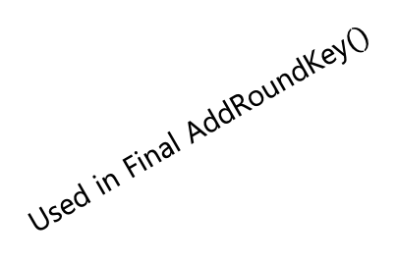
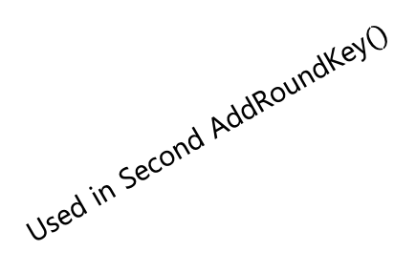
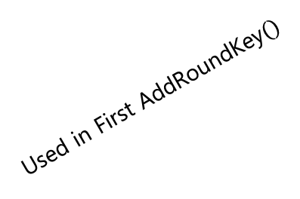
$4$ words
$4⋅(\text{Nr}+1)$ words
KeyExpansion()
$$⋯$$
Used in First $\text{AddRoundKey}()$
Used in Second $\text{AddRoundKey}()$
Used in Final $\text{AddRoundKey}()$

