Slide 1
Last Time
Cameras
Assignment 1
01/31/05
© 2005 University of Wisconsin

Slide 2
Today
Reflectance Functions Part 1
01/31/05
© 2005 University of Wisconsin

Slide 3
Irradiance
Irradiance is the power arriving at a surface, per unit area on the surface
  Denoted E in PBR, or sometimes Ir or sometimes I
  Units: Wm⁻²
A
r
p
θ
p
E(p)= Φ/4πr²
E(p)= Φcosθ/A
01/31/05
© 2005 University of Wisconsin

Slide 4
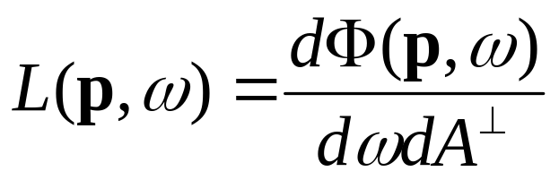
Radiance
Flux density per unit area perpendicular to the direction of travel, per unit solid angle:
  Units Wm⁻²sr⁻¹, power per unit area per unit solid angle
01/31/05
© 2005 University of Wisconsin
Notes:
Note uses foreshortened area. Depends on orientation of patch to direction of travel. Why this? Best definition for expressing the physics. Other papers use other definitions. Direction specified in several ways. Theta/phi or point to point.

Slide 5
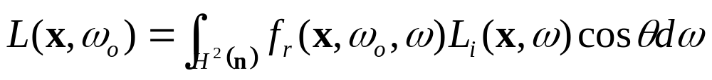
Direct Lighting
The simplest context for reflectance is direct lighting
Compute the outgoing radiance due to reflection of all incoming radiance
Integrate the proportion of light reflected from each incoming direction toward the outgoing direction
f_{r}: Bidirectional Reflectance Distribution Function (BRDF)
01/31/05
© 2005 University of Wisconsin

Slide 6
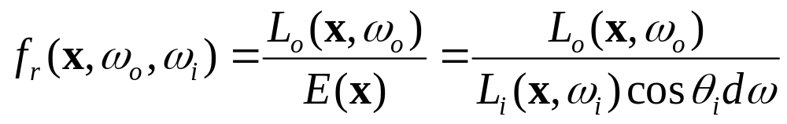
BRDF
The ratio of the radiance in the outgoing direction to the incident irradiance
The BRDF is like a probability distribution function
  The use of irradiance in the form on the bottom means the BRDF has no use unless integrated over a set of directions
The BRDF has units: sr⁻¹
01/31/05
© 2005 University of Wisconsin
Notes:
Units sr-1, Range 0 - inf, Symmetric (Helmholtz reciprocity principle) Hard to measure, changes with time and interaction, generally approximated in some way (to reduce number of parameters).

Slide 7
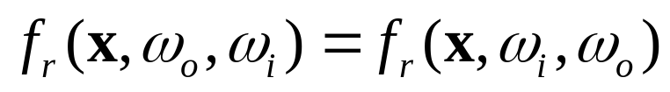
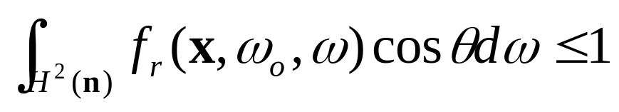
BRDF Properties
Must be symmetric:
  Many aspects of illumination depend on this
Must integrate to < 1 over the incoming hemisphere
  Cannot be large in too many places
  Light cannot be created
01/31/05
© 2005 University of Wisconsin

Slide 8
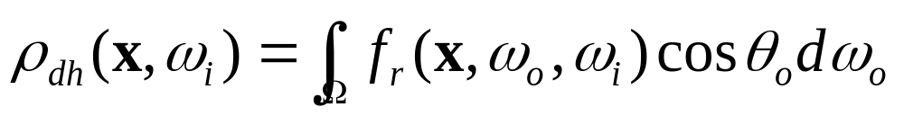
Hemispherical-Directional Reflectance
Directional Hemispheric Reflectance is the fraction of the incident irradiance in a given direction that is reflected by the surface
  Or, the total reflection in a given outgoing direction for constant illumination in the incoming direction
Useful for computation of some reflectance functions and for some algorithms
01/31/05
© 2005 University of Wisconsin
Notes:
Derivation on board. Grooved surface with alternating black white.

Slide 9
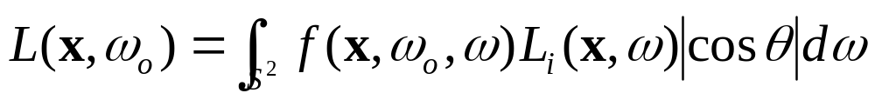
BTDF
Bidirectional Transmission Distribution Function, f_{t}
  For light coming from inside an object, like glass
Defined similar to BRDF
PBR combines them into the bidirectional scattering distribution function, f
01/31/05
© 2005 University of Wisconsin

Slide 10
Where Do You Get BRDFs?
Measured – repository at Cornell Graphics Group
Phenomenological – qualitatively similar to reality
Simulated – reflectance arises from physics of material and surface properties; these can be simulated
Physical (wave) Optics – solve Maxwell’s equations
Geometric Optics – like simulation, but analytic
01/31/05
© 2005 University of Wisconsin

Slide 11
Common BSDF Models
Lambertian (perfectly diffuse)
Specular (perfect mirror)
  Fresnel reflectance
Microfacet models
  Oren-Nayar
  Torrance-Sparrow
  Ward
  Schlick
Measured Models
  Lafortune
01/31/05
© 2005 University of Wisconsin

Slide 12
PBRT Reflectance
Given an incoming and outgoing ray direction, evaluate f
Given an incoming ray direction, sample an outgoing ray and return f, the sampled direction ω, and the probability with which the sample was chosen, p
  The p value is required for importance sampling
  Also need a routine that, given an incoming and outgoing, returns p
To evaluate the direct lighting integral, call Sample_f many times to get sample outgoing rays and weight according to f and p
01/31/05
© 2005 University of Wisconsin

Slide 13
Some Terminology
Classifying Reflectance:
  Diffuse – matte paint
  Perfect Specular – mirror
  Glossy Specular – metals
  Retro-reflective – moon, velvet
Symmetry?
  Isotropic reflectance does not depend on φ
  Anisotropic reflectance depends on viewing angle around the normal – grooved surfaces
    Require a consistent, surface parameterization to orient grooves
01/31/05
© 2005 University of Wisconsin

Slide 14
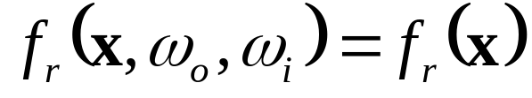
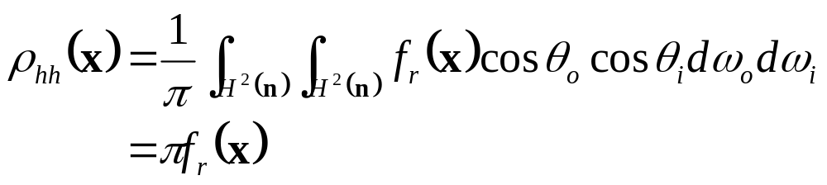
Lambertian BRDF
For ideal diffuse surfaces, the BRDF has no directional dependence:
Easiest to specify ρ_{hh}, total reflected for uniform total incoming:
01/31/05
© 2005 University of Wisconsin
Notes:
Do derivation on board

Slide 15
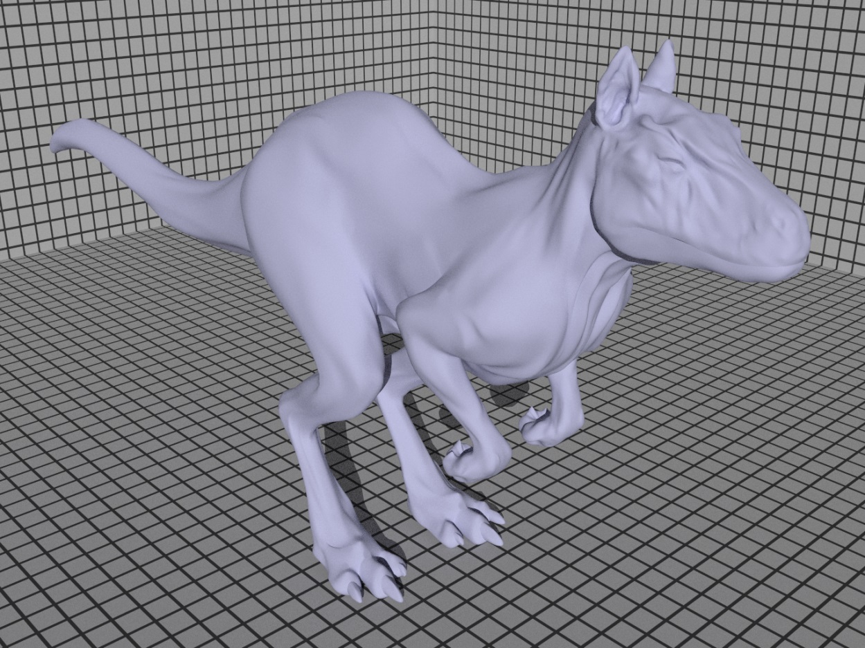
Lambertian Example
01/31/05
© 2005 University of Wisconsin

Slide 16
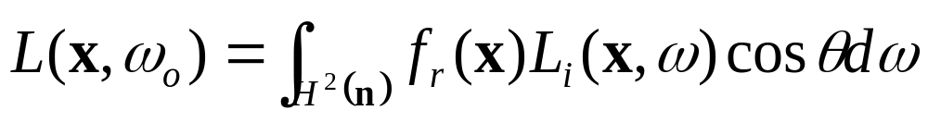
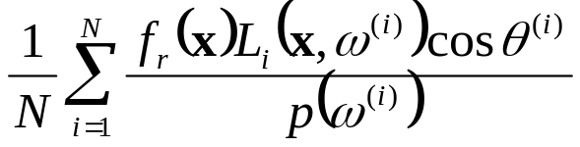
Sample Lambertian BRDF
Say we want to evaluate the direct lighting equation with a Lambertian BRDF:
In general, the incoming radiance, L_{i}, is non-uniform, so we will use Monte Carlo methods
  Sample N directions, ω^{(i)}
  Evaluate
The performance depends on the distribution used to sample directions, p
01/31/05
© 2005 University of Wisconsin

Slide 17
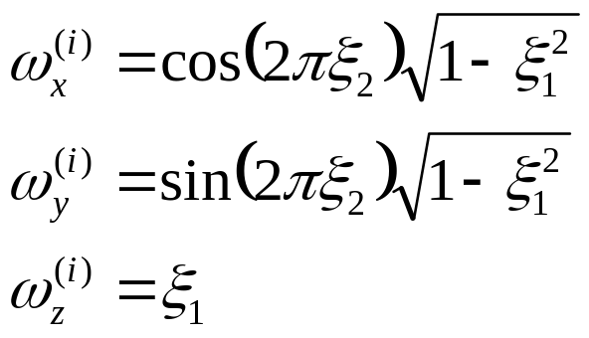
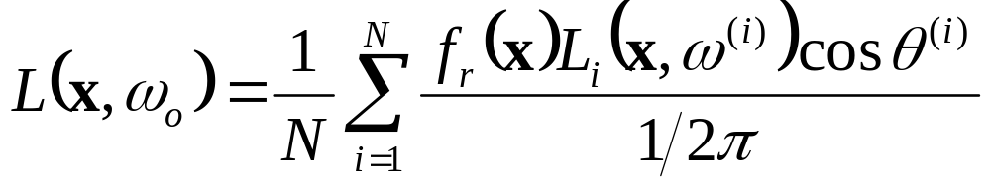
Option 1: Uniform Sampling (PBR 14.5.1)
Sample ξ₁ and ξ₁ uniform on [0,1]
Convert to a direction in the hemisphere with
Then
  2π is because we want to sample according to solid angle
01/31/05
© 2005 University of Wisconsin

Slide 18
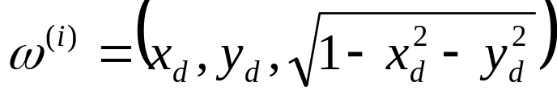
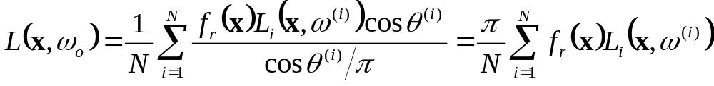
Option 2: Cosine Weighted (PBR 14.5.3)
Sample ξ₁ and ξ₁ uniform on [0,1]
Convert to a uniform sample on the disk, x_{d}, y_{d}
Project up onto the hemisphere
Then, with lower variance
01/31/05
© 2005 University of Wisconsin

Slide 19
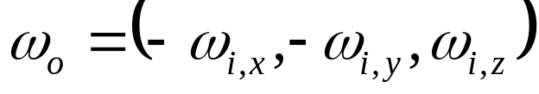
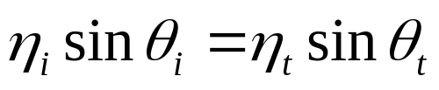
Specular Reflection/Transmission
Reflection: arriving energy from one direction goes out only in reflection direction:
Refraction: Outgoing direction based on Snell’s law:
  η is index of refraction
Two issues:
  Proportion of light transmitted or reflected depends on angle θ
  All light going in a single direction makes BRDF infinite!
01/31/05
© 2005 University of Wisconsin

Slide 20
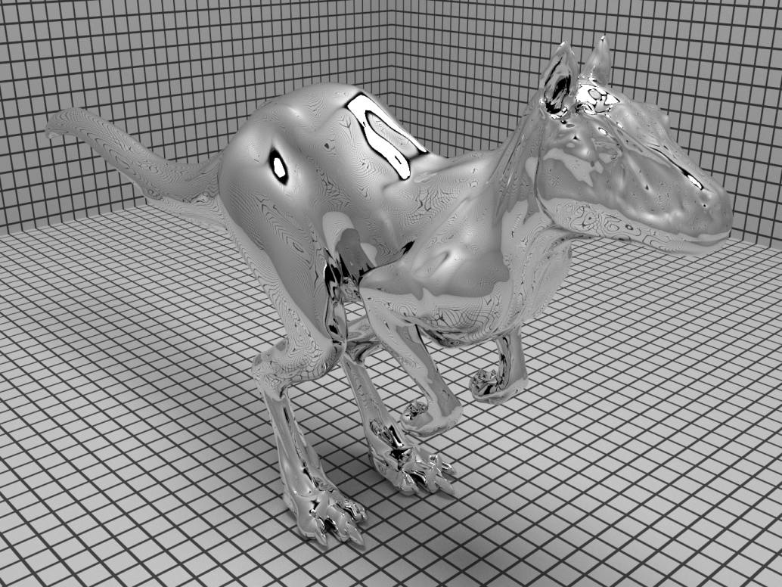
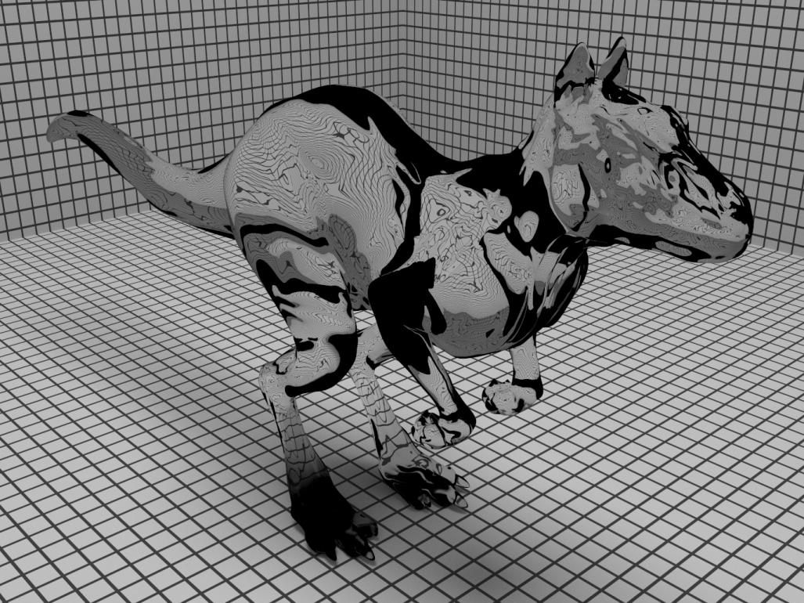
Total Reflection and Transmission
01/31/05
© 2005 University of Wisconsin

Slide 21
Fresnel Reflectance
For a completely smooth surface, the amount it reflects depends upon the direction you look at it
  A lake looks different depending on the angle you view it at
  Even paper looks different at extreme grazing angles
Fresnel’s equations capture this behavior based on Maxwell’s wave equations
For an ideal interface – a transition from one medium to another – some light is reflected, and the rest is transmitted
Fresnel’s equations give the proportion of light that is reflected, rest is transmitted or absorbed
01/31/05
© 2005 University of Wisconsin

Slide 22
Fresnel Issues
Different equations for dielectrics (no conductors like glass, plastic) and conductors (metals)
Depends on wavelength (we’ll use averages)
  Actually, index of refraction depends on wavelength
Depends on polarization (we’ll use an average)
  Polarized light is hard to deal with in rendering, but is possible
01/31/05
© 2005 University of Wisconsin

Slide 23
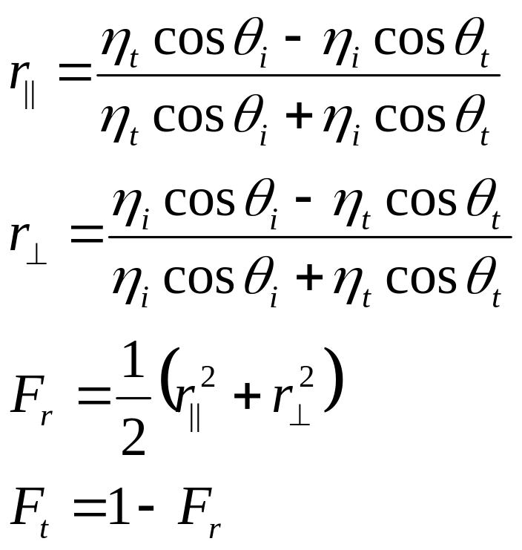
Fresnel for Dielectrics
An approximation to exact terms
All angle are such that cos is positive
01/31/05
© 2005 University of Wisconsin

Slide 24
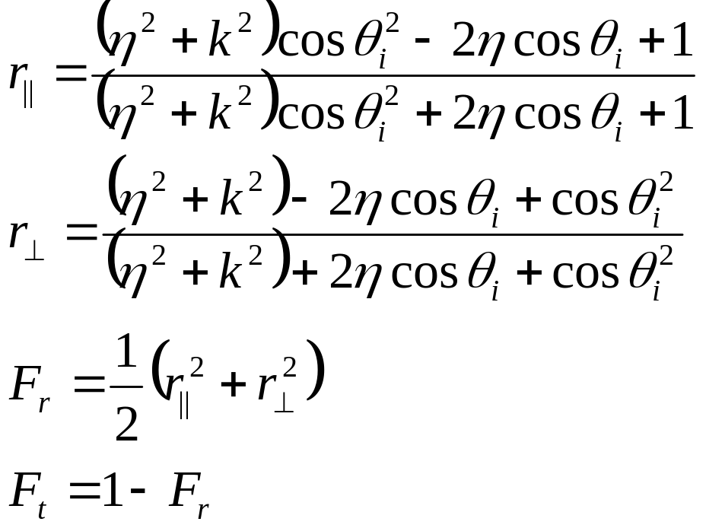
Fresnel for Conductors
An approximation to exact terms
Refraction is for the conductor
k is the absorption coefficient
The coefficients are rarely known – estimation methods exist
01/31/05
© 2005 University of Wisconsin

Slide 25
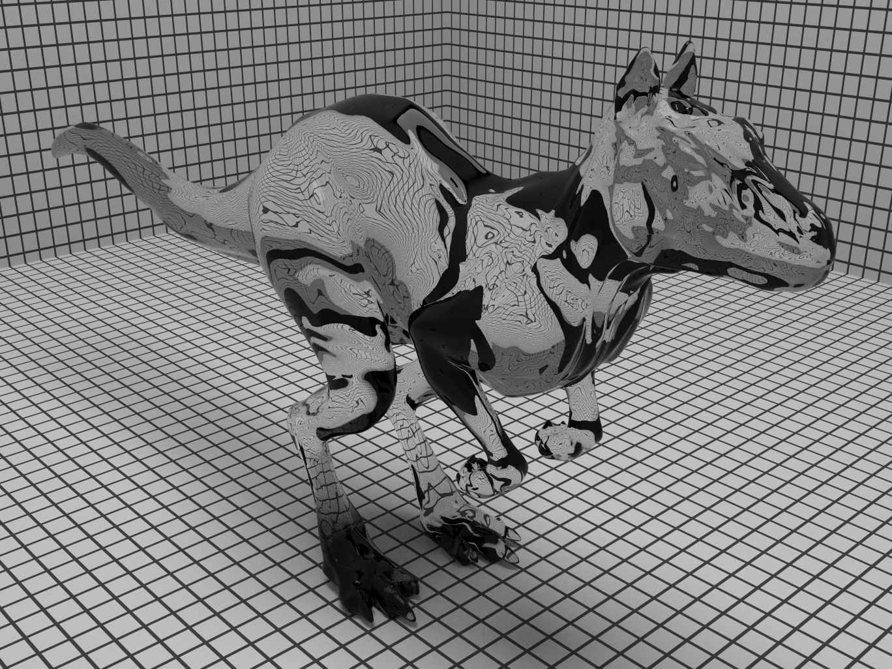
Fresnel Example
01/31/05
© 2005 University of Wisconsin

Slide 26

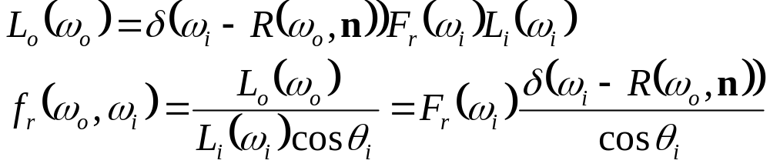
Specular Reflection BRDF
We require the BRDF to have the property that, for reflection directions ω_{i} and ω_{o}:
  It needs to be zero for all non-reflection direction pairs
Use the Dirac delta distribution, where we have:
01/31/05
© 2005 University of Wisconsin

Slide 27
Sampling for Specular Reflection
For any two arbitrary directions, there is no chance they are reflection directions, so the BRDF always returns 0
If asked to sample a direction according to the BRDF, we have only one choice – the reflection direction
  Return this direction
  Return 1 for p, because the choice was forced (no randomness)
How do we account for the Dirac delta?
  Have to make sure it cancels out in any Monte Carlo estimate
  Example …
01/31/05
© 2005 University of Wisconsin

Slide 28
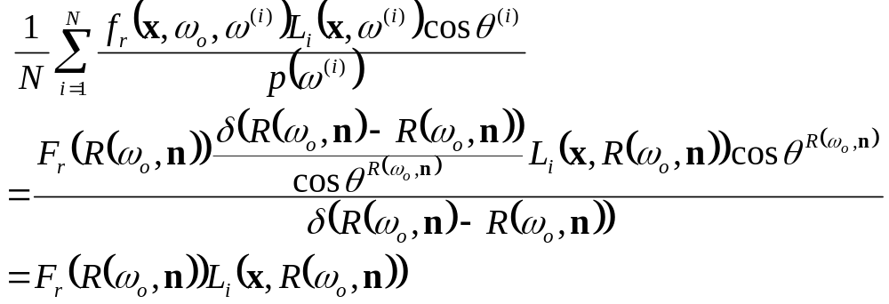
Specular Direct Lighting
We want to use Monte Carlo to integrate this equation
  Don’t need it, but the example is illustrative
We sample an incoming ray direction
  Which one?
We evaluate:
01/31/05
© 2005 University of Wisconsin

Slide 29
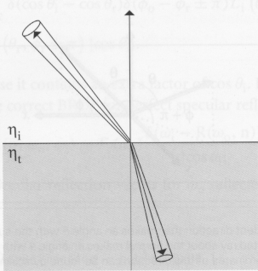
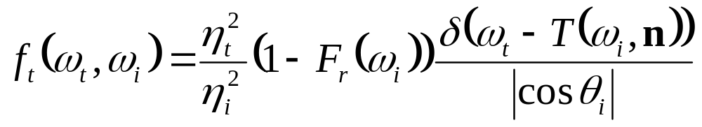
Specular Transmission BRDF
Complication because refraction squeezes (or stretches) solid angle measure
01/31/05
© 2005 University of Wisconsin

Slide 30
Next Time
Microfacet models
01/31/05
© 2005 University of Wisconsin

