Slide 1
user query
Hybrid Granularity
KV Management
runtime
GPU
cache
token-based
cache management
Meta-data
CPU
cache
Similarity-Guided
Important Token
Identification
meta-
data
chunk-based KV
storage and reordering

Slide 2

user request
prefix
query
Important Token Identification (§ 4.3)
Disk
CPU
Memory
GPU
Memory
…
meta-data
runtime
space
select KVs
Data Plane
…
CPU
cache
GPU
cache
prefix KVs
chunk-based KV
storage and reordering
token-based
cache management
Prefix KV Management (§ 4.4)
prefix KV transfer
control message

Slide 3
KV Prefetch (§ IV.C)
Important Token Identification (§ IV.B)
Disk
CPU
Memory
GPU
Memory
…
metadata
runtime
space
select KVs
Data Plane
…
CPU
cache
GPU
cache
prefix KVs
KV Reordering
(§ IV.D)
Cache Replacement
(§ IV.D)
Prefix KV Placement (§ IV.D)
Prefix KV transfer
Control message

Slide 4
user request
prefix
query
Important Token Identification (§ 4.3)
Disk
CPU
Memory
GPU
Memory
…
metadata
runtime
space
select KVs
Data Plane
…
CPU
cache
GPU
cache
prefix KVs
KV Reordering
(§ 4.4.1)
Cache Replacement
(§ 4.4.2)
Prefix KV Management (§ 4.4)
prefix KV transfer
control message

Slide 5
Output token: x_{l}
X_{out_0}
Output Layer
Linear 2
Linear 1
FFN
X_{out_(n-1)}
Transformer
Block_(n-1)
attention weights
attention output
…
Transformer
Block_0
q
Attention Layer
k
v
head 2
X_{in}
head 1
head 0
Input Layer
W_{q}
W_{k}
W_{v}
Input sequence:
S = [x₀, x₁, …, x_{l-1}]
X_{in}

Slide 6
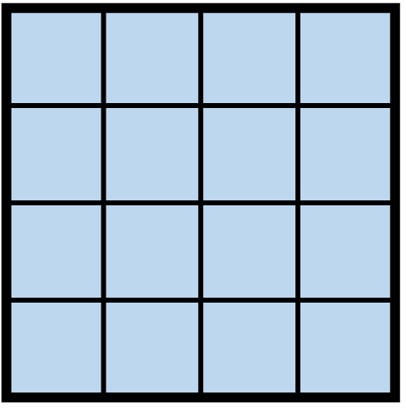
Output token: t_{l}
X_{out_0}
Output Layer
X_{out_(n-1)}
Linear 2
Linear 1
FFN
Transformer
Layer_(n-1)
…
attention weights
attention output
Transformer
Layer_0
X_{in}
Attention Layer
Q
q
K
k
V
v
head 2
Input Layer
head 1
head 0
W_{q}
W_{k}
W_{v}
Input sequence:
S = [t₀, t₁, …, t_{l-1}]
X_{in}

Slide 7
Computation
Stored prefix KVs
Prefix KV loading
(a)
query
L0
L1
L2
TTFT
time
(b)
prefix
query
L0
L1
L2
TTFT
time
(c)
query
L0
L1
L2
KVs in GPU/CPU
L0
L1
L2
TTFT
time
(d)
query
L0
L1
L2
KVs in Disk
L0
L1
L2
time
TTFT

Slide 8
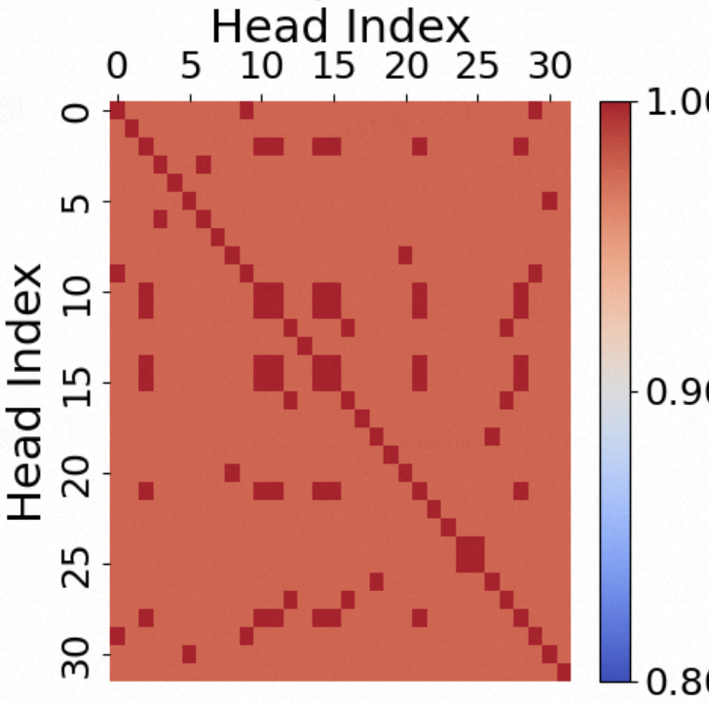
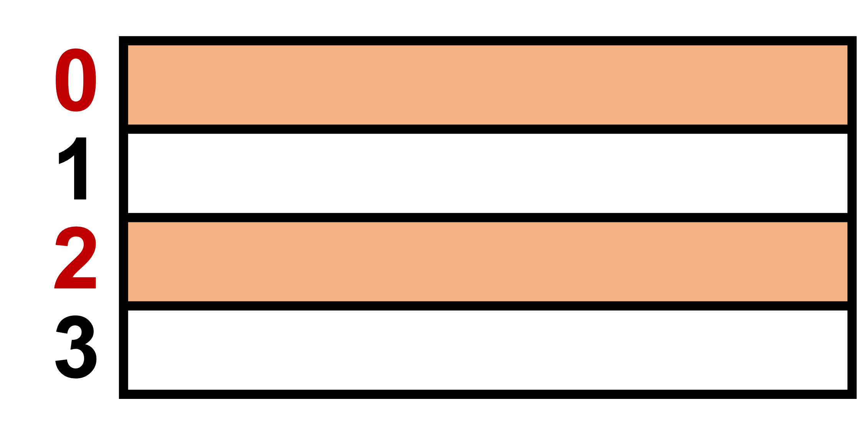
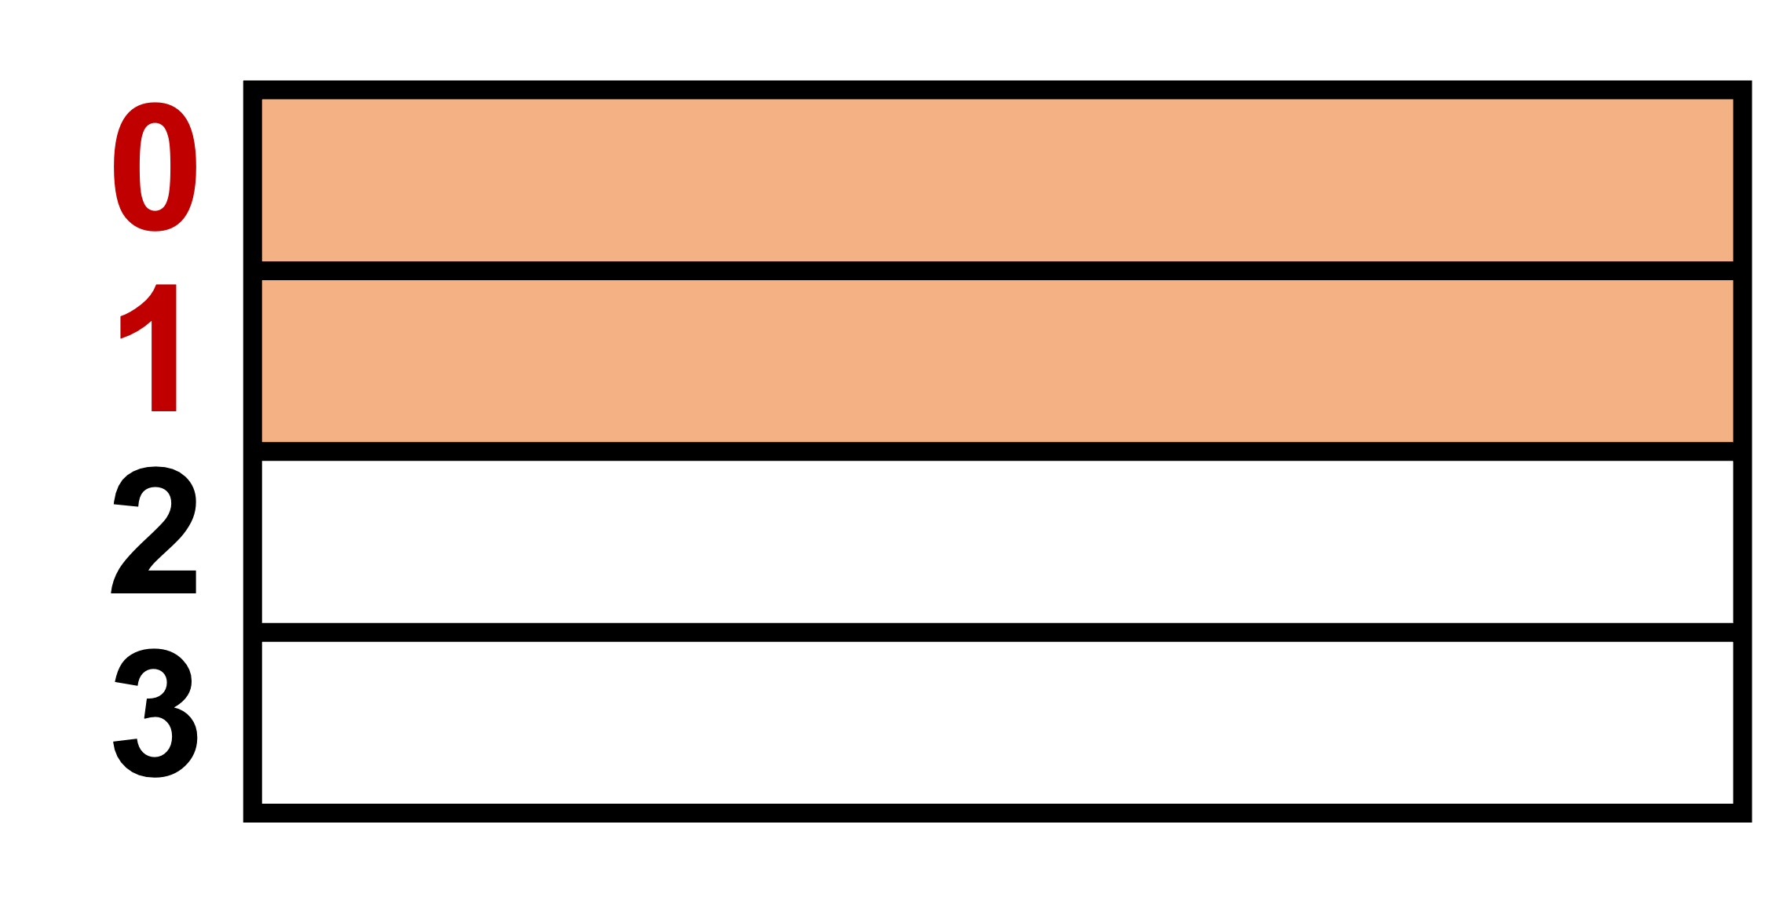
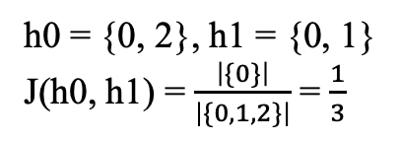
Key tensors of 4 tokens
token index
head 0:
h0 = {0, 2}, h1 = {0, 1}
J(h0, h1) = $\frac{\left|\{0\}\right|}{\left|\{0, 1, 2\}\right|}$ = $\frac{1}{3}$
head 1:
Head Index
0 10 20 30
token index
1.0
head 0:
30 20 10 0
Head Index
0.9
head 1:
0.8

Slide 9
L0
L1
L2
L0
L1
L2
K loading
token selection
V loading
computation
Idle
(a)
GPU stream
l0
l0
l1
l1
l2
l2
I/O stream
l0
l0
l1
l1
l2
l2
time
l0
l0
l1
l1
(b)
GPU stream
l2
l2
I/O stream
TTFT
Reduction
l0
l0
l0
l1
l1
l1
l2
l2
l2
time
l1
l1
l2
l0
l1
l1
l2
l2

Slide 10
L0
L1
L2
L0
L1
L2
K loading
token selection
V loading
computation
Idle
(a)
GPU stream
0
0
1
1
2
2
I/O stream
0
0
1
1
2
2
time
0
0
1
1
(b)
GPU stream
2
2
I/O stream
TTFT
Reduction
0
0
0
1
1
1
2
2
2
time
l1
l1
l2
l0
l1
l1
l2
l2

Slide 11
…
…
k
k
v
k
Stored prefix KV
(1) 15 k tensors
GPU
Stored prefix KV
GPU
(1) 15 k tensors
(2) {a, b} x 15
select
KVs
(2) {a, b} x 15
select
KVs
k
…
v
…
k
…
v
…
(3) 30 tokens’ v
(3) 30 tokens’ v
(1) 3 k tensors
(2) {a, b} x 1
select
KVs
k
…
v
…
(3) 30 tokens’ k, v
Stored prefix KV
(1) 3 k tensors
GPU
(2) {a, b}
select
KVs
k
…
v
…
(3) 30 tokens’ k, v

Slide 12
…
…
k
k
v
k
k
…
…
Stored prefix KV
GPU
(1) 15 k tensors
k
v
(2) {a, b} x 15
select
KVs
…
15
…
v
(3) 30 tokens’ v
(1) 3 k tensors
k
v
(2) {a, b} x 1
select
KVs
…
…
k
v
(3) 30 tokens’ k, v

Slide 13
…
…
k
k
v
k
k
…
…
Stored prefix KV
GPU
…
(1) 128 vectors
k
v
(2) { x_{i} }, 0≤ i ≤ 31
select
KVs
…
…
32
…
v
(3) 32 vectors
(1) 12 vectors
k
v
(2) {x}
select
KVs
…
…
k
v
(3) 64 vectors

Slide 14

{t0, t3}
target keys
t0
t3
t0
t3
CPU
Disk
t0
t1
t2
t3
t0
t3
t1
t2
t0 t1 t2 t3
t0 t3 t1 t2
token seq.
chunk 0
chunk 1
chunk 0
chunk 1
(a) before recordering
(b) after recordering

Slide 15
s0 = [t0, t1, t2, t3]
k_ptr:
v_ptr:
s0’ = [t0, t3, t1, t2]
m0 = [0, 2, 3, 1]
k_ptr:
v_ptr:
s2 = [t8, t9,
t10, t11]
s2 = [t9, t8, t10, t11]
s1 = [t4, t5,
t6, t7]
…
s1 = [t4, t5,
t6, t7]
…
m2 = [1, 0, 2, 3]
…
…
m1 = [0, 1, 2, 3]
(a) before recordering
(b) after recordering
s0 = [t0, t1, t2, t3]
k_ptr:[ , ]
v_ptr:[ , ]
s0’ = [t0, t3, t1, t2]
m0 = [0, 2, 3, 1]
k_ptr:[ , ]
v_ptr:[ , ]
s2 = [t8, t9,
t10, t11]
s2 = [t9, t8, t10, t11]
s1 = [t4, t5,
t6, t7]
…
s1 = [t4, t5,
t6, t7]
…
m2 = [1, 0, 2, 3]
…
…
m1 = [0, 1, 2, 3]
(a) before recordering
(b) after recordering

Slide 16
chunk 1
chunk 2
10*2=20 keys
15*1=15
keys
access
freq.
1.5
1
GPU
PCIe
CPU
New requests:
15 for chunk 1
10 for chunk 2
(a)
(b)

Slide 17
* 为了获取重要token的key/value vector, 需要先从disk读取所在的chunk，然后从CPU中读取重要的vector到GPU。
方法1：传统方法（LFU）
方法2：CPU-GPU按score
方法3：全按score
freq.
score
1
8
24
PCIe
PCIe
PCIe
CPU
GPU
CPU
GPU
CPU
GPU
1
2
2
1
3
1
2
10
10
3
7
14
Disk
3
Disk
3
Disk
2
新请求
8个ck1
10个ck2
7个ck3
8*3=24 PCIe
0
7*3=21 disk I/O
+ 7*2=14 PCIe
0
10*1=10 PCIe
7*3=21 disk I/O
+ 7*2=14 PCIe
0
10*3=30 disk I/O
+ 10*1=10 PCIe
7*2=14 PCIe
total
38 PCIe + 21 diskI/O
24 PCIe+21 diskI/O
24 PCIe + 30 diskI/O

Slide 18
CPU
GPU
w/
√
1
10
PCIE
w/o
10
1
disk
CPU
kaolu
1
10
√
10
1
disk wt

Slide 19
Backup
0
1
2
3
Key tensors of 4 tokens
head 0:
head 1:
0
1
2
3

