Slide 1
user query
Hybrid Granularity
KV Management
runtime
GPU
cache
token-based
cache management
Meta-data
CPU
cache
Similarity-Guided
Important Token
Identification
meta-
data
chunk-based KV
storage and reordering

Slide 2

user request
prefix
query
Important Token Identification (§ 4.3)
Disk
CPU
Memory
GPU
Memory
…
meta-data
runtime
space
select KVs
Data Plane
…
CPU
cache
GPU
cache
prefix KVs
chunk-based KV
storage and reordering
token-based
cache management
Prefix KV Management (§ 4.4)
prefix KV transfer
control message

Slide 3
KV Prefetch (§ IV.C)
Important Token Identification (§ IV.B)
Disk
CPU
Memory
GPU
Memory
…
metadata
runtime
space
select KVs
Data Plane
…
CPU
cache
GPU
cache
prefix KVs
KV Reordering
(§ IV.D)
Cache Replacement
(§ IV.D)
Prefix KV Placement (§ IV.D)
Prefix KV transfer
Control message

Slide 4
user request
prefix
query
Important Token Identification (§ 4.3)
Disk
CPU
Memory
GPU
Memory
…
metadata
runtime
space
select KVs
Data Plane
…
CPU
cache
GPU
cache
prefix KVs
KV Reordering
(§ 4.4.1)
Cache Replacement
(§ 4.4.2)
Prefix KV Management (§ 4.4)
prefix KV transfer
control message

Slide 5
Output token: x_{l}
X_{out_0}
Output Layer
Linear 2
Linear 1
FFN
X_{out_(n-1)}
Transformer
Block_(n-1)
attention weights
attention output
…
Transformer
Block_0
q
Attention Layer
k
v
head 2
X_{in}
head 1
head 0
Input Layer
W_{q}
W_{k}
W_{v}
Input sequence:
S = [x₀, x₁, …, x_{l-1}]
X_{in}

Slide 6
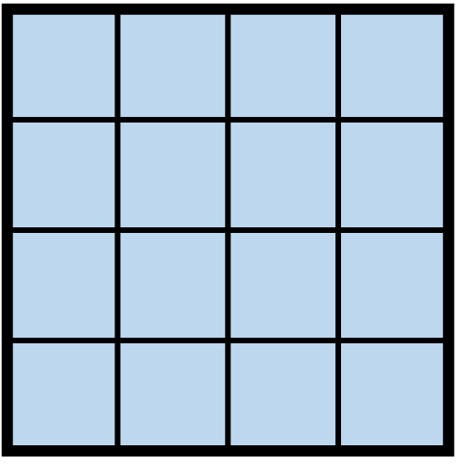
Output token: t_{l}
X_{out_0}
Output Layer
X_{out_(n-1)}
Linear 2
Linear 1
FFN
Transformer
Layer_(n-1)
…
attention weights
attention output
Transformer
Layer_0
X_{in}
Attention Layer
Q
q
K
k
V
v
head 2
Input Layer
head 1
head 0
W_{q}
W_{k}
W_{v}
Input sequence:
S = [t₀, t₁, …, t_{l-1}]
X_{in}

Slide 7
Computation
Stored prefix KVs
Prefix KV loading
(a)
query
L0
L1
L2
TTFT
time
(b)
prefix
query
L0
L1
L2
TTFT
time
(c)
query
L0
L1
L2
KVs in GPU/CPU
L0
L1
L2
TTFT
time
(d)
query
L0
L1
L2
KVs in Disk
L0
L1
L2
time
TTFT

Slide 8
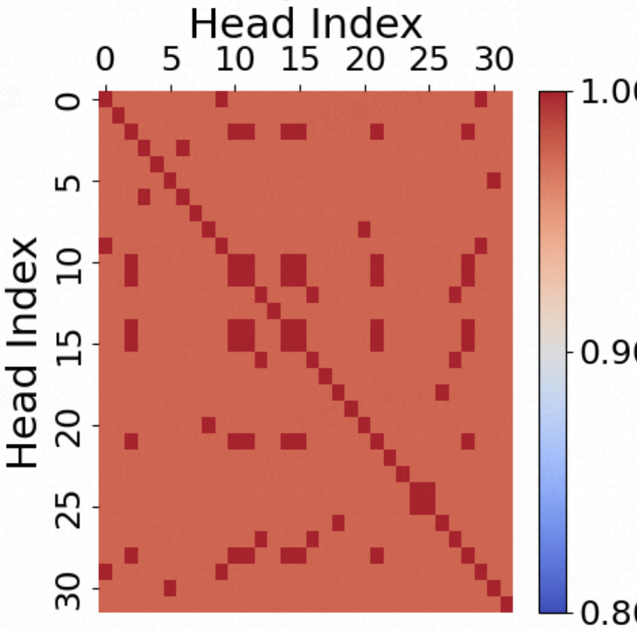
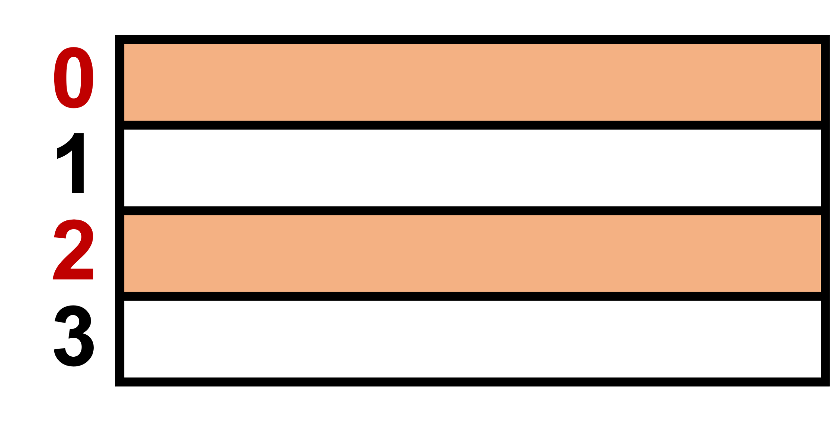
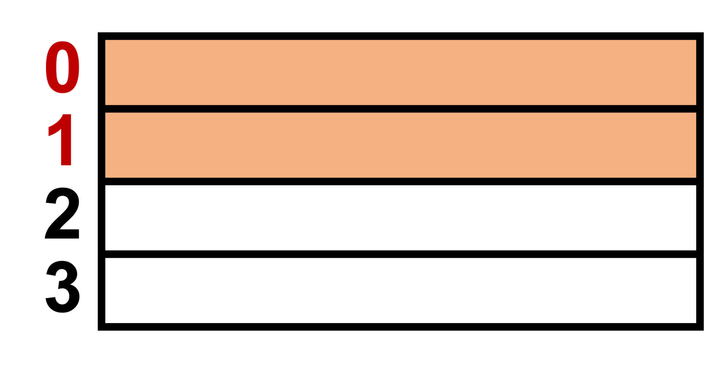
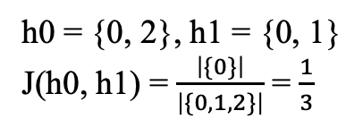
Key tensors of 4 tokens
token index
head 0:
h0 = {0, 2}, h1 = {0, 1}
J(h0, h1) = $\frac{\left|\{0\}\right|}{\left|\{0, 1, 2\}\right|}$ = $\frac{1}{3}$
head 1:
Head Index
0 10 20 30
token index
1.0
head 0:
30 20 10 0
Head Index
0.9
head 1:
0.8

Slide 9
L0
L1
L2
L0
L1
L2
K loading
token selection
V loading
computation
Idle
(a)
GPU stream
l0
l0
l1
l1
l2
l2
I/O stream
l0
l0
l1
l1
l2
l2
time
l0
l0
l1
l1
(b)
GPU stream
l2
l2
I/O stream
TTFT
Reduction
l0
l0
l0
l1
l1
l1
l2
l2
l2
time
l1
l1
l2
l0
l1
l1
l2
l2

Slide 10
L0
L1
L2
L0
L1
L2
K loading
token selection
V loading
computation
Idle
(a)
GPU stream
0
0
1
1
2
2
I/O stream
0
0
1
1
2
2
time
0
0
1
1
(b)
GPU stream
2
2
I/O stream
TTFT
Reduction
0
0
0
1
1
1
2
2
2
time
l1
l1
l2
l0
l1
l1
l2
l2

Slide 11
…
…
k
k
v
k
Stored prefix KV
(1) 15 k tensors
GPU
Stored prefix KV
GPU
(1) 15 k tensors
(2) {a, b} x 15
select
KVs
(2) {a, b} x 15
select
KVs
k
…
v
…
k
…
v
…
(3) 30 tokens’ v
(3) 30 tokens’ v
(1) 3 k tensors
(2) {a, b} x 1
select
KVs
k
…
v
…
(3) 30 tokens’ k, v
Stored prefix KV
(1) 3 k tensors
GPU
(2) {a, b}
select
KVs
k
…
v
…
(3) 30 tokens’ k, v

Slide 12
…
…
k
k
v
k
k
…
…
Stored prefix KV
GPU
(1) 15 k tensors
k
v
(2) {a, b} x 15
select
KVs
…
15
…
v
(3) 30 tokens’ v
(1) 3 k tensors
k
v
(2) {a, b} x 1
select
KVs
…
…
k
v
(3) 30 tokens’ k, v

Slide 13
…
…
k
k
v
k
k
…
…
Stored prefix KV
GPU
…
(1) 128 vectors
k
v
(2) { x_{i} }, 0≤ i ≤ 31
select
KVs
…
…
32
…
v
(3) 32 vectors
(1) 12 vectors
k
v
(2) {x}
select
KVs
…
…
k
v
(3) 64 vectors

Slide 14

{t0, t3}
target keys
t0
t3
t0
t3
CPU
Disk
t0
t1
t2
t3
t0
t3
t1
t2
t0 t1 t2 t3
t0 t3 t1 t2
token seq.
chunk 0
chunk 1
chunk 0
chunk 1
(a) before recordering
(b) after recordering
{t0, t3, t4}
target keys
prefetch
load
t0
t3
t4
t0
t3
t4
t0
t4
t3
CPU
Disk
t2
t3
t4
t5
t4
t5
t0
t4
t2
t3
t0
t1
t0
t3
t1
t2
t1
t5
chunk 0
chunk 1
chunk 2
chunk 0
chunk 1
chunk 2
chunk 0
chunk 1
chunk 2
(a) w/o recordering
(b) IMPRESS
(c) HyperInfer

Slide 15
s0 = [t0, t1, t2, t3]
k_ptr:
v_ptr:
s0’ = [t0, t3, t1, t2]
m0 = [0, 2, 3, 1]
k_ptr:
v_ptr:
s2 = [t8, t9,
t10, t11]
s2 = [t9, t8, t10, t11]
s1 = [t4, t5,
t6, t7]
…
s1 = [t4, t5,
t6, t7]
…
m2 = [1, 0, 2, 3]
…
…
m1 = [0, 1, 2, 3]
(a) before recordering
(b) after recordering
s0 = [t0, t1, t2, t3]
k_ptr:[ , ]
v_ptr:[ , ]
s0’ = [t0, t3, t1, t2]
m0 = [0, 2, 3, 1]
k_ptr:[ , ]
v_ptr:[ , ]
s2 = [t8, t9,
t10, t11]
s2 = [t9, t8, t10, t11]
s1 = [t4, t5,
t6, t7]
…
s1 = [t4, t5,
t6, t7]
…
m2 = [1, 0, 2, 3]
…
…
m1 = [0, 1, 2, 3]
(a) before recordering
(b) after recordering

Slide 16
chunk 1
chunk 2
10*2=20 keys
15*1=15
keys
access
freq.
1.5
1
GPU
PCIe
CPU
New requests:
15 for chunk 1
10 for chunk 2
(a)
(b)

Slide 17
* 为了获取重要token的key/value vector, 需要先从disk读取所在的chunk，然后从CPU中读取重要的vector到GPU。
方法1：传统方法（LFU）
方法2：CPU-GPU按score
方法3：全按score
freq.
score
1
8
24
PCIe
PCIe
PCIe
CPU
GPU
CPU
GPU
CPU
GPU
1
2
2
1
3
1
2
10
10
3
7
14
Disk
3
Disk
3
Disk
2
新请求
8个ck1
10个ck2
7个ck3
8*3=24 PCIe
0
7*3=21 disk I/O
+ 7*2=14 PCIe
0
10*1=10 PCIe
7*3=21 disk I/O
+ 7*2=14 PCIe
0
10*3=30 disk I/O
+ 10*1=10 PCIe
7*2=14 PCIe
total
38 PCIe + 21 diskI/O
24 PCIe+21 diskI/O
24 PCIe + 30 diskI/O

Slide 18
CPU
GPU
w/
√
1
10
PCIE
w/o
10
1
disk
CPU
kaolu
1
10
√
10
1
disk wt

Slide 19
Backup
0
1
2
3
Key tensors of 4 tokens
head 0:
head 1:
0
1
2
3

