Slide 1

R tips and tricks
Andrew East
Jun 2019

Slide 2
Outline
Concepts
Cheatsheets
Test Datasets
R Books
Vocab/Style Guides

Slide 3
Concepts
Make R a tool so you can think less
But, think enough to use R effectively
Not just about knowing tips/tricks/vocabulary
Dedicate time to it same as you do reading the lit.

Slide 4
“Usual” progression of useRs' skills:
Skillz
But it doesn’t
look good stage
Guys, I learned a
new trick! stage
Oh, I get it stage
The wtf stage
Time or Practice or Luck or Raw Stubbornness

Slide 5
“Usual” progression of useRs' skills:
The wtf stage
Amount of time with head on keyboard
But it doesn’t
look good stage
Guys, I learned a
new trick! stage
Oh, I get it stage
Time or Practice or Luck or Raw Stubbornness

Slide 6
“Usual” progression of useRs' skills:
Amount of code you will write yourself
Oh, I get it stage
Guys, I learned a
new trick! stage
But it doesn’t
look good stage
The wtf stage
Time or Practice or Luck or Raw Stubbornness

Slide 7
“Usual” progression of useRs' skills:
Amount of fun I’m having right now
Nobody cares when you’re the industry standard!
Time or Practice or Luck or Raw Stubbornness

Slide 8
Cheatsheets
Read them.
Like, actually read them.
Memorize them.
“I want to merge to data frames—I wonder if there is a function that does that?”
If you’d read a cheatsheet you’d find a function called “merge”

Slide 9
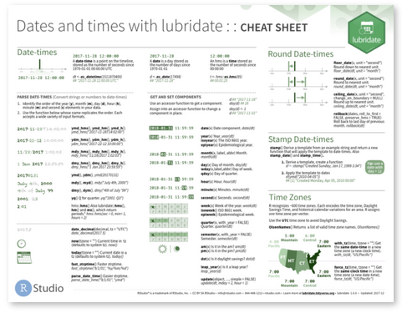
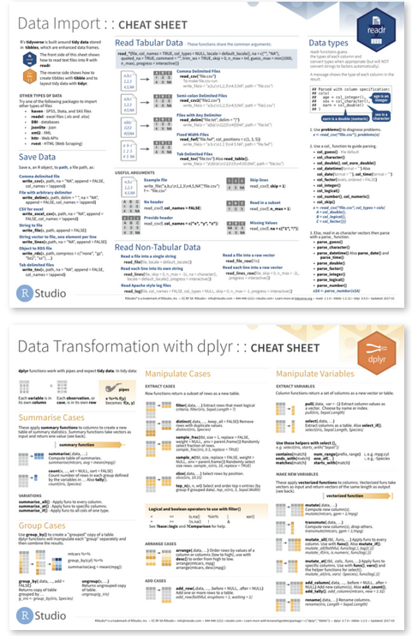
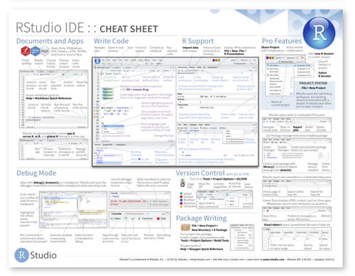
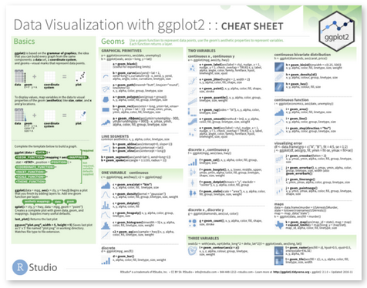
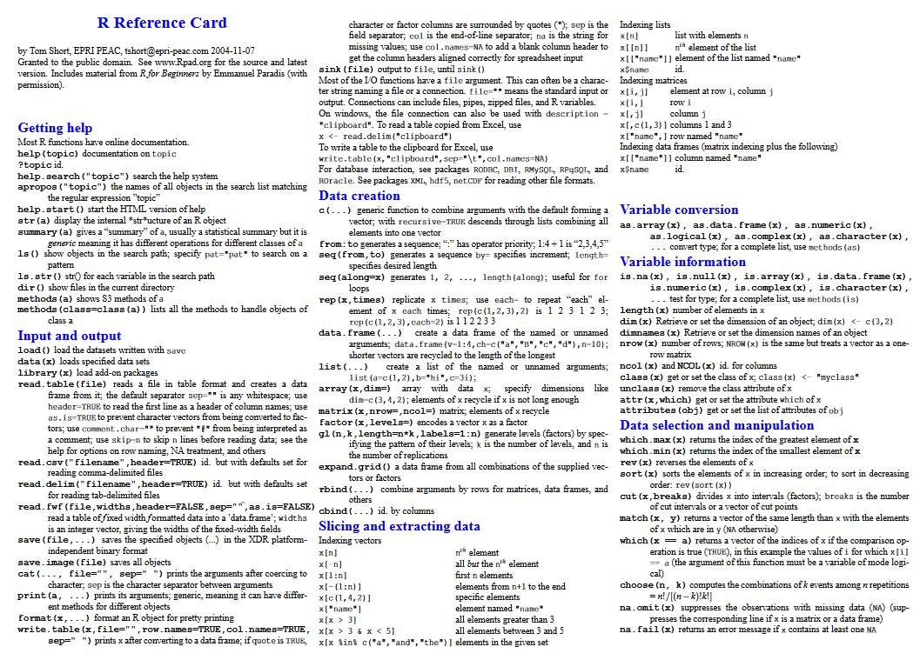
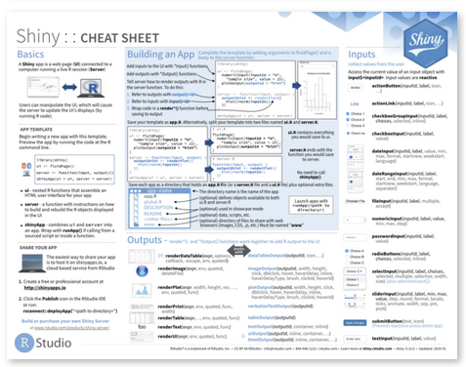
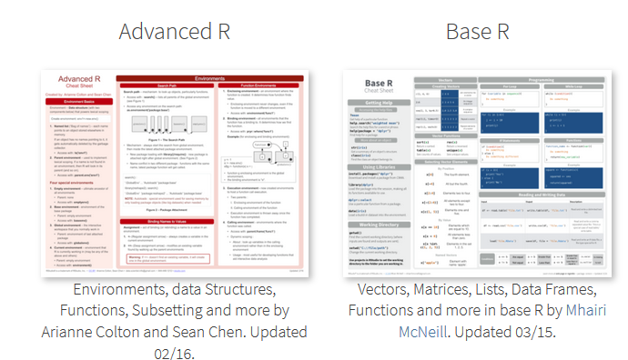
Cheatsheets
https://www.rstudio.com/resources/cheatsheets/

Slide 10
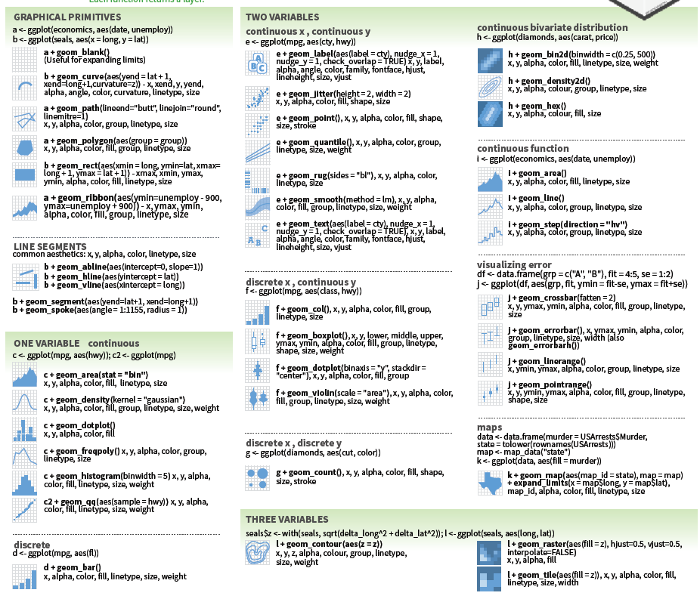
Cheatsheets
What do you want to do?
Only way to find out how to do it is to be aware of what is possible.

Slide 11
Test Datasets
Sometimes the best way to try and/or learn something is to play with a fake dataset that might be like one you’ll create.
data()
Or, make up your own. See script.

Slide 12
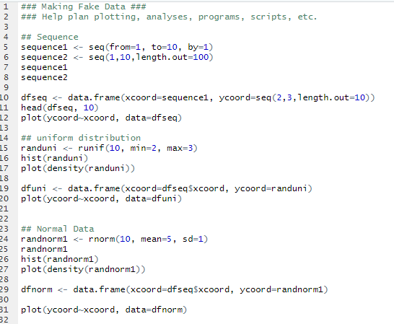
Test Datasets

Slide 13
R Books
r4ds
Advanced R
Hands-On Programming in R
Art of R Programming
R Cookbook
R Graphics Cookbook
Biometry/Intro to Stats/FSA/Derek Ogle website
See sharepoint stats stuff

Slide 14
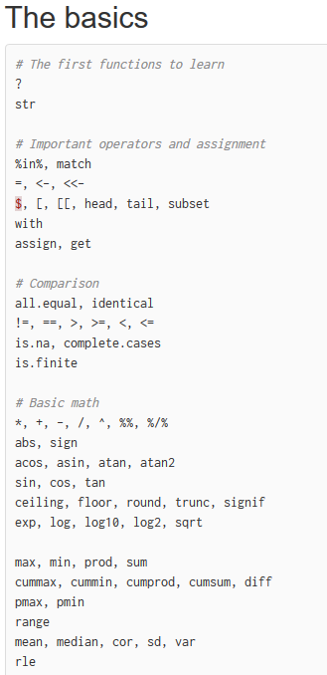
Vocab
http://adv-r.had.co.nz/Vocabulary.html

Slide 15
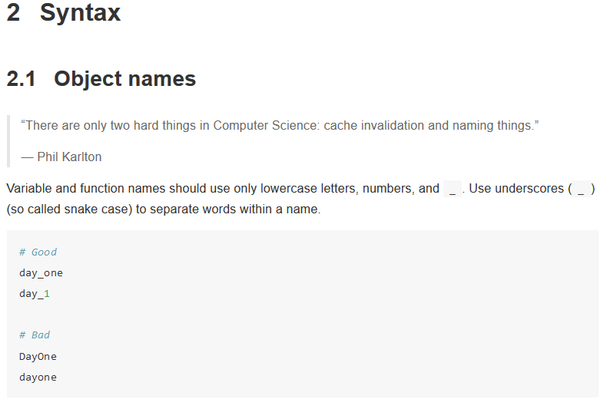
Style Guides
https://google.github.io/styleguide/Rguide.xml
https://style.tidyverse.org/
http://adv-r.had.co.nz/Style.html

Slide 16
Wrap Up
Make R a tool so you can think less
Dedicate time to it same as you do reading the lit.

