Slide 1
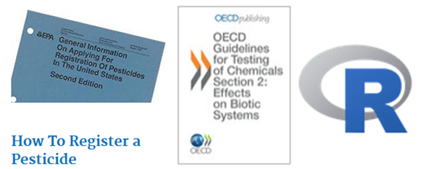
R for EcoTox #2b
Andrew East
April 2019

Slide 2
Plotting/Analysis
Plotting/analysis in general—read the R cookbook.
See Chris’ stats lectures as well—especially for ANOVAs.
Hot Topics:
Plot beautification
ggplot vs base plots
Arrows, segments, text annotation
Plot by some sort of grouping

Slide 3
Fake Data
Clone github.com/eastandrew/lecturenotes
Extract .zip into empty directory (folder)
Open datasourcing.r script
Edit with your code

Slide 4
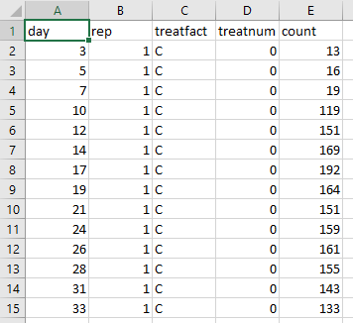
Fake Data
Populations through time
How many treatments?
How many replicates?

Slide 5
Fake Data
?length
length(data$vec)
?unique
length(unique(data$vec))

Slide 6
What ?’s

Slide 7
What ?’s
Number through time—mean, all, other stats
Difference from mean

Slide 8
Relatable data?
Something through time by multiple group levels
What other data are like that?

Slide 9
What kinds of plots?
Those that show trends and error/variability and groups
Those that support the type of analysis!

Slide 10
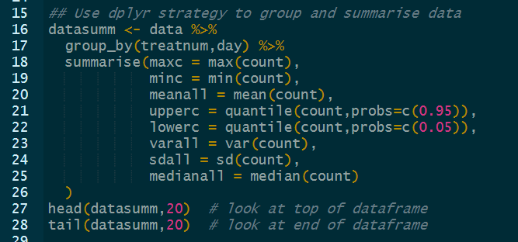
Mean through time
What do we need to do?
Summarize then plot

Slide 11
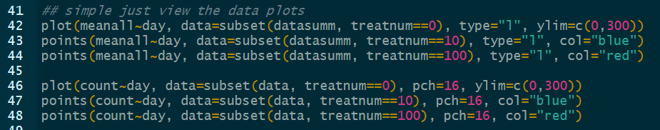
Mean through time

Slide 12
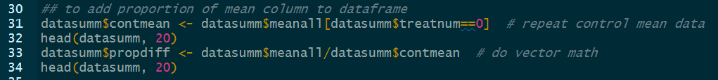
Diff from control
What do we need to do?
Summarize, calculate, then plot

Slide 13

Diff from control
What do we need to do?
Summarize, calculate, then plot

Slide 14
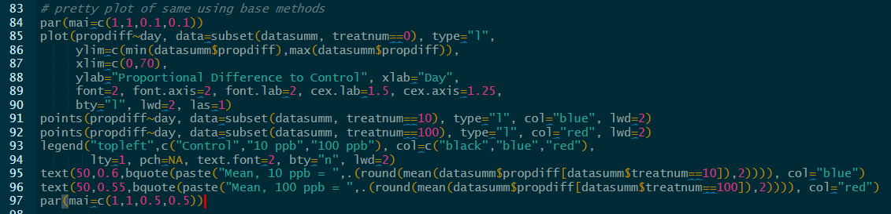
Diff from control
How to make pretty?
See ?par and the internet.

Slide 15
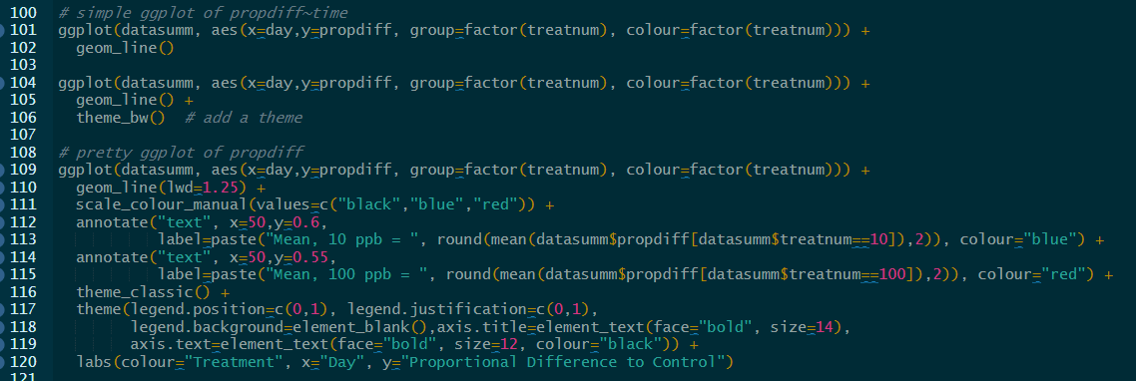
Diff from control
ggplot?
See also R cookbook for graphics

Slide 16

What about inds
Do individual replicates matter?
Confirm labeling/summary, plot carefully.

Slide 17
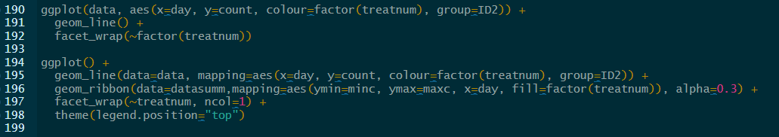
What about inds
Facets and ribbons?

Slide 18
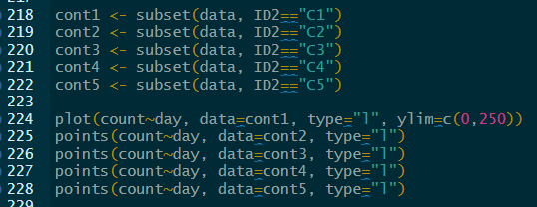
What about inds
In base this would require subsetting by each individual and plotting each individually…lots and lots of copy-paste and error likelihood.

Slide 19
More
Check out cheatsheet
https://www.rstudio.com/resources/cheatsheets/

