Slide 1
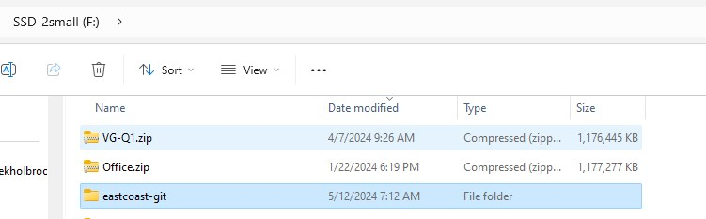
Setup GitHub Desktop
Create a new folder on your computer, make sure you know where it’s located on the drive

Slide 2
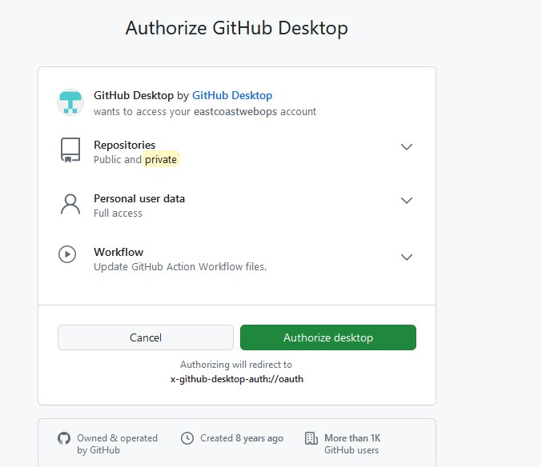
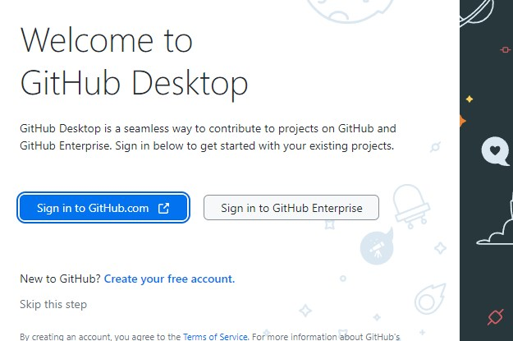
Download GitHub desktop and install

Slide 3
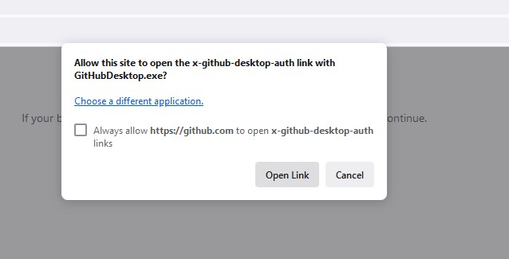
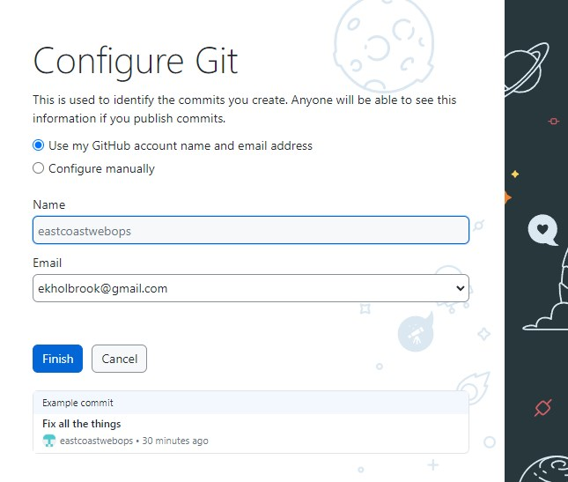
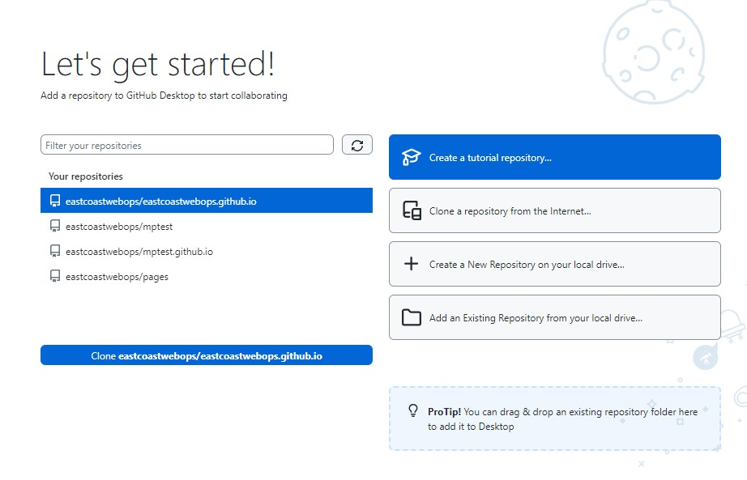
Choose the 2nd option

Slide 4
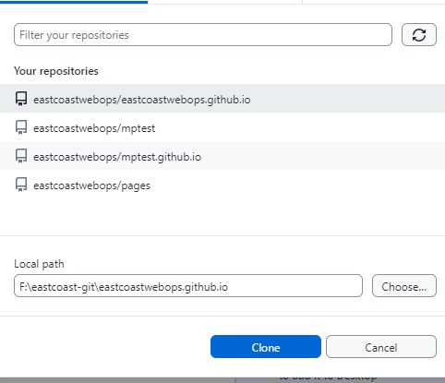
The choose your main repository and choose the folder your created in step 1.
Then Hit “Clone”

Slide 5
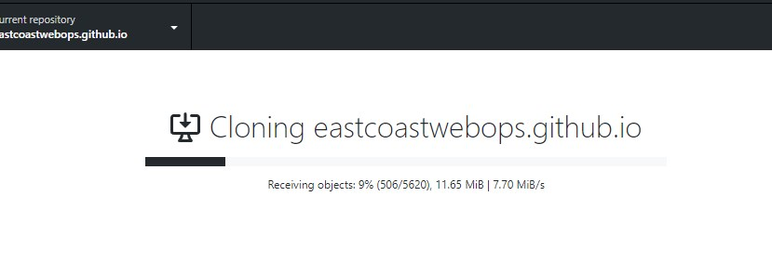

Slide 6
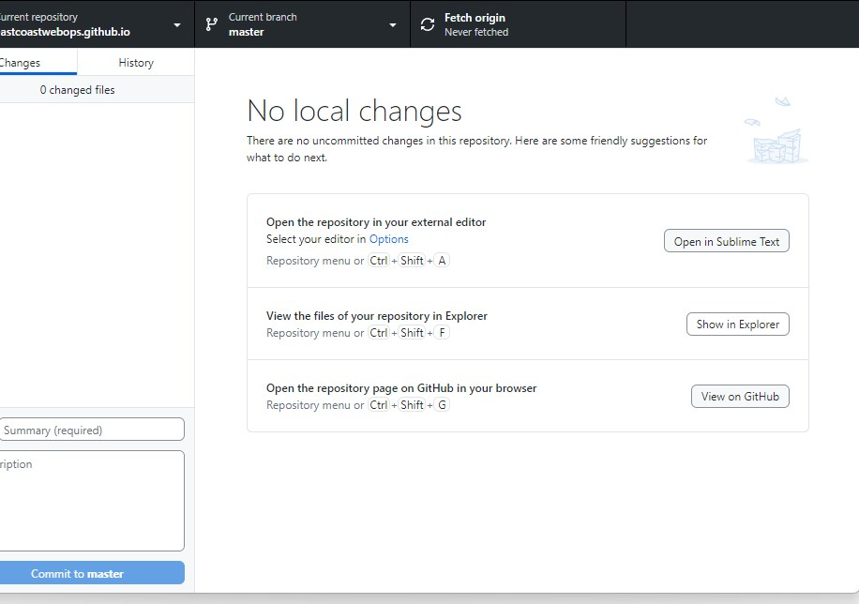
Choosing this will now open, in windows file exporer, the files and folders you had created on Github the other day, but now they will be on your computer, more easy to edit.

Slide 7
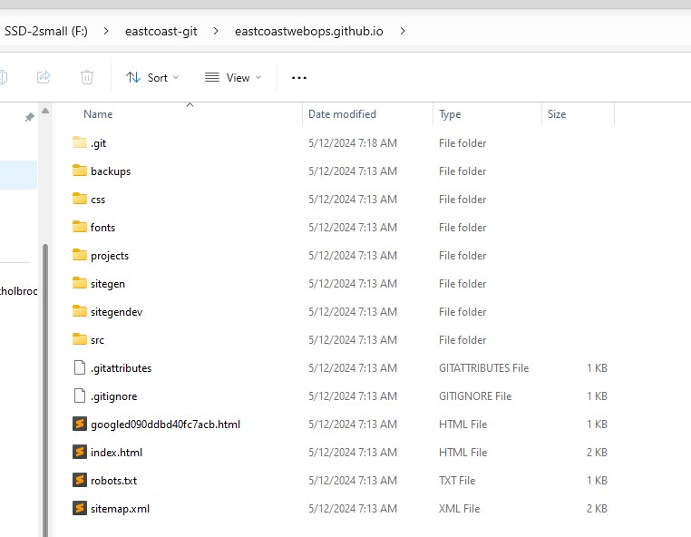
For mine, this is what I see. For you will be same idea, just different file names and folders a bit.
Everything in HERE, now becomes part of your github online site. You can edit offline or without the app running, and make changes. When the app is running, changes will be uploaded to the github site.
Let’s create a new test file ..

Slide 8
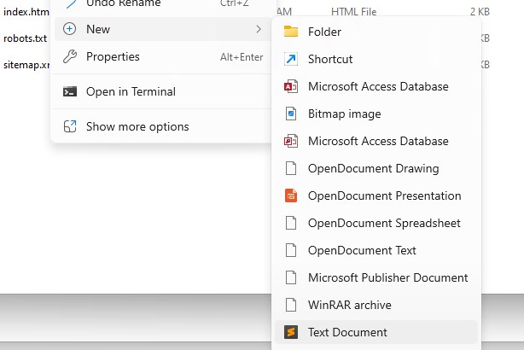
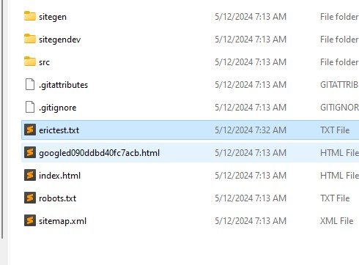
I created a new text file, called erictest.txt

Slide 9
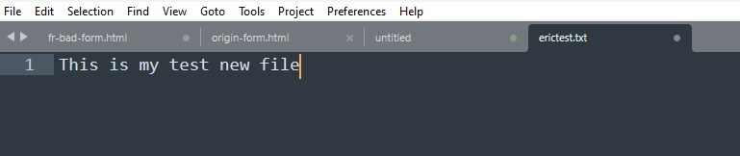
Opened it up to edit and drop in some text, then save

Slide 10
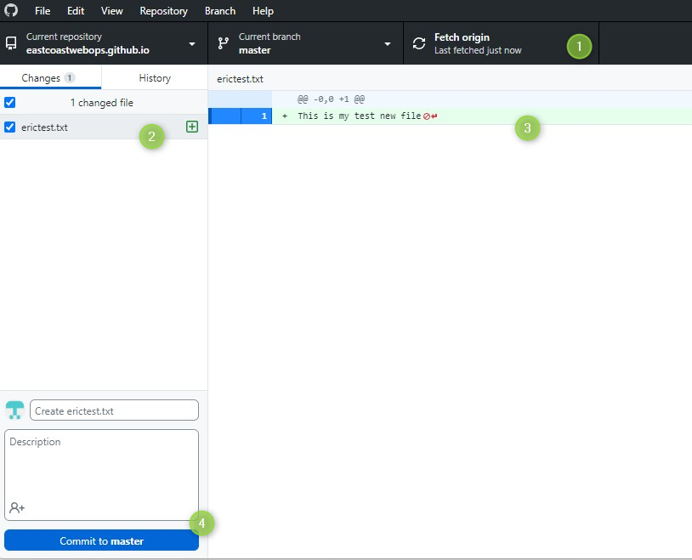
Go back to GitHub application and
Locate tabs across top, specifically at #1 and then changes seen #2. You may need to, first time choose “Fetch origin” on #1
This should get any new or changed files in your site/project online...and compare to local files.
Then notice how shortly it will find new file you created, and the content IN the new file.
Hit- commit to master, meaning your new file will become part of the main site (master) project as opposed to some other secondary project

Slide 11
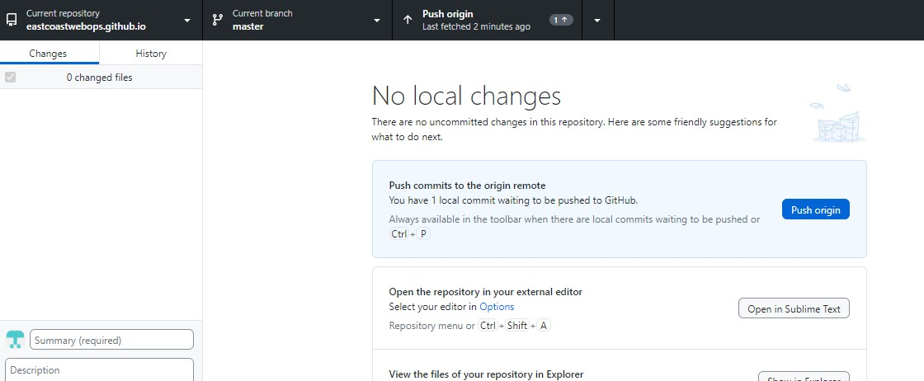
You can now “Push” or upload these changes to the site, either clicking on tab here on top (Push Origin and 1 change)…. Or this blue button

Slide 12
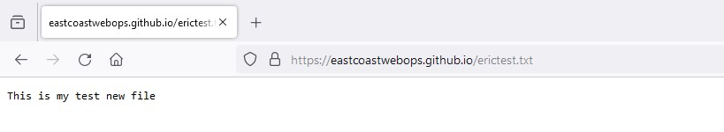
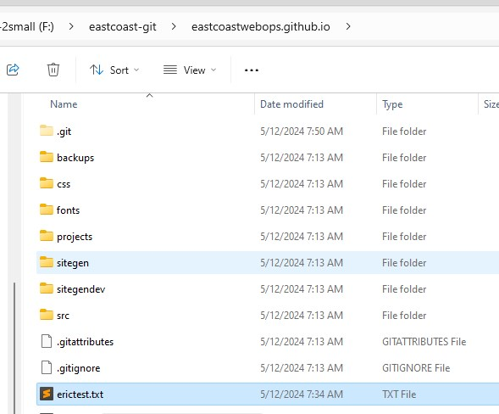
View your new file online. In same place you created “offline”
Meaning.. mine is eastcoastwebops.github.io/erictest.txt
And I can easily see this even in windows.

Slide 13
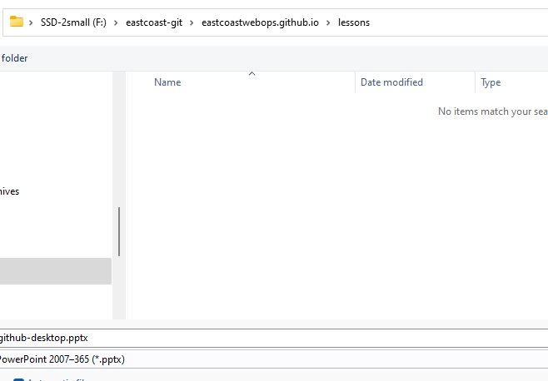
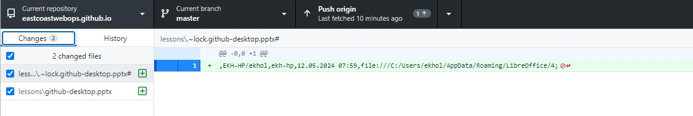
One final cool thing, because you can store files, while you do NOT want to store anything personal because, you can store a file like I am about to do for this Powerpoint. And create a PDF too. I created new folder in my windows side, saved out the file…
And github sees.. and I follow same exact steps!

Slide 14
The End

