Slide 2
problem explain, aim
Real-time video streaming technology is increasingly being utilized across a wide range of applications, with growing demand.
Initially limited to smaller tasks such as personal broadcasting and live security, it is now being actively employed in large-scale scenarios like warfare and intelligence operations.
Cost-effective and customizable systems for specific operational needs like drones have become critical.
With this in mind, we aim to develop a live video streaming system that is not only portable and mountable but can also be easily attached to any system. Additionally, we will analyze the network performance, to get deep understanding of network system.

Slide 3
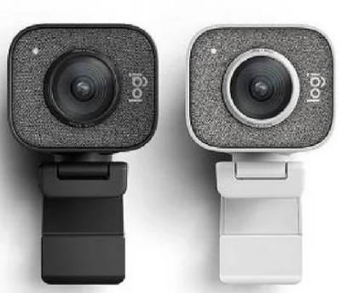
Limitations of Existing Camera Live Streaming Systems
Existing camera live streaming systems are often released as complete products, which limits their ability to be customized for specific scenarios.
For instance, users are typically unable to configure the communication protocol, adjust the video quality, or determine acceptable levels of delay.
Our goal is to develop this system from scratch, enabling us to customize network settings and optimize the system to meet our specific requirements.

