Slide 1
The QuickSort Project
By Python Team 2:
Easton Birdsong and Jessica Oh

Slide 2
Starting Out
Reform and decompose the problem:
Create a model of an “item” -- abstract an “item” class
Import data and store in a list -- change the data representation from CSV data to a list of items
Standardize input data between teams -- generalize the structure of the input file
Sort the list by item number -- recursively halve and sort the list
Output the sorted list - change the data representation back to CSV data from a list of items

Slide 3
Item Class
The purpose of a class is to act as a data type that contains information imported from a source CSV via the CSVitemImporter function.
Abstraction - The class allows us to hold and manipulate values that are important to our problem domain.
Generalization - We were able generalize different objects through an attribute that holds the item’s description. Had we created subclasses based on item type, then the generalization goes away.
Data Representation - The class is holds the attributes in a way that is conveniently available via setters and getters. Additionally, overloading __str__ gives convenience as an output for the CSVitemWriter function and printing item data during debugging.

Slide 4
The Functions
Algorithmic Design through functions:
CSVitemImporter - Import the data, create items from the data, and put items into list
quickSort - Sort a list of items
CSVitemWriter - Export a list of items to a data file
CheckArgCount - Checks if expected arguments were provided

Slide 5
CSVitemImporter Overview
The class decided on a standardized CSV input file with the header as:
item_number, quantity, bin_num, in_stock, name, price
The purpose of this function is to create a list of item objects from data contained in a CSV file. We opened the CSV file and read row by row. For each row of attributes, an item object was created and added to a list. The file was then closed.
We checked if the CSV file to be opened was able to be found and returned an error message and an empty list if an IO Error occurred.
Notes:
Jessica

Slide 6
CSVitemImporter Part 2
Data Representation:
By creating a list of items from CSV data, the data changes to a form that facilitates sorting.
Problem Reformation:
The DictReader class uses the first row in the CSV, the headers, to refer to the columns in the CSV. By using DictReader, we can refer to the columns as their header names.
362 csv_reader = csv.DictReader(csv_file)
...
366 for row in csv_reader:
...
373 itemList.append(item(int(row["item_number"]), int(row["quantity"]), int(row["bin_num"]), row["in_stock"], row["name"], float(row["price"])))

Slide 7
quickSort Overview
This function takes in a list of item class objects and then pops the last item off of the end of the list. That is the pivot item.
We then iterate through the item list, and, with the use of a getter function, compare the item’s “item_number” attribute to the pivot item’s attribute, the pivotValue. The items are appended to either the [greaterThan] or [lesserThan] sublists accordingly, with items equal to the pivotValue chosen to be appended to the [lesserThan] sublist.
The recursive calls hit the base case when the sublist length is either one or zero. If the list’s cardinality is even, we can handle it by going to zero. If the list’s cardinality is odd, this allows us to return up the call stack early.
We made all attributes private with decorators for setters and getters, meaning we can perform any sort of value validation if needed.
Notes:
Easton

Slide 8
quickSort Part 2
We identified the following computational thinking elements in quickSort:
Decomposition, Recursion, and Parallel Processing - Decomposition and Recursion occurs when the sublists are passed into a function that is the function nested within itself. This occurs in the following rows:
Problem Reformulation - This also can be found in the two lines above. We’re taking a larger problem and making it smaller with each recursive call.
Generalization - We generalized the infinite set of all integers into two groups-- larger than the pivot point and smaller than the pivot point-- when we sorted the list into two sublists.
337 returnList = quickSort(lesserThan) ... 341 returnList.extend(quickSort(greaterThan))

Slide 9
quickSort Part 3
Separation of Interface from Implementation - The rest of the code outside of the quickSort function’s definition only knows of quickSort. It’s a function that accepts a list of items and returns a list of items. The rest of the code is decoupled from quickSort’s inner workings.
Pattern Recognition - This can be found when we assess the list to see if it’s true for the base case. Unique cases should be acted upon differently than everything else.
# This is the base case, we can't sort a list that contains only one or zero items so we'll send it back up the call stack if len(itemList) < = 1: return itemList

Slide 10
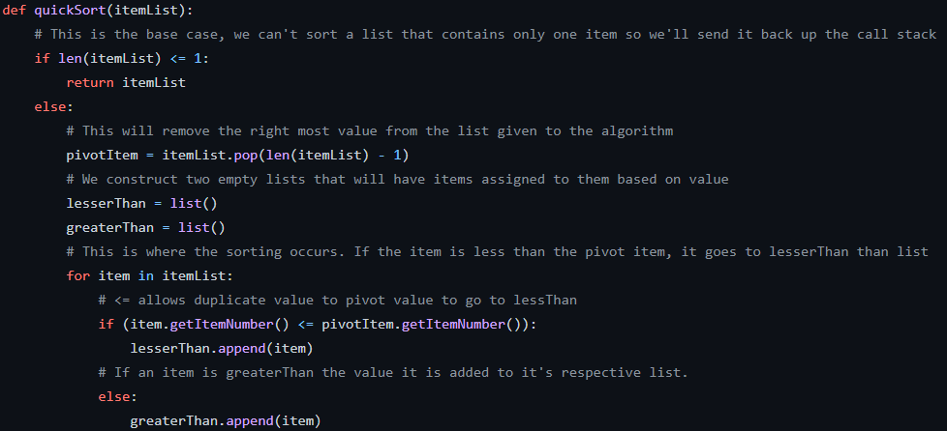
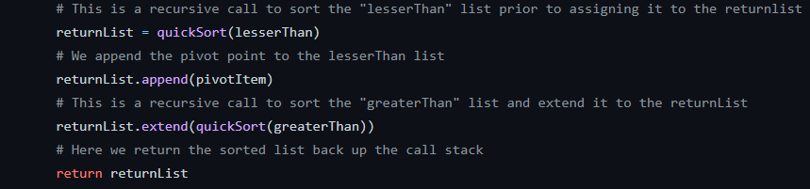
quickSort Part 4
Algorithmic Design - The quickSort algorithm is very easy to follow. Each line has a specific task and doesn’t call an earlier line using something like “goto”. The function halts when it completes appending sublists and pivot items and returns a sorted list to the originating function call in the call stack.

Slide 11
quickSort Part 5
Data Representation - The abstracted items are passed around in lists. This is a convenient way to handle multiple objects iterated through a “for loop”. Additionally, each element can be assigned to the return of an iterator, which can be used to call the item number “getter,” and is treated like any other integer at that point.

Slide 12
quickSort Parallel Processing Rational
We took into consideration parallel processing for our recursive function calls in quickSort. However, there were two major blockers to implementation.
First, the implementation was going to be very difficult because the native resource pooling module is daemonic and won’t allow for nested worker processes within worker processes that have already been spawned. This was going to require studying the module’s classes and overriding inherited constructors, etc.
Two, based on the dataset as per the project’s requirements, it takes less than a millisecond to perform all of the necessary iterating, recursive calls, and coming back up the call stack.
If we had implemented resource pooling, it would take longer to wait for the operating system to spawn additional processes with each recursive call, perform the necessary computations, and receive the signal that the process was successfully killed.

Slide 13
quickSort Function Profiling (Given Data Set)
During the execution phase of this project, we found an awesome module named cProfile. We had to fork our original code and modify it a bit, but it was well worth it. Here is a brief overview of what we were able to extract when comparing data from a Windows box to a Linux box with comparable hardware.
Main.py Statistics
Linux Stats | Windows Stats
471 function calls | 502 function calls
457 primitive calls | 488 primitive calls
Total Execution Time 0.001 sec | Total Execution Time 0.002 sec
35 Unique Functions Called | 36 Unique Functions Called
 | quickSort Statistics
 | ncalls | tottime | percall | cumtime | percall | filename:lineno(function)
Linux | 15/1 | 0.000 | 0.000 | 0.000 | 0.000 | main.py:336(quickSort)
Windows | 15/1 | 0.000 | 0.000 | 0.000 | 0.000 | Main.py:336(quickSort)

Slide 14
CSVitemWriter
We decided to create a function to transform a sorted list of items back into a CSV file.
We opened a new file to write in and cycled through the item objects in the given item list, writing each item’s attributes as its own line. Then, the file was closed.
Through another data representation change, the data is now in a form optimal for storage.
402 for itemObj in itemList
...
405 fileObject.write(str(itemObj) + “\n”)
Notes:
Jessica

Slide 15
The CSV Functions:
The major computational thinking terms related to both CSVitemImporter and CSVitemWriter are:
Decomposition and Algorithmic Design
The actions of importing from or exporting to a CSV file are separate and both functions must open and close the relevant CSV file.
Pattern Recognition
Both functions go through a “items”, as either a row of data or as an object in a list, in sequential order

Slide 16
CheckArgCount
Algorithmic Design - This function’s sole purpose is to ensure that the correct number of parameters are passed in. It shares this information with other functions by returning a Boolean value. We implemented “if-else” statements to catch the returned value to either continue executing as normal or to call a return in main, which terminates the program.
The benefit of this allows the input file and output file names to be determined when the program is ran.

Slide 17
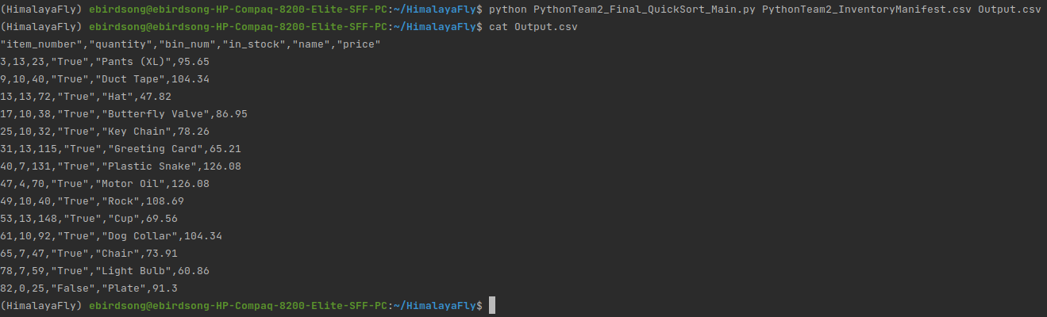
Our Python Script
Separation of Interface from Implementation - Executing the Python script requires two arguments: a valid input file and a path for an output file.

