Slide 1
Wrapping things up
Easton White
Alan Hastings
Winter 2018

Slide 2
Learning objectives
By the end of today:
Review the material from this entire quarter
Understand how to talk to other about important issues

Slide 3
Week | Date | Topic | In-class activity | Homework
1 | 9-Jan | Introduction, code of conduct, class goals |  | Read Baloney Detection Kit and answer questions on Canvas
2 | 16-Jan | Discuss Sagan’s kit. Logical fallacies | In-class: Logical fallacy detection | Assignment: Online video and questions
3 | 23-Jan | Scientific method | Group project: Black box activity | Finish group project
4 | 30-Jan | Quantitative thinking | Group project: Fermi problems | Finish group project
5 | 6-Feb | Common marketing strategies |  | Paper: Write about short video/news article
6 | 13-Feb | Prosecutors fallacy and the courtroom |  | Assignment: Breast cancer problem
7 | 20-Feb | Guest Lecture: Navigating the Web
8 | 27-Feb | Guest Lecture: Media and Politics
9 | 6-Mar | Pseudoscience |  | Paper: Choose tool to add or expand on
10 | 13-Mar | How to call out bullshit and teach others about detecting bullshit

Slide 4
Potential topics
Course evaluation
Where we started
What we have seen
How to you convince others of things?
Not more data
Not arguing based on your values

Slide 5
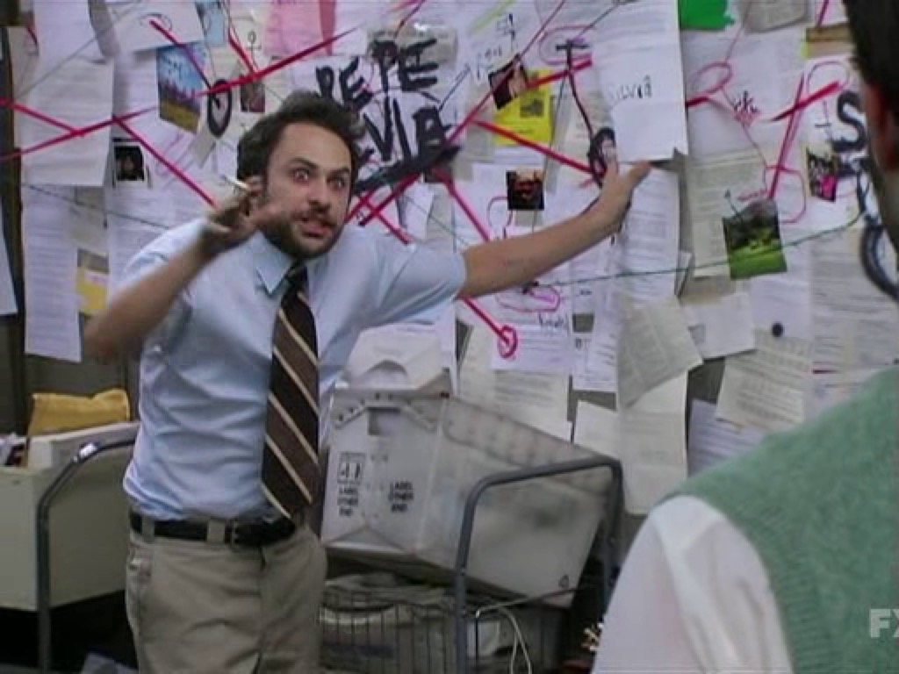
Suppose your friend is going on and on about a flat Earth
Or suppose your friend is against you on a political issue

Slide 6
Recent paper analyzed data from ChangeMyView.com to see if and how people could persuade:
should use definitive articles like “the” instead of “a”
Should use language like, “it could be the case”
Use “I” instead of “we” language
Stubborn views are more closely associated with words like
“anyone,” “certain,” and “nothing,” and “worst” and “best.”
Notes:
http://www.independent.co.uk/news/science/how-to-convince-some-to-change-their-mind-according-to-science-a6867291.html

Slide 7
More data is not usually the answer
Often termed the “backfire effect”
We become more entrenched in our beliefs when presented with data that contradicts those beliefs

Slide 8
Convincing someone of an argument
E.g. If you were a republican, how would you convince a liberal to support higher military spending?
Alternatively, if you are a democrat, how would you convince a republican to support gay marriage?
Notes:
https://www.vox.com/2016/11/23/13708996/argue-better-science
https://news.stanford.edu/2015/10/12/framing-persuasive-messages-101215/

Slide 9
Conservatives
Use what is called “Moral reframing”
Liberals
Patriotism
Loyalty
Limited government
Equality
Fairness
Government intervention

Slide 10
Homework for this week
Go back to Sagan’s baloney detection kit. Choose one of the tools he discussed OR create your own. Explain how the tool works.
Then, show an example of the tool applied to a news article, politician speaking, Youtube video, or something else
It is due by the 16th March (Friday) at midnight

