Slide 1
Living in a post-truth world: Building your personal baloney detection kit
Easton White
Alan Hastings
Winter 2018

Slide 2
Living in a post-truth world: Building your personal baloney detection kit
bullshit
Easton White
Alan Hastings
Winter 2018

Slide 3
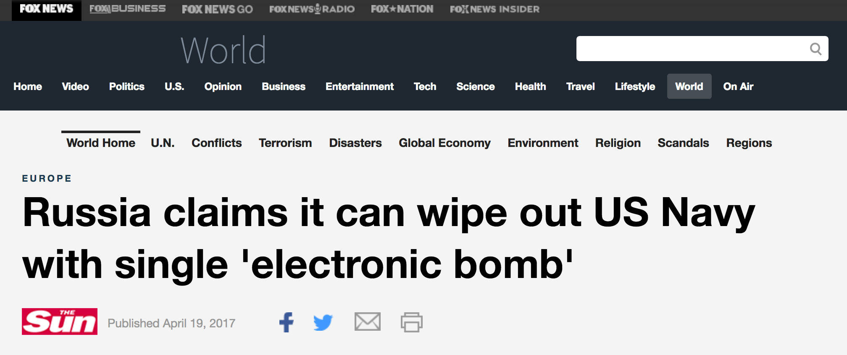
Notes:
https://www.nytimes.com/interactive/2017/06/07/world/europe/anatomy-of-fake-news-russian-propaganda.html?hp&action=click&pgtype=Homepage&clickSource=story-heading&module=second-column-region&region=top-news&WT.nav=top-news&_r=2

Slide 4
What happened?
April 12, 2014, a Russian Warplane flew close to the United States Navy destroyer ship the Donald Cook
Pentagon issued statement that the ship was fine, but the Russian’s actions were “provocative and unprofessional”

Slide 5
Where did this story come from? What are the facts?

Slide 6
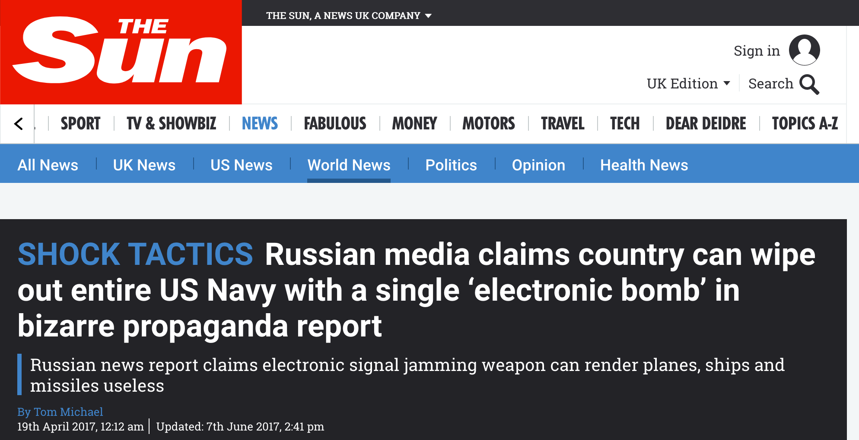

Slide 7
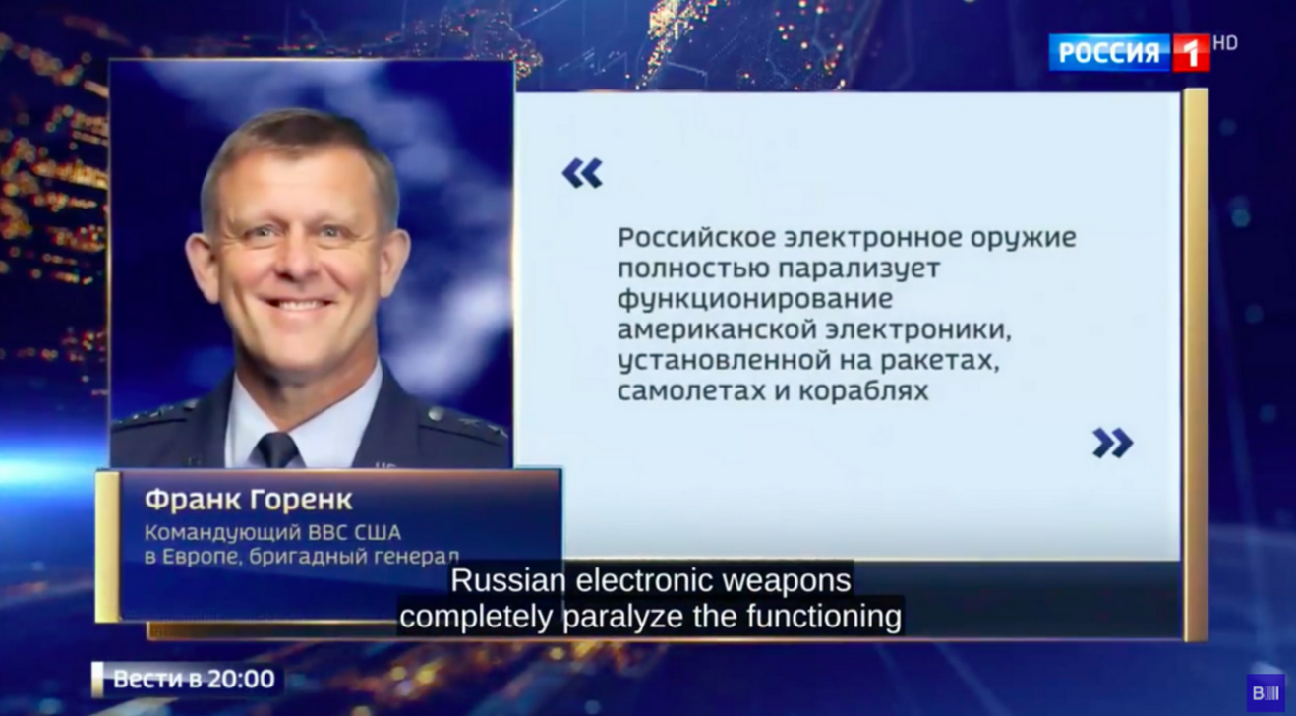
April 15, 2017: Russian television Rossiya-1 runs story about the 2014 incident
Included information about the radio-electric waves that deactivated the destroyer's main systems
Quote from Frank Gorenc, the former commander of the United States Air Force in Europe

Slide 8
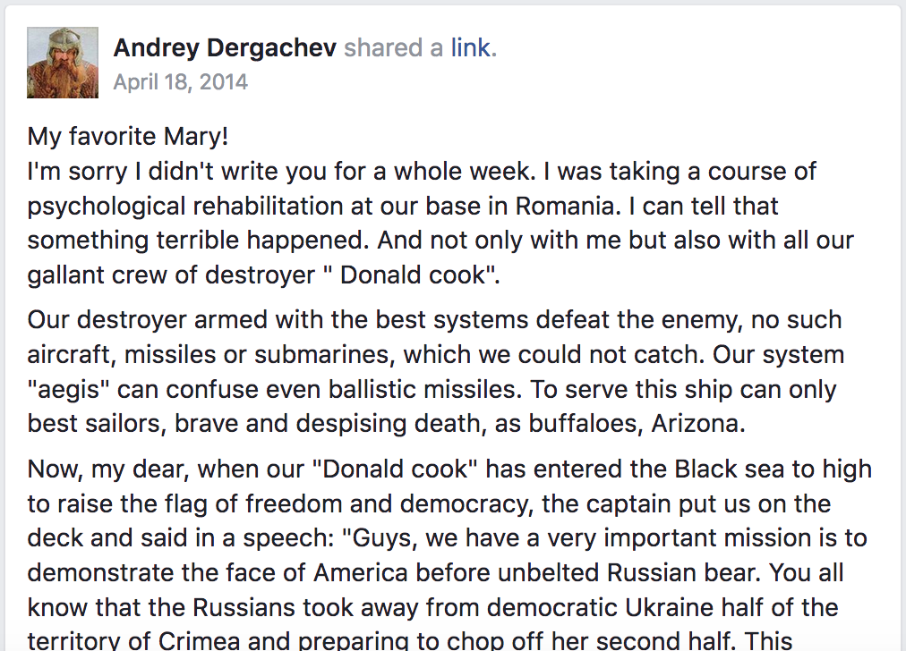
Posts spread on social media

Slide 9
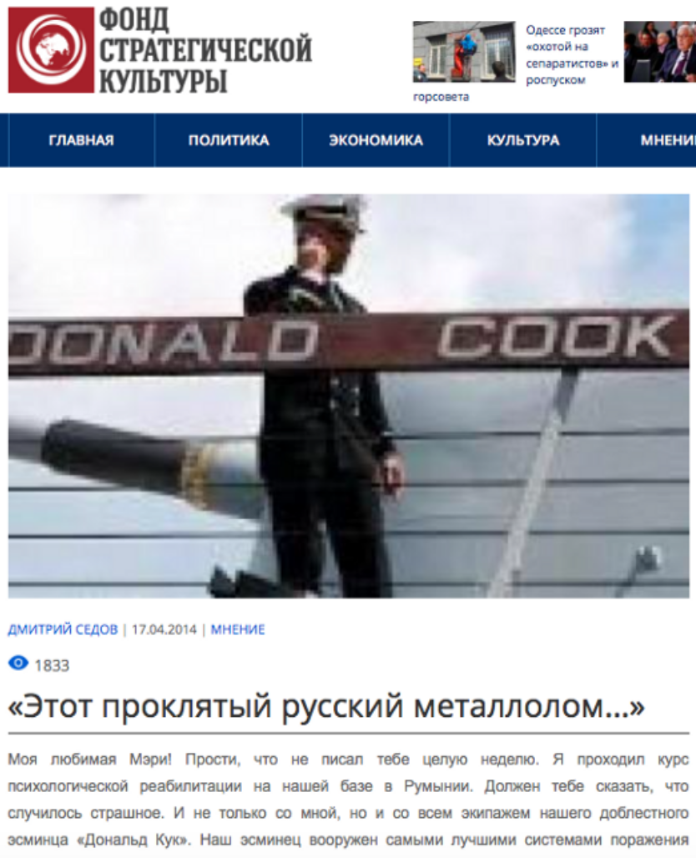
Parody website
Satirical piece wrote about the incident in the Black sea and included a fake description of a crewman’s account of an electronic bomb

Slide 10
Parody website
Satirical piece wrote about the incident in the Black sea and included a fake description of a crewman’s account of an electronic bomb

Slide 11
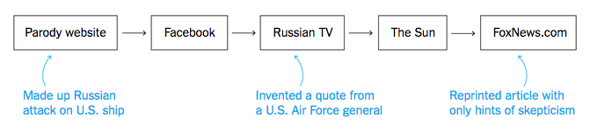
Timeline of fake news

Slide 12
Example of fake news and its consequences
Not just all fun and games

Slide 13
News and social media shape our perspective
Notes:
http://www.journalism.org/2008/10/29/cable-three-different-networks-three-different-perspectives/

Slide 14
News and social media shape our perspective
Notes:
http://www.journalism.org/2008/10/29/cable-three-different-networks-three-different-perspectives/

Slide 15
News and social media shape our perspective
Notes:
http://www.journalism.org/2008/10/29/cable-three-different-networks-three-different-perspectives/

Slide 16
News and social media shape our perspective
Percent of new stories
Notes:
http://www.journalism.org/2008/10/29/cable-three-different-networks-three-different-perspectives/

Slide 17
News and social media shape our perspective
Percent of new stories
Notes:
http://www.journalism.org/2008/10/29/cable-three-different-networks-three-different-perspectives/

Slide 18
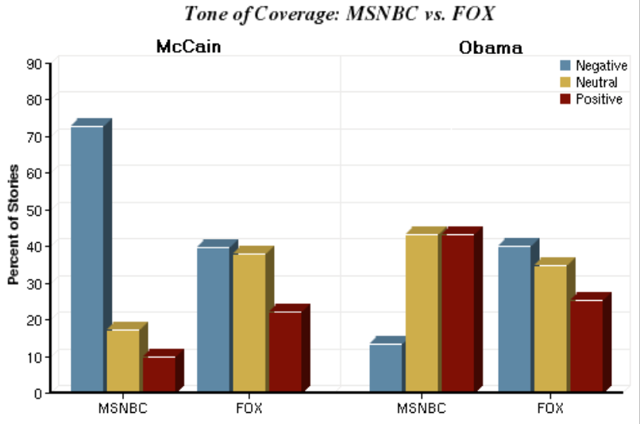
News and social media shape our perspective
PEW research center
Notes:
http://www.journalism.org/2008/10/29/cable-three-different-networks-three-different-perspectives/

Slide 19
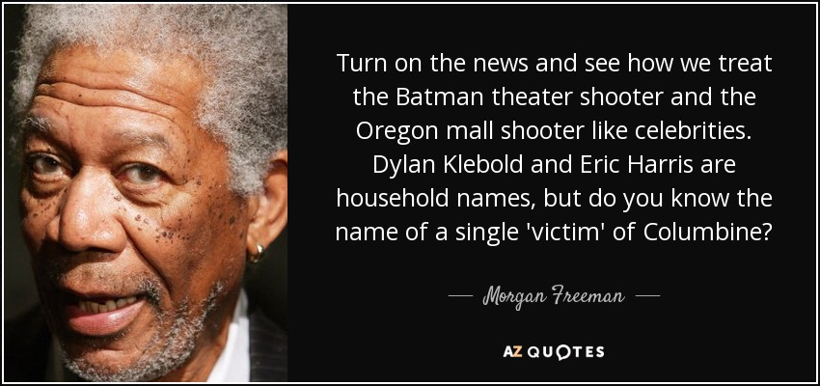

Slide 20
We need a set of tools to sort through so much information

Slide 21
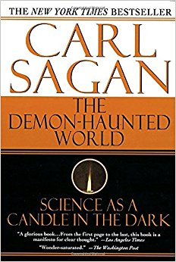
We need a set of tools to sort through so much information
Laid out a baloney detection kit
Independent confirmation of the facts
Occam’s Razor
Logical fallacies
And others

Slide 23
FAKE
Notes:
Quote spread online in response to Newtown shootings

Slide 24
Class logistics and schedule
We will meet every Tuesday from 3:10-4:00pm in this room
Assignments, announcements, readings, and grades will be posted to the Canvas page
Most weeks will involve reading or assignments at home in preparation for the following week

Slide 25
Tentative schedule
Week | Date | Topic | In-class activity | Homework
1 | 9-Jan | Introduction, code of conduct, class goals |  | Read Baloney Detection Kit and answer questions on Canvas
2 | 16-Jan | Discuss Sagan’s kit. Logical fallacies |  | Assignment: Logical fallacy detection
3 | 23-Jan | Quantitative thinking | Group project: thinking quantitatively | Finish group project
4 | 30-Jan | Scientific method | Group project: Black box activity | Finish group project
5 | 6-Feb | Common marketing strategies |  | Paper: Write about short video/news article
6 | 13-Feb | Navigating the web
7 | 20-Feb | Prosecutors fallacy and the courtroom |  | Assignment: Breast cancer problem
8 | 27-Feb | Media and Politics Guest Lecture
9 | 6-Mar | How to call out bullshit and teach others about detecting bullshit |  | Paper: Choose tool to add or expand on
10 | 13-Mar | TBD

Slide 26
How to be successful in this course
Attendance and participation in class is mandatory. A large part of your grade comes from in-class participation during discussions
Pay attention to due dates. Late assignments will lose points
Attend office hours for help with writing or other course assignments
The writing center (in the Student Academic Success Center) can help you with your writing as well

Slide 27
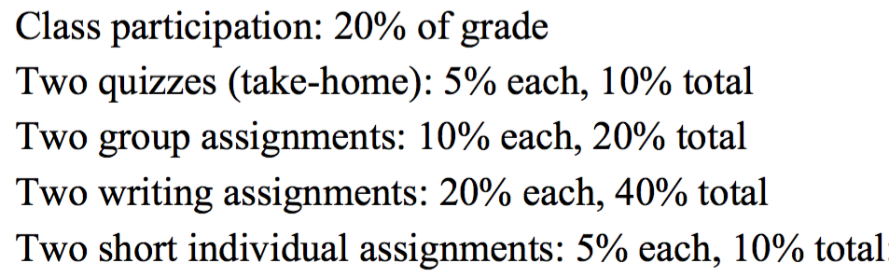
Grading: pass-fail course

Slide 28
Conduct of this class
Lots of classroom discussion on potentially “hot topics”
Classroom rules?

Slide 29
Homework for next week
Read Sagan’s Baloney Detection kit chapter. Answer short-answer questions on Canvas

