Slide 1
The scientific method
Easton White
Alan Hastings
Winter 2018

Slide 2
Changes to the syllabus
Week | Date | Topic | In-class activity | Homework
1 | 9-Jan | Introduction, code of conduct, class goals |  | Read Baloney Detection Kit and answer questions on Canvas
2 | 16-Jan | Discuss Sagan’s kit. Logical fallacies | In-class: Logical fallacy detection | Assignment: Online video and questions
3 | 23-Jan | Scientific method | Group project: Black box activity | Finish group project
4 | 30-Jan | Quantitative thinking | Group project: Fermi problems | Finish group project
5 | 6-Feb | Common marketing strategies |  | Paper: Write about short video/news article
6 | 13-Feb | Prosecutors fallacy and the courtroom |  | Assignment: Breast cancer problem
7 | 20-Feb | Guest Lecture: Navigating the Web
8 | 27-Feb | Guest Lecture: Media and Politics
9 | 6-Mar | How to call out bullshit and teach others about detecting bullshit |  | Paper: Choose tool to add or expand on
10 | 13-Mar | TBD

Slide 3
Think-pair-share exercise
What is science?

Slide 4
One definition
Science: collecting facts about natural processes

Slide 5
So, what is science?
Oxford dictionary: the intellectual and practical activity encompassing the systematic study of the structure and behavior of the physical and natural world through observation and experiment

Slide 6
Black box activity
You have 25 minutes

Slide 7
Two steps:
Answer questions about the object in your box
Trade boxes and papers with another group (peer review), have them evaluate the evidence that you presented

Slide 8
Questions about black box activity
What do you think was in your box? What is your evidence?

Slide 9
Questions about black box activity
What do you think was in your box? What is your evidence?
Did you agree with the group you evaluated in peer review?

Slide 10
Questions about black box activity
What do you think was in your box? What is your evidence?
Did you agree with the group you evaluated in peer review?
How does this activity related to science is done?

Slide 11
The scientific method

Slide 12
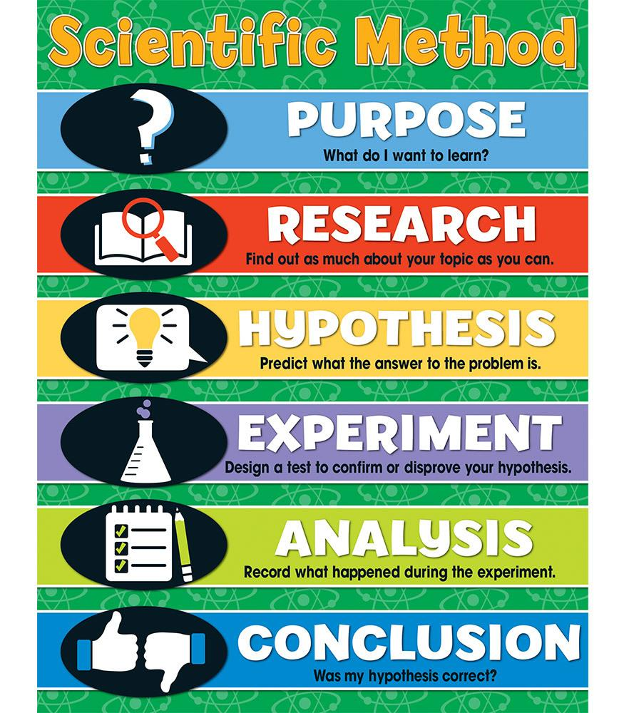

Slide 13
The Scientific Process
www.understandingscience.org

Slide 15
Homework for next week
Online exercises in preparation for next week
This will be posted on Thursday

