Slide 1
Puzzle Oracle Manual Data Formats
For puzzle creators, event administrators and event instructors Covers Software Version: 0.0
By Joseph M. Joy
Copyright © 2015, 2016 Rinworks, LLC Creative Commons License "Attribution 4.0 International (CC BY 4.0)" (http://creativecommons.org/licenses/by/4.0/)
Notes:
Welcome to a brief introduction to Puzzle Oracle. This presentation is to be viewed as a Microsoft "Mix" because the annotations add an important component. The Puzzle Oracle is an windows executable program. It is designed to be self-contained – everything it needs is on a thumb drive, including the program itself. It does not require administrator preveleges to run and does not access the network or any other location on the PC. Let's take a look at the thumb drive contents….

Slide 2
Contents
Master spreadsheet
Input files
puzzle-data.csv - puzzle ids, names, answers, hints
team-data.csv - team ids, names, machine names
current-team.txt - [optional] current team
Output files
logs\<team Id>-<machine name>-<random string>.csv – submission logs Example: logs\T24-JOSEPHJPC-ymXKSURo.csv

Slide 3
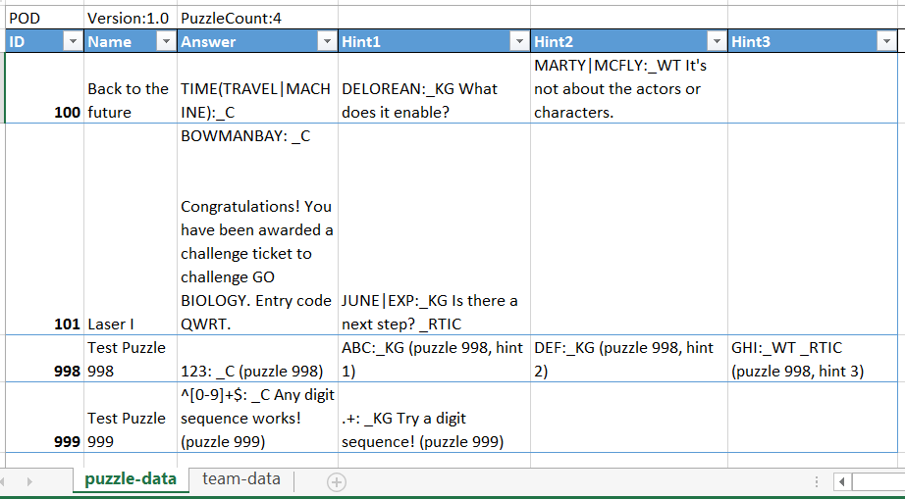
Master Spreadsheet – puzzle-data sheet

Slide 4
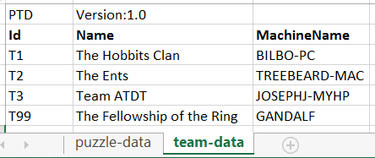
Master Spreadsheet – team-data sheet

Slide 5
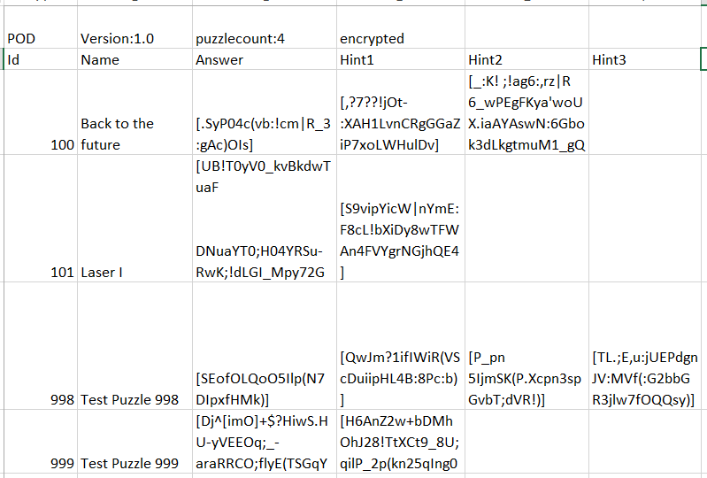
puzzle-data.csv (encrypted puzzle data)

Slide 6
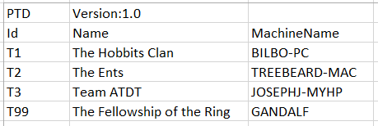

Team Data
team-data.csv
current-team.txt

Slide 7
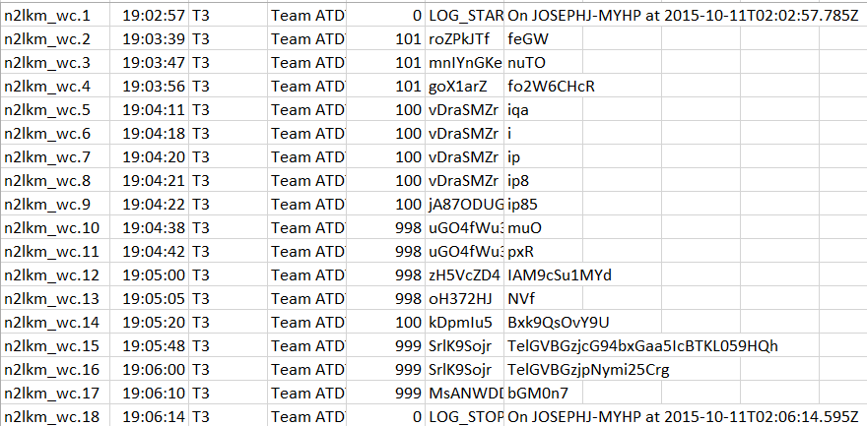
Submission log (example)
T3-JOSEPHJ-MYHP-n2lkm_wc.csv

