Slide 1
ISR
Interrupt Service Routine
(Uzulishlar xizmatining muntazamligi)

Slide 2
ISR nima?
Interrupt mikrokontrollerda dasturni bajarilishini to'xtatib turishiga va interrupt xizmatini bajaradigan yoki Interrupt Service Routine (ISR) deb nomlanadigan dasturni amalga oshiradigan signaldir. ISRdan so'ng dasturni bajarish davom etadi. Bu mikrokontrollerni buyruqni kutishga majburlamasdan, uning pinlaridan biridagi o’zgarish vaqtida sezgir vazifani samarali bajarishga imkon beradi.
Microkontroller prosessori ISR buyruq Intervalini chaqirguncha boshqa vazifalarni bajarishi mumkin.

Slide 3
Interrupt Service Routine (ISR)
Yordamchi kalit so’zlar:
PCMSK – (Pin Change Mask Register 0, 1 va 2)
PCICR – (PCI Control Register) boshqaruv registeri
PCIE – (PCI Enable – PCI yoqish) yoqish buyrug’i
PCI – (Pin Change Iterrupt) uzulish vaqtida pin o’zgarishi

Slide 4
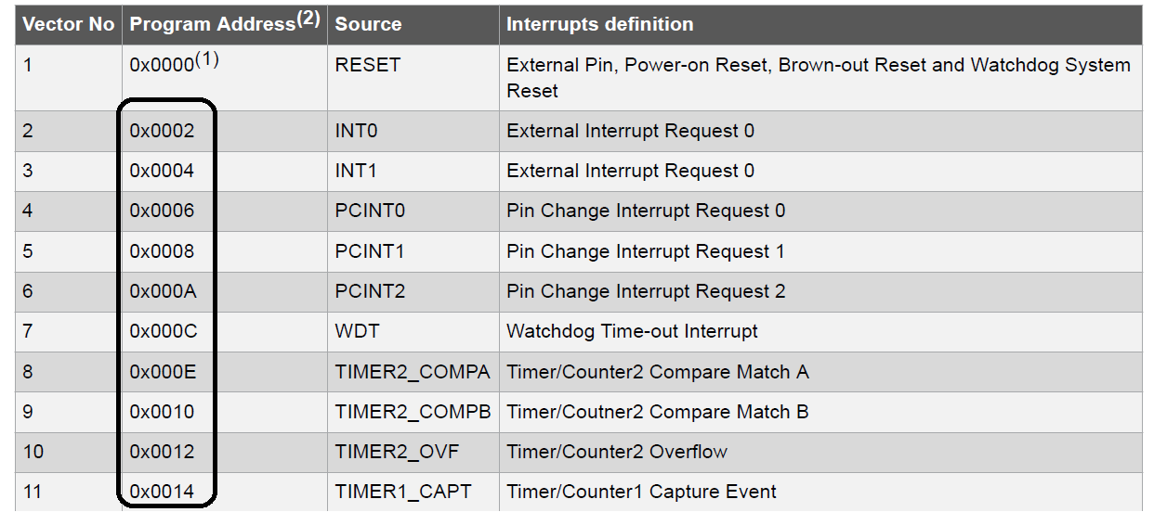
Atmega328 da kechikish (Interrupt) vektorlari

Slide 5
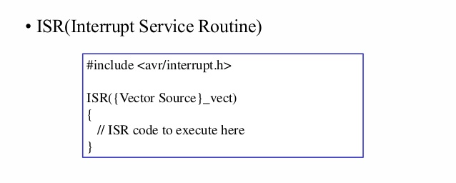
ISR dan foydalanish

Slide 6
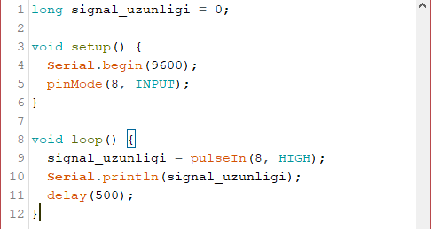
Misol
“pulseIn()” - funksiyasini ichki tuzilishini Interrupt orqali foydalash.

