Slide 1


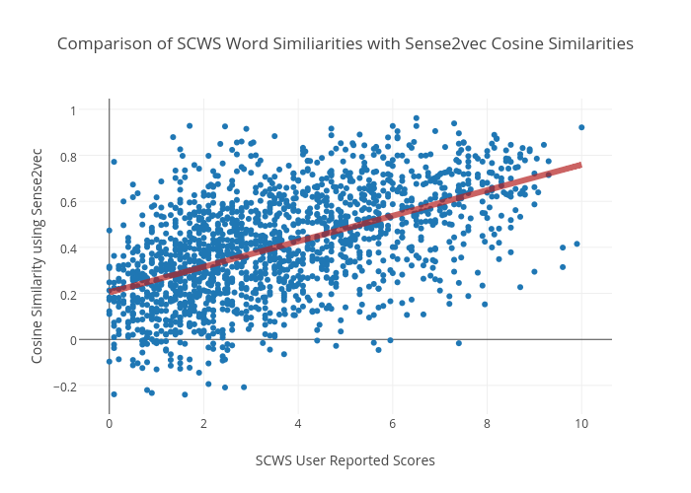
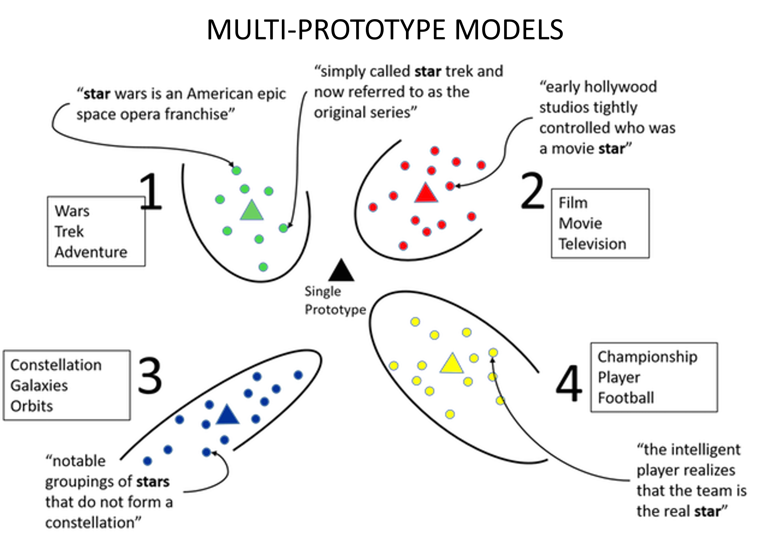
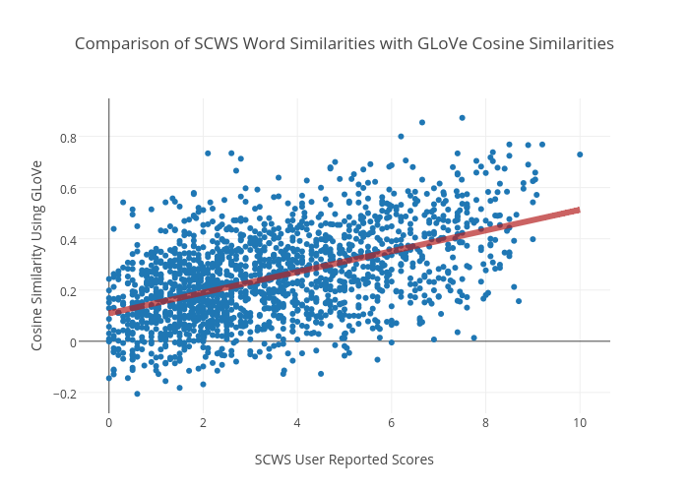
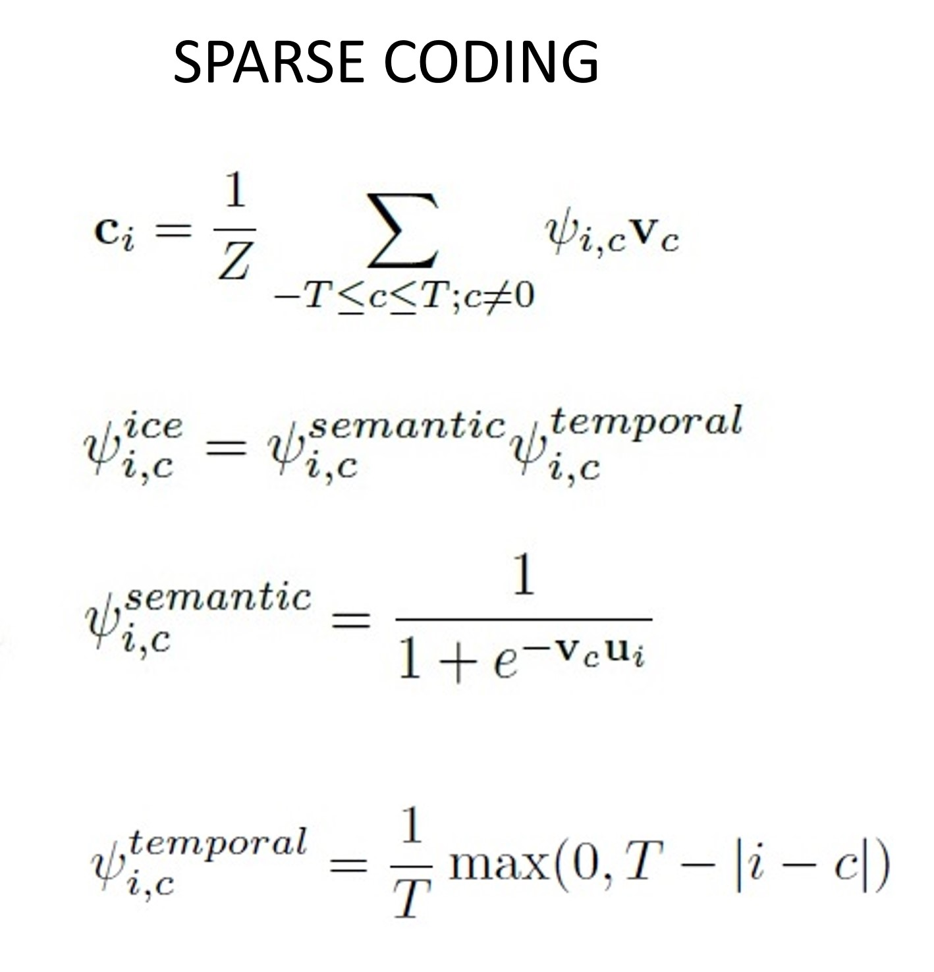
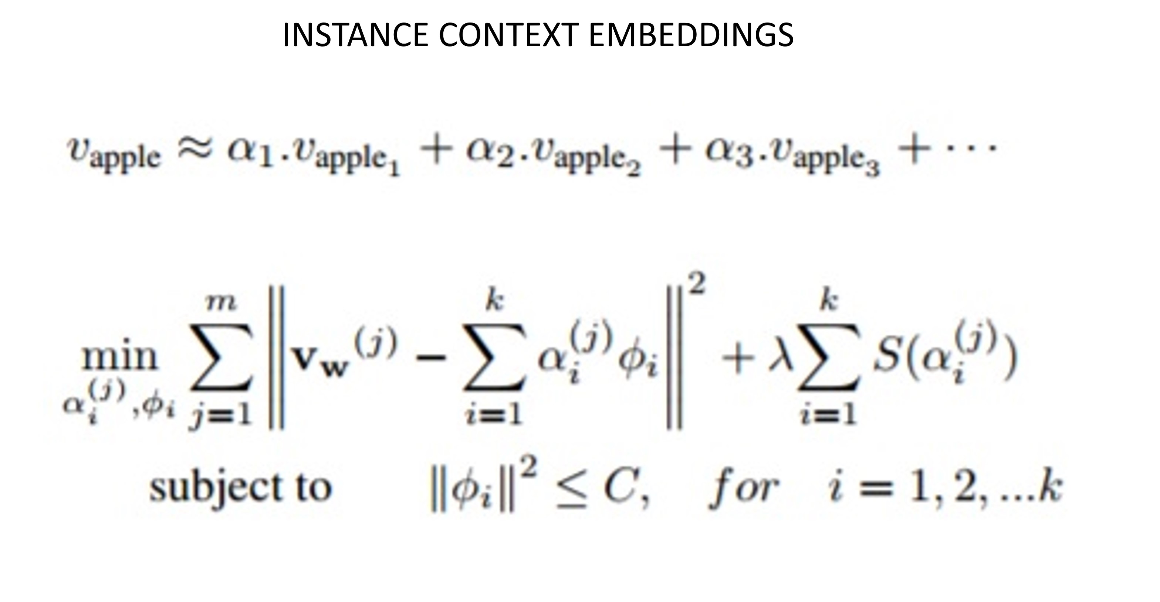

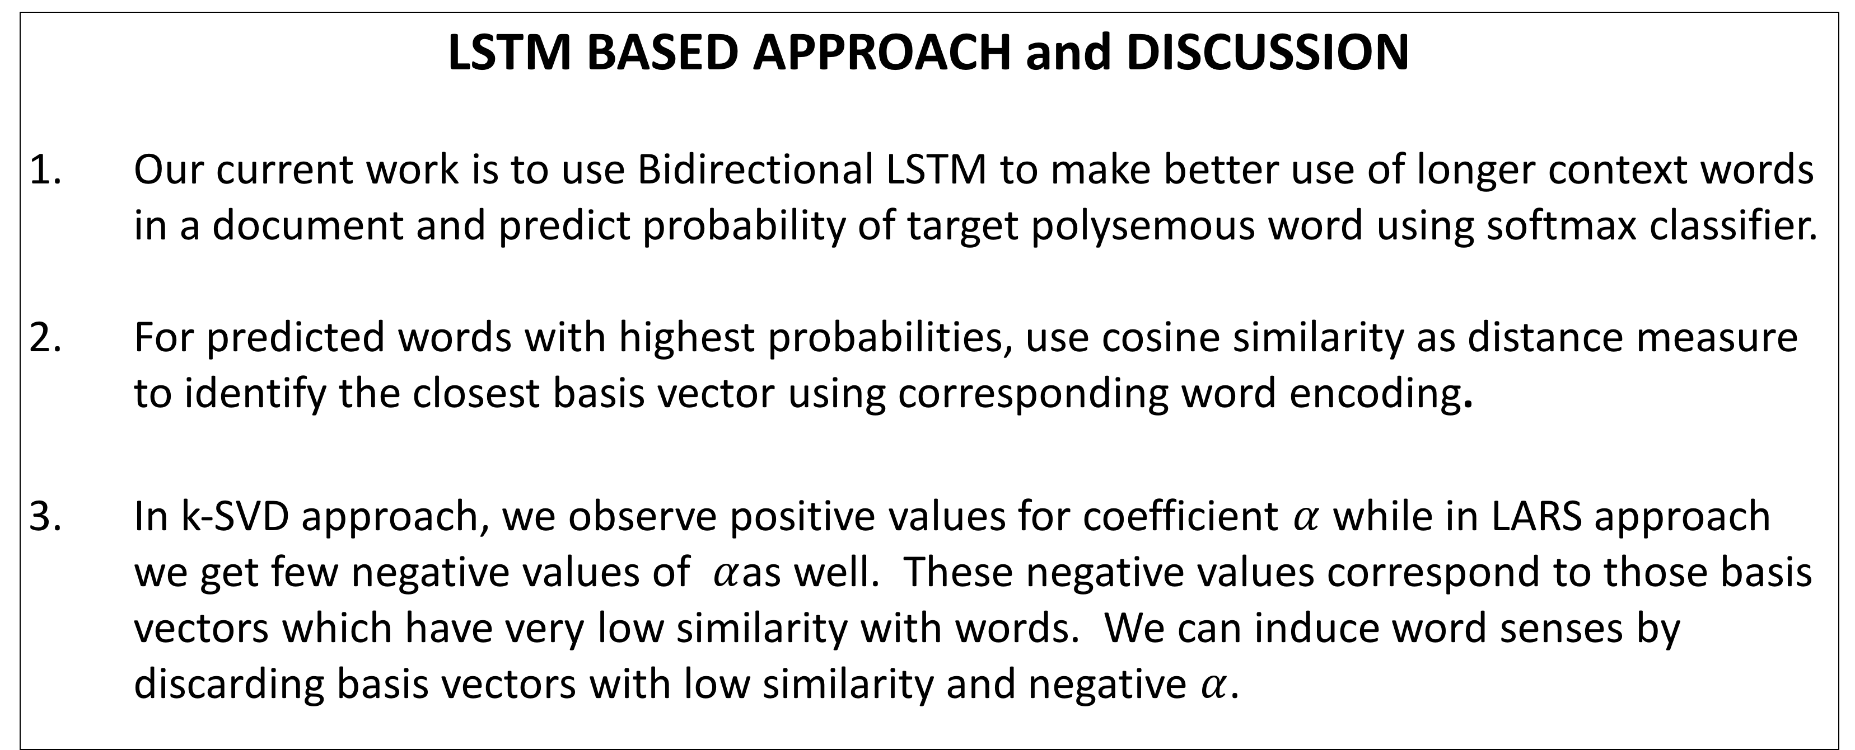
Extracting sense vectors from word embeddings
Devandra Sachan, Easwaran Ramamurthy, Tejus Siddagangaiah
ABSTRACT
Vector Space Models (VSMs) represent words as dense, real-valued vectors in an embedding space where semantically and syntactically similar words are closer to each other. However, one notable deficiency in these methods is that they cannot capture multiple senses of each word, thereby ignoring polysemes and homonyms. Recent methods such as ICE (instance-context embeddings)[1] and a sparse coding based method [2] have sought to overcome this problem. Our work focuses on first evaluating these methods and doing a comparative study of different embeddings schemes (such as GloVe, ICE and Sense2vec [3]) and evaluation methods followed by a proposal to develop an alternative method that learn context embeddings for words using ____ (DEVENDRA please fill in)
Nearest Neighbor Visualizations on Wikipedia dataset for 5 senses
Spearman’s rank correlation ($ρ$) on SCWS
LSTM BASED APPROACH and DISCUSSION
Our current work is to use Bidirectional LSTM to make better use of longer context words in a document and predict probability of target polysemous word using softmax classifier.
For predicted words with highest probabilities, use cosine similarity as distance measure to identify the closest basis vector using corresponding word encoding.
In k-SVD approach, we observe positive values for coefficient $α$ while in LARS approach we get few negative values of $α$as well. These negative values correspond to those basis vectors which have very low similarity with words. We can induce word senses by discarding basis vectors with low similarity and negative $α$.
REFERENCES
1. Mikael Kågebäck, Fredrik Johansson, Richard Johansson, and Devdatt Dubhashi. Neural context embeddings for automatic discovery of word senses. In Proceedings of NAACL-HLT, pages 25–32, 2015
2. Sanjeev Arora, Yuanzhi Li, Yingyu Liang, Tengyu Ma, and Andrej Risteski. Linear algebraic structure of word senses, with applications to polysemy. arXiv preprint arXiv:1601.03764,2016.
3. Andrew Trask, Phil Michalak, and John Liu. sense2vec-a fast and accurate method for word sense disambiguation in neural word embeddings. arXiv preprint arXiv:1511.06388, 2015.

Slide 2
Sparse Coding

Slide 3
ICE

