Slide 1


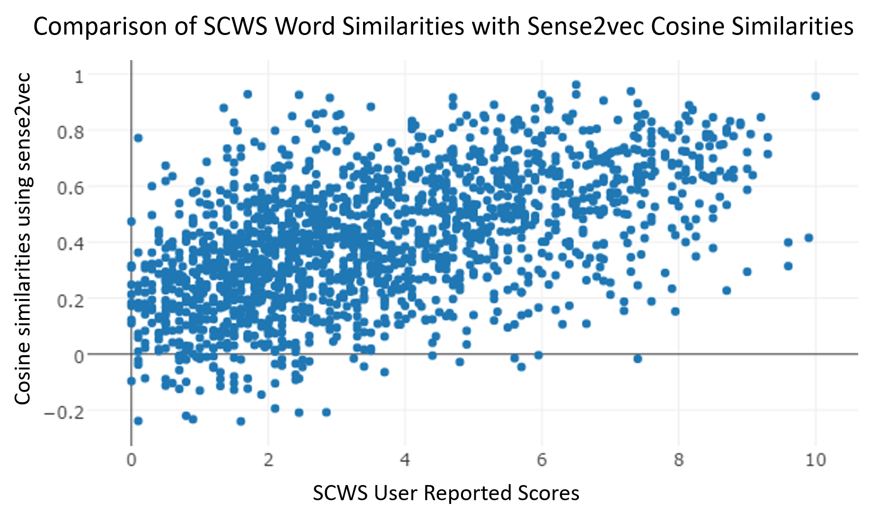
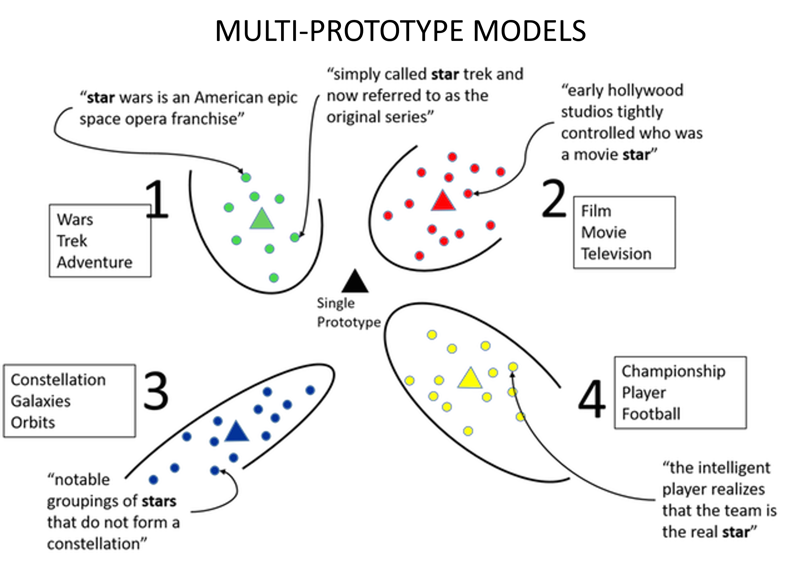
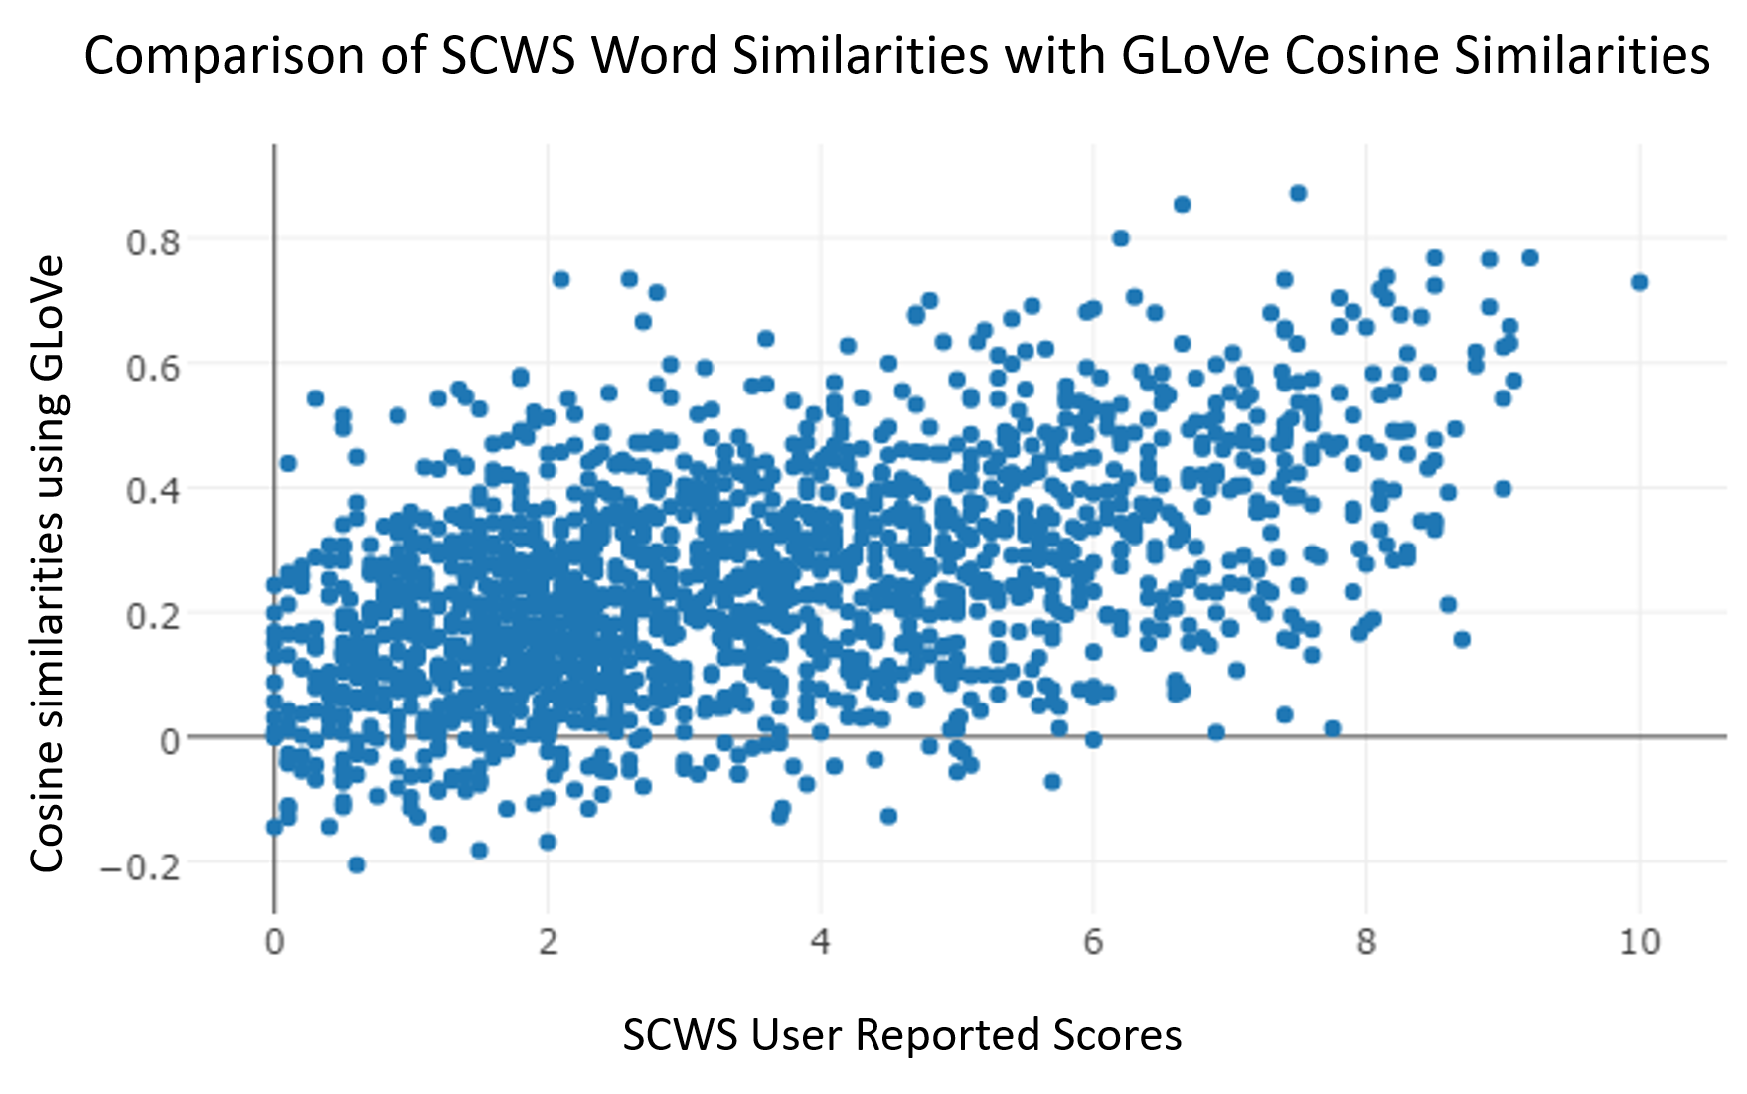
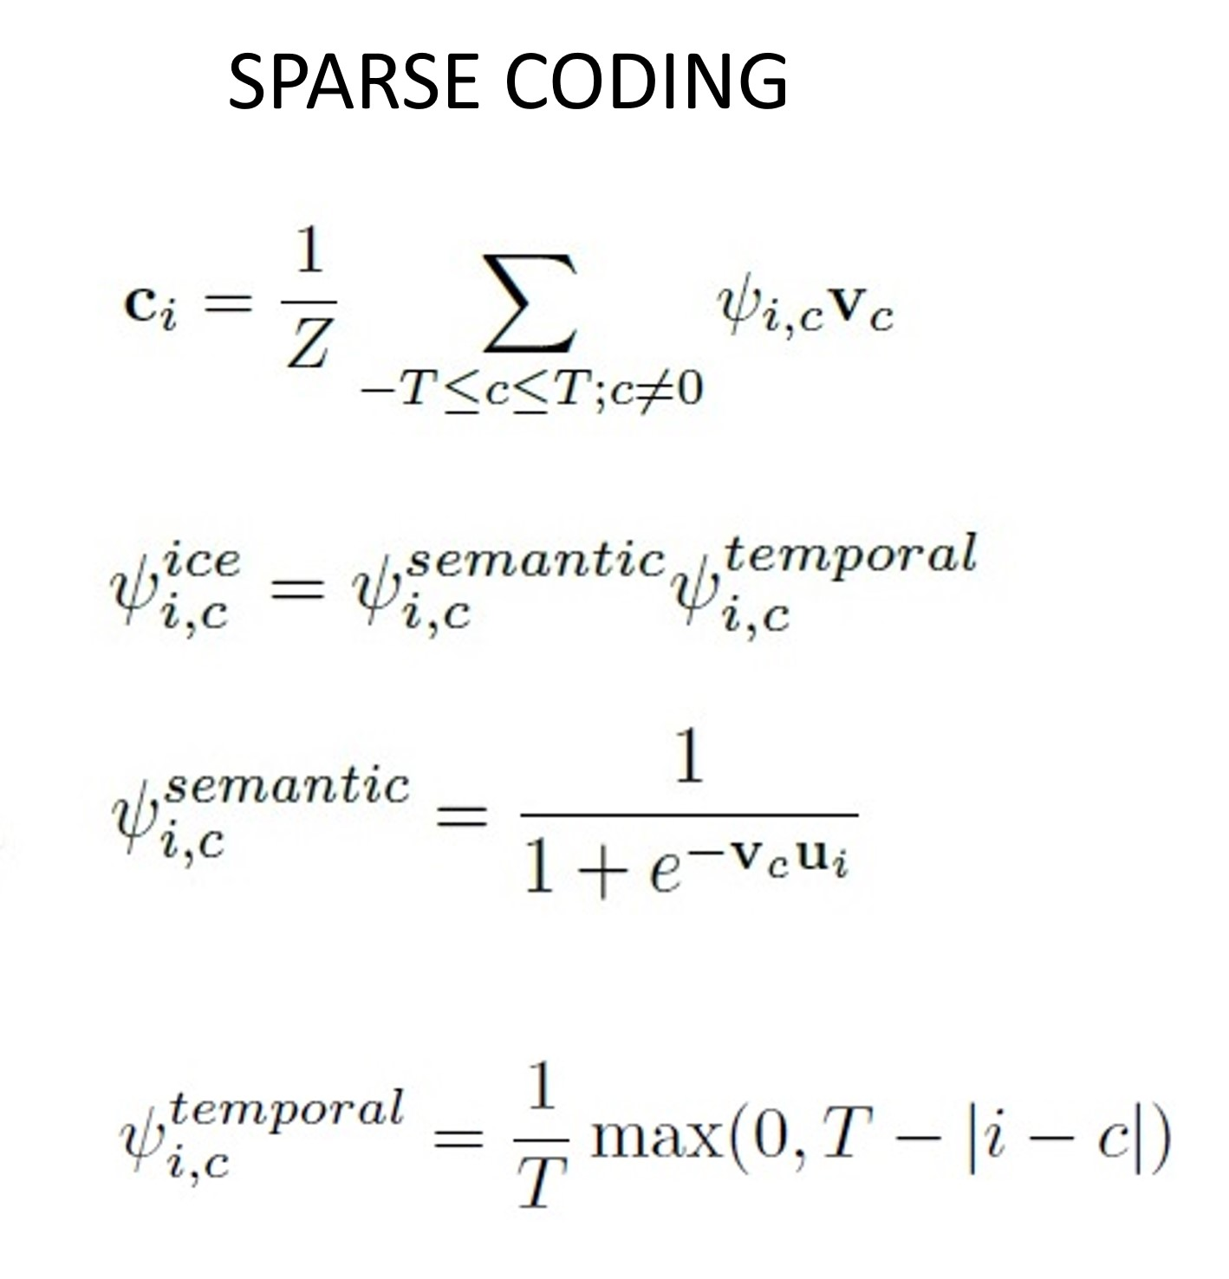
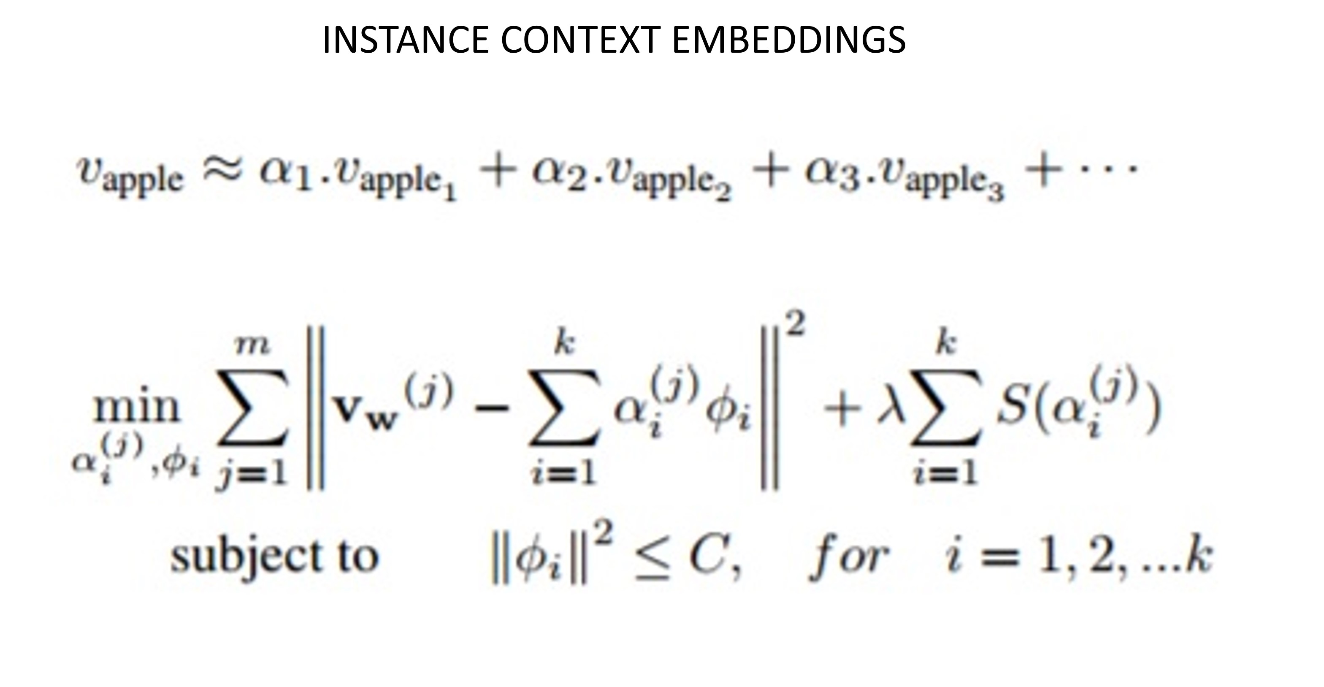
Extracting sense vectors from word embeddings
Devandra Sachan, Easwaran Ramamurthy, Tejus Siddagangaiah
ABSTRACT
Vector Space Models (VSMs) represent words as dense, real-valued vectors in an embedding space where semantically and syntactically similar words are closer to each other. However, one notable deficiency in these methods is that they cannot capture multiple senses of each word, thereby ignoring polysemes and homonyms. Recent methods such as ICE (instance-context embeddings)[1] and a sparse coding based method [2] have sought to overcome this problem. Our work focuses on first evaluating these methods and doing a comparative study of different embeddings schemes (such as GloVe, ICE and Sense2vec [3]) and evaluation methods followed by a proposal to develop an alternative method that learn context embeddings for words using ____ (DEVENDRA please fill in)
Add results here
Add results here
LSTM BASED APPROACH/DISCUSSION/CONCLUSIONS
Add Discussion here
REFERENCES
1. Mikael Kågebäck, Fredrik Johansson, Richard Johansson, and Devdatt Dubhashi. Neural context embeddings for automatic discovery of word senses. In Proceedings of NAACL-HLT, pages 25–32, 2015
2. Sanjeev Arora, Yuanzhi Li, Yingyu Liang, Tengyu Ma, and Andrej Risteski. Linear algebraic structure of word senses, with applications to polysemy. arXiv preprint arXiv:1601.03764,2016.
3. Andrew Trask, Phil Michalak, and John Liu. sense2vec-a fast and accurate method for word sense disambiguation in neural word embeddings. arXiv preprint arXiv:1511.06388, 2015.

