Slide 1
DBMS Stock Market Analytics
BACSE202 — Database Management Systems
Fall Semester 2026–2027
& Portfolio Management System
Team Members
K.M. MOHAMED IRFAN
25BCE1462
EASWAR AP
25BCE1512
Faculty: Dr. S. Geetha
MOHAMMED NADEEM
25BCE1771
VIT Chennai

Slide 2
Problem Statement & Objectives
The Problem
Individual investors lack integrated tools combining market analytics, portfolio management, and ML-based predictions — features locked behind expensive institutional platforms.
Raw NSE stock market data is heavily denormalized — 87.7 MB CSV with company info repeated across 287,310 rows, making it a classic DBMS normalization challenge.
Objectives
Design a fully normalized relational schema (1NF to BCNF) from raw CSV market data
Build dual-database architecture — PostgreSQL for relational data + TimescaleDB for time-series
Implement secure user authentication with bcrypt hashing and JWT tokens
Develop paper trading with virtual cash, row-level locking, and trigger-based audit trail
Train ML pipeline (HistGradientBoosting) for 5-day stock trend prediction
Build a financial UI with React and interactive charts
Achieve 72 automated tests covering all modules
287,310
Price Records
49
Companies
13
Sectors
1,653
Corp. Actions

Slide 3
System Architecture
Tech Stack
Frontend:
React 18, Vite, Recharts
Frontend — React + Vite (Port 5173)
Dashboard | Stock Explorer | Portfolio | Sectors | Watchlist | ML Predictions
Recharts for visualization | AuthContext + JWT localStorage | Dark UI theme
Backend:
FastAPI, Python 3.12
REST API + JWT
▼
Auth:
bcrypt 12-round, JWT
Backend — FastAPI + Python 3.12 (Port 8000)
27 API Endpoints | SQLAlchemy ORM | Pydantic Validation | Uvicorn ASGI
Relational DB:
PostgreSQL 17
Time-Series:
TimescaleDB (Docker)
Auth (bcrypt/JWT) | Trading (FOR UPDATE locks) | ML Inference (joblib)
ML:
scikit-learn, joblib
▼ ▼
PostgreSQL 17 (Port 5435)
stock_market_db
14 relational tables
6 views, 16 indexes Triggers + audit ledger
User auth, portfolios, trading
TimescaleDB / Docker (Port 5434)
stock_timescale_db daily_price_history hypertable 287,310 OHLCV records
360-day chunk interval (28 chunks) time_bucket() aggregation
Testing:
pytest — 72 tests
DevOps:
Docker Compose

Slide 4
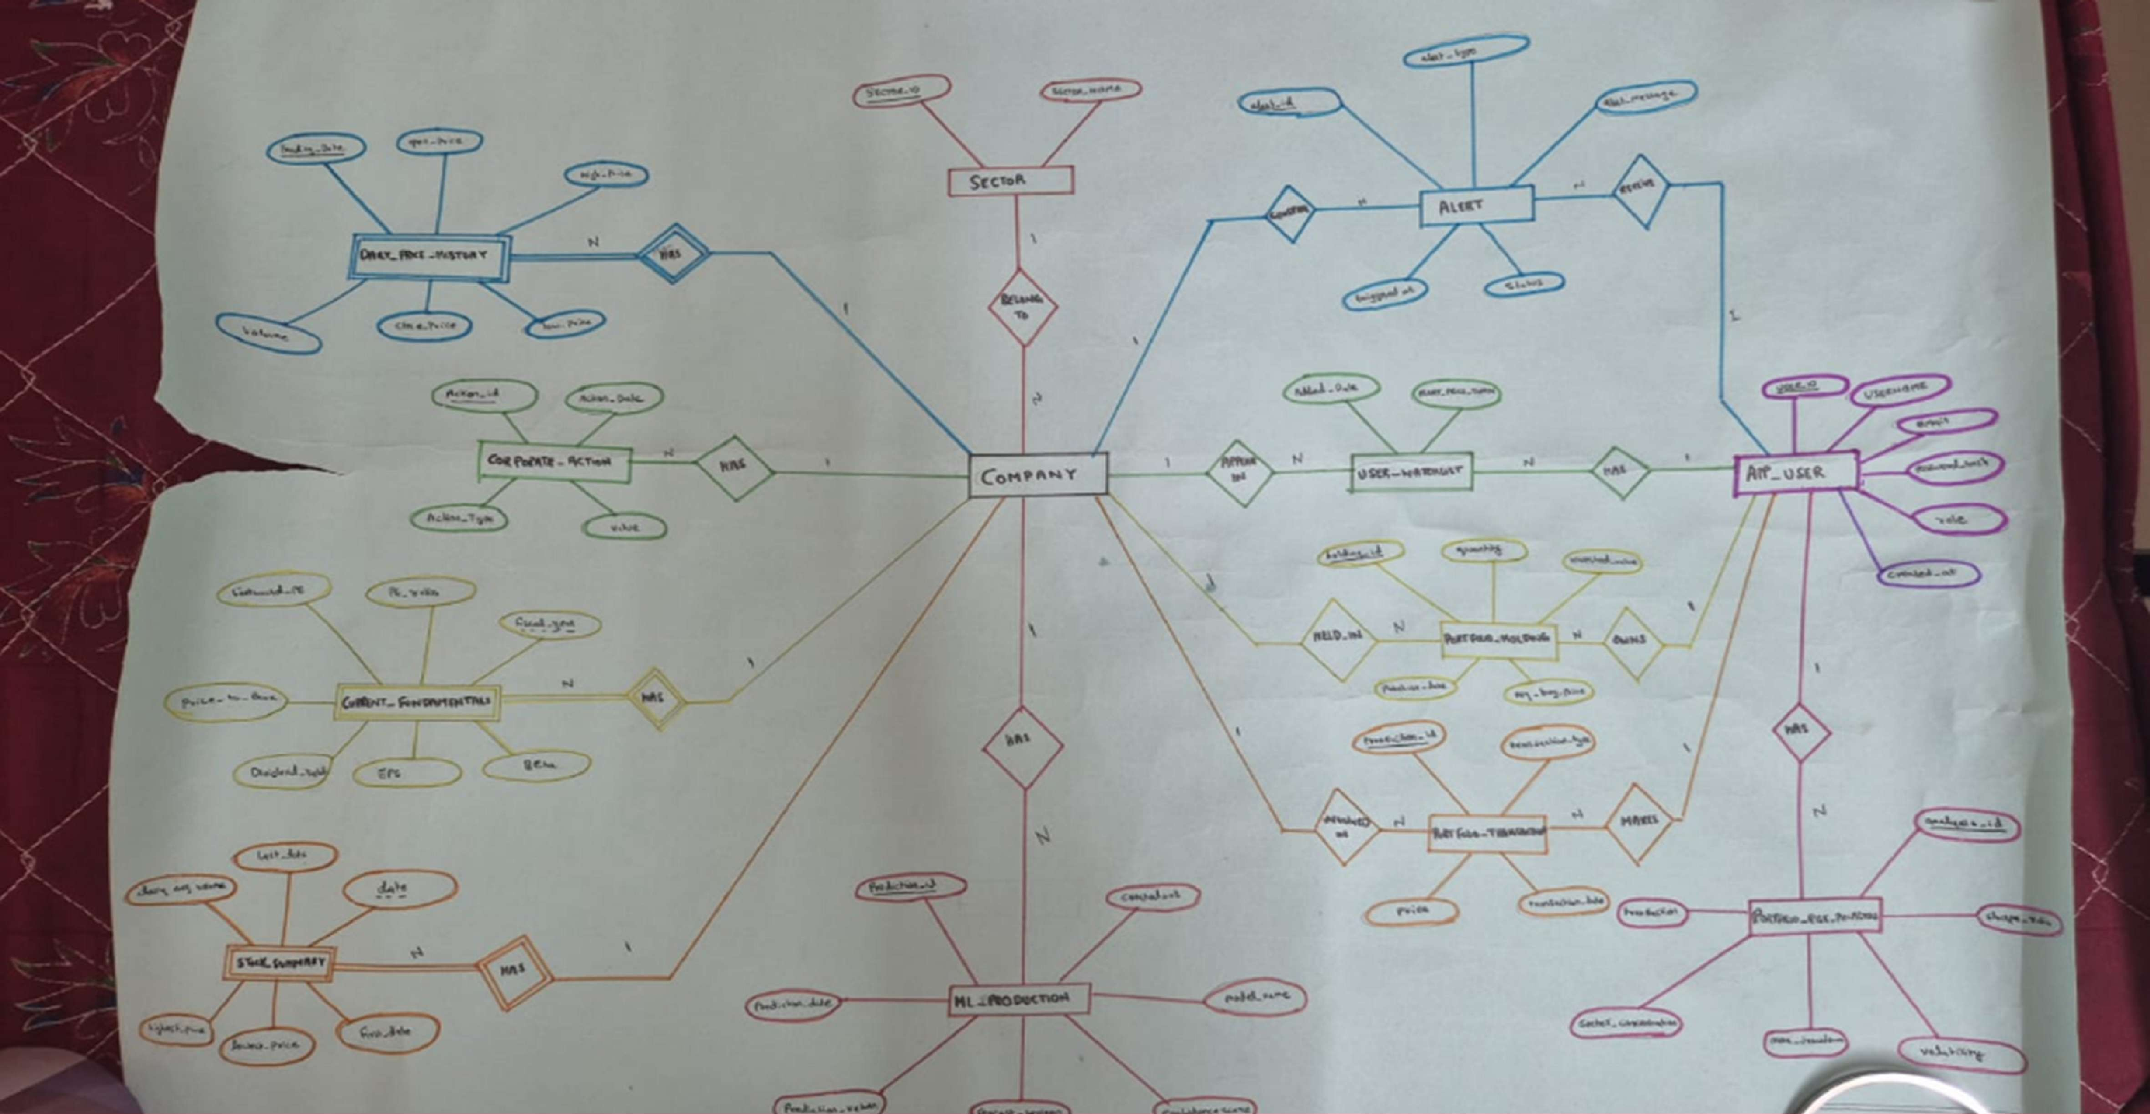
ER Diagram
16 entities | Dual-database boundary | Chen's notation with cardinality ratios
Entities (16)
sector (13 rows)
company (49) daily_price_history (287K) corporate_action (1,653)
current_fundamentals (49)
stock_summary (49)
app_user (137)
user_portfolio (149)
portfolio_holding (36)
portfolio_transaction (66)
portfolio_txn_audit (66)
portfolio_risk_analysis (2)
risk_sector_allocation (4)
user_watchlist (2)
alert (0)
ml_prediction (0)

Slide 5
Relational Schema — Keys & Constraints
sector
PK: sector_id | UK: sector_name
user_portfolio
PK: portfolio_id | FK: user_id → app_user UNIQUE(user_id, portfolio_name)
CHECK cash_balance ≥ 0 | DEFAULT 100000
company
PK: ticker | FK: sector_id → sector ON DELETE RESTRICT
portfolio_holding
PK: holding_id | FK: portfolio_id, ticker UNIQUE(portfolio_id, ticker)
CHECK qty ≥ 0, invested_value ≥ 0
daily_price_history
PK: (ticker, trading_date) | FK: ticker → company CHECK volume ≥ 0 | TimescaleDB hypertable
portfolio_transaction
PK: transaction_id
FK: holding ON DELETE SET NULL
CHECK type IN ('BUY','SELL','DIVIDEND','SPLIT')
corporate_action
PK: action_id | FK: ticker → company UNIQUE(ticker, action_date, type) CHECK type IN ('Dividend','Stock_Split')
portfolio_txn_audit
PK: audit_id | FK: transaction_id Trigger-populated, immutable ledger
current_fundamentals
PK/FK: ticker → company ON DELETE CASCADE
portfolio_risk_analysis
PK: analysis_id | FK: user_id → app_user
stock_summary
PK/FK: ticker | CHECK total_trading_days > 0
risk_sector_allocation
app_user
PK: user_id | UK: username, email
PK: (analysis_id, sector_id) | Both FK CHECK pct BETWEEN 0 AND 100
Replaces JSONB → 3NF normalized
CHECK role IN ('admin','user') | bcrypt hash
5/12

Slide 6
Normalization — From Raw CSV to BCNF
1NF Atomic Values
Raw CSV already satisfies 1NF.
2NF
No Partial Dependencies
3NF
No Transitive Dependencies
BCNF Superkey on LHS
All 8 decomposed relations verified.
Every non-trivial FD X → Y has X as a superkey.
Composite key {Ticker, Date} had partial dependencies:
Transitive chain found:
Ticker → Sector_ID → Sector_Name
Later found: JSONB sector_concentration column violated 1NF.
Ticker → Company_Name (partial)
Ticker → Sector (partial)
Fix: Created independent sector table with surrogate key sector_id as FK in company table.
Lossless joins proven via Heath's Theorem for every decomposition.
Fix: Decomposed into portfolio_risk_sector_allocation table.
Split into: company, fundamentals, stock_summary tables.
Anomalies Eliminated
Update: Change sector name in 1 row instead of 5,861 rows
Insertion: Add new sector without needing any stock record
Deletion: ON DELETE RESTRICT prevents losing sector data
Redundancy: 7.18 MB repeated data removed (12.44% saving)
Storage Comparison
Raw CSV (denormalized): 87.7 MB PostgreSQL heap: 30 MB
Indexes: 19 MB
Total Normalized DB: 58 MB
Saving: 7.18 MB redundant data eliminated (12.44%)

Slide 7
Important SQL Operations
TimescaleDB time_bucket() Aggregation
SELECT time_bucket('7 days', trading_date) AS bucket, AVG(close_price), SUM(volume)
FROM daily_price_history WHERE ticker = :ticker
GROUP BY bucket ORDER BY bucket;
Buy Stock — Row-Level Locking (FOR UPDATE)
SELECT cash_balance FROM user_portfolio WHERE portfolio_id = :pid FOR UPDATE;
UPDATE user_portfolio
SET cash_balance = cash_balance - :cost;
INSERT INTO portfolio_holding (...) ON CONFLICT (portfolio_id, ticker)
DO UPDATE SET qty = qty + EXCLUDED.qty;
Trigger-Based Audit Trail
CREATE FUNCTION fn_audit_trigger() RETURNS TRIGGER AS $$
BEGIN
INSERT INTO portfolio_transaction_audit (transaction_id, operation,
old_data, new_data) VALUES (NEW.id, TG_OP,
row_to_json(OLD), row_to_json(NEW)); RETURN NEW;
END; $$ LANGUAGE plpgsql;
Portfolio Holdings with Live P&L
SELECT h.ticker, h.quantity, h.average_buy_price, lp.close_price AS current_price, (lp.close_price * h.quantity)
AS current_value, (lp.close_price * h.quantity
- h.invested_value) AS profit_loss
FROM portfolio_holding h
JOIN v_latest_stock_prices lp ON h.ticker = lp.ticker;

Slide 8
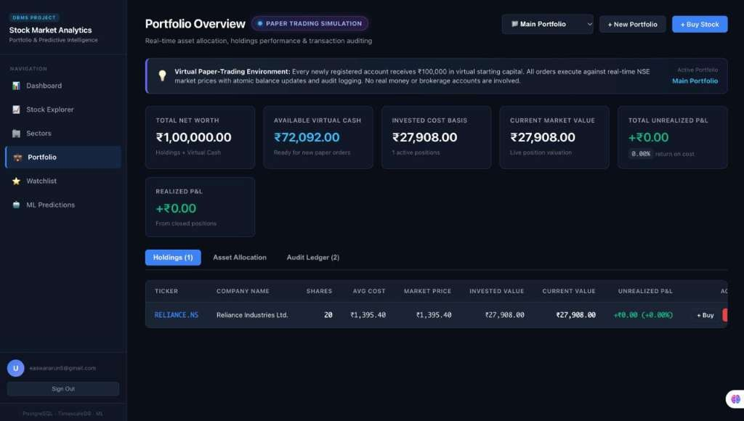
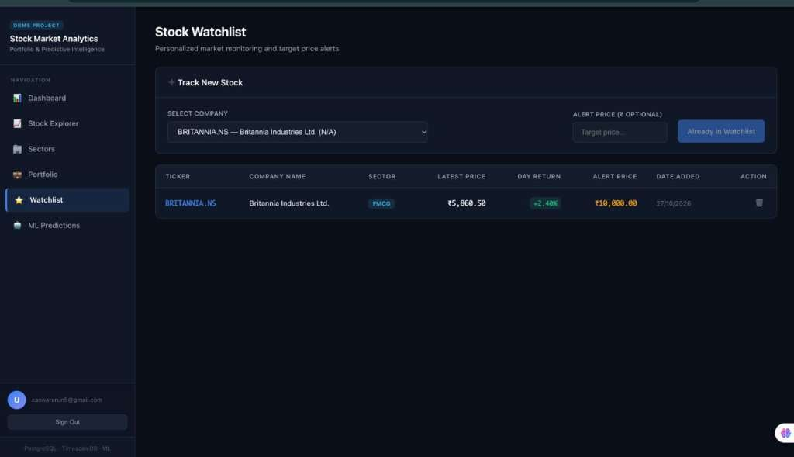
Working Application — Portfolio & Watchlist
Paper Trading Portfolio — Virtual cash, weighted avg cost, real-time P&L Watchlist — Personalized stock monitoring with target price alerts
Portfolio Key Features
FOR UPDATE row locks prevent double-spending
Weighted-average cost auto-recalculated on each buy
ON CONFLICT upsert — one row per stock per portfolio
Every trade logged to immutable audit trail via trigger
Watchlist Key Features
Track any Nifty 50 stock with optional alert price
Live price & daily return from TimescaleDB
UNIQUE(user_id, ticker) — no duplicates allowed
User-scoped via JWT — full isolation between users

Slide 9
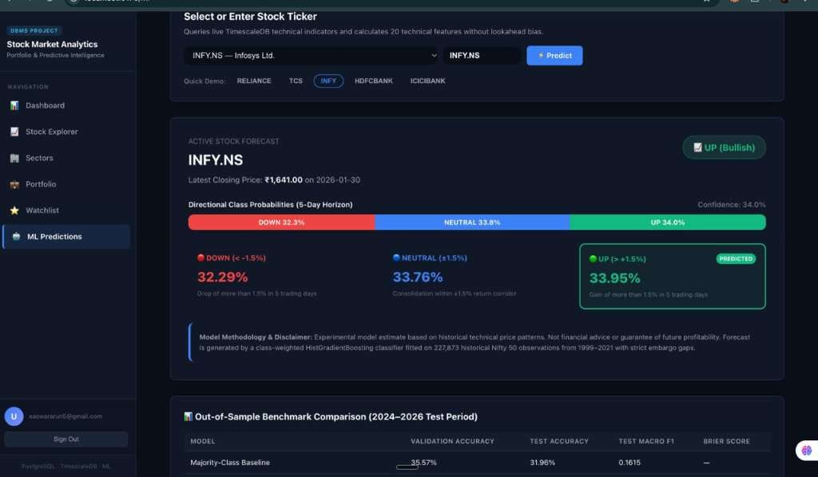
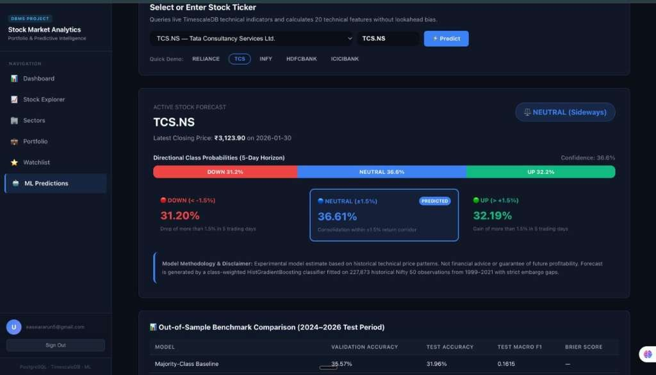
Working Application — ML Stock Trend Predictions
ML Pipeline Summary
Model: HistGradientBoosting Classifier | 20 technical features (returns, MAs, volatility, RSI) | Target: 5-day trend (UP/DOWN/NEUTRAL, ±1.5% threshold) Chronological split: Train ≤ 2021 | Validation 2022–2023 | Test ≥ 2024 | 5-session embargo gaps | 7 models compared | No data leakage
INFY.NS — Predicted: UP (Bullish), Confidence: 34.0%
TCS.NS — Predicted: NEUTRAL (Sideways), Confidence: 36.6%

Slide 10
Testing & Key Findings
72
test_api.py
35
Health checks, dual DB, time-bucket, corporate actions, pagination
test_auth_and_portfolio.py Registration, bcrypt, JWT, portfolio isolation, overselling rejection
Tests Passed
16
test_ml_pipeline.py
12
No data leakage, probability normalization, chronological embargo
test_normalized_portfolio_and_risk.py
8
3NF validation, weighted-avg cost, FK integrity, audit triggers
test_paper_trading.py
1
Complete 12-step lifecycle: register → buy → sell → verify → isolation
Key Findings
Normalization reduced storage by 12.44% — eliminated 7.18 MB of redundant data across 287,310 records
Dual-database architecture cleanly separates OLTP (PostgreSQL) and analytical (TimescaleDB) workloads
TimescaleDB time_bucket() provides 3–5x faster aggregation vs DATE_TRUNC on vanilla PostgreSQL
FOR UPDATE row-level locks prevent double-spending without table-level locking
JSONB-to-relational migration achieved 100% data integrity, verified via SHA-256 checksums
Trigger-based audit ledger provides immutable transaction history for compliance auditing
HistGradientBoosting with chronological embargo outperforms all baselines with zero data leakage
10/12

Slide 11
Limitations & Future Enhancements
Current Limitations
Static data — prices pre-loaded up to Jan 2026, no live market feed
Paper trading only — virtual cash, no real brokerage integration
ML predicts 5-day trends only — no exact price targets or long-term forecasts
Limited to 49 Nifty 50 companies — no mid-cap or international stocks
REST polling — no WebSocket real-time streaming
Single-server deployment — not horizontally scalable
Alert engine schema exists but notification logic not yet built
Future Enhancements
Live market data via NSE/Yahoo Finance APIs with scheduled ingestion
WebSocket streaming for real-time price tickers
LSTM/Transformer models for longer-horizon predictions
Alert engine — email + push notifications on price triggers
Multi-currency and international exchange support
Horizontal scaling — read replicas, Redis cache, Kubernetes
Mobile app (React Native) using the same backend
Automated backtesting engine for trading strategies

Slide 12
Thank You!
DBMS Stock Market Analytics & Portfolio Management System

