Slide 1
EGM Data Modelling Activities
Ahmed Abid
23/01/2020

Slide 2












Data In The Context Of Aquaculture
Heterogeneous data
Format
Speed
Bandwidth
Security
Data processors
Different scales
Within a farm
Between farms
With outside world
Data cloud
Query
Notification
Data producers
Data consumers
Interoperable interfaces
Open
Extensible
Secured

Slide 3


AI Applications for the Aquaculture
Detecting Fish behaviors by IoT component and using Machine Learning Algorithms help in Discovering the needs of fishes in real time.
Activating automatically the appropriate process (such as feeding, origination..) in the right moment,
Providing insight on biomass repartition
…
I'm hungry
I'm need More Oxygen

Slide 4
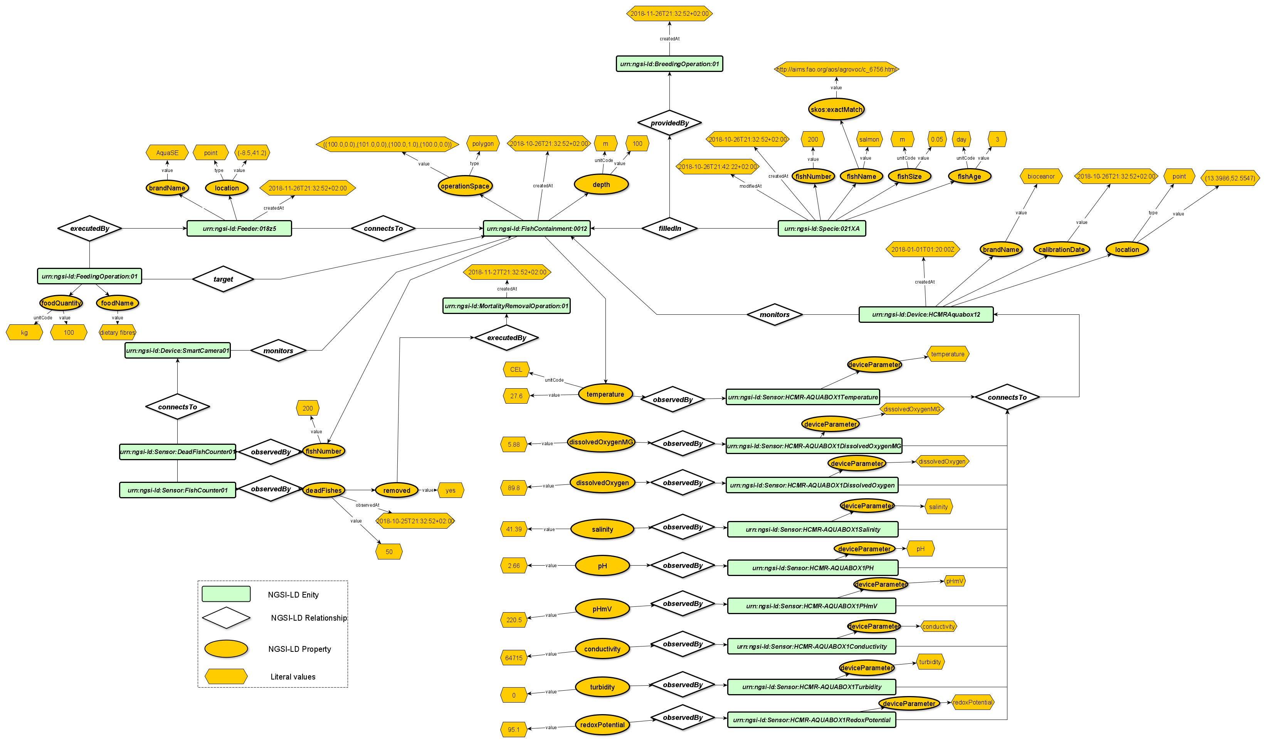
Data in The Context of Aquaculture

Slide 5
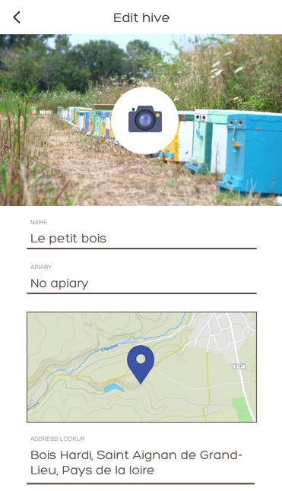
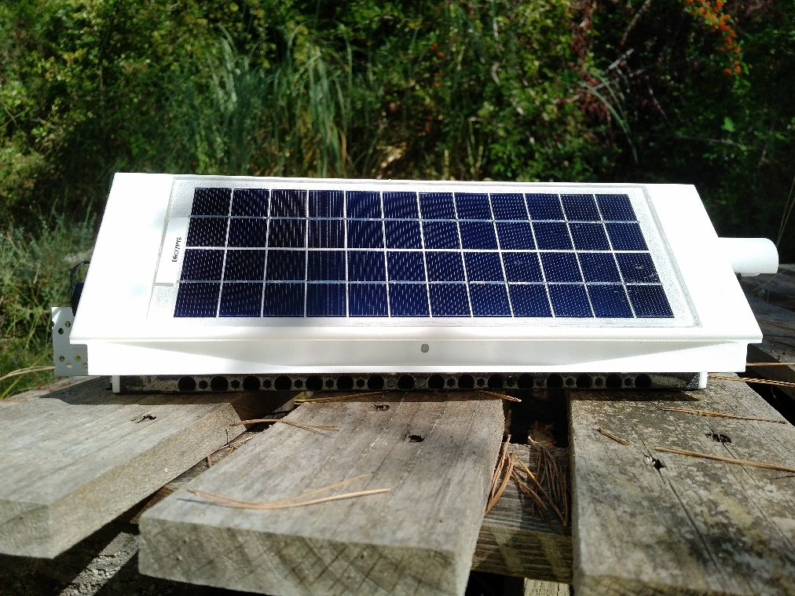
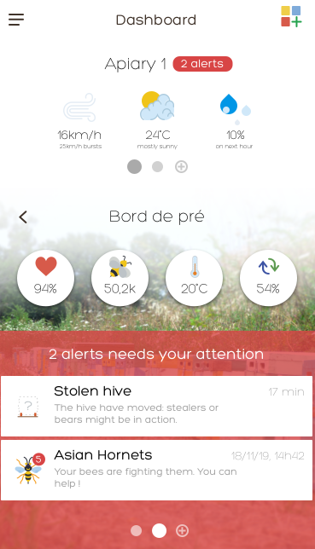
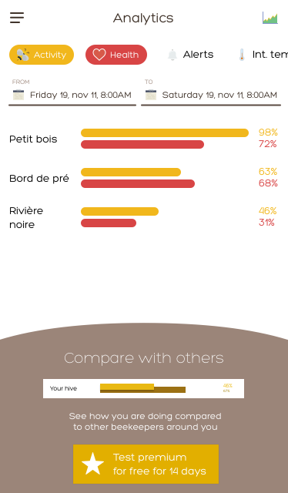
Diatomic

Slide 6
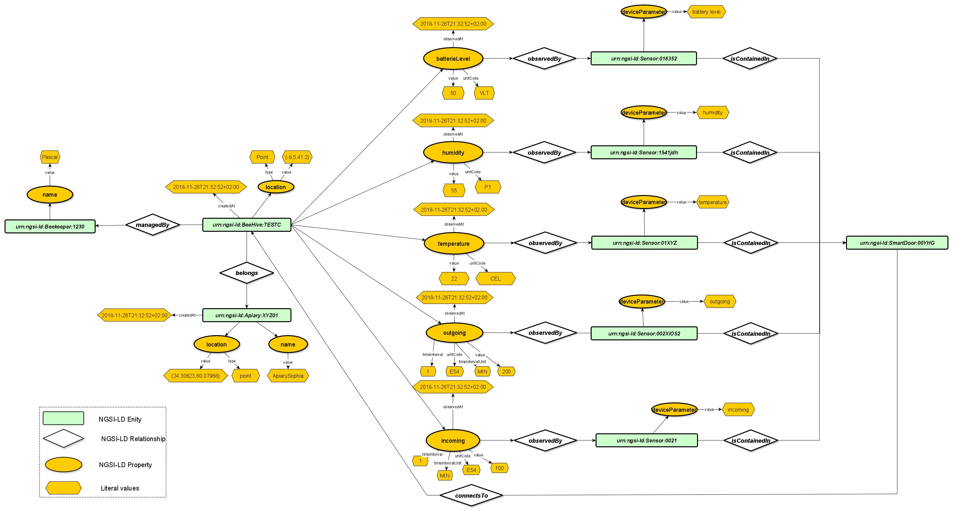
Data in The Context of connected BeeHive

Slide 7
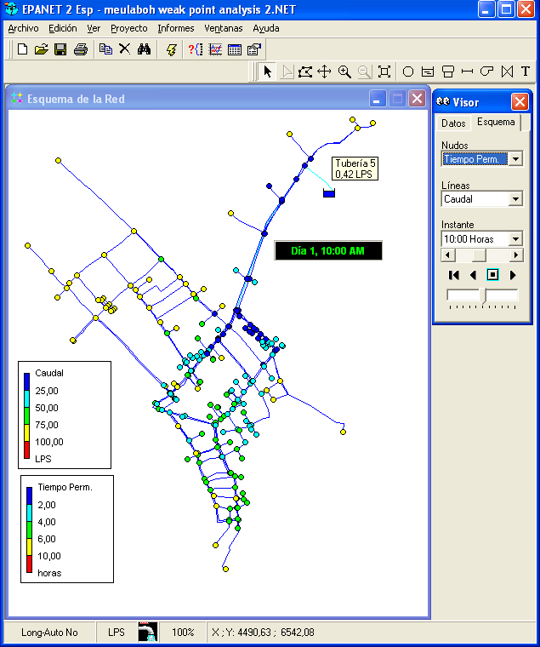
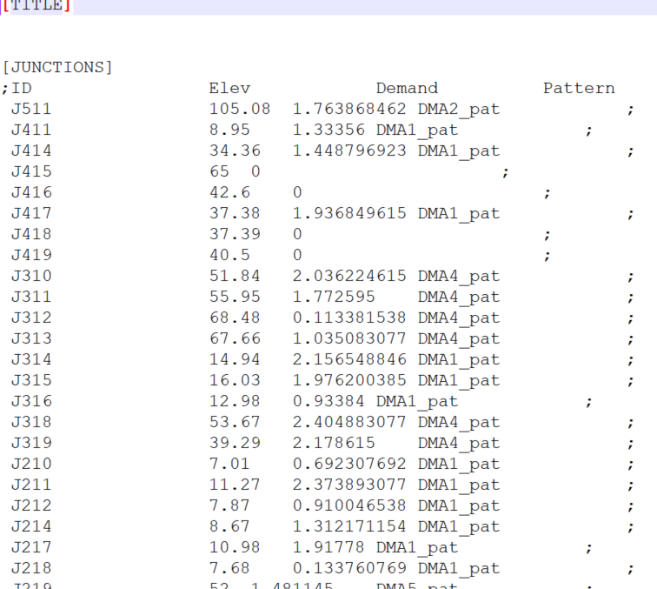
Epanet

Slide 8
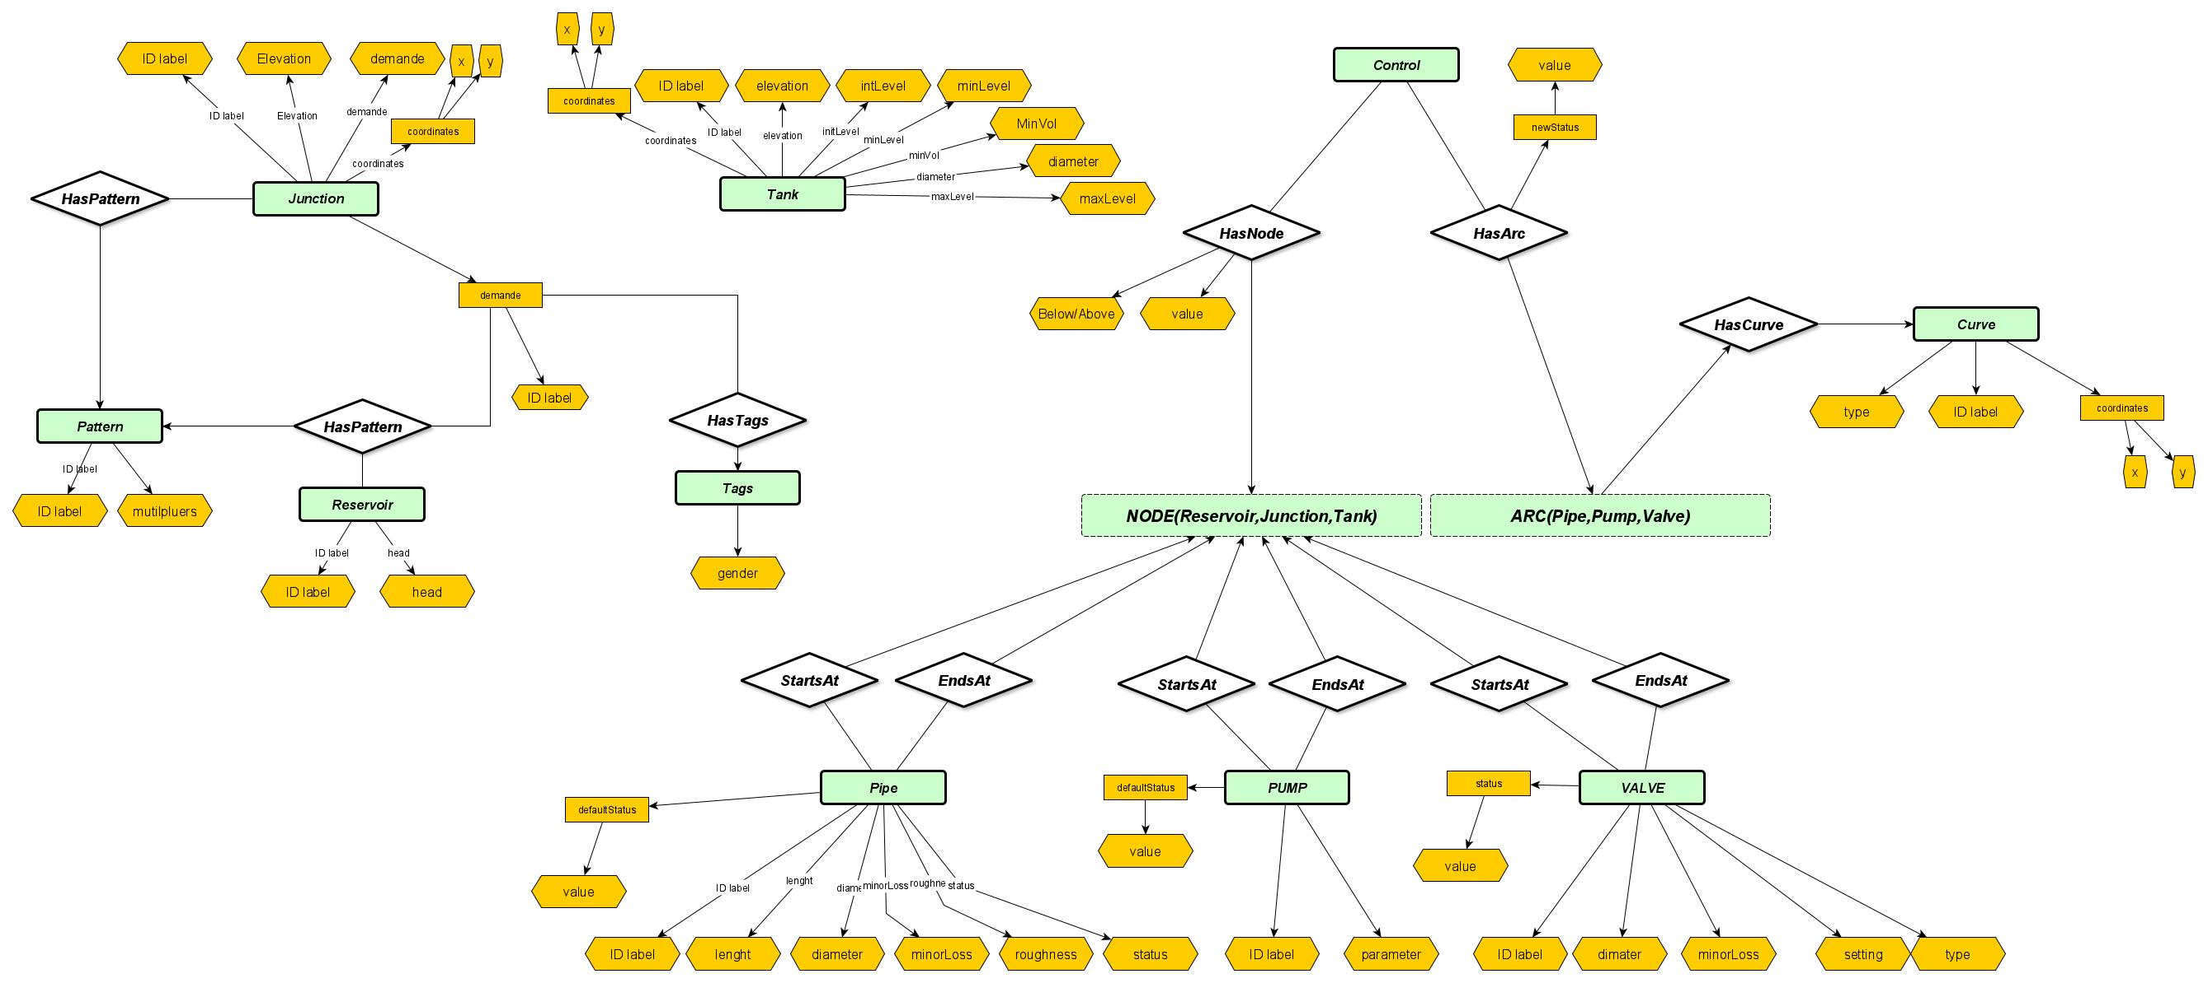
Fiware4Water: Epanet to NGSI-LD

Slide 9
Ahmed Abid
Ph.D, R&D Engineer
+33 9 82 33 06 72
ahmed.abid@eglobalmark.com

