Slide 1

Easy Peasy Robotics Crash Course
Mechanics in robotics
Mattia Salvi
Mattia.salvi@iit.it
@salvi-mattia

Slide 2
Easy Peasy Robotics Crash Course mechanics in robotics
What are we going to see:
iCub the robot, a fast overview [mechanic POV]
Mechanics in robotics
Basics on cad design: OnShape
What are we going to design

Slide 3
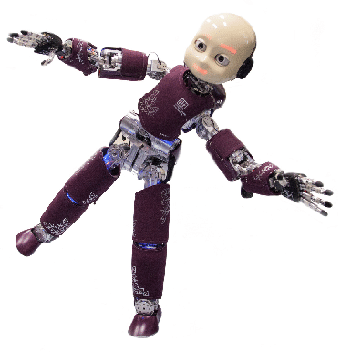
Easy Peasy Robotics Crash Course mechanics in robotics
What are we going to see:
iCub the robot, a fast overview [mechanic POV]
Mechanics in robotics
Basics on cad design: OnShape
What are we going to design
iCub is a 53 DOFs humanoid robot
designed not to perform specific tasks but to behave in a unstructured, human environment.
He (it? She?) has got sensors to perceive the world and himself and motors to react.
The mechanical design is developed using a 3D CAD [PTC CREO] let’s give it a look
You can get the whole project here:
https://github.com/icub-tech-iit/cad-mechanics-public

Slide 4
Easy Peasy Robotics Crash Course mechanics in robotics
What are we going to see:
iCub the robot, a fast overview [mechanic POV]
Mechanics in robotics
Basics on cad design: OnShape
What are we going to design
Some concepts
Joints
Links
Motors
Speed reducer
DOF [degrees of freedom]

Slide 5
Easy Peasy Robotics Crash Course mechanics in robotics
What are we going to see:
iCub the robot, a fast overview [mechanic POV]
Mechanics in robotics
Basics on cad design: OnShape
What are we going to design

Slide 6
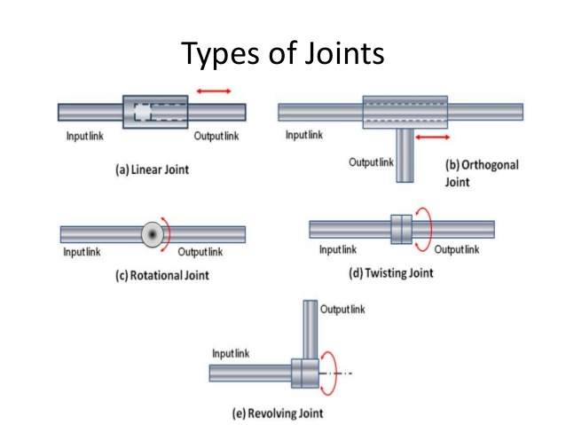
Easy Peasy Robotics Crash Course mechanics in robotics
What are we going to see:
iCub the robot, a fast overview [mechanic POV]
Mechanics in robotics
Basics on cad design: OnShape
What are we going to design

Slide 7
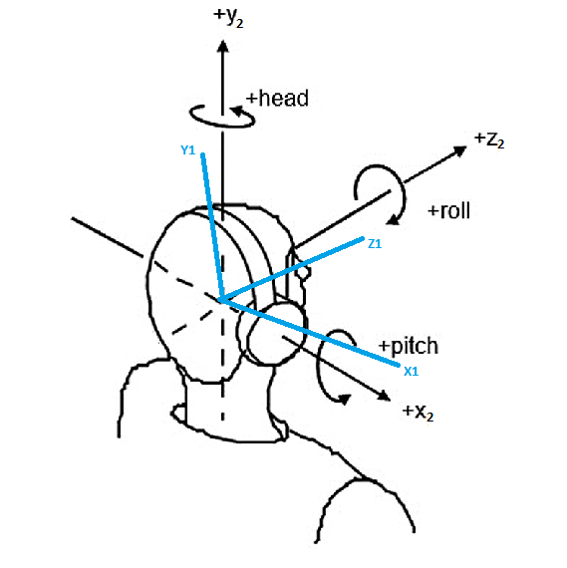
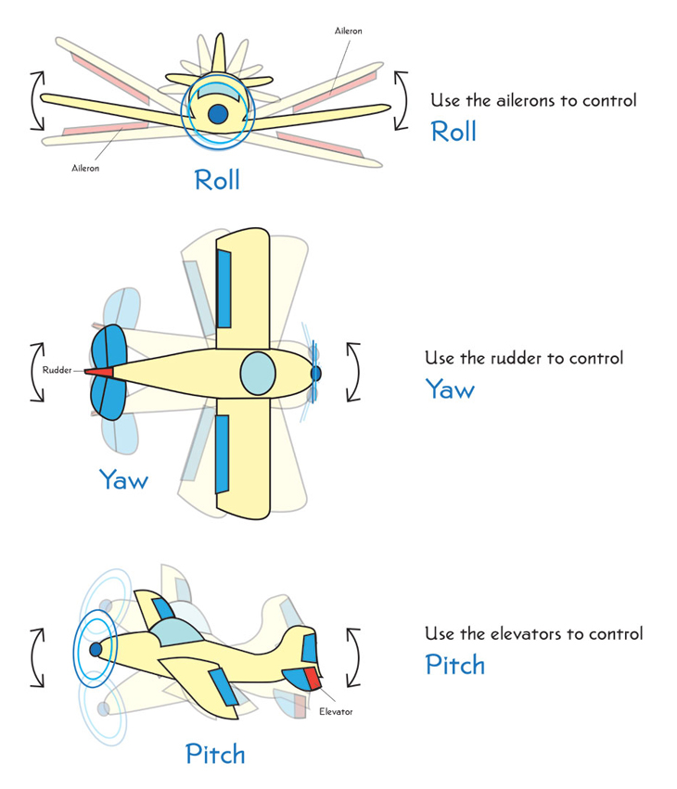
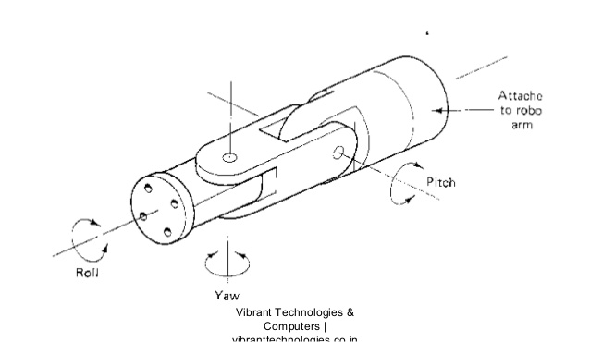
Easy Peasy Robotics Crash Course mechanics in robotics
What are we going to see:
iCub the robot, a fast overview [mechanic POV]
Mechanics in robotics
Basics on cad design: OnShape
What are we going to design
Some concepts
Joints
Links
Motors
Speed reducer
DOF [degrees of freedom]

Slide 8
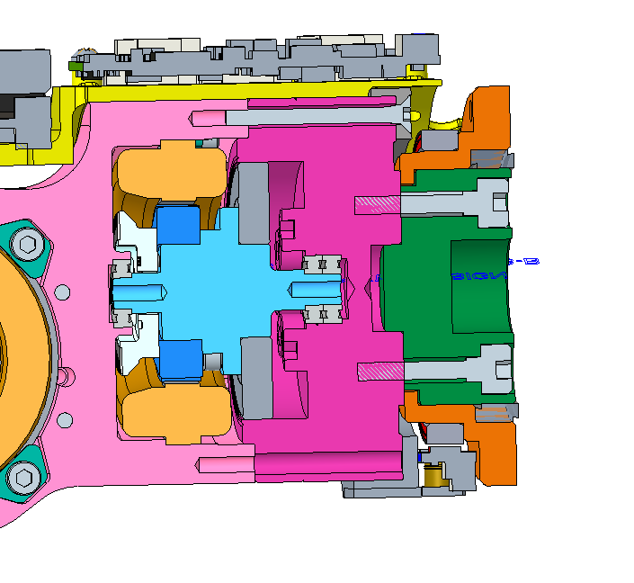
Easy Peasy Robotics Crash Course mechanics in robotics
What are we going to see:
iCub the robot, a fast overview [mechanic POV]
Mechanics in robotics
Basics on cad design: OnShape
What are we going to design
SPEED REDUCER INPUT
STATOR
SLOW SHAFT
[low speed – high torque]
FAST SHAFT
[high speed – low torque]
SPEED REDUCER
ROTOR

Slide 9
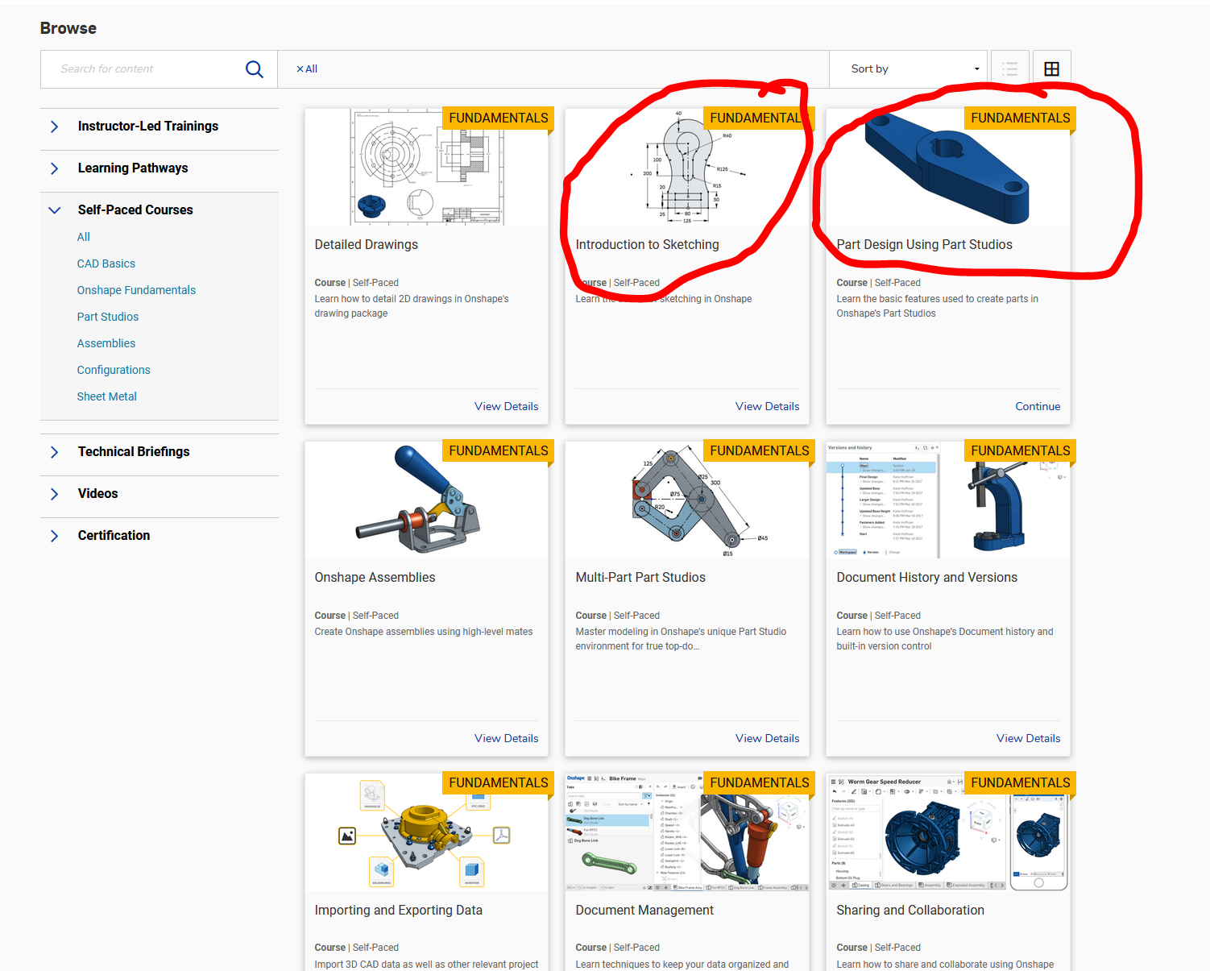
Easy Peasy Robotics Crash Course mechanics in robotics
What are we going to see:
iCub the robot, a fast overview [mechanic POV]
Mechanics in robotics
Basics on cad design: OnShape
What are we going to design
Onshape is a Computer-aided design [CAD] software system that runs n your browser.
You can find a full learning platform here: https://learn.onshape.com/
Really meaningfull the self paced course

Slide 10
Easy Peasy Robotics Crash Course mechanics in robotics
What are we going to see:
iCub the robot, a fast overview [mechanic POV]
Mechanics in robotics
Basics on cad design: OnShape
What are we going to design
Onshape is a Computer-aided design [CAD] software system that runs n your browser.
You can find a full learning platform here: https://learn.onshape.com/
Really meaningfull the self paced courses you can find here: https://learn.onshape.com/catalog?labels=%5B%22Self-Paced%20Courses%22%5D&values=%5B%22All%22%5D

Slide 11
Easy Peasy Robotics Crash Course mechanics in robotics
What are we going to see:
iCub the robot, a fast overview [mechanic POV]
Mechanics in robotics
Basics on cad design: OnShape
What are we going to design
Onshape is a Computer-aided design [CAD] software system that runs n your browser.
LET’S GIVE IT A LOOK
You can find a full learning platform here: https://learn.onshape.com/
Really meaningfull the self paced courses you can find here: https://learn.onshape.com/catalog?labels=%5B%22Self-Paced%20Courses%22%5D&values=%5B%22All%22%5D

Slide 12
Easy Peasy Robotics Crash Course mechanics in robotics
What are we going to see:
iCub the robot, a fast overview [mechanic POV]
Mechanics in robotics
Basics on cad design: OnShape
What are we going to design
Let’s try to design some specific parts we need in or robot,
We need them:
to give power to the speed gears
to have a speed reducer output
to move our joint
to give a look around

