Slide 1
Mechanical requirements for assignments

Slide 2
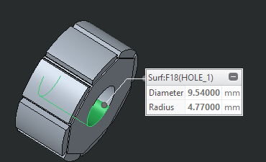
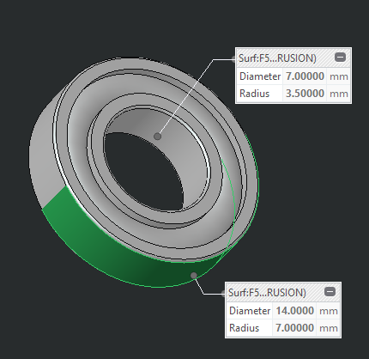
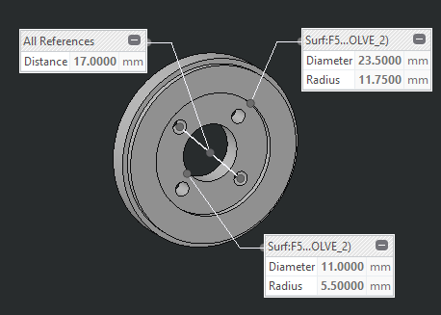
1_motor shaft
We need to connect the rotor to the speed reducer.
We need to support the shaft wit a bearing on the other side
SPEED REDUCER depth 5.3mm
ROTOR depth 12.1mm
BEARING depth 3.5mm
M3 HOLES

Slide 3
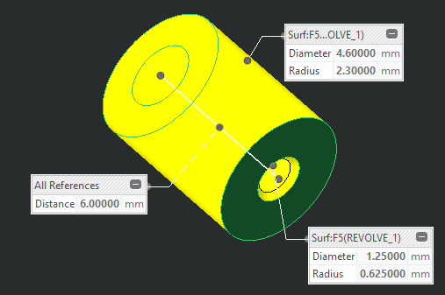
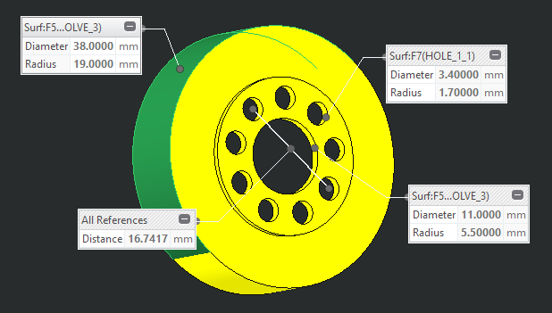
2_output pulley
We need to connect the pulley to the speed reducer [output]
We need to create housing for a tangential cable crimp
SPEED REDUCER
depth 11mm
CRIMP
depth 6mm

Slide 4
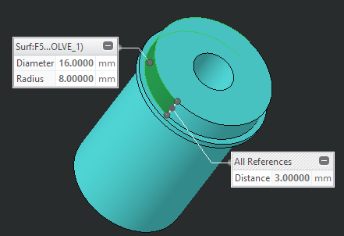
3_elbow shaft
We need to support the shaft on both side with bearings.
We need to create housing for a tangential cable crimp.
We need to host the forearm flange.
CRIMP
depth 6mm
FOREARM FLANGE
BEARING depth 3.5mm

Slide 5
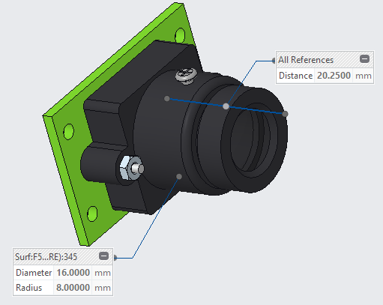
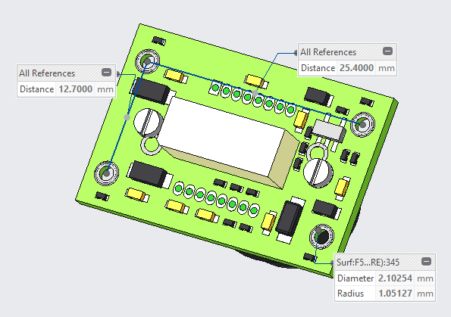
3_eye ball
We need to create a 41mm Ø hemisphere.
We need room for the lens to see.
We need to screw in the camera board.
CAMERA FRONT VIEW
CAMERA FRONT VIEW

