Slide 1

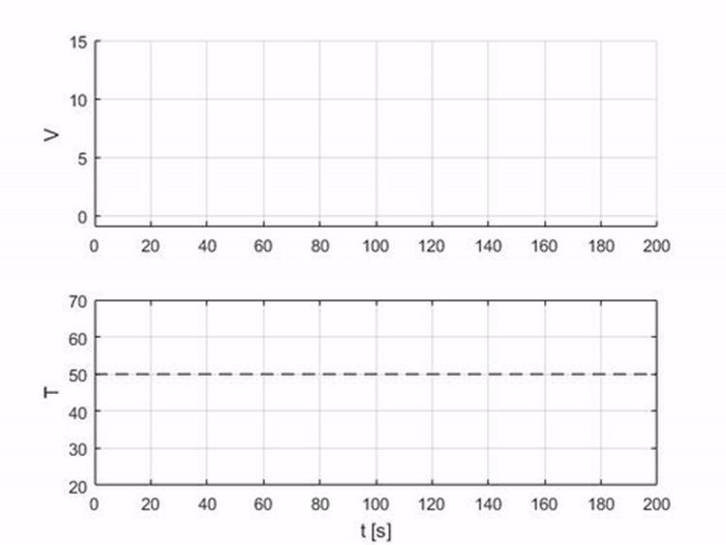
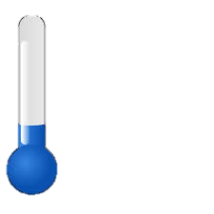

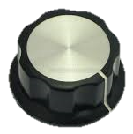
Experiment (1/6)
Manual Control
thermometer
T
electric heater
V

Slide 2
Experiment (1/6)
Manual Control
thermometer
T
electric heater
V

Slide 3
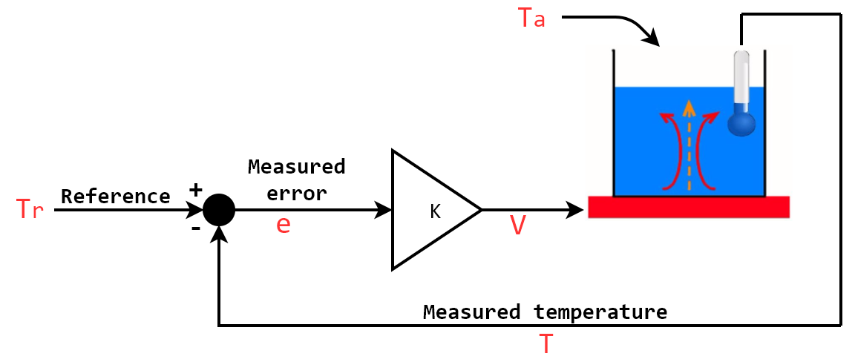
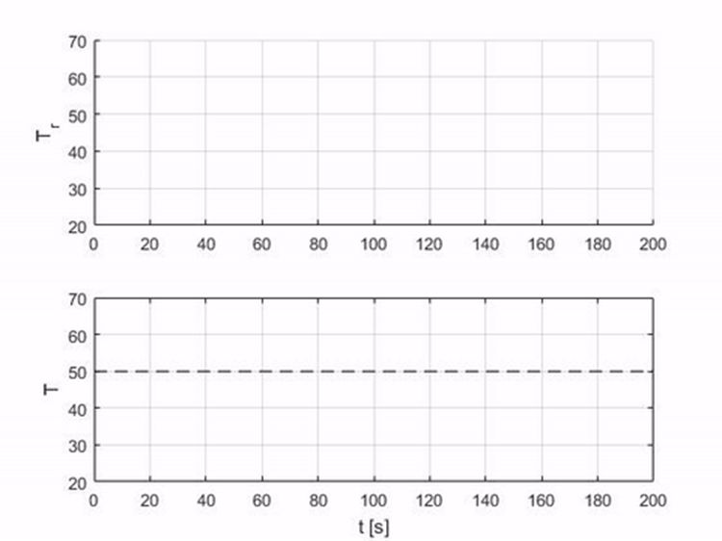
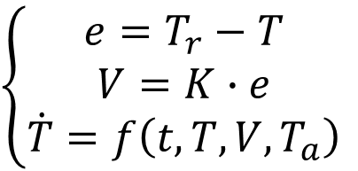
Experiment (2/6)
Automatic Control
$$\left\{\begin{aligned}e=T_{r}−T \\ V=K∙e \\ \dot{T}=f\left(t,T,V,T_{a}\right)\end{aligned}\right.$$

Slide 4
Experiment (2/6)
Automatic Control
$$\left\{\begin{aligned}e=T_{r}−T \\ V=K∙e \\ \dot{T}=f\left(t,T,V,T_{a}\right)\end{aligned}\right.$$

Slide 5
Experiment (3/6)
Increasing gain K

Slide 6
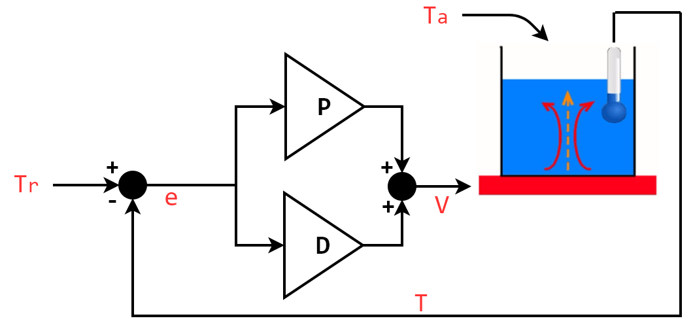
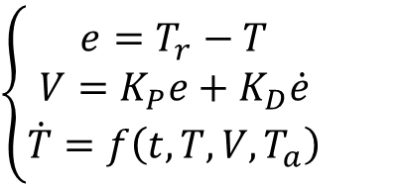
Experiment (4/6)
$$\left\{\begin{aligned}e=T_{r}−T \\ V=K_{P}e+K_{D}\dot{e} \\ \dot{T}=f\left(t,T,V,T_{a}\right)\end{aligned}\right.$$

Slide 7
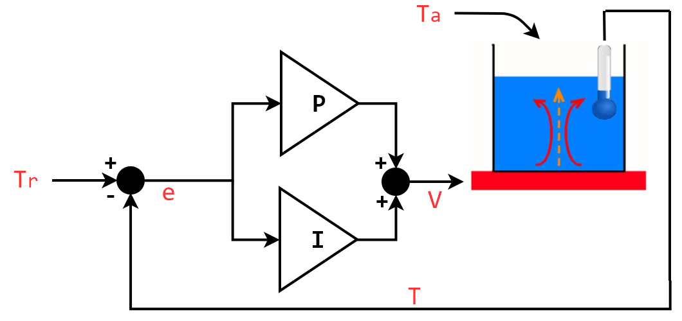
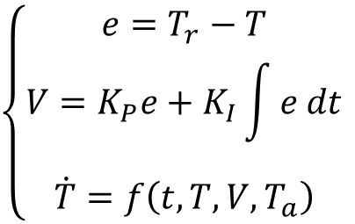
Experiment (5/6)
$$\left\{\begin{aligned}e=T_{r}−T \\ V=K_{P}e+K_{I}\int{e dt} \\ \dot{T}=f\left(t,T,V,T_{a}\right)\end{aligned}\right.$$

Slide 8
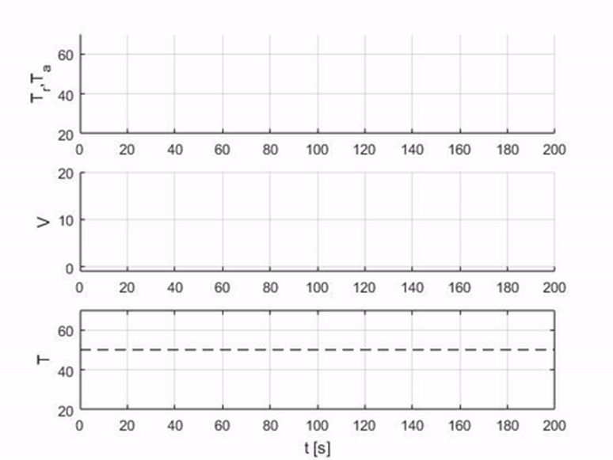
Experiment (6/6)
$$\left\{\begin{aligned}e=T_{r}−T \\ V=K_{P}e+K_{I}\int{e dt} \\ \dot{T}=f\left(t,T,V,T_{a}\right)\end{aligned}\right.$$
Disturbance Rejection

Slide 9
Experiment (6/6)
$$\left\{\begin{aligned}e=T_{r}−T \\ V=K_{P}e+K_{I}\int{e dt} \\ \dot{T}=f\left(t,T,V,T_{a}\right)\end{aligned}\right.$$
Disturbance Rejection

Slide 10
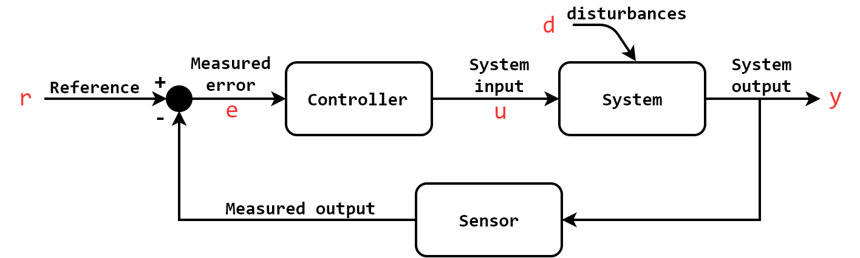
Feedback Control (Closed-loop)
Dynamical Systems (differential equation); No static maps
Linear vs. Nonlinear Systems/Control
Continuous vs. Discrete
Design: Time Performance, Stability, Robustness
Applications: Automotive, Aerospace, Robotics, Industries, Embedded, Military… Everywhere!
Large variety of techniques, but PID rules the world of controllers!

Slide 11
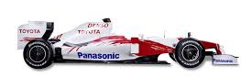
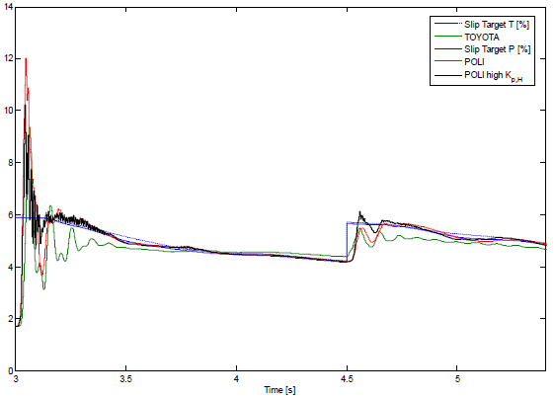
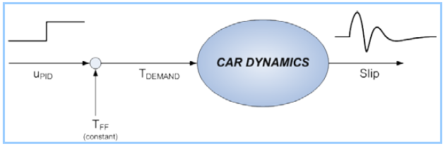
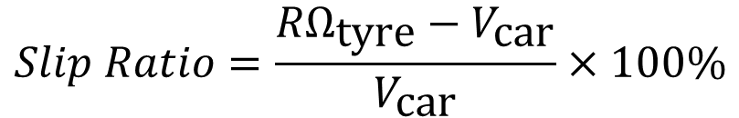
Hi-Tech Applications of PID
Traction Control
$$Slip Ratio=\frac{{RΩ}_{\text{tyre}}−V_{\text{car}}}{V_{\text{car}}}×100\%$$

Slide 12
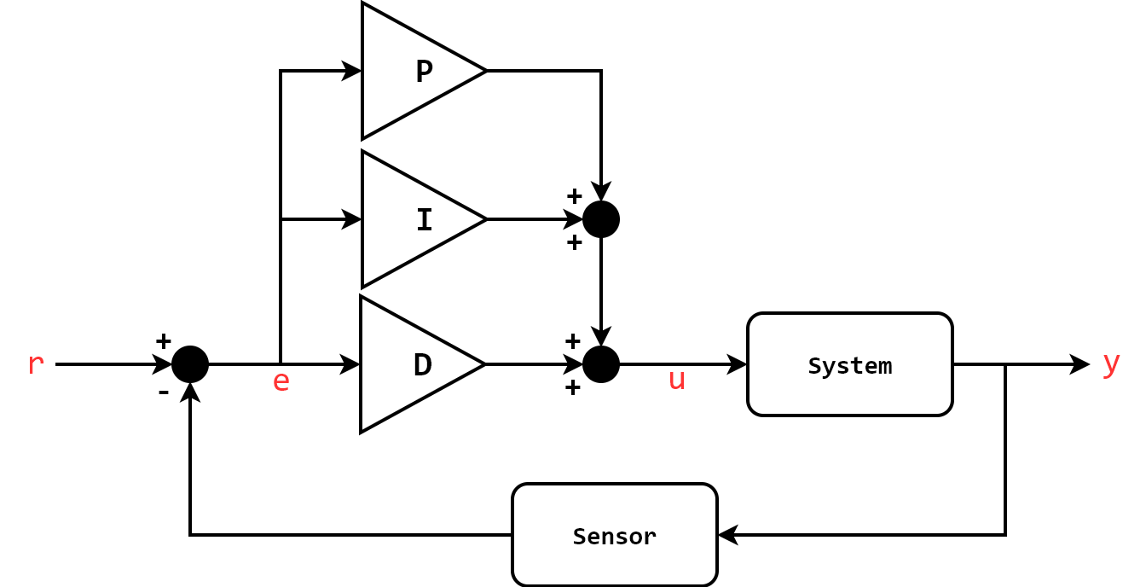
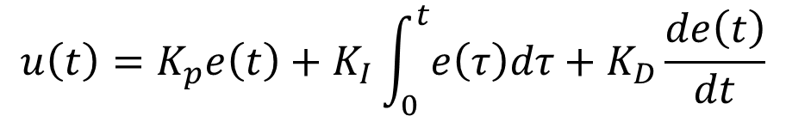
PID Control
$$u\left(t\right)=K_{p}e\left(t\right)+K_{I}\int_{0}^{t}{e\left(τ\right)dτ}+K_{D}\frac{de\left(t\right)}{dt}$$

Slide 13
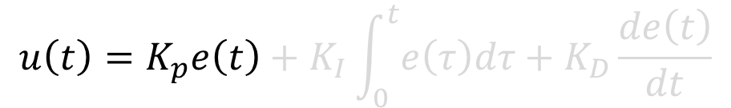
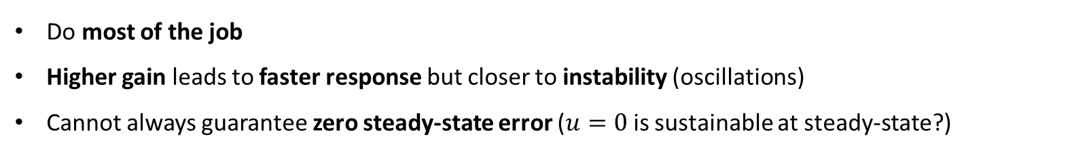
PID: Proportional
$$u\left(t\right)=K_{p}e\left(t\right)+K_{I}\int_{0}^{t}{e\left(τ\right)dτ}+K_{D}\frac{de\left(t\right)}{dt}$$
Do most of the job
Higher gain leads to faster response but closer to instability (oscillations)
Cannot always guarantee zero steady-state error ($u=0$ is sustainable at steady-state?)

Slide 14
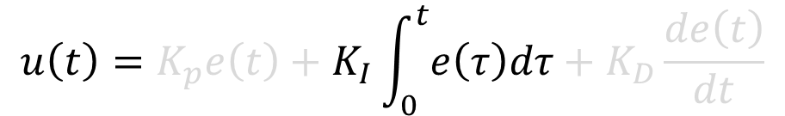
PID: Integral
$$u\left(t\right)=K_{p}e\left(t\right)+K_{I}\int_{0}^{t}{e\left(τ\right)dτ}+K_{D}\frac{de\left(t\right)}{dt}$$
Look back at the accumulated error P is unable to correct
Guarantee zero steady state error
Increase controller’s inertia, hence instability

Slide 15
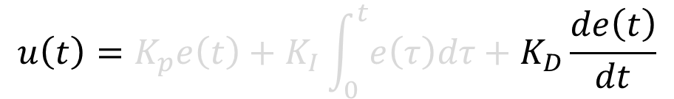
PID: Derivative
$$u\left(t\right)=K_{p}e\left(t\right)+K_{I}\int_{0}^{t}{e\left(τ\right)dτ}+K_{D}\frac{de\left(t\right)}{dt}$$
Look forward regulating the predicted error
Reduce oscillations
Computing derivative robustly is difficult → noise gets amplified

Slide 16
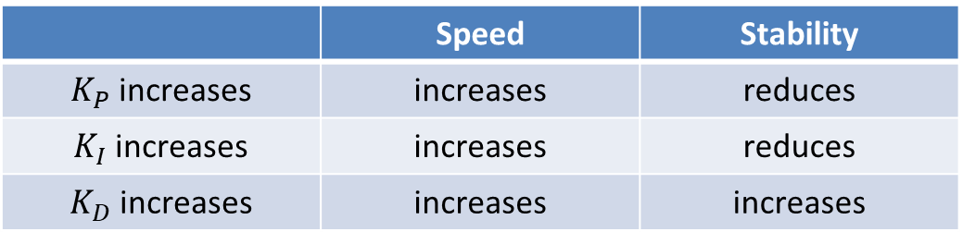
How to tune a PID?
$$u\left(t\right)=K_{p}e\left(t\right)+K_{I}\int_{0}^{t}{e\left(τ\right)dτ}+K_{D}\frac{de\left(t\right)}{dt}$$
 | Speed | Stability
$K_{P}$ increases | increases | reduces
$K_{I}$ increases | increases | reduces
$K_{D}$ increases | increases | increases

Slide 17
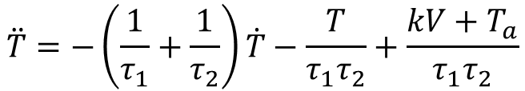

Modeling and Identification
(aka Tuning made right)
$$\dot{T}=f\left(t,T,V,T_{a}\right)$$
$$\ddot{T}=−\left(\frac{1}{τ_{1}}+\frac{1}{τ_{2}}\right)\dot{T}−\frac{T}{τ_{1}τ_{2}}+\frac{kV+T_{a}}{τ_{1}τ_{2}}$$

Slide 18
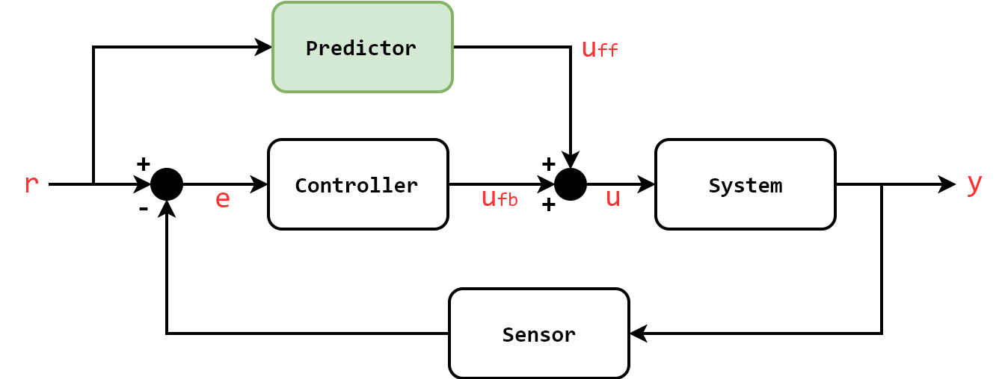

Feed-forward Control (Open-loop)
$$u=u_{ff}+u_{fb}$$
If the model is known, why don’t we use this information?
Increase performance
Feedback controller is still used to ensure robustness

Slide 19
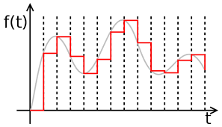
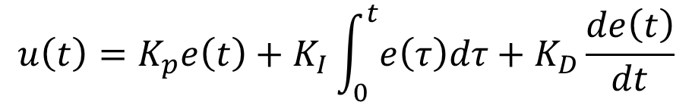

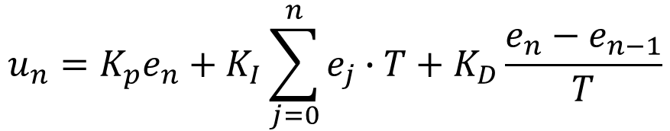
Discrete PID
$$u\left(t\right)=K_{p}e\left(t\right)+K_{I}\int_{0}^{t}{e\left(τ\right)dτ}+K_{D}\frac{de\left(t\right)}{dt}$$
$$u_{n}=K_{p}e_{n}+K_{I}\sum_{j=0}^{n}{e_{j}∙T}+K_{D}\frac{e_{n}−e_{n−1}}{T}$$
$$T$$
Time to take on some challenges ;)
https://janismac.github.io/ControlChallenges

Slide 20
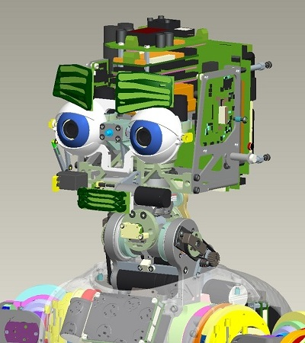
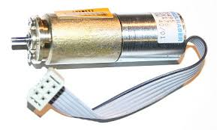
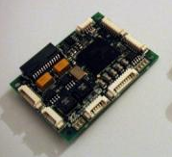
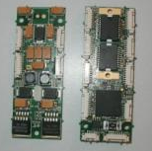
Joint Control (1/5)
USER CODE @ 100 Hz
ipos->positionMove(poss.data());
while (norm(poss-encs)>1.0) {
Time::delay(0.1);
ienc->getEncoders(encs.data());
cout<<encs.toString()<<endl;
}
Gbit Ethernet
PC104
DC MOTORS
FIRMWARE @ 1 KHz
CONTROLLERS
Sensors & Actuators

Slide 21
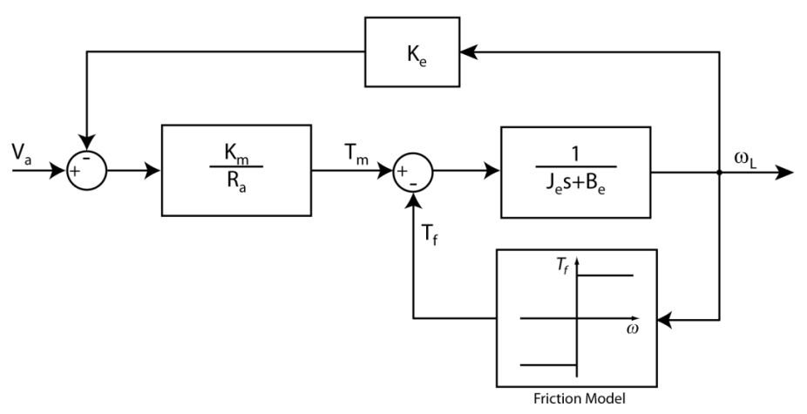

Joint Control (2/5)
USER CODE @ 100 Hz
ipos->positionMove(poss.data());
while (norm(poss-encs)>1.0) {
Time::delay(0.1);
ienc->getEncoders(encs.data());
cout<<encs.toString()<<endl;
}
Gbit Ethernet
$$\dot{ω_{L}}=−\frac{ω_{L}+K∙V_{a}}{τ}$$
PC104
DC MOTORS
FIRMWARE @ 1 KHz
CONTROLLERS
Sensors & Actuators

Slide 22
Joint Control (3/5)
OPENING THE JOINT INTERFACE
#include <yarp/dev/all.h>
Property option;
option.put("device",“remote_controlboard");
option.put("remote","/icubSim/head");
option.put("local","/client/head");
PolyDriver clientJointCtrl(option);
IEncoders *ienc=NULL;
IControlMode *imod=NULL;
IVelocityControl *ivel=NULL;
if (clientJointCtrl.isValid()) {
clientJointCtrl.view(ienc);
clientJointCtrl.view(imod);
clientJointCtrl.view(ivel);
}

Slide 23
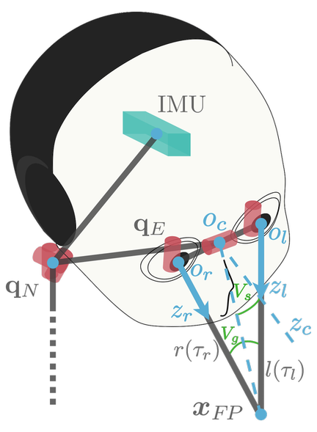
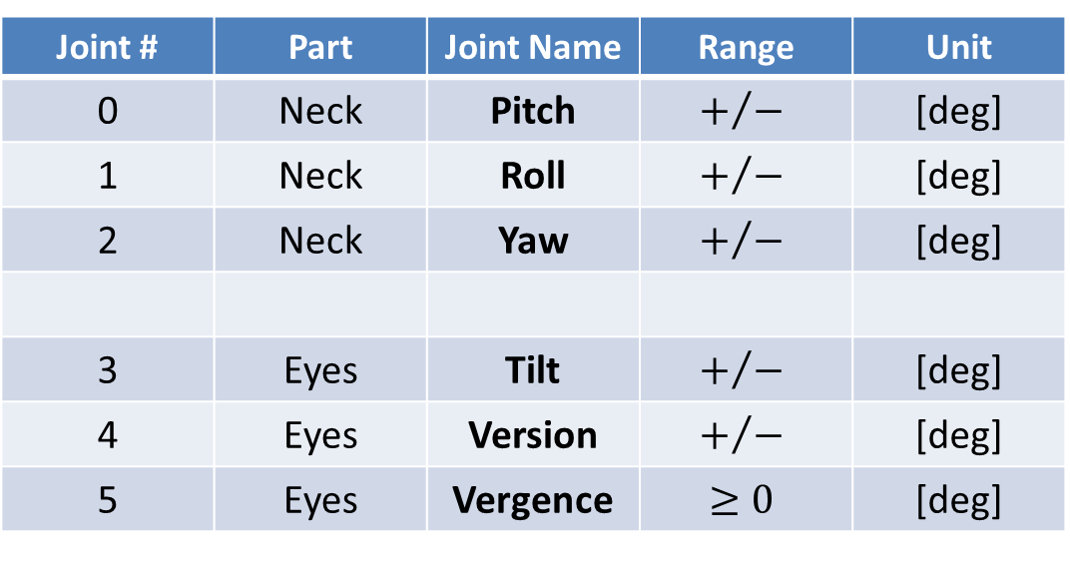
Joint Control (4/5)
Joint # | Part | Joint Name | Range | Unit
0 | Neck | Pitch | $$+/−$$ | [deg]
1 | Neck | Roll | $$+/−$$ | [deg]
2 | Neck | Yaw | $$+/−$$ | [deg]
3 | Eyes | Tilt | $$+/−$$ | [deg]
4 | Eyes | Version | $$+/−$$ | [deg]
5 | Eyes | Vergence | $$≥0$$ | [deg]

Slide 24
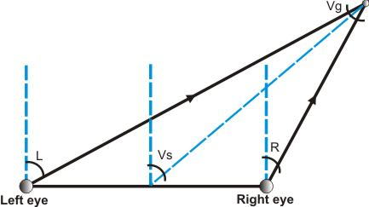
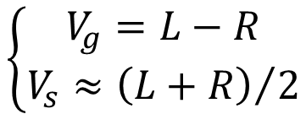
Joint Control (5/5)
$$\left\{\begin{aligned}V_{g}=L−R \\ V_{s}≈{\left(L+R\right)}/2\end{aligned}\right.$$

Slide 25
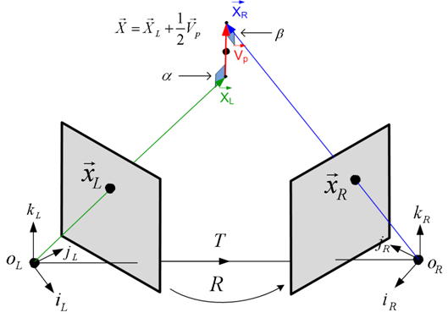




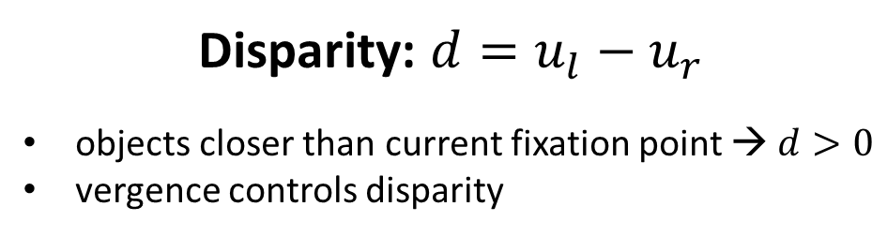
Geometry of Pixels
$$u_{l}$$
$$u_{r}$$
0,0
$$v_{l}$$
$$v_{r}$$
Left Image 320x240
Right Image 320x240
Disparity: $d=u_{l}−u_{r}$
objects closer than current fixation point → $d>0$
vergence controls disparity

Slide 26
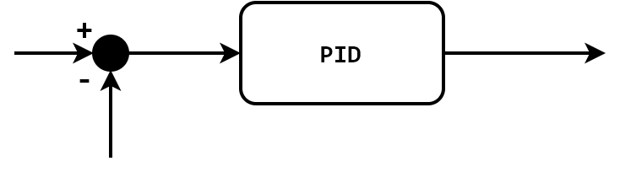


Image Based Joint Velocity Control (1/2)
$$u_{l}$$
$$v_{l}$$
?
?
Left Image 320x240
?
?
?
?

Slide 27




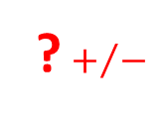

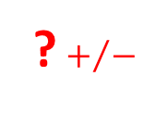

Image Based Joint Velocity Control (1/2)
$$u_{l}$$
$$v_{l}$$
$$160$$
$$v_{vers}$$
? $+/−$
Left Image 320x240
$$u_{l}$$
Is P sufficient?
What happens if the object moves at constant speed?
$$120$$
$$v_{tilt}$$
? $+/−$
$$v_{l}$$

Slide 28


Image Based Joint Velocity Control (2/2)
$$u_{l}$$
$$v_{l}$$
Left Image 320x240
?
$$u_{r}$$
?
$$v_{r}$$
?
Right Image 320x240

Slide 29


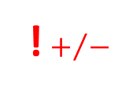


Image Based Joint Velocity Control (2/2)
$$u_{l}$$
$$v_{l}$$
Left Image 320x240
$$u_{r}$$
$$0$$
$$v_{verg}$$
! $+/−$
$$v_{r}$$
$$d$$
Version and Vergence are coupled!
Right Image 320x240

Slide 30
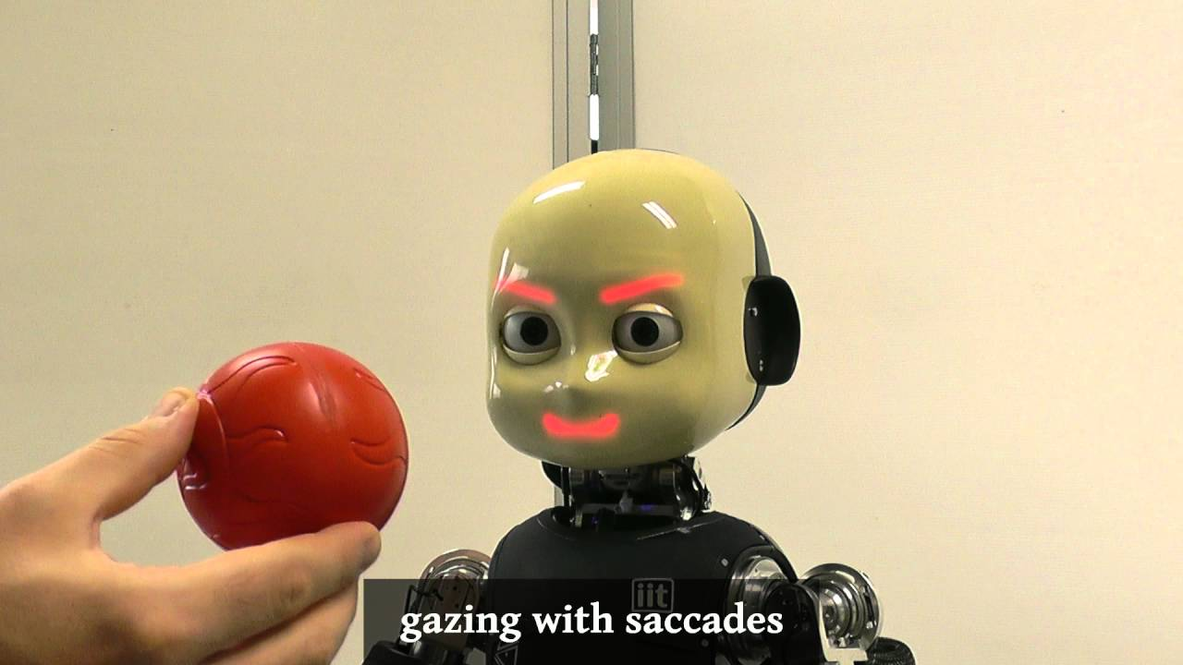
The Gaze Controller
http://y2u.be/I4ZKfAvs1y0

