Slide 1
ccwo <- read.csv("C:/Users/nando/workspaces/ufal/masters_experiment_analysis/datasetatoms.csv") ccwo$Minutes[ccwo$Minutes < 0] <- NA
md.pattern(ccwo)
## /\ /\ ## { `---' } ## { O O } ## ==> V <== No need for mice. This data set is completely observed. ## \ \|/ / ## `-----'

Slide 2
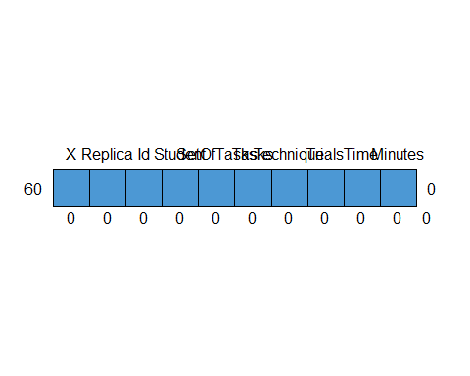

Slide 3
## X Replica Id Student SetOfTasks Tasks Technique Trials Time Minutes ## 60 1 1 1 1 1 1 1 1 1 1 0 ## 0 0 0 0 0 0 0 0 0 0 0
## ## iter imp variable ## 1 1 ## 1 2 ## 1 3 ## 1 4 ## 1 5 ## 2 1 ## 2 2 ## 2 3 ## 2 4 ## 2 5 ## 3 1 ## 3 2 ## 3 3 ## 3 4 ## 3 5 ## 4 1 ## 4 2 ## 4 3 ## 4 4 ## 4 5 ## 5 1 ## 5 2 ## 5 3 ## 5 4 ## 5 5 ## 6 1 ## 6 2 ## 6 3 ## 6 4 ## 6 5 ## 7 1 ## 7 2 ## 7 3 ## 7 4 ## 7 5 ## 8 1 ## 8 2 ## 8 3 ## 8 4 ## 8 5 ## 9 1 ## 9 2 ## 9 3 ## 9 4 ## 9 5 ## 10 1 ## 10 2 ## 10 3 ## 10 4 ## 10 5 ## 11 1 ## 11 2 ## 11 3 ## 11 4 ## 11 5 ## 12 1 ## 12 2 ## 12 3 ## 12 4 ## 12 5 ## 13 1 ## 13 2 ## 13 3 ## 13 4 ## 13 5 ## 14 1 ## 14 2 ## 14 3 ## 14 4 ## 14 5 ## 15 1 ## 15 2 ## 15 3 ## 15 4 ## 15 5 ## 16 1 ## 16 2 ## 16 3 ## 16 4 ## 16 5 ## 17 1 ## 17 2 ## 17 3 ## 17 4 ## 17 5 ## 18 1 ## 18 2 ## 18 3 ## 18 4 ## 18 5 ## 19 1 ## 19 2 ## 19 3 ## 19 4 ## 19 5 ## 20 1 ## 20 2 ## 20 3 ## 20 4 ## 20 5 ## 21 1 ## 21 2 ## 21 3 ## 21 4 ## 21 5 ## 22 1 ## 22 2 ## 22 3 ## 22 4 ## 22 5 ## 23 1 ## 23 2 ## 23 3 ## 23 4 ## 23 5 ## 24 1 ## 24 2 ## 24 3 ## 24 4 ## 24 5 ## 25 1 ## 25 2 ## 25 3 ## 25 4 ## 25 5 ## 26 1 ## 26 2 ## 26 3 ## 26 4 ## 26 5 ## 27 1 ## 27 2 ## 27 3 ## 27 4 ## 27 5 ## 28 1 ## 28 2 ## 28 3 ## 28 4 ## 28 5 ## 29 1 ## 29 2 ## 29 3 ## 29 4 ## 29 5 ## 30 1 ## 30 2 ## 30 3 ## 30 4 ## 30 5 ## 31 1 ## 31 2 ## 31 3 ## 31 4 ## 31 5 ## 32 1 ## 32 2 ## 32 3 ## 32 4 ## 32 5 ## 33 1 ## 33 2 ## 33 3 ## 33 4 ## 33 5 ## 34 1 ## 34 2 ## 34 3 ## 34 4 ## 34 5 ## 35 1 ## 35 2 ## 35 3 ## 35 4 ## 35 5 ## 36 1 ## 36 2 ## 36 3 ## 36 4 ## 36 5 ## 37 1 ## 37 2 ## 37 3 ## 37 4 ## 37 5 ## 38 1 ## 38 2 ## 38 3 ## 38 4 ## 38 5 ## 39 1 ## 39 2 ## 39 3 ## 39 4 ## 39 5 ## 40 1 ## 40 2 ## 40 3 ## 40 4 ## 40 5 ## 41 1 ## 41 2 ## 41 3 ## 41 4 ## 41 5 ## 42 1 ## 42 2 ## 42 3 ## 42 4 ## 42 5 ## 43 1 ## 43 2 ## 43 3 ## 43 4 ## 43 5 ## 44 1 ## 44 2 ## 44 3 ## 44 4 ## 44 5 ## 45 1 ## 45 2 ## 45 3 ## 45 4 ## 45 5 ## 46 1 ## 46 2 ## 46 3 ## 46 4 ## 46 5 ## 47 1 ## 47 2 ## 47 3 ## 47 4 ## 47 5 ## 48 1 ## 48 2 ## 48 3 ## 48 4 ## 48 5 ## 49 1 ## 49 2 ## 49 3 ## 49 4 ## 49 5 ## 50 1 ## 50 2 ## 50 3 ## 50 4 ## 50 5
## Warning: Number of logged events: 1
## Replica Id SetOfTasks Technique Trials Time ## 1 41 1 ST1 Without Atom 7 13 ## 2 41 1 ST2 With Atom 3 16 ## 3 41 2 ST1 With Atom 5 21 ## 4 41 2 ST2 Without Atom 3 15 ## 5 42 1 ST1 Without Atom 5 14 ## 6 42 1 ST2 With Atom 12 39 ## 7 42 2 ST1 With Atom 7 16 ## 8 42 2 ST2 Without Atom 12 22 ## 9 43 1 ST1 Without Atom 5 18 ## 10 43 1 ST2 With Atom 9 53 ## 11 43 2 ST1 With Atom 9 21 ## 12 43 2 ST2 Without Atom 5 15 ## 13 44 1 ST1 Without Atom 4 9 ## 14 44 1 ST2 With Atom 4 24 ## 15 44 2 ST1 With Atom 6 17 ## 16 44 2 ST2 Without Atom 6 23 ## 17 45 1 ST1 With Atom 9 25 ## 18 45 1 ST2 Without Atom 7 28 ## 19 45 2 ST1 Without Atom 5 7 ## 20 45 2 ST2 With Atom 8 18 ## 21 46 1 ST1 With Atom 7 32 ## 22 46 1 ST2 Without Atom 9 32 ## 23 46 2 ST1 Without Atom 4 10 ## 24 46 2 ST2 With Atom 12 31 ## 25 47 1 ST1 Without Atom 4 18 ## 26 47 1 ST2 With Atom 5 53 ## 27 47 2 ST1 With Atom 5 21 ## 28 47 2 ST2 Without Atom 4 24 ## 29 48 1 ST1 With Atom 7 15 ## 30 48 1 ST2 Without Atom 3 12 ## 31 48 2 ST1 Without Atom 10 25 ## 32 48 2 ST2 With Atom 29 60 ## 33 49 1 ST1 Without Atom 8 33 ## 34 49 1 ST2 With Atom 10 23 ## 35 49 2 ST1 With Atom 6 9 ## 36 49 2 ST2 Without Atom 3 2 ## 37 50 1 ST1 With Atom 8 21 ## 38 50 1 ST2 Without Atom 5 19 ## 39 50 2 ST1 Without Atom 7 19 ## 40 50 2 ST2 With Atom 10 29 ## 41 51 1 ST1 Without Atom 5 22 ## 42 51 1 ST2 With Atom 6 24 ## 43 51 2 ST1 With Atom 6 9 ## 44 51 2 ST2 Without Atom 5 15 ## 45 52 1 ST1 With Atom 9 23 ## 46 52 1 ST2 Without Atom 24 38 ## 47 52 2 ST1 Without Atom 7 16 ## 48 52 2 ST2 With Atom 14 52 ## 49 53 1 ST1 With Atom 5 11 ## 50 53 1 ST2 Without Atom 4 8 ## 51 53 2 ST1 Without Atom 5 9 ## 52 53 2 ST2 With Atom 15 31 ## 53 54 1 ST1 Without Atom 4 27 ## 54 54 1 ST2 With Atom 7 34 ## 55 54 2 ST1 With Atom 6 33 ## 56 54 2 ST2 Without Atom 3 26 ## 57 55 1 ST1 With Atom 5 23 ## 58 55 1 ST2 Without Atom 4 19 ## 59 55 2 ST1 Without Atom 5 10 ## 60 55 2 ST2 With Atom 19 46

Slide 4
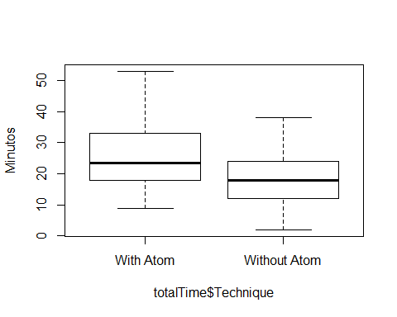

Slide 5
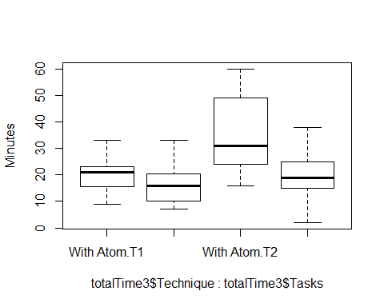

Slide 6
## Replica Tasks Technique Trials Time ## 1 41 T1 With Atom 5 21 ## 2 41 T1 Without Atom 7 13 ## 3 41 T2 With Atom 3 16 ## 4 41 T2 Without Atom 3 15 ## 5 42 T1 With Atom 7 16 ## 6 42 T1 Without Atom 5 14 ## 7 42 T2 With Atom 12 39 ## 8 42 T2 Without Atom 12 22 ## 9 43 T1 With Atom 9 21 ## 10 43 T1 Without Atom 5 18 ## 11 43 T2 With Atom 9 53 ## 12 43 T2 Without Atom 5 15 ## 13 44 T1 With Atom 6 17 ## 14 44 T1 Without Atom 4 9 ## 15 44 T2 With Atom 4 24 ## 16 44 T2 Without Atom 6 23 ## 17 45 T1 With Atom 9 25 ## 18 45 T1 Without Atom 5 7 ## 19 45 T2 With Atom 8 18 ## 20 45 T2 Without Atom 7 28 ## 21 46 T1 With Atom 7 32 ## 22 46 T1 Without Atom 4 10 ## 23 46 T2 With Atom 12 31 ## 24 46 T2 Without Atom 9 32 ## 25 47 T1 With Atom 5 21 ## 26 47 T1 Without Atom 4 18 ## 27 47 T2 With Atom 5 53 ## 28 47 T2 Without Atom 4 24 ## 29 48 T1 With Atom 7 15 ## 30 48 T1 Without Atom 10 25 ## 31 48 T2 With Atom 29 60 ## 32 48 T2 Without Atom 3 12 ## 33 49 T1 With Atom 6 9 ## 34 49 T1 Without Atom 8 33 ## 35 49 T2 With Atom 10 23 ## 36 49 T2 Without Atom 3 2 ## 37 50 T1 With Atom 8 21 ## 38 50 T1 Without Atom 7 19 ## 39 50 T2 With Atom 10 29 ## 40 50 T2 Without Atom 5 19 ## 41 51 T1 With Atom 6 9 ## 42 51 T1 Without Atom 5 22 ## 43 51 T2 With Atom 6 24 ## 44 51 T2 Without Atom 5 15 ## 45 52 T1 With Atom 9 23 ## 46 52 T1 Without Atom 7 16 ## 47 52 T2 With Atom 14 52 ## 48 52 T2 Without Atom 24 38 ## 49 53 T1 With Atom 5 11 ## 50 53 T1 Without Atom 5 9 ## 51 53 T2 With Atom 15 31 ## 52 53 T2 Without Atom 4 8 ## 53 54 T1 With Atom 6 33 ## 54 54 T1 Without Atom 4 27 ## 55 54 T2 With Atom 7 34 ## 56 54 T2 Without Atom 3 26 ## 57 55 T1 With Atom 5 23 ## 58 55 T1 Without Atom 5 10 ## 59 55 T2 With Atom 19 46 ## 60 55 T2 Without Atom 4 19

Slide 7
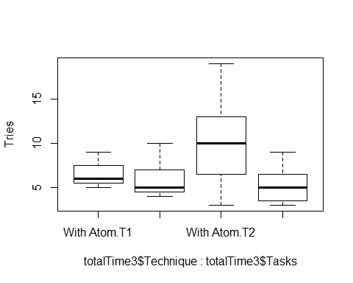

Slide 8
## X Replica Id Student SetOfTasks Tasks ## 1 1 41 1 paulo ST1 AV1.2:CO1.2:DE1.2 ## 2 1 41 1 paulo ST2 AV2.1:CO2.1:DE2.1 ## 3 1 41 2 RomÃ¡rio ST1 AV1.1:CO1.1:DE1.1 ## 4 1 41 2 RomÃ¡rio ST2 AV2.2:CO2.2:DE2.2 ## 5 2 42 1 Igor ST1 AV1.2:CO1.2:DE1.2 ## 6 2 42 1 Igor ST2 AV2.1:CO2.1:DE2.1 ## 7 2 42 2 Hyago ST1 AV1.1:CO1.1:DE1.1 ## 8 2 42 2 Hyago ST2 AV2.2:CO2.2:DE2.2 ## 9 3 43 1 ST1 AV1.2:CO1.2:DE1.2 ## 10 3 43 1 ST2 AV2.1:CO2.1:DE2.1 ## 11 3 43 2 ST1 AV1.1:CO1.1:DE1.1 ## 12 3 43 2 ST2 AV2.2:CO2.2:DE2.2 ## 13 4 44 1 ST1 AV1.2:CO1.2:DE1.2 ## 14 4 44 1 ST2 AV2.1:CO2.1:DE2.1 ## 15 4 44 2 ST1 AV1.1:CO1.1:DE1.1 ## 16 4 44 2 ST2 AV2.2:CO2.2:DE2.2 ## 17 5 45 1 Matheus Costa ST1 AV1.1:CO1.1:DE1.1 ## 18 5 45 1 Matheus Costa ST2 AV2.2:CO2.2:DE2.2 ## 19 5 45 2 Davi Jose ST1 AV1.2:CO1.2:DE1.2 ## 20 5 45 2 Davi Jose ST2 AV2.1:CO2.1:DE2.1 ## 21 6 46 1 Marlon LÃºcio ST1 AV1.1:CO1.1:DE1.1 ## 22 6 46 1 Marlon LÃºcio ST2 AV2.2:CO2.2:DE2.2 ## 23 6 46 2 Jackson Barbosa da Silva ST1 AV1.2:CO1.2:DE1.2 ## 24 6 46 2 Jackson Barbosa da Silva ST2 AV2.1:CO2.1:DE2.1 ## 25 7 47 1 Allan ST1 AV1.2:CO1.2:DE1.2 ## 26 7 47 1 Allan ST2 AV2.1:CO2.1:DE2.1 ## 27 7 47 2 Dielson Sales de Carvalho ST1 AV1.1:CO1.1:DE1.1 ## 28 7 47 2 Dielson Sales de Carvalho ST2 AV2.2:CO2.2:DE2.2 ## 29 8 48 1 Thiago ST1 AV1.1:CO1.1:DE1.1 ## 30 8 48 1 Thiago ST2 AV2.2:CO2.2:DE2.2 ## 31 8 48 2 ST1 AV1.2:CO1.2:DE1.2 ## 32 8 48 2 ST2 AV2.1:CO2.1:DE2.1 ## 33 9 49 1 Rodrigo Lima ST1 AV1.2:CO1.2:DE1.2 ## 34 9 49 1 Rodrigo Lima ST2 AV2.1:CO2.1:DE2.1 ## 35 9 49 2 Jardel Costa ST1 AV1.1:CO1.1:DE1.1 ## 36 9 49 2 Jardel Costa ST2 AV2.2:CO2.2:DE2.2 ## 37 10 50 1 Felipe Pontes ST1 AV1.1:CO1.1:DE1.1 ## 38 10 50 1 Felipe Pontes ST2 AV2.2:CO2.2:DE2.2 ## 39 10 50 2 Jairo Souza ST1 AV1.2:CO1.2:DE1.2 ## 40 10 50 2 Jairo Souza ST2 AV2.1:CO2.1:DE2.1 ## 41 11 51 1 julios ST1 AV1.2:CO1.2:DE1.2 ## 42 11 51 1 julios ST2 AV2.1:CO2.1:DE2.1 ## 43 11 51 2 Romero Malaquias ST1 AV1.1:CO1.1:DE1.1 ## 44 11 51 2 Romero Malaquias ST2 AV2.2:CO2.2:DE2.2 ## 45 12 53 1 Bruno Georgevich Ferreira ST1 AV1.1:CO1.1:DE1.1 ## 46 12 53 1 Bruno Georgevich Ferreira ST2 AV2.2:CO2.2:DE2.2 ## 47 12 53 2 jadson ST1 AV1.2:CO1.2:DE1.2 ## 48 12 53 2 jadson ST2 AV2.1:CO2.1:DE2.1 ## 49 13 55 1 ST1 AV1.1:CO1.1:DE1.1 ## 50 13 55 1 ST2 AV2.2:CO2.2:DE2.2 ## 51 13 55 2 Arthur ST1 AV1.2:CO1.2:DE1.2 ## 52 13 55 2 Arthur ST2 AV2.1:CO2.1:DE2.1 ## 53 14 52 1 ST1 AV1.1:CO1.1:DE1.1 ## 54 14 52 1 ST2 AV2.2:CO2.2:DE2.2 ## 55 14 52 2 vinicius lopes ST1 AV1.2:CO1.2:DE1.2 ## 56 14 52 2 vinicius lopes ST2 AV2.1:CO2.1:DE2.1 ## 57 15 54 1 Thiago Tenorio ST1 AV1.2:CO1.2:DE1.2 ## 58 15 54 1 Thiago Tenorio ST2 AV2.1:CO2.1:DE2.1 ## 59 15 54 2 Joao Victor Ribeiro Ferro ST1 AV1.1:CO1.1:DE1.1 ## 60 15 54 2 Joao Victor Ribeiro Ferro ST2 AV2.2:CO2.2:DE2.2 ## Technique Trials Time Minutes ## 1 Without Atom 7 13 13 ## 2 With Atom 3 16 16 ## 3 With Atom 5 21 21 ## 4 Without Atom 3 15 15 ## 5 Without Atom 5 14 14 ## 6 With Atom 12 39 39 ## 7 With Atom 7 16 16 ## 8 Without Atom 12 22 22 ## 9 Without Atom 5 18 18 ## 10 With Atom 9 53 53 ## 11 With Atom 9 21 21 ## 12 Without Atom 5 15 15 ## 13 Without Atom 4 9 9 ## 14 With Atom 4 24 24 ## 15 With Atom 6 17 17 ## 16 Without Atom 6 23 23 ## 17 With Atom 9 25 25 ## 18 Without Atom 7 28 28 ## 19 Without Atom 5 7 7 ## 20 With Atom 8 18 18 ## 21 With Atom 7 32 32 ## 22 Without Atom 9 32 32 ## 23 Without Atom 4 10 10 ## 24 With Atom 12 31 31 ## 25 Without Atom 4 18 18 ## 26 With Atom 5 53 53 ## 27 With Atom 5 21 21 ## 28 Without Atom 4 24 24 ## 29 With Atom 7 15 15 ## 30 Without Atom 3 12 12 ## 31 Without Atom 10 25 25 ## 32 With Atom 29 60 60 ## 33 Without Atom 8 33 33 ## 34 With Atom 10 23 23 ## 35 With Atom 6 9 9 ## 36 Without Atom 3 2 2 ## 37 With Atom 8 21 21 ## 38 Without Atom 5 19 19 ## 39 Without Atom 7 19 19 ## 40 With Atom 10 29 29 ## 41 Without Atom 5 22 22 ## 42 With Atom 6 24 24 ## 43 With Atom 6 9 9 ## 44 Without Atom 5 15 15 ## 45 With Atom 5 11 11 ## 46 Without Atom 4 8 8 ## 47 Without Atom 5 9 9 ## 48 With Atom 15 31 31 ## 49 With Atom 5 23 23 ## 50 Without Atom 4 19 19 ## 51 Without Atom 5 10 10 ## 52 With Atom 19 46 46 ## 53 With Atom 9 23 23 ## 54 Without Atom 24 38 38 ## 55 Without Atom 7 16 16 ## 56 With Atom 14 52 52 ## 57 Without Atom 4 27 27 ## 58 With Atom 7 34 34 ## 59 With Atom 6 33 33 ## 60 Without Atom 3 26 26
## Replica Tasks Minutes Time ## 1 41 AV1.2:CO1.2:DE1.2 13 13 ## 2 41 AV1.1:CO1.1:DE1.1 21 21 ## 3 42 AV1.2:CO1.2:DE1.2 14 14 ## 4 42 AV1.1:CO1.1:DE1.1 16 16 ## 5 43 AV1.2:CO1.2:DE1.2 18 18 ## 6 43 AV1.1:CO1.1:DE1.1 21 21 ## 7 44 AV1.2:CO1.2:DE1.2 9 9 ## 8 44 AV1.1:CO1.1:DE1.1 17 17 ## 9 45 AV1.1:CO1.1:DE1.1 25 25 ## 10 45 AV1.2:CO1.2:DE1.2 7 7 ## 11 46 AV1.1:CO1.1:DE1.1 32 32 ## 12 46 AV1.2:CO1.2:DE1.2 10 10 ## 13 47 AV1.2:CO1.2:DE1.2 18 18 ## 14 47 AV1.1:CO1.1:DE1.1 21 21 ## 15 48 AV1.1:CO1.1:DE1.1 15 15 ## 16 48 AV1.2:CO1.2:DE1.2 25 25 ## 17 49 AV1.2:CO1.2:DE1.2 33 33 ## 18 49 AV1.1:CO1.1:DE1.1 9 9 ## 19 50 AV1.1:CO1.1:DE1.1 21 21 ## 20 50 AV1.2:CO1.2:DE1.2 19 19 ## 21 51 AV1.2:CO1.2:DE1.2 22 22 ## 22 51 AV1.1:CO1.1:DE1.1 9 9 ## 23 53 AV1.1:CO1.1:DE1.1 11 11 ## 24 53 AV1.2:CO1.2:DE1.2 9 9 ## 25 55 AV1.1:CO1.1:DE1.1 23 23 ## 26 55 AV1.2:CO1.2:DE1.2 10 10 ## 27 52 AV1.1:CO1.1:DE1.1 23 23 ## 28 52 AV1.2:CO1.2:DE1.2 16 16 ## 29 54 AV1.2:CO1.2:DE1.2 27 27 ## 30 54 AV1.1:CO1.1:DE1.1 33 33
## Replica Tasks Minutes Time ## 1 41 AV2.1:CO2.1:DE2.1 16 16 ## 2 41 AV2.2:CO2.2:DE2.2 15 15 ## 3 42 AV2.1:CO2.1:DE2.1 39 39 ## 4 42 AV2.2:CO2.2:DE2.2 22 22 ## 5 43 AV2.1:CO2.1:DE2.1 53 53 ## 6 43 AV2.2:CO2.2:DE2.2 15 15 ## 7 44 AV2.1:CO2.1:DE2.1 24 24 ## 8 44 AV2.2:CO2.2:DE2.2 23 23 ## 9 45 AV2.2:CO2.2:DE2.2 28 28 ## 10 45 AV2.1:CO2.1:DE2.1 18 18 ## 11 46 AV2.2:CO2.2:DE2.2 32 32 ## 12 46 AV2.1:CO2.1:DE2.1 31 31 ## 13 47 AV2.1:CO2.1:DE2.1 53 53 ## 14 47 AV2.2:CO2.2:DE2.2 24 24 ## 15 48 AV2.2:CO2.2:DE2.2 12 12 ## 16 48 AV2.1:CO2.1:DE2.1 60 60 ## 17 49 AV2.1:CO2.1:DE2.1 23 23 ## 18 49 AV2.2:CO2.2:DE2.2 2 2 ## 19 50 AV2.2:CO2.2:DE2.2 19 19 ## 20 50 AV2.1:CO2.1:DE2.1 29 29 ## 21 51 AV2.1:CO2.1:DE2.1 24 24 ## 22 51 AV2.2:CO2.2:DE2.2 15 15 ## 23 53 AV2.2:CO2.2:DE2.2 8 8 ## 24 53 AV2.1:CO2.1:DE2.1 31 31 ## 25 55 AV2.2:CO2.2:DE2.2 19 19 ## 26 55 AV2.1:CO2.1:DE2.1 46 46 ## 27 52 AV2.2:CO2.2:DE2.2 38 38 ## 28 52 AV2.1:CO2.1:DE2.1 52 52 ## 29 54 AV2.1:CO2.1:DE2.1 34 34 ## 30 54 AV2.2:CO2.2:DE2.2 26 26
## [1] 18.23333
## [1] 27.7

Slide 9
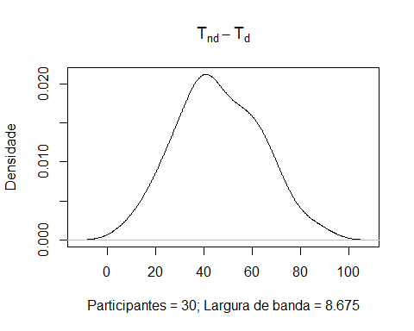

Slide 10
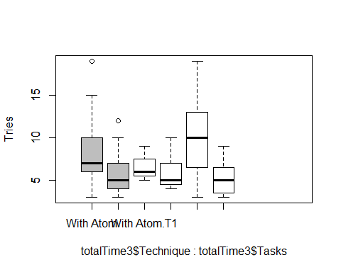

Slide 11
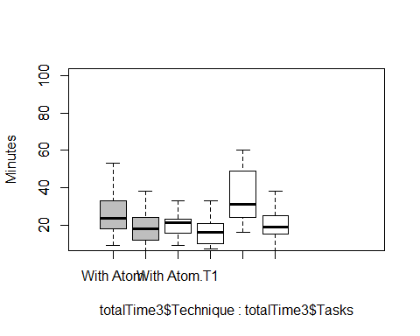

Slide 12
totalTrials <- sqldf("select Replica, Id, SetOfTasks, Technique, sum(Trials) as Trials from ccwocd group by Replica, Id,SetOfTasks, Technique") totalTrials
## Replica Id SetOfTasks Technique Trials ## 1 41 1 ST1 Without Atom 7 ## 2 41 1 ST2 With Atom 3 ## 3 41 2 ST1 With Atom 5 ## 4 41 2 ST2 Without Atom 3 ## 5 42 1 ST1 Without Atom 5 ## 6 42 1 ST2 With Atom 12 ## 7 42 2 ST1 With Atom 7 ## 8 42 2 ST2 Without Atom 12 ## 9 43 1 ST1 Without Atom 5 ## 10 43 1 ST2 With Atom 9 ## 11 43 2 ST1 With Atom 9 ## 12 43 2 ST2 Without Atom 5 ## 13 44 1 ST1 Without Atom 4 ## 14 44 1 ST2 With Atom 4 ## 15 44 2 ST1 With Atom 6 ## 16 44 2 ST2 Without Atom 6 ## 17 45 1 ST1 With Atom 9 ## 18 45 1 ST2 Without Atom 7 ## 19 45 2 ST1 Without Atom 5 ## 20 45 2 ST2 With Atom 8 ## 21 46 1 ST1 With Atom 7 ## 22 46 1 ST2 Without Atom 9 ## 23 46 2 ST1 Without Atom 4 ## 24 46 2 ST2 With Atom 12 ## 25 47 1 ST1 Without Atom 4 ## 26 47 1 ST2 With Atom 5 ## 27 47 2 ST1 With Atom 5 ## 28 47 2 ST2 Without Atom 4 ## 29 48 1 ST1 With Atom 7 ## 30 48 1 ST2 Without Atom 3 ## 31 48 2 ST1 Without Atom 10 ## 32 48 2 ST2 With Atom 29 ## 33 49 1 ST1 Without Atom 8 ## 34 49 1 ST2 With Atom 10 ## 35 49 2 ST1 With Atom 6 ## 36 49 2 ST2 Without Atom 3 ## 37 50 1 ST1 With Atom 8 ## 38 50 1 ST2 Without Atom 5 ## 39 50 2 ST1 Without Atom 7 ## 40 50 2 ST2 With Atom 10 ## 41 51 1 ST1 Without Atom 5 ## 42 51 1 ST2 With Atom 6 ## 43 51 2 ST1 With Atom 6 ## 44 51 2 ST2 Without Atom 5 ## 45 52 1 ST1 With Atom 9 ## 46 52 1 ST2 Without Atom 24 ## 47 52 2 ST1 Without Atom 7 ## 48 52 2 ST2 With Atom 14 ## 49 53 1 ST1 With Atom 5 ## 50 53 1 ST2 Without Atom 4 ## 51 53 2 ST1 Without Atom 5 ## 52 53 2 ST2 With Atom 15 ## 53 54 1 ST1 Without Atom 4 ## 54 54 1 ST2 With Atom 7 ## 55 54 2 ST1 With Atom 6 ## 56 54 2 ST2 Without Atom 3 ## 57 55 1 ST1 With Atom 5 ## 58 55 1 ST2 Without Atom 4 ## 59 55 2 ST1 Without Atom 5 ## 60 55 2 ST2 With Atom 19
boxplot(totalTrials$Trials~totalTrials$Technique, #names=c("Disciplinado", "NÃ£o disciplinado") #names=c("Disciplined", "Undisciplined") )

Slide 13
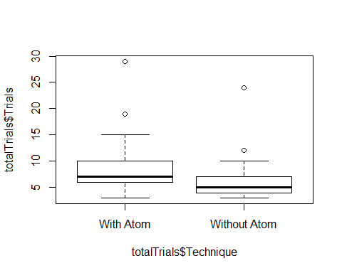

Slide 14
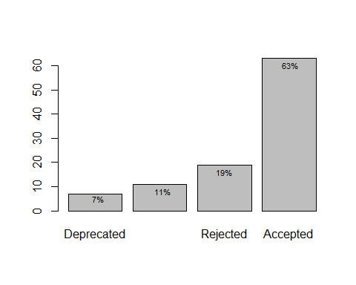

Slide 15
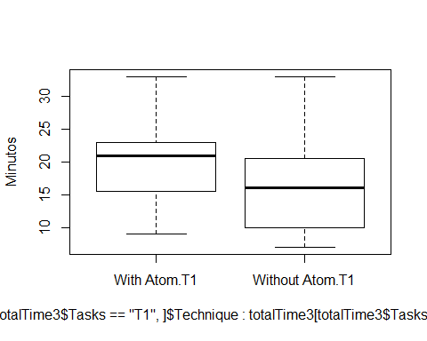

Slide 16
totalTime <- sqldf("select Replica, Id, SetOfTasks, Technique, sum(Trials) as Trials, sum(Minutes) as Time from ccwocd where Tasks = 'AV1.1:CO1.1:DE1.1' or Tasks = 'AV1.2:CO1.2:DE1.2' group by Replica, Id,SetOfTasks, Technique") #totalTime$Trials <- with(totalTime, (Trials - min(Trials)) / (max(Trials) - min(Trials))) #totalTime$Time <- with(totalTime, (Time - min(Time)) / (max(Time) - min(Time))) #totalTime$Trials <- with(totalTime, sqrt(Trials)) #totalTime$Time <- with(totalTime, sqrt(Time)) totalTime$Time <- with(totalTime, log2(Time))
totalTime$Replica = as.factor(totalTime$Replica) totalTime$Id = as.factor(totalTime$Id) totalTime$SetOfTasks = as.factor(totalTime$SetOfTasks) totalTime$Technique = as.factor(totalTime$Technique)
totalTime.gvlma = gvlma(lm(Time ~ Technique, data=totalTime)) summary(totalTime.gvlma)
## ## Call: ## lm(formula = Time ~ Technique, data = totalTime) ## ## Residuals: ## Min 1Q Median 3Q Max ## -1.1119 -0.5229 0.1858 0.3257 1.1251 ## ## Coefficients: ## Estimate Std. Error t value Pr(>|t|) ## (Intercept) 4.2066 0.1609 26.147 <2e-16 *** ## TechniqueWithout Atom -0.2873 0.2275 -1.263 0.217 ## --- ## Signif. codes: 0 '***' 0.001 '**' 0.01 '*' 0.05 '.' 0.1 ' ' 1 ## ## Residual standard error: 0.6231 on 28 degrees of freedom ## Multiple R-squared: 0.05387, Adjusted R-squared: 0.02008 ## F-statistic: 1.594 on 1 and 28 DF, p-value: 0.2171 ## ## ## ASSESSMENT OF THE LINEAR MODEL ASSUMPTIONS ## USING THE GLOBAL TEST ON 4 DEGREES-OF-FREEDOM: ## Level of Significance = 0.05 ## ## Call: ## gvlma(x = lm(Time ~ Technique, data = totalTime)) ## ## Value p-value Decision ## Global Stat 2.611e+00 0.6249 Assumptions acceptable. ## Skewness 2.499e-01 0.6171 Assumptions acceptable. ## Kurtosis 9.031e-01 0.3419 Assumptions acceptable. ## Link Function 1.105e-15 1.0000 Assumptions acceptable. ## Heteroscedasticity 1.458e+00 0.2272 Assumptions acceptable.
summary(aov(lm(Time ~ Technique, data=totalTime)))
## Df Sum Sq Mean Sq F value Pr(>F) ## Technique 1 0.619 0.6189 1.594 0.217 ## Residuals 28 10.870 0.3882

Slide 17
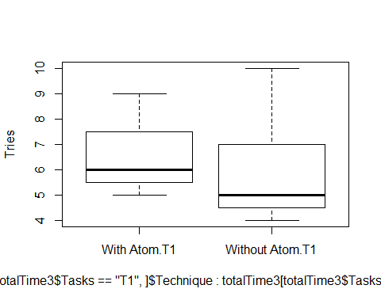

Slide 18
totalTrials <- sqldf("select Replica, Id, SetOfTasks, Technique, sum(Trials) as Trials from ccwocd where Tasks = 'AV1.1:CO1.1:DE1.1' or Tasks = 'AV1.2:CO1.2:DE1.2' group by Replica, Id,SetOfTasks, Technique") totalTrials$Trials <- with(totalTrials, Trials + 1) totalTrials$Trials <- with(totalTrials, log2(Trials))
totalTrials$Replica = as.factor(totalTrials$Replica) totalTrials$Id = as.factor(totalTrials$Id) totalTrials$SetOfTasks = as.factor(totalTrials$SetOfTasks:totalTrials$Technique) totalTrials$Technique = as.factor(totalTrials$Technique)
summary(aov(Trials ~ Replica + Replica:Id + SetOfTasks + Technique, data=totalTrials))
## Df Sum Sq Mean Sq ## Replica 14 1.6643 0.1189 ## SetOfTasks 1 0.3582 0.3582 ## Replica:Id 14 1.1195 0.0800
totalTrials.gvlma = gvlma(lm(Trials ~ Technique, data=totalTrials)) summary(totalTrials.gvlma)
## ## Call: ## lm(formula = Trials ~ Technique, data = totalTrials) ## ## Residuals: ## Min 1Q Median 3Q Max ## -0.3732 -0.2741 -0.1063 0.2927 0.7643 ## ## Coefficients: ## Estimate Std. Error t value Pr(>|t|) ## (Intercept) 2.91367 0.08141 35.789 <2e-16 *** ## TechniqueWithout Atom -0.21854 0.11514 -1.898 0.068 . ## --- ## Signif. codes: 0 '***' 0.001 '**' 0.01 '*' 0.05 '.' 0.1 ' ' 1 ## ## Residual standard error: 0.3153 on 28 degrees of freedom ## Multiple R-squared: 0.114, Adjusted R-squared: 0.08236 ## F-statistic: 3.603 on 1 and 28 DF, p-value: 0.06803 ## ## ## ASSESSMENT OF THE LINEAR MODEL ASSUMPTIONS ## USING THE GLOBAL TEST ON 4 DEGREES-OF-FREEDOM: ## Level of Significance = 0.05 ## ## Call: ## gvlma(x = lm(Trials ~ Technique, data = totalTrials)) ## ## Value p-value Decision ## Global Stat -3.799e+01 1.0000 Assumptions acceptable. ## Skewness 1.729e+00 0.1886 Assumptions acceptable. ## Kurtosis 3.856e-01 0.5346 Assumptions acceptable. ## Link Function -4.011e+01 1.0000 Assumptions acceptable. ## Heteroscedasticity 9.333e-04 0.9756 Assumptions acceptable.
summary(aov(Trials ~ Technique, data=totalTrials))
## Df Sum Sq Mean Sq F value Pr(>F) ## Technique 1 0.3582 0.3582 3.603 0.068 . ## Residuals 28 2.7838 0.0994 ## --- ## Signif. codes: 0 '***' 0.001 '**' 0.01 '*' 0.05 '.' 0.1 ' ' 1

Slide 19
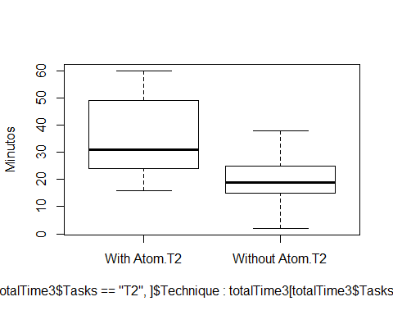

Slide 20
totalTime <- sqldf("select Replica, Id, SetOfTasks, Technique, sum(Trials) as Trials, sum(Minutes) as Time from ccwocd where Tasks = 'AV2.1:CO2.1:DE2.1' or Tasks = 'AV2.2:CO2.2:DE2.2' group by Replica, Id,SetOfTasks, Technique") totalTime$Time <- with(totalTime, log2(Time))
totalTime$Replica = as.factor(totalTime$Replica) totalTime$Id = as.factor(totalTime$Id) totalTime$SetOfTasks = as.factor(totalTime$SetOfTasks:totalTime$Id) totalTime$Technique = as.factor(totalTime$Technique)
totalTime.gvlma = gvlma(lm(Time ~ Technique + SetOfTasks, data=totalTime)) summary(totalTime.gvlma)
## ## Call: ## lm(formula = Time ~ Technique + SetOfTasks, data = totalTime) ## ## Residuals: ## Min 1Q Median 3Q Max ## -3.02383 -0.40984 0.05571 0.61837 1.11443 ## ## Coefficients: ## Estimate Std. Error t value Pr(>|t|) ## (Intercept) 5.0905 0.2642 19.265 < 2e-16 *** ## TechniqueWithout Atom -0.9570 0.3124 -3.064 0.00491 ** ## SetOfTasksST2:2 -0.1097 0.3124 -0.351 0.72825 ## --- ## Signif. codes: 0 '***' 0.001 '**' 0.01 '*' 0.05 '.' 0.1 ' ' 1 ## ## Residual standard error: 0.8536 on 27 degrees of freedom ## Multiple R-squared: 0.2642, Adjusted R-squared: 0.2097 ## F-statistic: 4.847 on 2 and 27 DF, p-value: 0.01589 ## ## ## ASSESSMENT OF THE LINEAR MODEL ASSUMPTIONS ## USING THE GLOBAL TEST ON 4 DEGREES-OF-FREEDOM: ## Level of Significance = 0.05 ## ## Call: ## gvlma(x = lm(Time ~ Technique + SetOfTasks, data = totalTime)) ## ## Value p-value Decision ## Global Stat 36.4165 2.375e-07 Assumptions NOT satisfied! ## Skewness 14.0019 1.826e-04 Assumptions NOT satisfied! ## Kurtosis 20.9989 4.595e-06 Assumptions NOT satisfied! ## Link Function 1.1795 2.774e-01 Assumptions acceptable. ## Heteroscedasticity 0.2362 6.270e-01 Assumptions acceptable.
summary(aov(lm(Time ~ Technique, data=totalTime)))
## Df Sum Sq Mean Sq F value Pr(>F) ## Technique 1 6.974 6.974 9.881 0.00393 ** ## Residuals 28 19.762 0.706 ## --- ## Signif. codes: 0 '***' 0.001 '**' 0.01 '*' 0.05 '.' 0.1 ' ' 1
## ## Kruskal-Wallis rank sum test ## ## data: Time by Technique ## Kruskal-Wallis chi-squared = 9.1927, df = 1, p-value = 0.00243

Slide 21
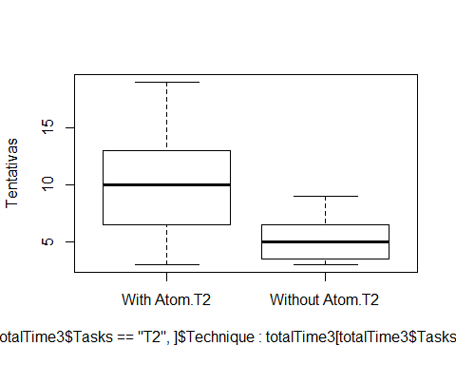

Slide 22
totalTrials <- sqldf("select Replica, Id, SetOfTasks, Technique, sum(Trials) as Trials from ccwocd where Tasks = 'AV2.1:CO2.1:DE2.1' or Tasks = 'AV2.2:CO2.2:DE2.2' group by Replica, Id,SetOfTasks, Technique") totalTrials$Trials <-ifelse(totalTrials$Trials == 0, 1, totalTrials$Trials) totalTrials$Trials <- with(totalTrials, log2(Trials))
totalTrials$Replica = as.factor(totalTrials$Replica) totalTrials$Id = as.factor(totalTrials$Id) totalTrials$SetOfTasks = as.factor(totalTrials$SetOfTasks:totalTime$Id) totalTrials$Technique = as.factor(totalTrials$Technique)
summary(aov(Trials ~ Technique, data=totalTrials))
## Df Sum Sq Mean Sq F value Pr(>F) ## Technique 1 4.852 4.852 6.608 0.0158 * ## Residuals 28 20.560 0.734 ## --- ## Signif. codes: 0 '***' 0.001 '**' 0.01 '*' 0.05 '.' 0.1 ' ' 1
totalTrials.gvlma = gvlma(lm(Trials ~ Technique, data=totalTrials)) summary(totalTrials.gvlma)
## ## Call: ## lm(formula = Trials ~ Technique, data = totalTrials) ## ## Residuals: ## Min 1Q Median 3Q Max ## -1.62191 -0.56706 -0.08059 0.39815 2.18244 ## ## Coefficients: ## Estimate Std. Error t value Pr(>|t|) ## (Intercept) 3.2069 0.2213 14.494 1.53e-14 *** ## TechniqueWithout Atom -0.8044 0.3129 -2.571 0.0158 * ## --- ## Signif. codes: 0 '***' 0.001 '**' 0.01 '*' 0.05 '.' 0.1 ' ' 1 ## ## Residual standard error: 0.8569 on 28 degrees of freedom ## Multiple R-squared: 0.1909, Adjusted R-squared: 0.162 ## F-statistic: 6.608 on 1 and 28 DF, p-value: 0.01576 ## ## ## ASSESSMENT OF THE LINEAR MODEL ASSUMPTIONS ## USING THE GLOBAL TEST ON 4 DEGREES-OF-FREEDOM: ## Level of Significance = 0.05 ## ## Call: ## gvlma(x = lm(Trials ~ Technique, data = totalTrials)) ## ## Value p-value Decision ## Global Stat 1.636e+00 0.8023 Assumptions acceptable. ## Skewness 1.544e+00 0.2140 Assumptions acceptable. ## Kurtosis 7.535e-02 0.7837 Assumptions acceptable. ## Link Function 7.228e-15 1.0000 Assumptions acceptable. ## Heteroscedasticity 1.623e-02 0.8986 Assumptions acceptable.
summary(aov(Trials ~ Technique, data=totalTrials))
## Df Sum Sq Mean Sq F value Pr(>F) ## Technique 1 4.852 4.852 6.608 0.0158 * ## Residuals 28 20.560 0.734 ## --- ## Signif. codes: 0 '***' 0.001 '**' 0.01 '*' 0.05 '.' 0.1 ' ' 1
ss = summary(aov(Trials ~ Technique, data=totalTrials))[[1]]$"Sum Sq" eta.sq = ss[1]/(ss[1] + ss[2]) print(paste0("The eta-squared is ",toString(round(eta.sq,3))))
## [1] "The eta-squared is 0.191"
q <- TukeyHSD(aov(Trials~Technique, data=totalTrials)) q
## Tukey multiple comparisons of means ## 95% family-wise confidence level ## ## Fit: aov(formula = Trials ~ Technique, data = totalTrials) ## ## $Technique ## diff lwr upr p adj ## Without Atom-With Atom -0.8043511 -1.445296 -0.1634066 0.0157578
slices <- c(67, 33) lbls <- c("Perfectiva", "NÃ£o Perfectiva") pct <- round(slices/sum(slices)*100) lbls <- paste(lbls, pct) # add percents to labels lbls <- paste(lbls,"%",sep="") # ad % to labels pie(slices,labels = lbls, col=rainbow(length(lbls)) )

Slide 23
